Slide 1

GOOD
MORNING

Slide 2

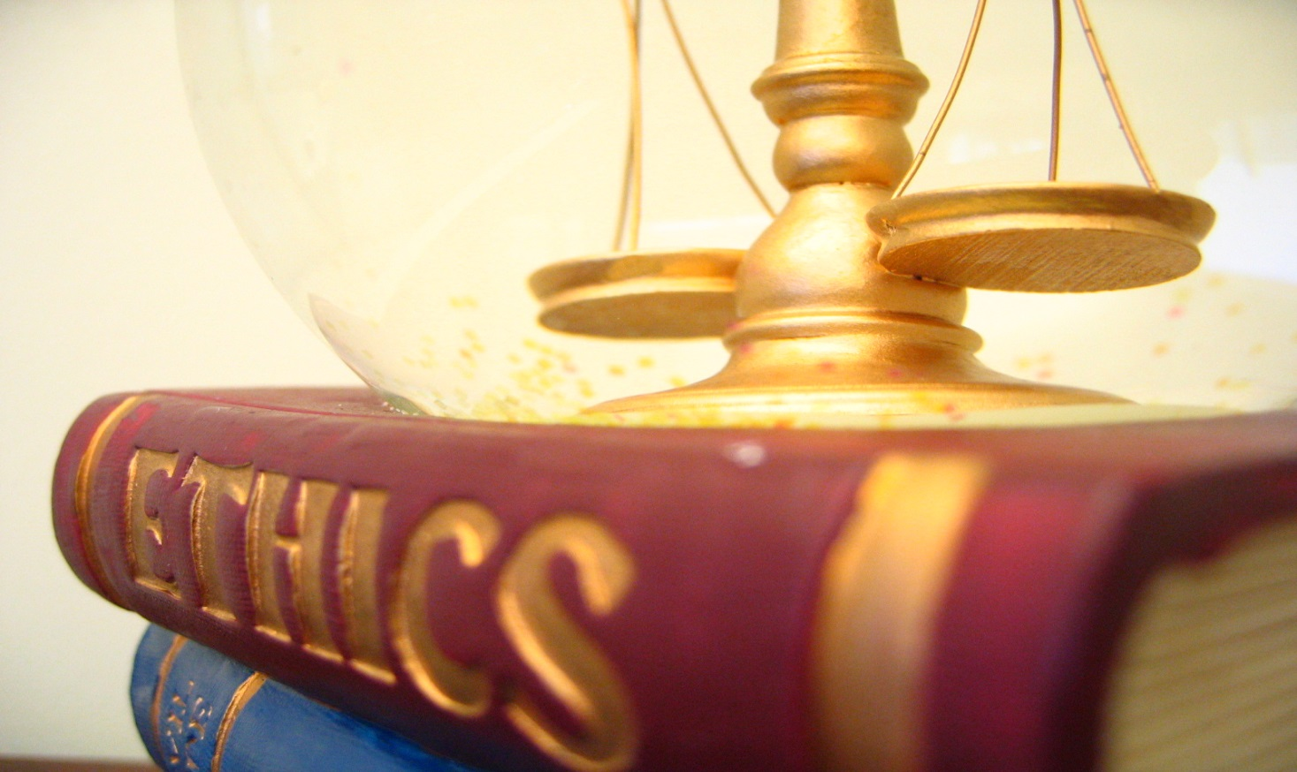
ETHICS IN DENTISTRY

Slide 3
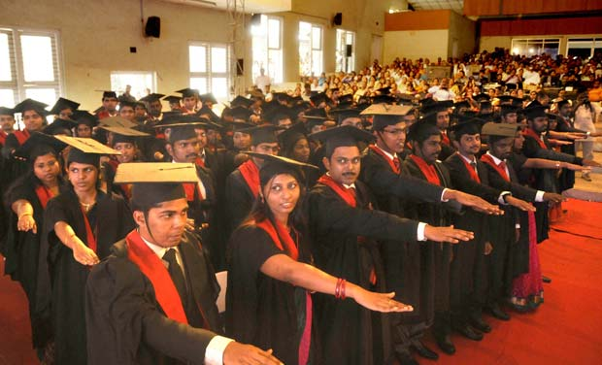

Slide 4
INTRODUCTION
The Dental Profession holds a special position of trust within society.
The profession has certain privileges that are not available to the public.
The profession makes a commitment to the society that its members will follow to high ethical standards of conduct.

Slide 5
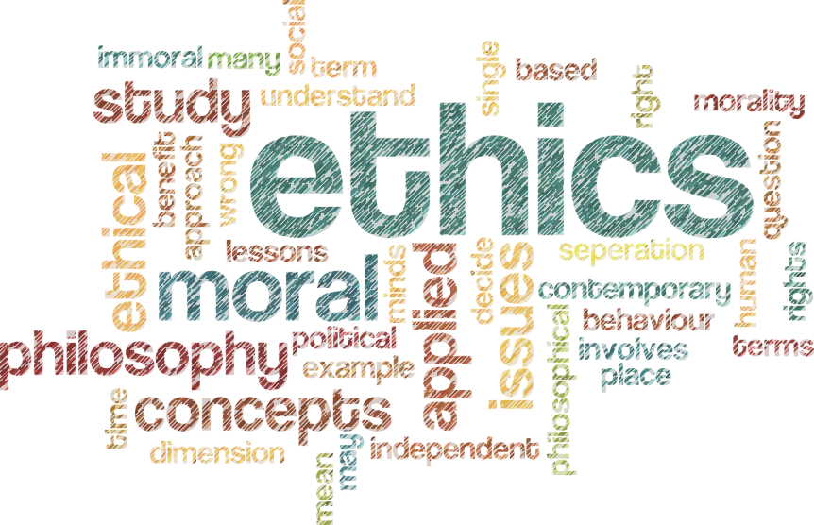
Ethics
Derived from Greek word ethos meaning “character or conduct”.
Ethics Definition.
It is the philosophy of human conduct, a way of stating and evaluating principles by which problems of behavior can be solved.

Slide 6
Dental Ethics
Dental ethics
“The moral duties and obligations of a dentist towards his/her patients, professional colleagues and society”.
Dental ethics applies moral principles and virtues to the practice of dentistry.

Slide 7
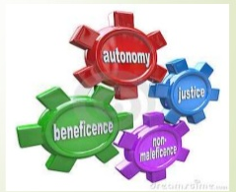
Principles of Dental Ethics
These principles help in choosing the right course of actions in certain difficult decision making situations.
The principles of ethics are as under:
To do no harm
To do good
Respect for persons
Justice
Truthfulness/Veracity
confidentiality

Slide 8
To do no harm( Non Maleficence)
Foundation of social morality
Use of unsterilized instruments, under-filling or overfilling, carelessness in handling hard and soft tissues can harm the patients.
Notes:
Hippocrates has laid an emphasis on it.
The dentist has a duty to refrain from harming the patient
Iatrogenic disease is the name we give to doctor- induced illness

Slide 9

To do Good (Beneficence)
Beneficence refers to the principle of promoting or doing good.
Should always think about the welfare of the patient.
Put the patient’s best interests as priority.
Eg – treating questionable dental caries it is not enough to say that it will not harm the patient. Attempts should be made to maximize the benefits and minimize harm

Slide 10
RESPECT FOR PERSONS
AUTONOMY
INFORMED CONSENT

Slide 11

AUTONOMY
The primary way to respect individuals is to abide by their choices whether or not others believe these choices to be wise or beneficial
The dentist’s primary obligation include involving patients in treatment decisions in a meaningful way, with due consideration being given to the patient’s needs, desires and abilities, and safeguarding the patient’s privacy

Slide 12
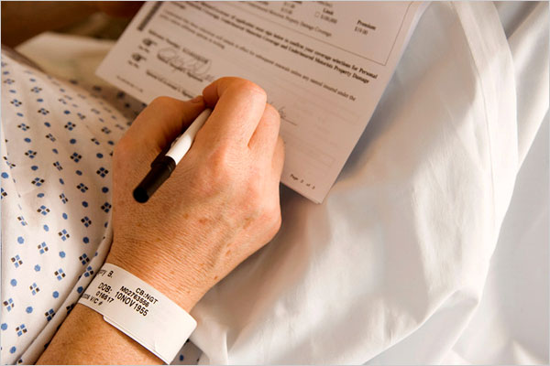
INFORMED CONSENT
The term consent is defined as “when two or more person agree upon same thing in same sense they are said to be in consent” given in section 13 of Indian contract act 1872.
It is the first stated and largest principle of Nuremberg Code

Slide 13
INFORMED CONSENT
Consent must be
  voluntary
  Legally competent
  Informed
  Comprehending

Slide 14
INFORMED CONSENT
All information must be explained in comprehensible non medical terms preferably in local language about:
Diagnosis
Nature of treatment
Risk involved
Prospects of success
prognosis

Slide 15
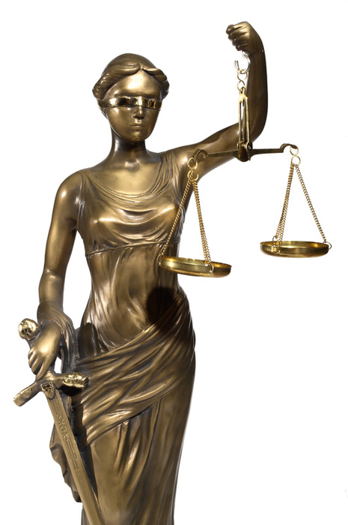
Justice
Dealing with people justly and delivering dental care without prejudice.
Patients selection: while dentists, in serving the public, may exercise reasonable discretion in selecting patients for their practices, dentists shall not refuse to accept patients in to their practice or deny dental service to patients because of the patient’s race, creed, color, sex, or national origin.

Slide 16

Confidentiality
There should be understanding b/w dentist and patient.
Any information revealed by the patient to the dentist will not be divulged without the patient’s consent.
Except the situation where disclosure is needed to protect others, the patient itself and community.

Slide 17

Truthfulness or Veracity
Patient doctor relationship based on mutual trust.
The dentist has a duty to communicate truthfully.
Dentists shall not represent the care being rendered to their patients in a false or misleading manner.
Patient expect the dentist to be truthful about the information given , treatment rendered and the prognosis.

Slide 18
ETHICAL RULES FOR DENTISTS
THE DUTIES AND OBLIGATIONS OF DENTISTS TOWARDS PATIENT
Be courteous, sympathetic, friendly and always be ready to the call of patients.
The welfare of the patient should be the top priority
Race, Religion, Nationality or Relation should not interfere in providing the best available services.
Provide high quality of care to the patient
Keep all personal information regarding a patient confidentiality.

Slide 19
Duties Towards Colleagues
Cherish a proper pride in your colleagues and should not disparage them either by act or word
When the dentist is entrusted with the care of the patient of another, during sickness or absence, mutual arrangement should be made regarding remuneration
Retire in favor of the regular dentist, after the emergency is over.
Should not make disparaging comments of the procedures or qualification of colleagues.

Slide 20
Duties of the dentists to the public
Dentists has to assume a leadership role in the community on matters related to dental health
To participate in community affairs
Educate the public in promotion of health
To be trustworthy and honest
To follow community laws
To use the social services provided

Slide 21
Unethical Practices
Practice by unregistered persons employed by the dentists.
Issuing any certificate signed by the dentist which is untrue, misleading or improper.
Dentist advertising whether directly or indirectly, for purpose of obtaining patients.
Use of bogus diplomas, allowing or accepting commissions.
Undercutting the charges in order to solicit patients

Slide 22
Unethical Practices
Non referral, in case treatment beyond the dentist skill.
Performing unnecessary services for purpose of monetary gain.
Emerging consultation during temporary absence of patient’s dentist, and patient is not sent back.
If consulted the dentist accepts charge of the case without request of referring dentist

Slide 23
ETHICS
THE NUREMBERG CODE
DECLARATION OF GENEVA
DECLARATION OF HELSINKI

Slide 24
CONCLUSION
“Ethics warms the heart and cools the mind” .
Ethics is not an object , it can’t be bought or sold or bartered, but it can be shared.

Slide 25


