Slide 1
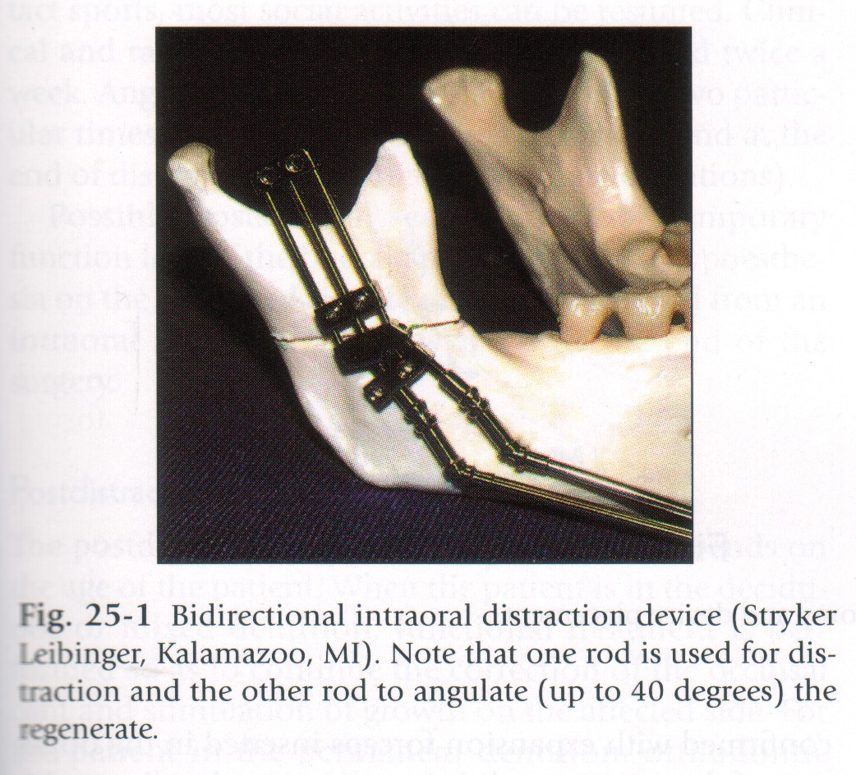
DISTRACTION OSTEOGENESIS

Slide 2
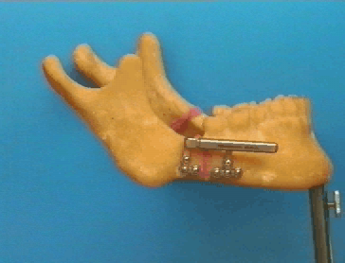
INTRODUCTION
Distraction osteogenesis as a biologic process of new bone formation between the surfaces of bone segments that are gradually separated by incremental traction
The traction generates tension that stimulates new bone formation parallel to the vector of distraction

Slide 3
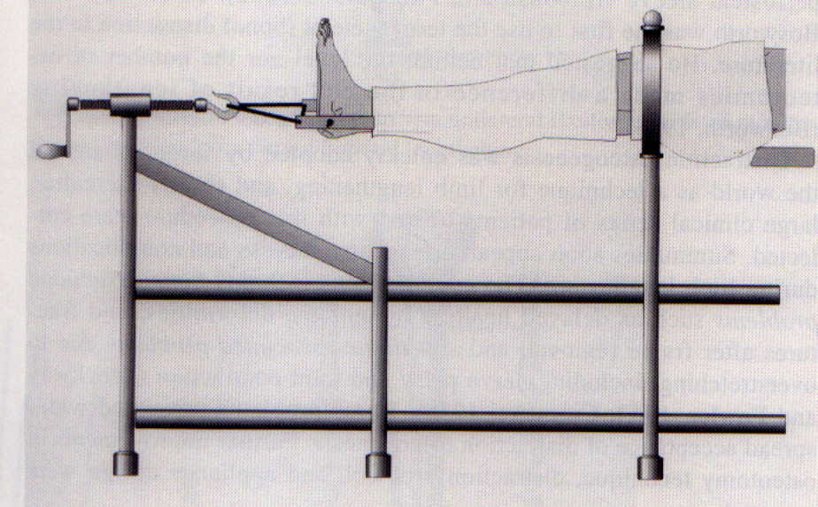

First described by CODIVILLA in 1905 on femur for correction of leg length discrepancy.

Slide 4
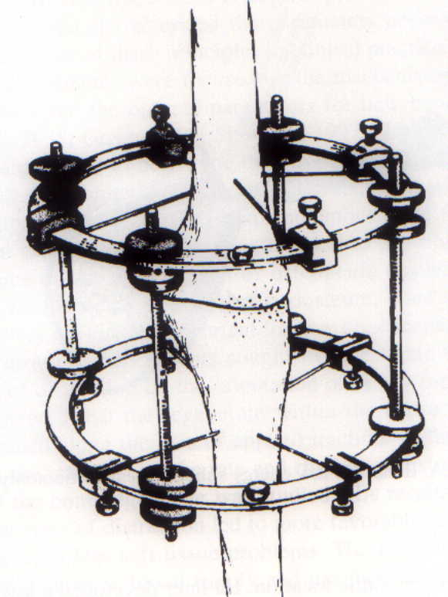
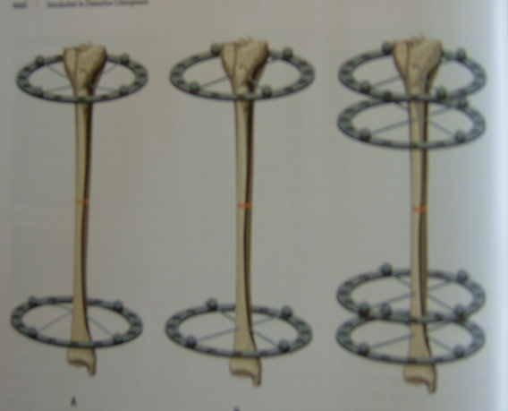
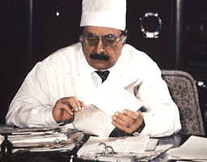
GAVRIL ILIZAROV (1951) – introduced DO for treatment of fractures and nonunion of long bones.

Slide 5
Snyder 1973 performed DO on canine mandible.
Mc Carthy & colleagues 1992 - extra oral distraction osteogenesis on four children with congenital abnormalities.

Slide 6
Distraction device classification
DISTRACTION DEVICE CLASSIFICATION
Craniofacial Distraction Devices
External
Internal
Bone borne
Subcutaneous
Intraoral
Unidirectional
Bidirectional
Multidirectional
Bone borne
Tooth borne

Slide 7
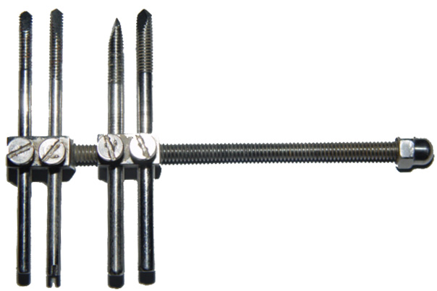
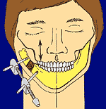
Unidirectional device

Slide 8
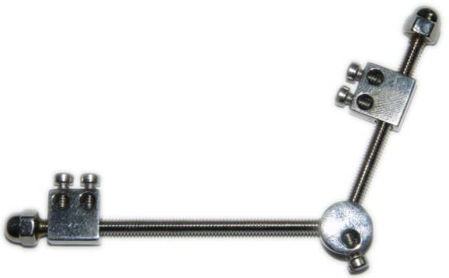
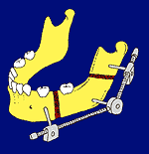
Bidirectional device

Slide 9
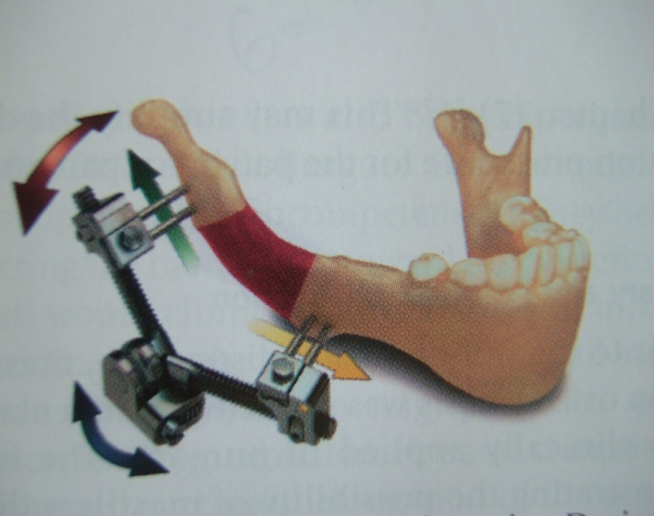
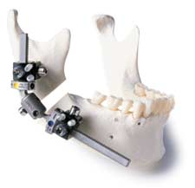
Multidirectional device

Slide 10
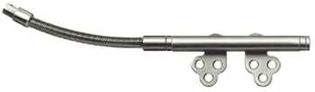
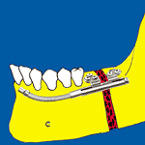
Intra oral device

Slide 11
Sequential periods of DO:
1. Osteotomy
2. Latency
3. Distraction
4. Consolidation
5. Retention

Slide 12
ILIZAROV principles
Osteotomy of the bone site with minimal periosteal stripping.
Latency period: 3,5 or 7 days, depending on the surgical site.
Distraction rate: 1.0mm per day (0.5-2.0mm)
Distraction rhythm: continuous force application is best.
          Device activation is bid.
Consolidation: until cortical outline can be seen radiographically across the gap. Usually 6 weeks.
Retention phase: device removed and jaw stabilised.

Slide 13
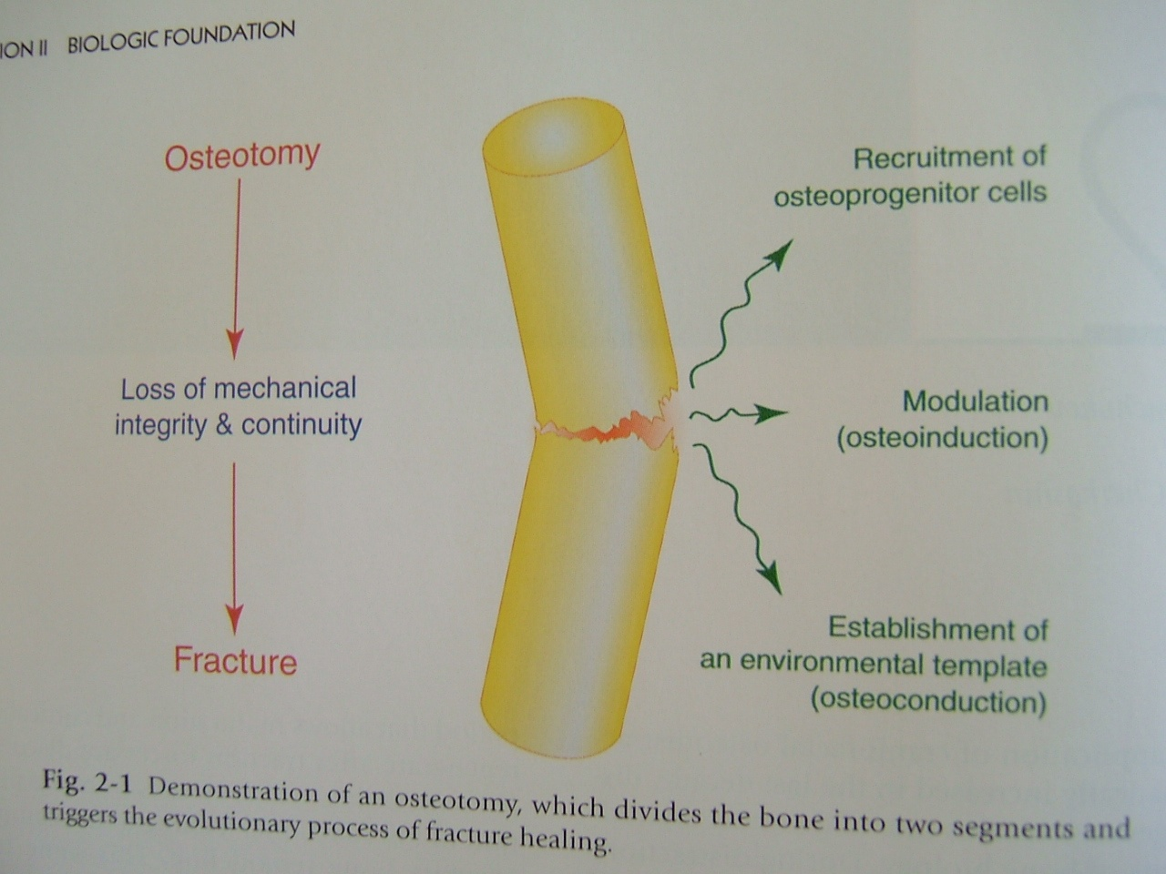
OSTEOTOMY
Division of bone in two segments.
Preserve the blood supply of the bone.
Distraction device is attached.
Triggers bone healing ( # healing )

Slide 14
LATENCY PERIOD
Period from bone division to onset of traction
Represents time allowed for callus formation.
After osteotomy the boney fragments were retained in position with device for a period of 5 -7 days.

Slide 15
Formation of adequate fibro vascular bridge between the bony ends i.e. callus formation takes place.
In younger pts it is 1- 2 days since callus formation is faster.

Slide 16
DISTRACTION PERIOD
Application of traction forces to osteotomised bone segments.
Bone segments are gradually pulled apart resulting in formation of new bone tissue with in progressively increasing inter segmentary gap.

Slide 17
Normal # healing:
-fibrocartilagenous tissue of soft callus is replaced by osteoblasts into hard callus.
- stage hard callus lasts for 3-4 months followed by remodeling.
Distraction :
-normal process of healing is interrupted by application of gradual traction which leads to microenvironment.
- changes at cellular and sub cellular level
- growth stimulating effect
- shape forming effect

Slide 18
Growth stimulating effect:
- prolongation of angiogenesis
- increased fibroblast proliferation
Shape forming effect:
- causes altered phenotypic expression of fibroblasts
( distraction fibroblast )
- polarization of these distraction fibroblasts parallel to vector of distraction.
- soft callus becomes longitudinally oriented along the axis of distraction

Slide 19
Between 3-7 day of distraction capillaries grow into fibrous tissue
During the 2nd week of distraction primary treabeculae begins to form

Slide 20
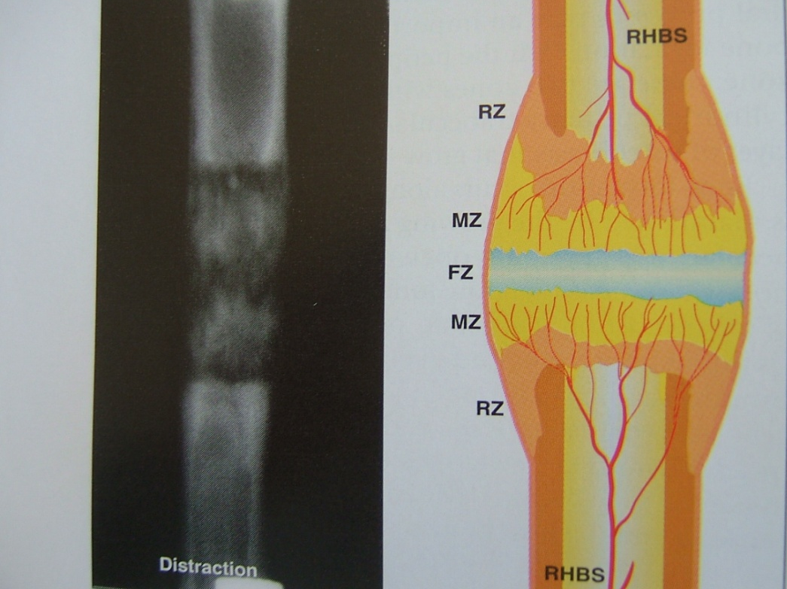
By the end of 2nd week osteoid begins to mineralize

Slide 21
a. Rate
Amount of separation to be achieved between the osteotomised bone ends per day.
Tensile stress created over bone ends which are separated by 1mm per day creates the best regenerated bone.
1.5 to 2.0mm in children.
Advancement more than this results in necrosis due to compromised vascular supply.

Slide 22
Rhythm
No. of times the distraction force is applied to the device in a day.
Continuous application will be the ideal.
Twice a day will be better i.e. activating device 2 times 0.5mm each to make it 1.0mm a day.
Presence of pain – 0.25 mm for 4 times a day to make it 1.0mm.

Slide 23
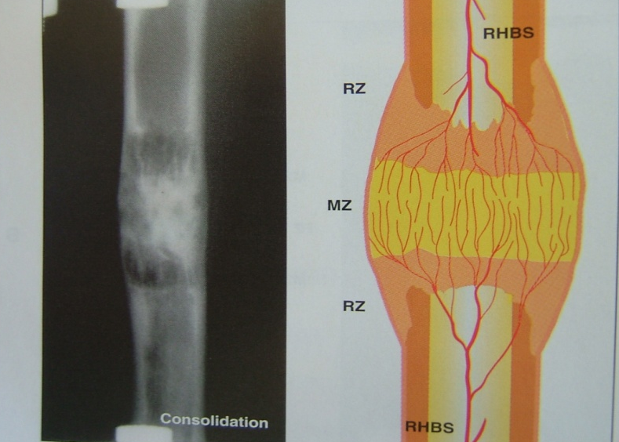
CONSOLIDATION PERIOD
Time between cessation of traction and removal of distraction devices.
This period represents the time required for complete mineralization

Slide 24
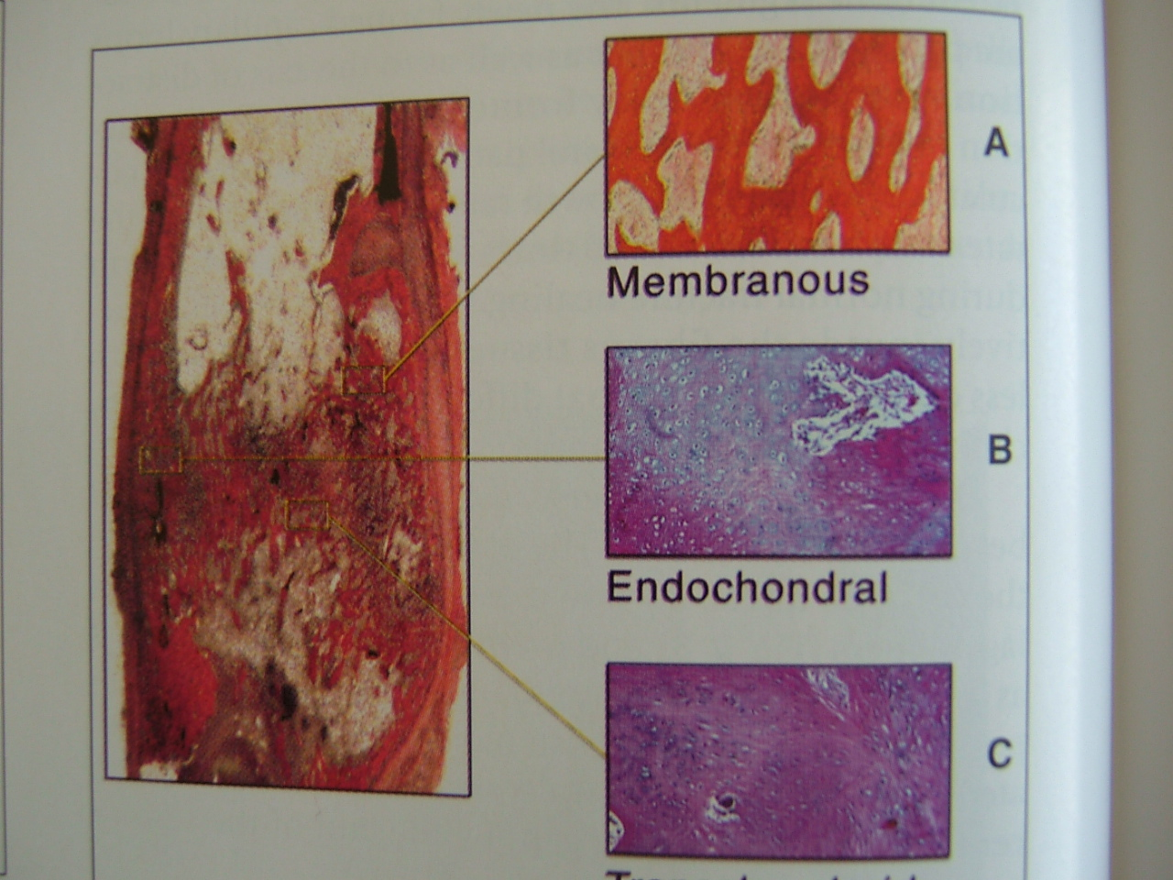
Distraction regenerate forms predominantly via membranous ossification.

Slide 25
Once satisfactory amount of distraction has taken place the regenerate is stabilized in position for complete ossification.
Distraction device is held in position for 4-6 weeks similar to a healing fracture.
Cortical outline was seen in radiograph.
premature removal of device results in relapse.

Slide 26
Retention phase
Distraction device is removed and jaws are stabilized with orthodontic appliance or occlusal splints.

Slide 27
REMODELING PERIOD
Period from the application of full functional loading to the complete remodeling of newly formed bone.

Slide 28
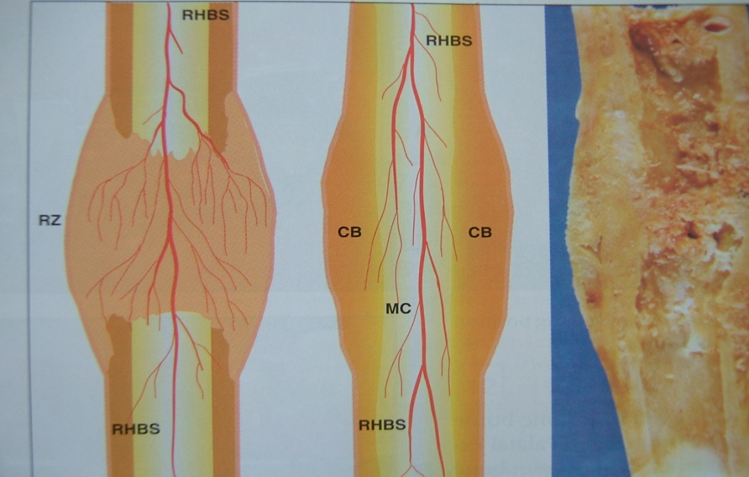
Last stage of cortical reconstruction normalizes the bony structure ( 1 year )

Slide 29
EFFECT OF DISTRACTION ON SKELETAL MUSCLES
Muscle orient in a plane parallel to distraction force & adapt with compensatory regeneration.
( Guerrirre & co workers )

Slide 30
During distraction fibers of the attached muscles undergo incremental gradual stretching of muscle fibers which in turn stretches the sarcomeres increasing their length.

Slide 31
Indications of Distraction Osteogenesis
Children or infants with severe retrognathia associated
with a syndrome (Pierre Robin syndrome, Treacher
Collins syndrome)
  Unilateral hypoplasia of the mandible (Hemifacial
  microsomia)
Mandibular hypoplasia due to trauma and/or ankylosis
of the temporomandibular joint

Slide 32
Nonsyndromic mandibular hypoplasia associated with a dental malocclusion where movement of mandible required is >10mm
Mandibular transverse deficiency associated with a dental malocclusion and dental crowding
Severe obstructive sleep apnea in patients who are morbidly obese
Shortened vertical height of the alveolar bone to receive an implant

Slide 33
Contraindications of Distraction Osteogenesis
Patients who are unable or unwilling to comply with the distraction schedule
Infants < 6 months of age due to fragility of bones to place distraction devices
Inadequate bone surface to accept distraction device

Slide 34
Inadequate bone surface area to provide regeneration of bone
patients who have undergone radiation therapy. This is because of delayed bone formation due to reduced number of stem cells
In elderly patients because of the decreased number of mesenchymal stem cells

Slide 35
Distraction device selection
External devices
Advantages :
  multidirectional
  excellent control of bone segment
  available in longer lengths
  easier to place and maintain
  simple to remove
Disadvantages :
  skin scarring
  poor patient compliance

Slide 36
Intaoral devices
Advantages :
  no scarring
  better patient compliance.
Disadvantages :
  difficult to place
  risk of injuries to nerves, vessels and tooth buds
  second surgical procedure is required for removal
  Lack of availability of multidirectional devices

Slide 37
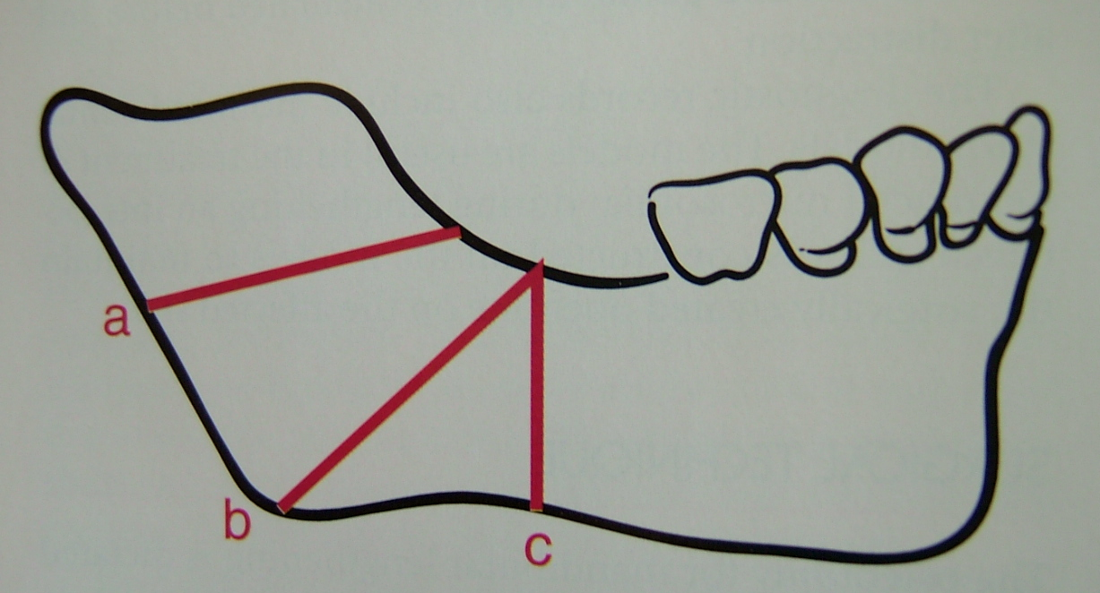

Slide 38
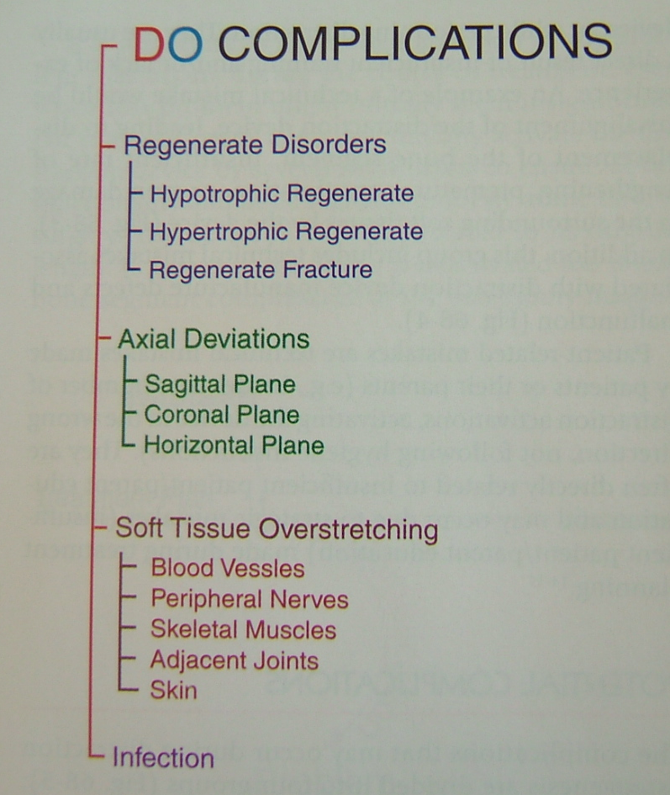
Potential complications

Slide 39
References
Craniofacial distraction osteogenesis – Mikhail L. Samchukov, Jason B. Cope, Alexander M. Cherkashin
Distraction of the craniofacial skeleton – Joseph G. McCarthy.
Oral and maxillofacial surgery – Peter Wardbooth.
Oral and maxillofacial surgery – Fonceca.

Slide 40

THANKYOU

