Slide 1
DIABETES MELLITUS
Dr. B. MRUDULA
READER
DEPT OF ORAL MEDICINE & RADIOLOGY

Slide 2
Diabetes mellitus (DM) is a group of diseases characterized by high levels of blood glucose resulting from defects in insulin production, insulin action, or both.
The term diabetes mellitus describes a metabolic disorder of multiple aetiology characterized by chronic hyperglycaemia with disturbances of carbohydrate, fat and protein metabolism resulting from defects in insulin secretion, insulin action, or both.
The effects of diabetes mellitus include long–term damage, dysfunction and failure of various organs.

Slide 3
Diabetes mellitus may present with characteristic symptoms such as thirst, polyuria, blurring of vision, and weight loss.
In its most severe forms, ketoacidosis or a non–ketotic hyperosmolar state may develop and lead to stupor, coma and, in absence of effective treatment, death.
Often symptoms are not severe, or may be absent, and consequently hyperglycaemia sufficient to cause pathological and functional changes may be present for a long time before the diagnosis is made.
Notes:
Stupor - unconciousness

Slide 4
The long–term effects of diabetes mellitus include progressive development of the specific complications of retinopathy with potential blindness, nephropathy that may lead to renal failure, and/or neuropathy with risk of foot ulcers, amputation, Charcot joints, and features of autonomic dysfunction.
People with diabetes are at increased risk of cardiovascular, peripheral vascular and cerebrovascular disease.

Slide 5
TYPES OF DM
Type 1 Diabetes Mellitus
Type 2 Diabetes Mellitus
Gestational Diabetes
Prediabetes

Slide 6
Type 1 diabetes
Was previously called insulin-dependent diabetes mellitus (IDDM) or juvenile-onset diabetes.
Type 1 diabetes develops when the body’s immune system destroys pancreatic beta cells, the only cells in the body that make the hormone insulin that regulates blood glucose.
This form of diabetes usually strikes children and young adults, although disease onset can occur at any age.
Type 1 diabetes may account for 5% to 10% of all diagnosed cases of diabetes.
Risk factors for type 1 diabetes may include autoimmune, genetic, and environmental factors.

Slide 7
Type 2 diabetes
Was previously called non-insulin-dependent diabetes mellitus (NIDDM) or adult-onset diabetes.
Type 2 diabetes may account for about 90% to 95% of all diagnosed cases of diabetes.
It usually begins as insulin resistance, a disorder in which the cells do not use insulin properly. As the need for insulin rises, the pancreas gradually loses its ability to produce insulin.
Type 2 diabetes is associated with older age, obesity, family history of diabetes, history of gestational diabetes, impaired glucose metabolism, physical inactivity, and race/ethnicity.
African Americans, Hispanic/Latino Americans, American Indians, and some Asian Americans and Native Hawaiians or Other Pacific Islanders are at particularly high risk for type 2 diabetes.
Type 2 diabetes is increasingly being diagnosed in children and adolescents.

Slide 8
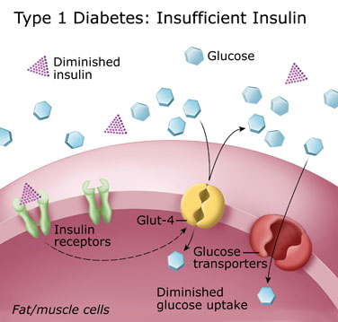
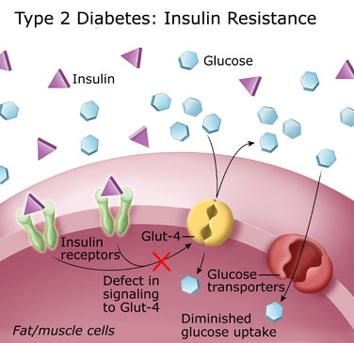

Slide 9
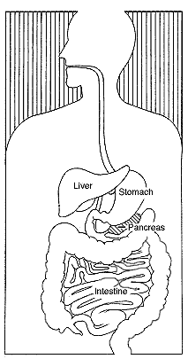
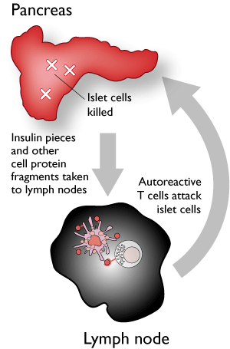
Diabetes Mellitus
Type 1 Diabetes
- cells that produce insulin are destroyed
- results in insulin dependence
- commonly detected before 30
Type 2 Diabetes
- blood glucose levels rise due to
1) Lack of insulin production
2) Insufficient insulin action (resistant cells)
- commonly detected after 30
- effects > 90%
- eventually leads to β-cell failure
(resulting in insulin dependence)
Gestational Diabetes
3-5% of pregnant women in the US develop gestational diabetes

Slide 10
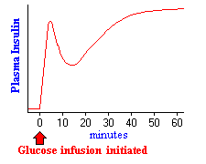
Testing :
Fasting Plasma Glucose Test
(FPG) - (cheap, fast)
*fasting B.G.L. 100-125 mg/dl signals pre-diabetes
*>126 mg/dl signals diabetes
Oral Glucose Tolerance Test
(OGTT)
*tested for 2 hrs after glucose-
rich drink
*140-199 mg/dl signals pre-
diabetes
*>200 mg/dl signals diabetes
A.K.A.: Glycated Hemoglobin tests
A1C
80 to 90 mg per 100 ml, is the normal fasting blood glucose concentration in humans and most mammals which is associated with very low levels of insulin secretion.

Slide 11
Clinical Manifestations
Polyuria
Polydipsia
Polyphagia
Fatigue, tingling or numbness in hands, slow healing wounds and recurrent infections

Slide 12
Diagnostic findings
Fasting plasma glucose—125 mg/dL
Random sugar >200mg/dL
According to text, OGTT and IV glucose tolerance test no longer used routinely—see latest guidelines

Slide 13
HGB A1C
Measures blood levels over 2-3 months (per text)
High levels of glucose will attach to hemoglobin
Helps to ensure that the patient’s glucometer is accurate

Slide 14
Ketones
Check in pregnancy
During illness
If BS >240

Slide 15
Insulin therapy
Rapid acting—lispro (Humalog) and insulin aspart (Novolog) onset 15’, peak 60-90’ and last from 2-4 hours
Short acting—regular. Onset is 30-60’, peak in 2-3h and last for 4-6 hours. Regular insulin is only kind for IV use.
Discovered in 1921 by Banting and Best

Slide 16
Insulin Therapy
Intermediate insulins—NPH or Lente. Onset 3-4h, peak 4-12 hours and lst 16-20 hours. Names include Humulin N, Novolin N, Humulin L, Novolin L
Long acting—Humulin Ultralente. Onset 6-8h, peak 12-16 h and lasts 20-30h.
Peakless insulins: determir and glargine

Slide 17
Complications of Insulin Therapy
Local allergic reactions
Systemic allergic reactions
Insulin lipodystrophy (lipoatrophy or lipohypertrophy)
Insulin resistance
Morning hyperglycemia—Dawn phenomenon (nocturnal surges of growth hormone) so give dose at HS not before dinner

Slide 18
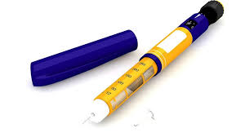
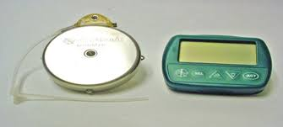
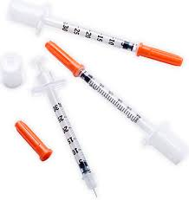
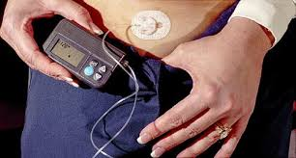
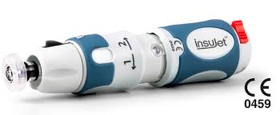
Methods of Insulin Delivery
Pens
Jet injectors
Insulin pumps—insulin is delivered at .5-2 units/hour. Most common risk of insulin pump therapy is ketoacidosis.
Implantable devices
Transplantation of pancreatic cells

Slide 19
Oral antidiabetic agents
Sulfonylureas—glipizide, glyburide and glimepiride. Hypoglycemia
Biguanides—metformin. Lactic acidosis.
Alpha-glucosidase inhibitors—acarbose. Delay absorption of CHO

Slide 20
Oral Agents
Non-sulfonylurea secretagogues—repaglinide. Cause secretion of insulin.
Thiazolidinediones—pioglitazone and rosiglitazone. Sensitize. Weight gain.Fertility. Liver.
Pramlintide (Symlin). Analogue of amylin. Used with insulin. Injection.
Exanatide (Byetta). Incretin mimetic. Causes satiety. Wt loss.
Januvia.

Slide 21
Acute Complications of Diabetes
Hypoglycemia—50-60 or less
DKA
Hyperglycemic Hyperosmolar Nonketotic Syndrome

Slide 22
Hypoglycemia
Caused by too much insulin or oral agents, too little food or excessive physical activity
Surge in epinephrine and norepinephrine results in sweating, tremors, tachycardia, palpitations, nervousness and hunger

Slide 23
Hypoglycemia
CNS effects—inability to concentrate, headache, lightheadedness, confusion, memory problems, slurred speech, incoordination, double vision, seizures and even loss of consciousness.

Slide 24
Hypoglycemic unawareness
Related to autonomic neuropathy
Will not experience the sympathetic surge—with sweating, shakiness, etc.

Slide 25
Treatment for hypoglycemia
2-3 tsp. of sugar or honey
6-10 hard candies
4-6oz. of fruit juice or soda
3-4 commercially prepared glucose tablets
Recheck BS 15 minutes, same s/s, repeat treatment. After improvement, then cheese and crackers or milk.
Extreme situations, give glucagon. (can cause n/v). D50W.

Slide 26
Diabetic Ketoacidosis
Clinical features are:
Hyperglycemia
Dehydration and electrolyte loss
acidosis

Slide 27
DKA
Three main causes: illness, undiagnosed and untreated and decreased insulin
Other causes: patient error, intentional skipping of insulin

Slide 28
Presentation of DKA
3 P’s
Orthostatic hypotension
Ketosis
GI s/s
Acetone breath
hyperventilation

Slide 29
Diagnostic Findings of DKA
BS between 300-800
Acidosis
Electrolyte abnormalities
Elevated BUN, creatinine and hct r/t dehydration

Slide 30
Medical Management of DKA
Rehydrate with normal saline, then follow with .45% NaCl then D5.45NS (or other)
Restore electrolytes
ECGs
Hourly blood sugars
IV insulin
Avoid bicarbonate as can affect serum K+

Slide 31
Hyperglycemic Hyperosmolar Nonketotic Syndrome
Predominated by hyperosmolarity and hyperglycemia
Minimal ketosis
Osmotic diuresis
Glycosuria and increased osmolarity
Occurs over time
Blood sugar is usually over 600

Slide 32
HHNS
Occurs more often in older people
Type 2 diabetes mellitus
No ketosis
Do not usually have the concomitant n/v
Hyperglycemia, dehydration and hyperosmolarity may be more severe than in DKA

Slide 33
Medical Management
Similar treatment as seen in DKA
Watch fluid resuscitation if history of heart failure
ECG
Lytes monitoring
Fluids with potassium replacement

Slide 34
Long term complications of Diabetes
Increasing numbers of deaths from cardiovascular and renal complications
Renal (microvascular) disease is more common in type 1 diabetics
Cardiovascular disease (macrovascular) complications are more common in type 2 diabetics

Slide 35
Risk factors for Diabetes Mellitus
Family history
Cardiovascular disease
Obesity
Sedentary lifestyle
History of impaired fasting glucose or impaired glucose tolerance
Hypertension
PCOS
Gestational diabetes

Slide 36
Recommended Screening
Fasting glucose levels
Oral glucose tolerance testing using 75g of Glucola
Fasting glucose of 100-125mg/dL=prediabetes
Fasting level >126 is diagnostic
OGTT>200 is diagnostic

Slide 37
Controlling blood sugar
Hemoglobin A1C less than or equal to 6.5%
Fasting plasma glucose <110
Two hour postprandial sugar <140
Comprehensive education

Slide 38
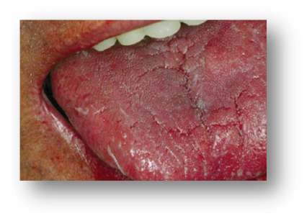
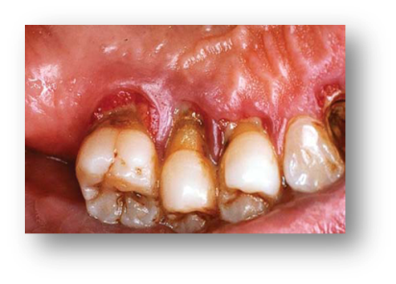
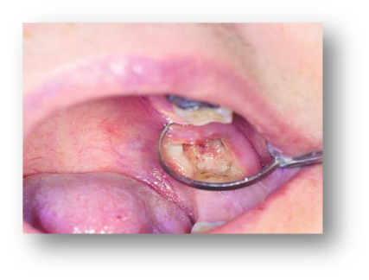
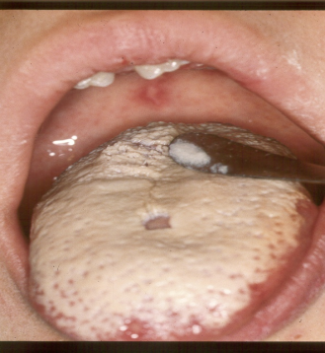
Oral manifestations
Dental caries
xerostomia
Acetone breath
Gingivitis and periodontitis
Periodontal abscess
Dry socket.
lichen planus and Recurrent aphthous stomatitis, recurrent HSV infections have been reported.
Vascular changes in pulp, gingiva, pdl, have been reported
Candidiasis
Burning mouth sensation

