Slide 1

Good Morning

Slide 2
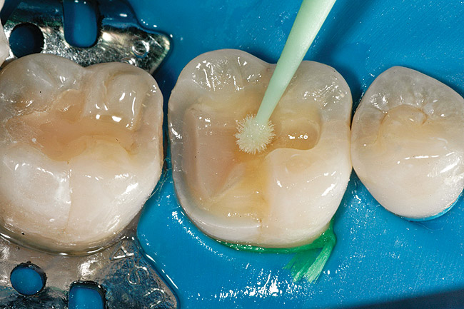
DENTIN BONDING AGENTS
SONAM ASOPA

Slide 3


CONTENTS
Introduction
History
Basic concepts of adhesion
Clinical factors affecting adhesion
Enamel adhesion
Dentin adhesion
Challenges in dentin adhesion
Ideal requirements of DBA
Adhesion to dentin
  Etching/conditioning
  Primers
  Fillers
  Adhesive resin
Mechanism of bonding
Classification of DBA
Critical steps in bonding
Wet/dry bonding
Microleakage
Nanoleakage
Additives for enamel and dentin adhesion
Biocompatibility
Application of bonding agents
Common clinical problems
Bond strength testing
Failures in bonding
Methods to improve bond strength
Conclusion
References

Slide 4


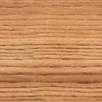
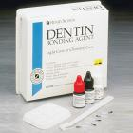
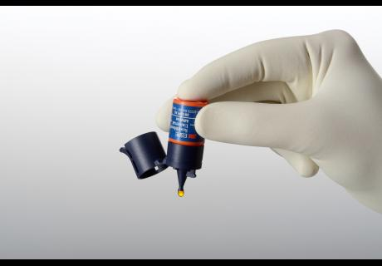
INTRODUCTION
The production of a stable long term bond to the tooth substance is an ideal requirement for the success of all restorations.
Notes:
The field of dentistry has not been exempt from this challenge and this is best reflected by the evolution seen in dentine bonding agents. The advent of Dentin Bonding Agents(DBA), with its property of adherence to the tooth structure by both micromechanical and chemical means, has heralded a new era in the field of dentistry. The production of a stable long term bond to the tooth substance is an ideal requirement for the success of all restorations.

Slide 5
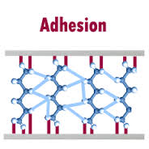
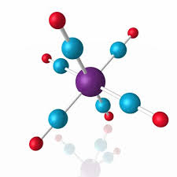
INTRODUCTION
An adhesion permits the placement of a more conservative restoration, reduces micro leakage and dentin sensitivity.
A solid understanding of biological, chemical and physical aspects of these adhesives is very essential for their proper use in field of dentistry.
Dentin Bonding Agents are di or multi-functional organic molecules that contain reactive group, which interacts with dentin and the monomer of the restorative resin.

Slide 6

HISTORY
1938 | Development of epoxy molecule by Castan
1951 | Glycerophosphoric acid dimethacrylate developed by Dr. Oscar Haggart
1952 | Glycerophosphoric acid dimethacrylate used by Kramer & Mc Lean
1955 | Buonocore acid etching with phosphoric acid
1956 | Buonocore developed the first dentin bonding agents
1957 | Bowen gave BISGMA resin system
1965 | Causto described how primers work
1975 | Gwinnet and Silverstone three patterns of etching of enamel
1982 | Bowen, Cobb and Rapson developed multilayer adhesive system
1987 | Fusayama -concept of total etching and bonding
1990s | Kanca-concept of wet bonding
1997 | Ferrari-bonding mechanism of one bottle adhesive system
2000 | Ferrari -evaluated bonding ability of 6th gen bonding systems
2003 | Ferrari-seventh generation bonding agents

Slide 7
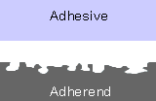
BASIC CONCEPTS OF ADHESION
Adhesion: The state in which two surfaces are held together by interfacial forces, which may consists of valence forces or interlocking forces or both. (The American Society for Testing and Materials; specification D 907)
Adherend: The surface or substrate that is adhered .
Adhesive/adherent: A material that can join substances together, resist separation and transmit loads across the bond.
Adhesive failure: The bond that fails at the interface between the two substrates.
Cohesive failure: The bond fails within one of the substrates, but not at the interface.

Slide 8
BASIC CONCEPTS OF ADHESION
Microscopic Penetration
Mechanical adhesion
Stresses
Diffusion
Ionic Bonds
Primary valence forces
Covalent bonds
Chemical adhesion
Secondary valence forces
Van der Waals forces
Hydrogen bonding
Bonding mechanisms

Slide 9
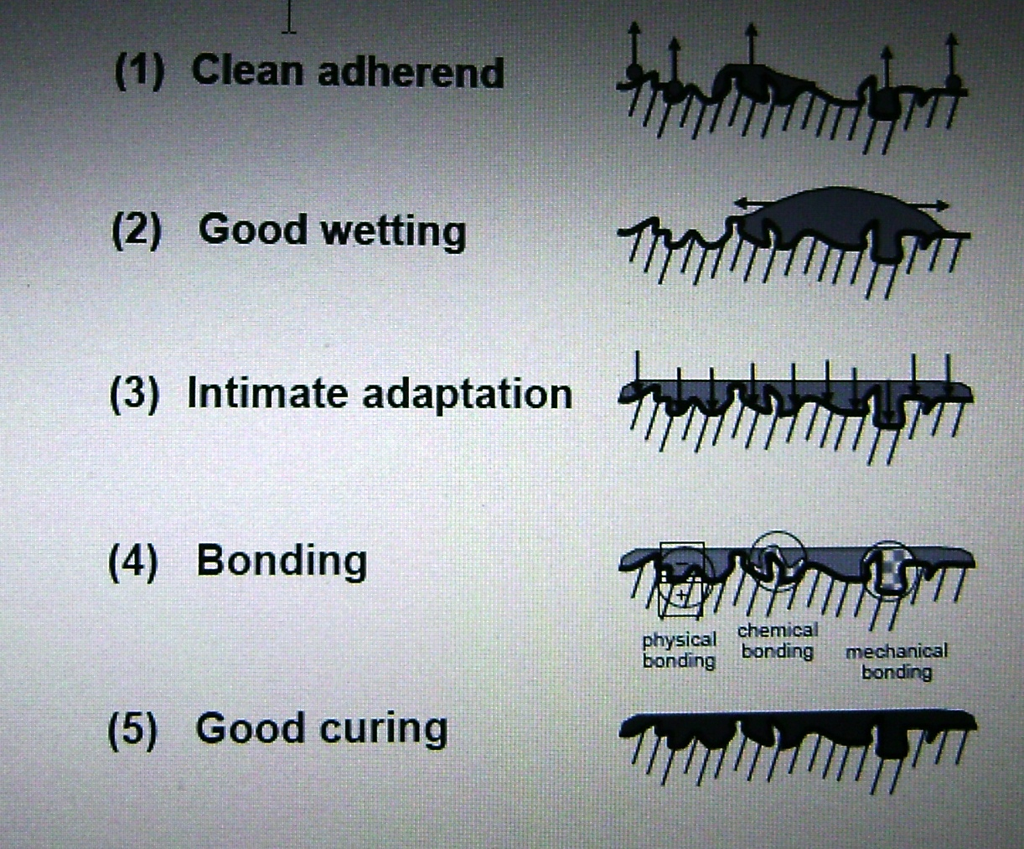
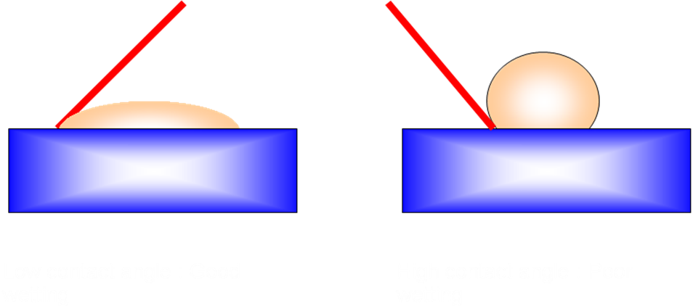
BASIC CONCEPTS OF ADHESION
Surface energy:
Degree of spreading of a liquid drop on a solid surface.
Contact angle -liquid surface and the interface separating the liquid and solid.
Good Wetting
The surface tension of the adhesive must be lower than the surface energy of enamel and dentin.
Penetration of the surface:
The liquid adhesives must penetrate into the surface
Therefore an adhesive with low surface tension low contact angle and low viscocity is preferred

Slide 10
BASIC CONCEPTS OF ADHESION
ADHESION
Interface 1
Adhesive
Adhesive System
or Luting Cement
Interface 1
Interface 2
ADHESIVE
JOINT
Adherend 1
Adherend 2
ENAMEL, DENTIN >
Liner, Base, Cement >
Post and Core >
Dental Amalgam >
Implant >
< Pit and fissure sealant
<Composite, Amalgam
< Cast Inlay, Onlay, or Crown
< All-Ceramic Inlay, Onlay, or Crown
< Veneers, Maryland Bridges
< Orthodontic Brackets

Slide 11
CLINICAL FACTORS AFFECTING ADHESION
Flow of Saliva and /Or Blood Contamination
Moisture contamination
Oil contamination
Although dentin is a wet substrate, saliva and blood can destroy good dentin bonding.
The use of rubber dam or other dry field methods.
Water leakage from air-rotor hand piece
Air-water syringe can effect bonding.
Lack of maintenance of dental equipments
Prevented by using effective oil filters

Slide 12
CLINICAL FACTORS AFFECTING ADHESION
Flow of Saliva and /Or Blood Contamination
Moisture contamination
Oil contamination
Presence of Plaque, Calculus, Extrinsic Stains or Debris
Tooth structure
Location and Size of Dentinal Tubules
  Altered tooth resists acid etching.
  For effective etching -double the normal etching time.
  If tubules are small, attachment is less and if tubules are large, attachment is enhanced.
Impair effective bonding.
Cleaned with scalers, abrasive prophy pastes using rubber cups or with abrasive rotary instruments.

Slide 13
CLINICAL FACTORS AFFECTING ADHESION
Flow of Saliva and /Or Blood Contamination
Moisture contamination
Oil contamination
Presence of Plaque, Calculus, Extrinsic Stains or Debris :
Tooth structure :
Location and Size of Dentinal Tubules :
Varnishes copal cellulose or polyamide varnishes and resin liners affects the bonding
Cause collapse of exposed collagen and may prevent resin infiltration and impair bonding.
Presence of Bases or Liners on Prepared Teeth
Tooth dehydration

Slide 14
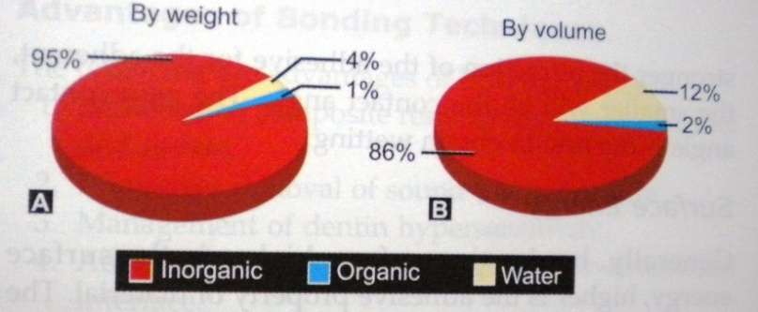

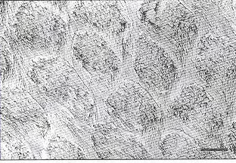

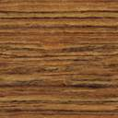
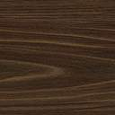
ENAMEL ADHESION
Composition of enamel
Primary component – hydroxyapetite
Inorganic content – higher
Homogenous in structure and composition
Inorganic fraction - prism.
Natural surface -smooth
Operatively prepared surface expose rods in tangential, oblique, and longitudinal planes
Normal enamel rods - key-hole pattern.
14

Slide 15
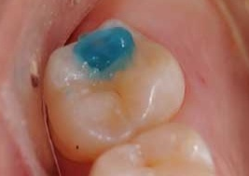
ENAMEL ADHESION
1st meaningful proof of intraoral adhesion – 1955, by Michael Bunocore- CONCEPT OF ACID ETCHING
Etching to enable micromechanical bonding
Enamel surface generally have low surface energy (organic pellicle, smear layer as surface contaminants)
Removal of surface layer, making the enamel surface more reactive is known as “conditioning” or “etching”.
Effects
Remove residual pellicle
Creates porous layer
Increase wettability
Increase surface area
Increase surface energy
Makes rough

Slide 16
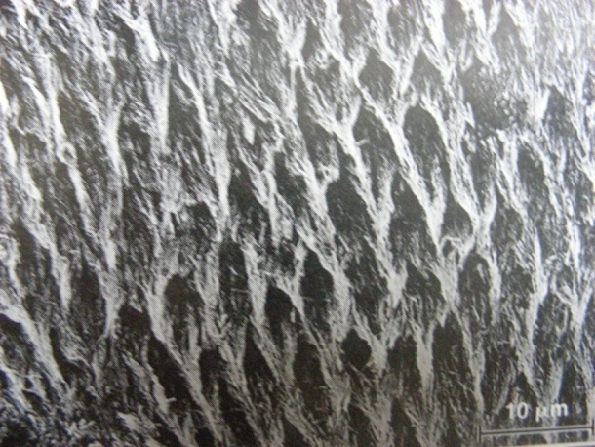
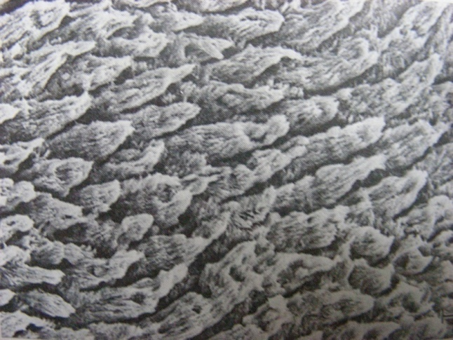
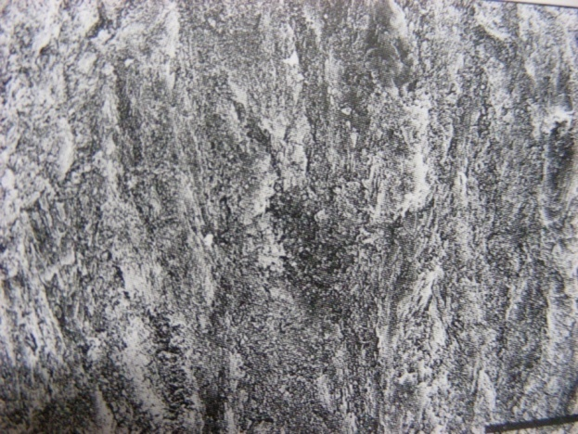
ENAMEL ADHESION
ETCHING PATTERNS OF ENAMEL
Type I-Dissolution of the prism cores without the dissolution of the prism peripheries.
Type III- Combination
Type II - Peripheral enamel is dissolved but cores are left intact.
16
Enamel etching patterns

Slide 17
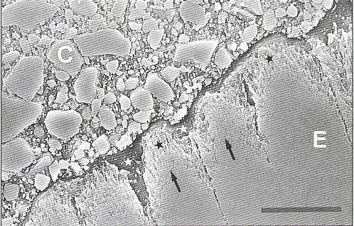
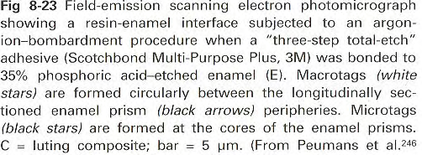
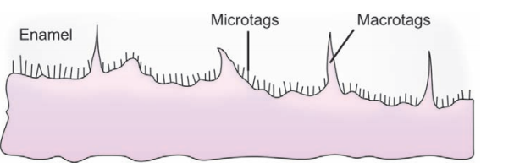
ENAMEL ADHESION
.
Enamel acid etching – removes 10 micron of enamel
Creates microporous layer 5 to50 microns deep
Smooth surface – irregular surface with high surface energy 72dynes/cm
Unfilled liquid acrylic resin (enamel bonding agent)
Wets the surface
Enters into microporosities by capillary action
Two types of resin tags are formed
Macrotags Microtags
(fill up spaces surrounding enamel prisms ) (form at the core of etched enamel prisms )

Slide 18
ENAMEL ADHESION
EDTA (24%; pH =7)
Citric acid
Tannic acid
Maleic acid
Polyacrylic acid
Nitric acid
Sulfuric acid
Hydro chloric acid
Pyruvic acid
E
T
C
H
A
N
T
S
Phosphoric acid
Concentration 30 – 40%
Etching time- not less than 15 sec
Washing times- 5-10 sec
50%
Less than 27%-
Untill 40%
Acid applied for 60 sec- monocalcium phosphate monohydrate – rinsed off
Dicalcium phosphate dihydrate- couldn’t easily removed
Calcium dissolution and etching depth increases and then reverse effect seen

Slide 19
ENAMEL ADHESION
ETCHING TIME
Time for etching- traditionally, 60 sec
But SEM studies have shown same surface roughness in 15 sec
Similar shear bond strengths & marginal leakage values for 15 & 60 sec have been observed
Current recommendations- permanent teeth, 15 to 20 sec
Fluoridated enamel, primary teeth- require more time
Clinically, the most important measure of a properly etched tooth is the frosty white appearance of the surface

Slide 20
ENAMEL ADHESION
LIQUID/GEL
Liquid-gel
Liquid-gel
Silica particles
High pH
Polymer beads
Lower pH- deep etch
On smooth surfaces, etching liquids and gels result in similar etch patterns.
With deep grooves and fissures, a liquid etch is recommended, because it penetrates the irregularities of the occlusal surface.

Slide 21
ENAMEL ADHESION
RINSING ETCHANT
Insufficient washing leaves debris that interferes with the flow of resin into the enamel channels.
Acid-etched enamel must be washed for 10 seconds; gel etchants should be washed longer.
Some studies have shown a 10- to 30-second wash time yields the same bond strength.
Time- 3-5 sec on flat surfaces –provide for adequate bond and seal
Complex preparations- 5 – 10 sec
Ethanol – remove residual water – enhance resin penetration

Slide 22
ENAMEL ADHESION
NEWER ALTERNATIVES TO ETCHING
Crystal growth on enamel surface
Treatment with a solution of polyacrylic acid & potassium sulfate
Laser etching
Mainly CO₂, Argon, and Nd:YAG Lasers are used. enamel to a depth of 10 to 20 µm.
Air Abrasive Technology
high speed stream of purified Aluminium Oxide particles (0.5 um) propelled by air-pressure.
Depositing calcium sulfate crystals on the surface of enamel -trapped resin to retain it mechanically
Laser etching is a process of continuous vaporization and micro explosions.
It can prepare enamel and dentin for bonding, similar to chemical etching.

Slide 23
DENTIN ADHESION

Slide 24
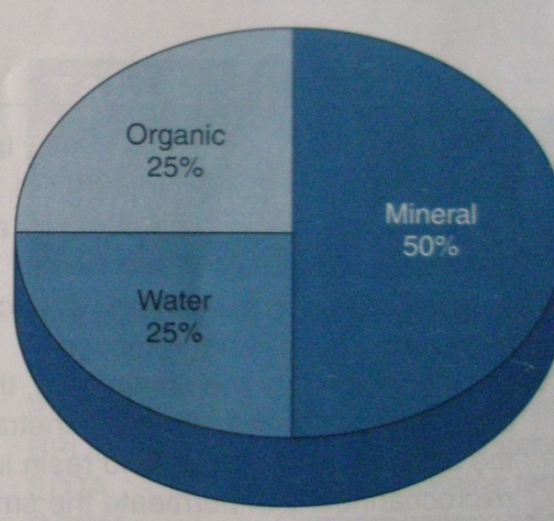
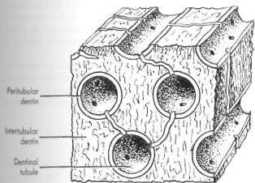
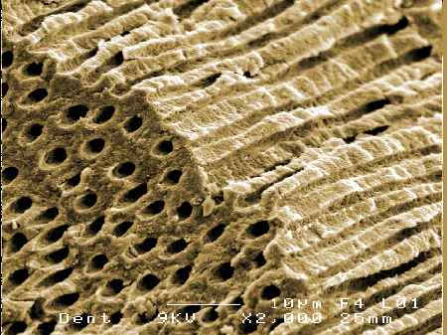
CHALLENGES IN DENTIN BONDING
Higher percentage of water and organic matter (Type I collagen).
Heterogeneous
Dentinal tubules with dentinal fluid
Changes due to caries, trauma- sclerotic dentine.
Smear layer

Slide 25
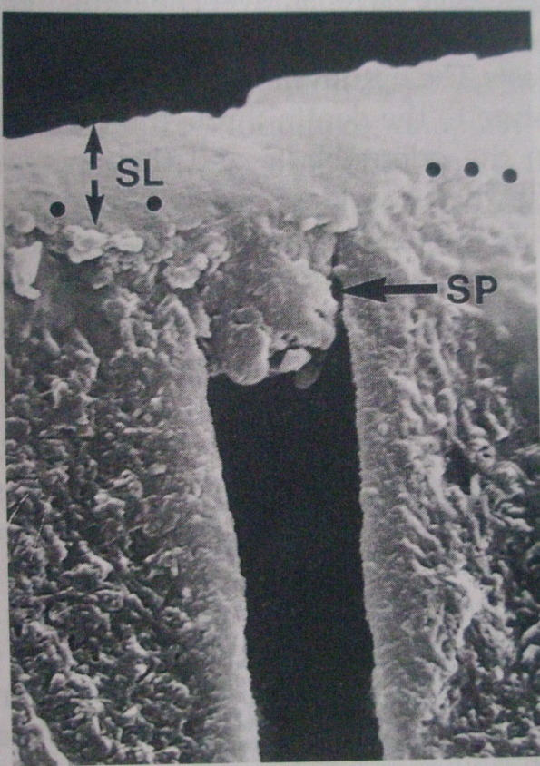
CHALLENGES IN DENTIN BONDING
SMEAR LAYER
Any debris, calcific in nature, produced by reduction or instrumentation of dentine, enamel or cementum that precludes interaction with underlying pure tooth tissue.
Orifices of the dentinal tubules are obstructed by debris tags called smear plugs.
Affects bond between cut tooth and the restorative material.
Smear layer is responsible for:
Physical barrier for bacteria and bacterial products
Restricting the surface area available for diffusion of both small and large molecules.
Resistance to fluid movement.
In vital teeth, the smear layer restricts the dentinal fluid from flushing the dentin surface.

Slide 26
CHALLENGES IN DENTIN BONDING
TECHNIQUE OF SMEAR LAYER TREATMENT
No Treatment at all
Removal and replacement of smear layer
Dissolution of the smear layer
Removal of smear layer by acid etching
Modification of smear layer
Resin would infiltrate through the entire thickness of smear layer and even bond to underlying matrix or penetrate into tubules
Eg. Scotch bond and prisma bond.
Removal of smear layer by acid etching and replacement with another mediation agent.
Tenure replaces smear layers with oxalate crystals which are deposited in dentinal tubules.
This dissolved smear layer plays an vital role in chemical attachment of dentin bonding agent to dentin
Eg. Scotchbond-2.
Modification of smear layer allows between interaction of dentin bonding agent with the smear layer.
Eg. Bonding agent – Prisma 2, XR Bond, All bond.
Acid etching agents are used to remove smear layer and develops attachment directly to intact dentin (through primers).

Slide 27
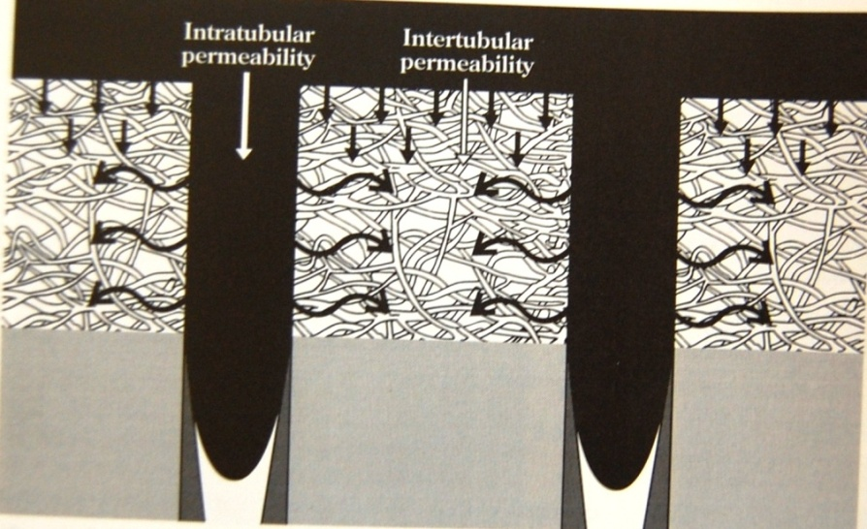
CHALLENGES IN DENTIN BONDING
DENTINAL PERMEABILITY
It refers to the ease with which a substance can move into or across a diffusion barrier.
Variation in permeability affects the bonding mechanism of dentin.
Intratubular
Intertubular

Slide 28

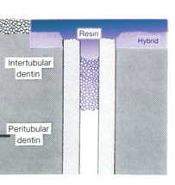
CHALLENGES IN DENTIN BONDING
DENTINAL PERMEABILITY
INTERTUBULAR PERMEABILITY
Diffusion of monomer into demineralized intertubular dentin, the dentin between the tubules.
Demineralized to expose the collagen fibrils of the dentinal matrix and to create diffusion pathways for monomer infiltration into long, continuous, interconnected, narrow channels, or pores
INTRATUBULAR PERMEABILITY
The movement of fluid within dentinal tubules
Responsible for dentinal sensitivity
Formation of resin tags
Notes:
The movement of resin monomer into these long, continuous, interconnected, narrow channels, or pores

Slide 29
CHALLENGES IN DENTIN BONDING
FACTORS AFFECTING INTERACTION OF DENTNAL
PERMEABILITY AND MONOMER DIFFUSION
Collagen fibril network
Non collagenous proteins
Primer solubility
Resin monomers penetrate acid etched collagen via spaces that can swell or shrink depending on bonding condition.
Molecular entanglement of resin polymer with biologic polymer may be responsible for resin bonds to collagen.
They are highly charged molecules that bind to water in demineralized dentin.
Collagenous +non collagenous proteins + GAG’s = hydrogel.
Hydrogel- insoluble hydrophilic polymer network.
HEMA can replace water in spaces around collagen fibrils, it can serve as a polymerizable solvent for subsequently placed adhesive monomers, given sufficient diffusion time.
Notes:
The movement of resin monomer into these long, continuous, interconnected, narrow channels, or pores

Slide 30
CHALLENGES IN DENTIN BONDING
FACTORS AFFECTING INTERACTION OF DENTNAL
PERMEABILITY AND MONOMER DIFFUSION
Collagen fibril network
Non collagenous proteins
Primer solubility
Fluid flow
Tubular branching
  Areas with high tubule density that are in direct contact with pulp are difficult to dehydrate.
  Multiple applications of primer allow sufficient occlusion with resin monomers to block diffusion of water from the pulp.
  Dentinal tubules permit adhesive monomers to flow.
  Most tubules contain lateral branches that radiate 2-6 µm from lumen.
  These branches provide route for monomer infiltration.
Notes:
The movement of resin monomer into these long, continuous, interconnected, narrow channels, or pores

Slide 31
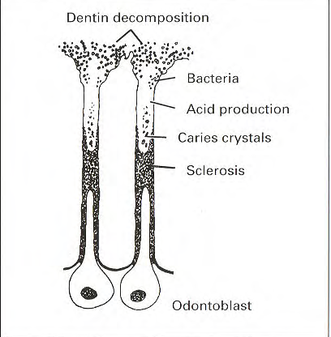
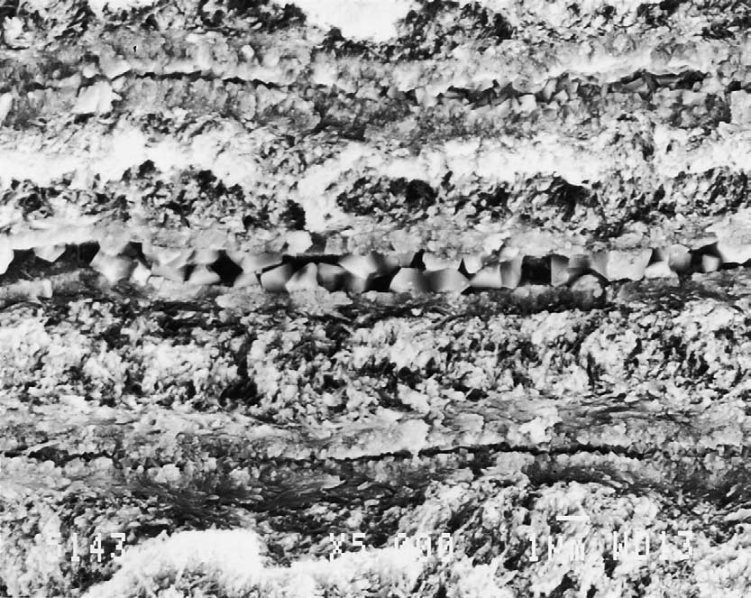
CHALLENGES IN DENTIN BONDING
CHANGES IN DENTIN: Sclerosed dentin
Formation of transparent, glass like dentin. which occurs in the cervical areas of teeth
Reactive- response to slowly progressive or mild irritation e.g, mechanical abrasion or chemical erosion.
Sclerotic dentin contains few, if any, patent tubules & therefore, has low permeability
It has areas of complete hyper-mineralization, without tubule exposure even when etched
Thus, its less receptive to adhesive treatments than is normal dentin

Slide 32
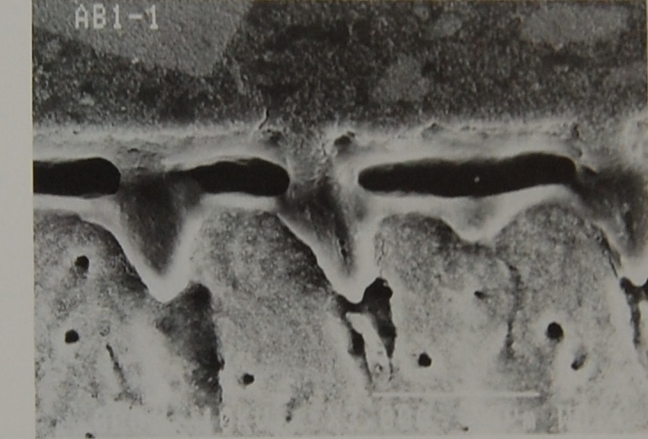
CHALLENGES IN DENTIN BONDING
CHANGES IN DENTIN: Disease
Caries
Reduced permeability
Non caries cervical
Short resin tags

Slide 33
IDEAL REQUIREMENTS OF DENTIN BONDING AGENTS
Provide high bond strength to dentin that should be present immediately after placement and that should be permanent.
Provide bond strength to dentin similar to that of enamel.
Show biocompatibility to dental tissue including the pulp.
Minimize microleakage at the margins of the restorations.
Prevent recurrent caries and marginal staining.
Be easy to use and minimally technique sensitive.
Possess a good shelf life.
Be compatible with a wide range of resins.
In addition it should be non toxic and non sensitizing to the operators or patients.
Bonding agents should seal the tooth surfaces from oral fluids.

Slide 34
Adhesion to Dentin
Etching
Bonding
Priming

Slide 35
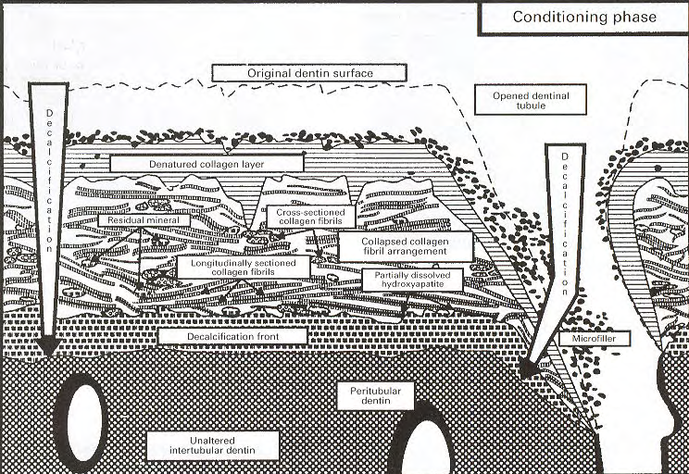
ETCHING/CONDITIONING
An acidic agent that dissolves the inorganic structure in dentin resulting in collagen mesh that allows infiltration of an adhesive resin
Removes smear layer and smear plugs
Demineralizes intertubular dentin (1-5µ)
Exposes collagen fibers
Demineralizes peritubular dentin.
Decreases free surface energy
Increase roughness
Notes:
Removes smear layer and smear plugs
Demineralizes intertubular dentin
- upto a depth of 1-5µ
- Exposes longitudinally / obliquely oriented collagen fibres
- Interfibrillar spaces – 15 –20nm (nanochannels)
Demineralizes peritubular dentin.
- Opens tubule orifices in a typical funnel shape configuration
- Exposes a circularly oriented collagen fibril arrangement.
Decreases free surface energy
Increases surface roughness

Slide 36
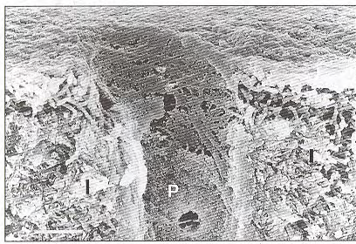
PRIMERS
Definition
Primers are the agents that promote wetting of the dentin with the bonding agent and increase the penetration of the bonding agent into the dentin.
Objective-
Hydrophilic dentin
Hydrophobic and spongy
Allow resin penetration
Primer applied on etched dentin
Notes:
displaces residual surface moisture
by use of bifunctional molecules, wets and envelops the exposed collagen fibrils.
sufficiently carry monomers into interfibrillar channels
transforms a hydrophilic substrate into a hydrophobic tissue state
increases the surface free energy

Slide 37
PRIMERS
Composition
Calcium monomers
Solvents
Acetone
PENTA(dipentaerythritol penta acrylate monophosphate)
BPDM(biphenyl dimethacrylate)
NTG-GMA(N-tolylglycine glycidal methacrylate)
HEMA – promotes adhesion , excellent wetting properties
Water
Ethanol
Notes:
They have surface tension less than the surface free energy of the acid etched dentin.
Amphiphilic bifunctional molecules.
The primer solvent should be water or water miscible.
The primer monomer should be amphiphilic or hydrophilic because they must compete with water and diffuse through water in the depths of demineralized zone.

Slide 38
PRIMERS
Acetone based primers
Advantages :
Slow evaporation
Not sensitive to wetness of dentin.
Have capacity to raise collapsed fibers.(9%-50%)
Advantages :
Excellent water chaser,
Dries quickly
Advantages :
Evaporates less quickly
Less sensitive to wetness of dentin.
Good surface energy and good penetration
Ethanol based primers
Disadvantages :
Evaporates quickly after being dispensed.
Can evaporate from the container change in composition.
Sensitive to wetness of dentin ( risk of over drying. )
Multiple coats may be required.
Offensive odour.
Volatile, bond strength may be significantly reduced.
Disadvantage:
Long drying time.
Water can interfere with adhesive if not removed
Water based primers
Disadvantage:
Extra drying time.
Acetone & H₂O
Eg: Tenure- quick
Acetone & ethanol
Eg: All bond 2 ( Bisco)
Ethanol & water
Eg: Gluma comfort bond
Scotchbond
Combination
Excite
Optibond solo Plus
Amalgabond plus
Prompt pop
Scotch bond multipurpose
One step
Prime and Bond NT
Gluma one bond.

Slide 39

ACETONE | ACETONE WATER | ACETONE ETHANOL | ETHANOL | ETHANOL- WATER | WATER
ABC Enhanced (Chameleon) | AQ Bond (sun Medical) | All –Bond 2 (BISCO) | Excite (vivadent) | Gluma Comfort Bond (kulzer) | Amalgambond Plus (parkell)
EG Bond (Sun Medical) | Reactmer (shofu) | Optibond solo plus(Kerr) | Optibond FL (kerr) | ARTBond (coltene) | Scotchbond Multi-Purpose(3M)
Gluma One Bond (Kulzer) | Tenure Quik (Den- Mat) | PQ 1(ultradent) | Permaquik (ultradent) | Clearfil SE Bond (kurary)
One step(BISCO) |  |  |  | Quadrant unibond (Lavex) | Denthesive II(kulzer)
Permagen(ultradent) |  |  |  | Scotch bond1 (3M) | EBS (ESPE) Fujibond LC (GC)
Prime & Bond |  |  |  | Syntac sprint(vivadent) | One-Coat bond (colleen)
Solid bond (kulzer) |  |  |  | Xeno 111(dentsply) | Prompt-L-pop 1,2 (ESPE)
Solist (DMG) |  |  |  |  | Syntac single component (vivadent)

Slide 40
FILLERS
Most of the bonding agents are unfilled
May contain inorganic fillers 0. 5% to 40% by wt.
Microfillers, or nanofillers, and submicron glass.
Advantages of nanofillers:
    Prevents nanoleakage.
    Causes uniform thickness of adhesive layer
    Better flexibility to adhesives
    Better dissipation of forces
    Scatter of light is prevented.
    Provides radio opacity

Slide 41
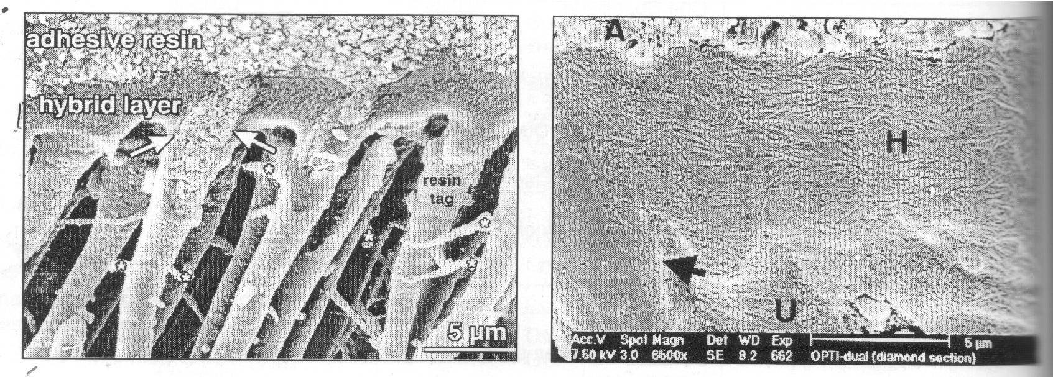
ADHESIVE RESIN
Hydrophobic monomers- BIS-GMA, UDMA, TEG-DMA and hydrophilic monomers like HEMA
Light cure/ auotcure
Fill up the remaining pores between the collagen fibrils
Form resin tags to seal open dentinal tubules
Initiates and advance the polymerization co polymerizes with the primer
Stabilze hybrid layer and form resin tags
Notes:
Light cure- before application of restorative resin- to avoid its displacement, adequate light intensity available.
An unfilled or partially filled resin which includes monomers that are mostly hydrophobic (BIS-GMA) but may contain a small percentage of hydrophilic monomers. Such as HEMA.
fill up the remaining pores between the collagen fibrils
form resin tags to seal open dentinal tubules
initiates and advance the polymerization reaction and co polymerizes with the primer molecules
stabilizes the formed hybrid layer and resin tags

Slide 42
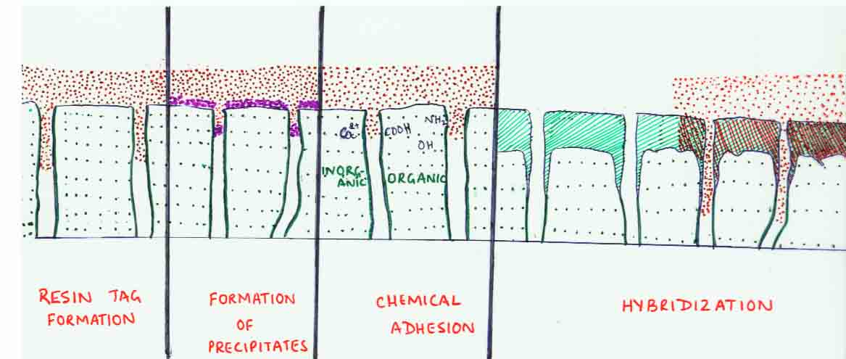
MECHANISM OF BONDING
STRUCTURE
M
R
X
Hydrophobic part:
Reacts with the restorative resin
Usually made of Methacrylate group
R- Spacer
Is responsible for making the molecule large enough to keep methacrylate groups spatially located for optimal chemical reaction with the composites.
Hydrophilic part:
Displaces water & wets the surface.
Permits penetration into
porosities of dentin. Reacts with organic and inorganic portions
( phosphate esters Or carboxylic acid groups )
Capable of bonding to dentin.

Slide 43
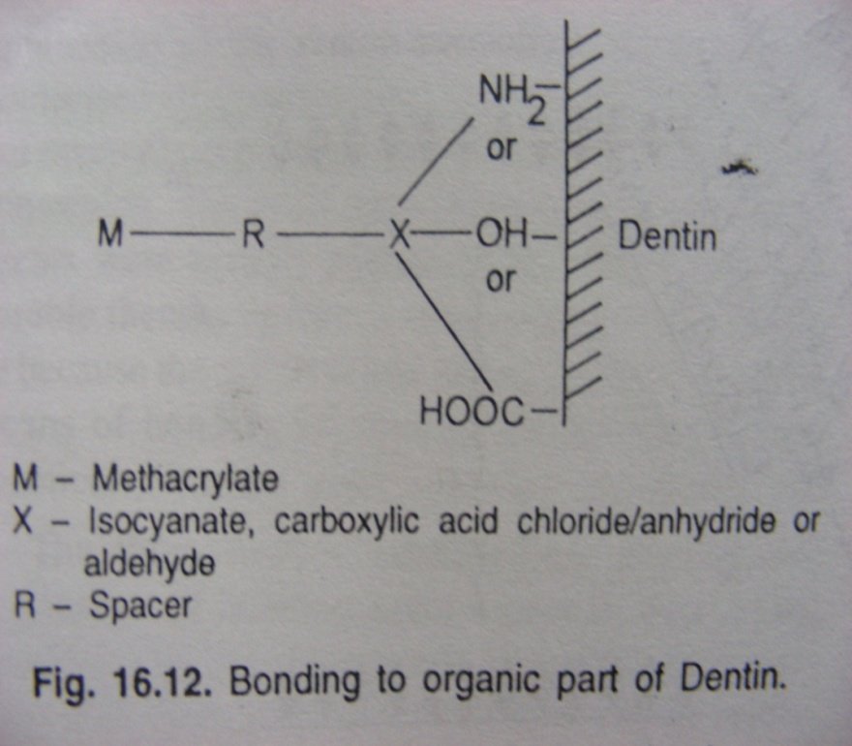
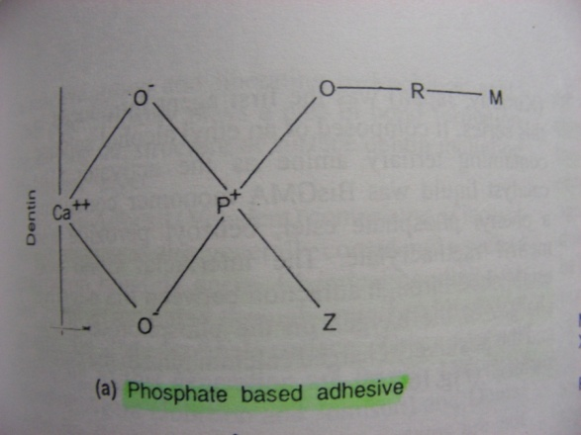
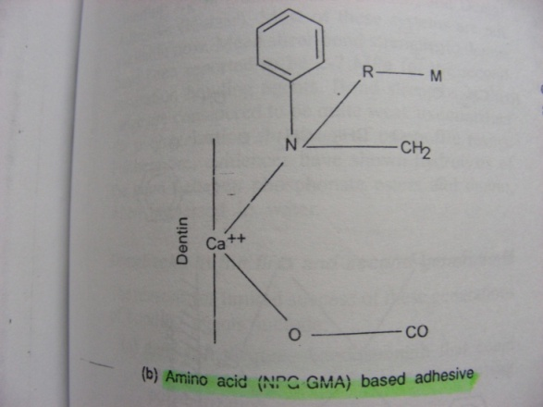
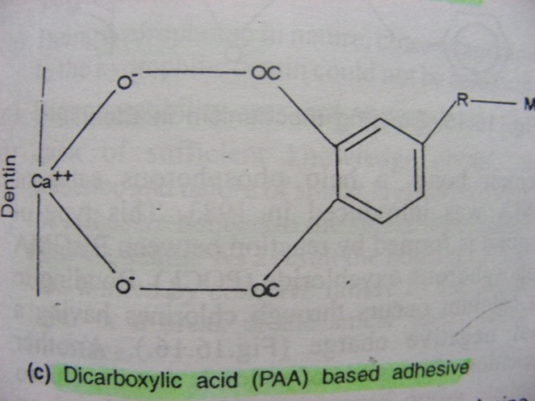
MECHANISM OF BONDING
.
Dentine
Adhesive
Inorganic portion
Between +ve Ca ions

Slide 44
MECHANISM OF BONDING
Acid washing / rinsing
Removes smear layer
Dissolves HA
Drying shrinks remaining
Collagen polymer molecules
Rehydration / priming
Swells collagen

Slide 45
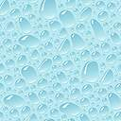
MECHANISM OF BONDING
Monomer polymerisation
And collagen entanglement
Monomer penetration

Slide 46
CLASSIFICATION OF DENTIN BONDING AGENTS
According to generations.
According to adhesion strategy( No of clinical applications).
According to chemical composition.
According to treatment of smear layer.
According to pH.
According to bond strength.
According to mode of curing.
According to type of solvent.

Slide 47
EVOLUTION OF BONDING AGENTS
According to generations:
Evolution of bonding agents from
No etch to
total etch
and self etch.

Slide 48
FIRST GENERATION
Bonding mechanism:
The development of surface active co-monomer NPG-GMA was first commercially available agent in 1965.
Chelation with calcium on the tooth surface to generate water resistant chemical bonds of resin to dentinal calcium.
Agents used in this generation:
NPG-GMA.
Glycerophosphoric acid dimethacrylate (GPA-DMA).
Cyanoacrylates
Polyurethanes
Notes:
Buonocore four decades ago found that a resin containing GPA-DMA could bond to HCl etched dentin surfaces. However the bonds formed were water soluble.
Bowen in 1965 developed N- Phenylglycine glycidyl methacrylate( NPG- GMA), a surface active comonomer, that could theoretically mediate water resistant bonds of resin to dentinal calcium.
Agents used in this generation:
NPG-GMA.
Glycerophosphoric acid dimethacrylate.( GPA-DMA).
Cyanoacrylates
Polyurethanes.

Slide 49
FIRST GENERATION
Bond Strength: 2-3 Mpa.
Disadvantages:
  The bond strength of these adhesives was poor (about 3 MPa).
  Poor mechanical retention.
Eg: Cervident( S.S White, Lake wood, NJ) First commercially available bonding agent.
  Cosmic bond( Amalgamated Dental Company)
  Palakav( Kulzer, USA).
Notes:
Buonocore four decades ago found that a resin containing GPA-DMA could bond to HCl etched dentin surfaces. However the bonds formed were water soluble.
Bowen in 1965 developed N- Phenylglycine glycidyl methacrylate( NPG- GMA), a surface active comonomer, that could theoretically mediate water resistant bonds of resin to dentinal calcium.
Agents used in this generation:
NPG-GMA.
Glycerophosphoric acid dimethacrylate.( GPA-DMA).
Cyanoacrylates
Polyurethanes.

Slide 50
SECOND GENERATION
In 1978, the Clearfil Bond System F( Kuraray, Osaka, Japan) was introduced in Japan, -the first product of the second generation adhesives.
Phosphorous esters of methacrylate derivatives.
Agents used in this generation:
Clearfil bond system F.
Scotch bond dual cure( 3M ESPE).
Bondlite ( Kerr).
Prisma Universal Bond( Johnson and Johnson).
Notes:
Disadvantages:
Low bond strength of 1-10 Mpa was too weak to counteract the polymerization shrinkage of composite resin.
Inadequate hydrolytic stability in oral environment - microleakage.
Devoid of hydrophilc groups and had large contact angles.
Poor clinical performance: -bonding agents is the fact that they bond to the smear layer rather than the dentin itself.

Slide 51

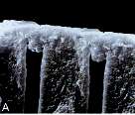
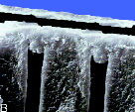
SECOND GENERATION
Mechanism of action:
Surface wetting phenomenon and ionic interaction between negatively charged phosphate groups in the resin and positively charged calcium in the smear layer.
Bond strength:
5 Mpa, which was considerably low
Smear layer not removed in second generation adhesives

Slide 52
THIRD GENERATION
These adhesives were introduced in the mid to late 1980s.
The third generation procedures involved two approaches:
  Modification of smear layer to improve its properties.
  Removal of smear layer partially without disturbing the plugs that occluded the dentinal tubules.
The conditioning agents either:
  Modified "SMEAR LAYER-MODIFYING SYSTEM" or
  Removed "SMEAR LAYER-REMOVING SYSTEM" the smear layer before placement of adhesive resins.
Notes:
Counterpressure of dentinal fluid and its abudment presence on the bonding surface hindered the micromechanical attchment,
Based this Clearfil New bond – with..
in the Europe because, acid etching did not produce significant improvements in dentin bond strengths because of the hydrophobic nature of the resin.
Further more inflammatory responses were thought to be triggered, providing another reason not to use acid.
Thus with the third generation type of smear layer treatment, the manufacturers effectively combined the dentin etching philosophy advocated in Japan with more cautious approach advocated in Europe and United States.
The result was preservation of a modified smear layer with slight demineralization of the underlying intertubular dentin surface.

Slide 53
THIRD GENERATION
Mechanism of action:
The phosphate primers modifies the smear layer by softening it; after penetration it cures forming a hard surface
Bond strength: 9-15 Mpa.
Disadvantages:
    More number of steps.
    Technique sensitive
    Retention decreased with time ( longevity questionable )

Slide 54
FOURTH GENERATION
Total – etch concept (3 step)
“ideal bonding agent”
Bertolloti “ total etch, total seal, total success
Introduced in late 1980s by Bertolotti and Kanca
Fear of damage to pulp- discouraged as very little acid actually penetrates dentin
Mild acids- didn’t remove smear layer completely
Involved phosphoric acid etching of dentin as well as enamel.
Notes:
The total etch concept was

Slide 55
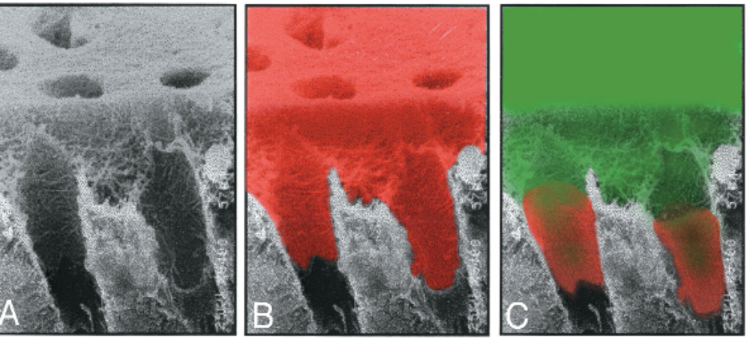
FOURTH GENERATION
  Universal bonding systems
Mechanism of action :
Etching removes smear layer completely , opens the tubules upto 7.5 µ and increases the permeability.
Primer wets & penetrates the collagen meshwork and increases its surface energy and wettability into which the resin flows.
Bond strength : 17-30 Mpa

Slide 56
FOURTH GENERATION
Complete removal of smear layer
Total etch technique
Wet bonding
Hybrid layer formation
Etchant
+
Primer
Adhesive
+
3 step total etch
4th Generation

Slide 57
FOURTH GENERATION
Total etch and Complete removal of smear layer
57

Slide 58
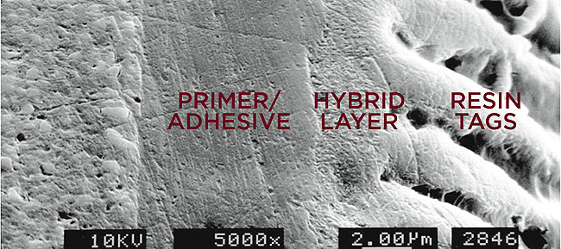
HYBRID LAYER
Concept introduced in 1982 by Nobuo Nakabayashi
“ A process of diffusion and impregnation of resins into the substrate of partially demineralized dentin followed by its polymerisation creating a “resin – reinforced hybrid layers” or a “resin – dentin interdiffusion zone”
(Nakabayashi1991)
“ The structure formed in dental hard tissues (enamel, dentin, cementum) by demineralization of the surface and subsurface, followed by infiltration of monomers and subsequent polymerization” is known as Hybridized dental hard tissues; hybrid layer
(Nakabayashi, Pashley 1998)

Slide 59
HYBRID LAYER
Fundamental principle of hybridization is a micromechanical bonding mechanism, leading to formation of resin reinforced zone .
Exchange process
Inorganic tooth material is exchanged for synthetic resin.

Slide 60
HYBRID LAYER
Involves 2 phases
Removal phase
Removing calcium phosphate
Micro porosities exposed at both the enamel and dentin tooth surface
Hybridization phase
Infiltration of resin monomers by diffusion
In situ polymerization of resin within the created surface micro porosities
Micro mechanical interlocking
Notes:
Phase 1 -REMOVAL PHASE
Removing calcium phosphate
Micro porosities exposed at both the enamel and dentin
tooth surface
Phase 2 – HYBRIDIZATION PHASE
infiltration of resin monomers by diffusion
↓
in situ polymerization of resin within the created surface micro porosities
↓
micro mechanical interlocking

Slide 61
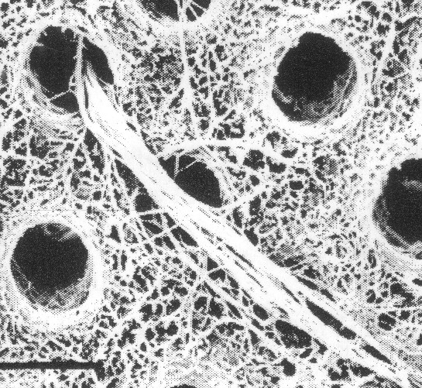
Specific structure seen in hybrid layer
HYBRID LAYER
Shag carpet appearance
Appears when dentin surface after being acid etched is actively scrubbed with an acidic primer solution.
Mechanism of action:
The combined mechanical and chemical action of rubbing the acid etched dentin with an acidic primer dissolves additional mineral salts while fluffing and separating the entangled collagen at the surface.
Notes:
Shag carpet appearance
Appears when dentin surface after being acid etched is actively scrubbed with an acidic primer solution.
The combined mechanical and chemical action of rubbing the acid etched dentin with an acidic primer dissolves additional mineral salts while fluffing and separating the entangled collagen at the surface.

Slide 62
HYBRID LAYER
Tubule wall hybridization:
Extension of the hybrid layer into tubule wall area.
Hermetically sealing the pulpodentinal complex against microleakage
Especially protective when bond fails at top or bottom of the hybrid layer
The resin tags keep tubules which ensures a leakage free seal of tubules.
Adhesive resin
Hybrid layer
Intertubular dentin
Resin tag
Notes:
Tubule wall hybridization:
Extension of the hybrid layer into tubule wall area.
Hermetically seals the pulpodentinal complex against microleakage
Specially protective when bond fails at top or bottom of the hybrid layer
The resin tags keep tubules sealed as they break off at the level of hybrid layer.
This is attributed to tubule wall hybridization which ensures a leakage free seal of tubules.

Slide 63
HYBRID LAYER
Lateral tubule hybridization :
Formation of tiny hybrid layer into the walls of lateral tubule branches.
This microversion of hybrid layer typically surrounds a central core of resin called microresin tag.
Micro resin tag

Slide 64
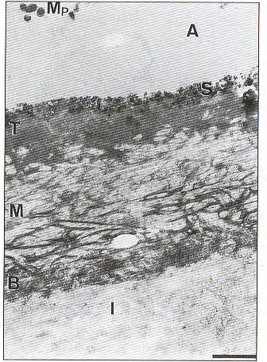
LAYERS
HYBRID LAYER
Amorphous electron dense layer –denatured collagen or very loosely arranged collagen
Interfibrillar spaces in which hydroxyapatite crystals have been repalced by resin monomer because of hybridization process
Consists of almost unaffected dentin with partially demineralized zone of dentin
Notes:
Layers-
Top-amorphoros electron dense phase – denatured collagen
Middle – sectioned collagen firbrils seperated by electronlucent spaces
Base- gradual transition to unaltered dentin

Slide 65
HYBRID LAYER
Properties of hybrid layer
Primarily organic composition of top 2-4 µm of dentin
Acid – resistant
Proteolysis – resistant
Modulus of elasticity is lower than dentin
More tough than dentin
Modulus of Elasticity (G Pa) | Mineralized Dentin | Demineralized | Resin infiltrated | Restorative resin
 | 14-17 | 0.005 | 2-6 | 4-27
 | Mineralized | Demineralized | Resin infiltrated
Fracture Toughness MN/mm3 | 4.2±1.1 | 11.3±3.5 | 27.7±10.8
Notes:
ACID – RESISTANT
Hybridized dentin can resist an acidic challenge with 6 mol / L hydrochloric acid (HCl) for 30 sec
PROTEOLYSIS – RESISTANT
Resists proteolytic challenge of 1% NaOCl for 10 minutes
The hybrid layer is considerably more elastic than either dentin or the restorative resin
Acts as an inherent elastic buffering layer that is able to absorb the resin composites polymerization shrinkage stress

Slide 66
HYBRID LAYER
Reverse Hybrid layer:
Acid etched surface of dentin, when subjected to treatment with NaOCl, , dissolution of exposed collagen fibrils occurs.
Further the use of self etching primers results in superficial etching of the surface. Here the hybrid layer is surrounded by more of inorganic material
Ghost hybrid layer:
Formed due to incorporation of air bubbles at the substrate adhesive interface.

Slide 67
Albaladejo A et al (2010) evaluated the effectiveness in the formation of resin tags, adhesive lateral branches and hybrid layers of etch and rinse & self etch adhesive systems, when bonding to dentine
They stated that hybrid layer (resin tags) formed were longer in etch and rinse adhesive systems.

Slide 68
FOURTH GENERATION
Multiple bottles- cumbersome.
Post-operative sensitivity
Technique sensitive. Over drying or Over wetting can interfere with the effective bonding.
Good bond strength
- Similar bond strengths to both enamel and dentin
- No reduction in bond strength on moist surfaces
- Can bond to other surfaces (metals, amalgam, porcelain)
Notes:
Bond strengths approached the typical bond strengths of resin to etched enamel.
They were more effective than their predecessors in reducing microleakage at dentinal and cementum margins because it primarily relied on mechanical means of bonding as opposed to the less reliable chemical adhesion.
Better clinical performance.

Slide 69
FOURTH GENERATION
Name | Bond Strength | Conditoner | Primer | Unfilled resin
All bond 2 bisco | 21.2+7.8Mpa | 37% phosphoric | 2%NTG- GMA 16%BPDM | BisGMA 40% 30%UDMA 30%HEMA
Scotch bond multipurpose-3M | 21.8 MPa to wet dentin 17.8 Mpa to dry dentin | 10% maliec acid 3Mic M depth | Aqueous solution of HEMA Polyalkenoate polymers | Bis GMA containing HEMA
Amalgam Bond |  | 10% Citric acid 19% Ferric Chloride | HEMA with water | 4- META MMA-TBB.
Panavia 21 Kuraray | 21+_1.5 Mpa | MDP HEMA 5 NMSA |  | Phosphoric acid ester of MDP

Slide 70
FIFTH GENERATION
“ONE BOTTLE” SYSTEMS / SELF PRIMING SYSTEMS
Objective-
Separate etch and rinse phase(total etch) followed by application of combined primer-adhesive resin solution.
Bond strength: 17 – 24 MPa.
Mechanism of action
Penetration into partially opened tubules
Formation of hybrid layer by hydrophilic monomers
Chemical interactions using first and second order bonding
+
+
Primer and adhesive
Primer
Adhesive
Etchant
+
Notes:
Total etch / Etch & rinse… Rely on wet bonding
- Self priming adhesive. ( One bottle adhesive systems )
Mechanism of action
Penetration into partially opened tubules
Formation of hybrid layer by hydrophilic monomers
Chemical interactions using first and second order bonding

Slide 71
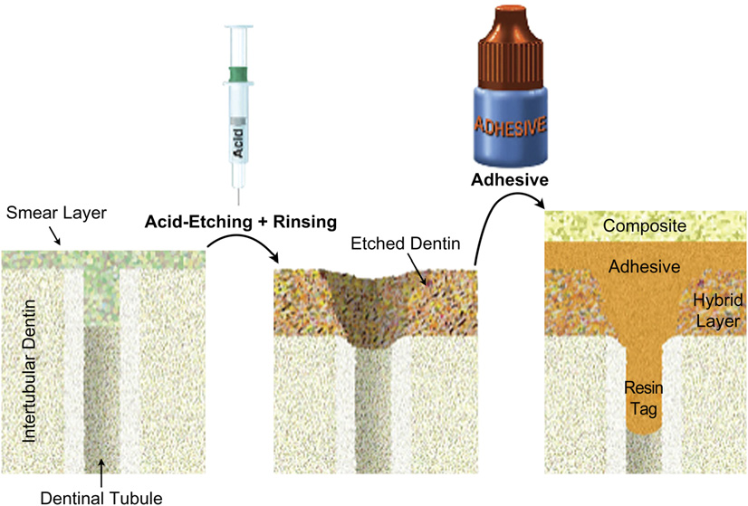
FIFTH GENERATION

Slide 72
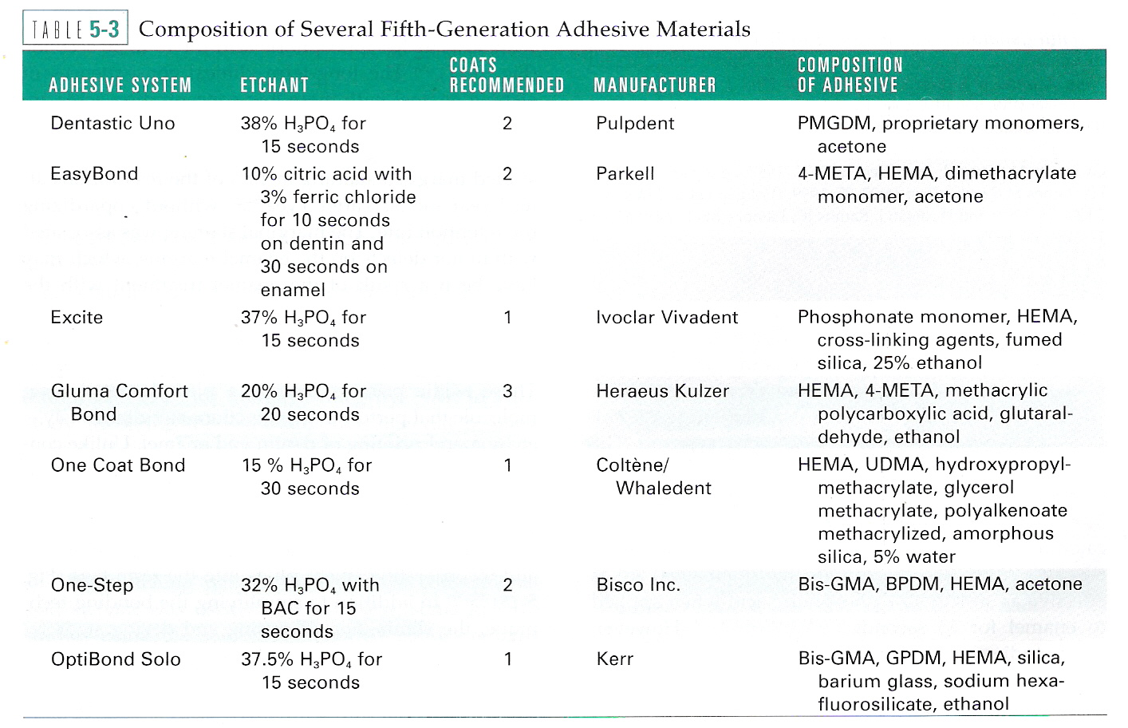
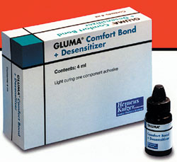
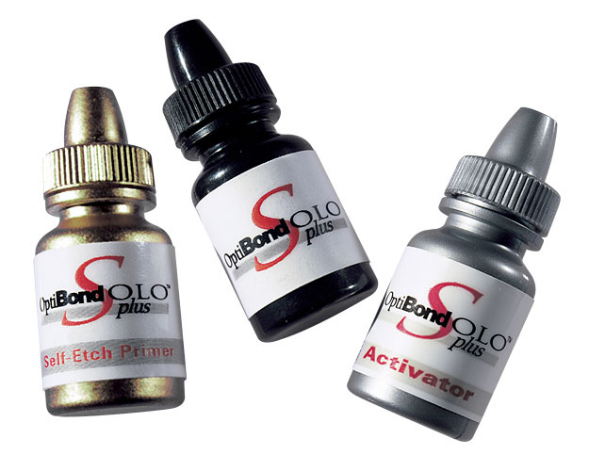
FIFTH GENERATION

Slide 73
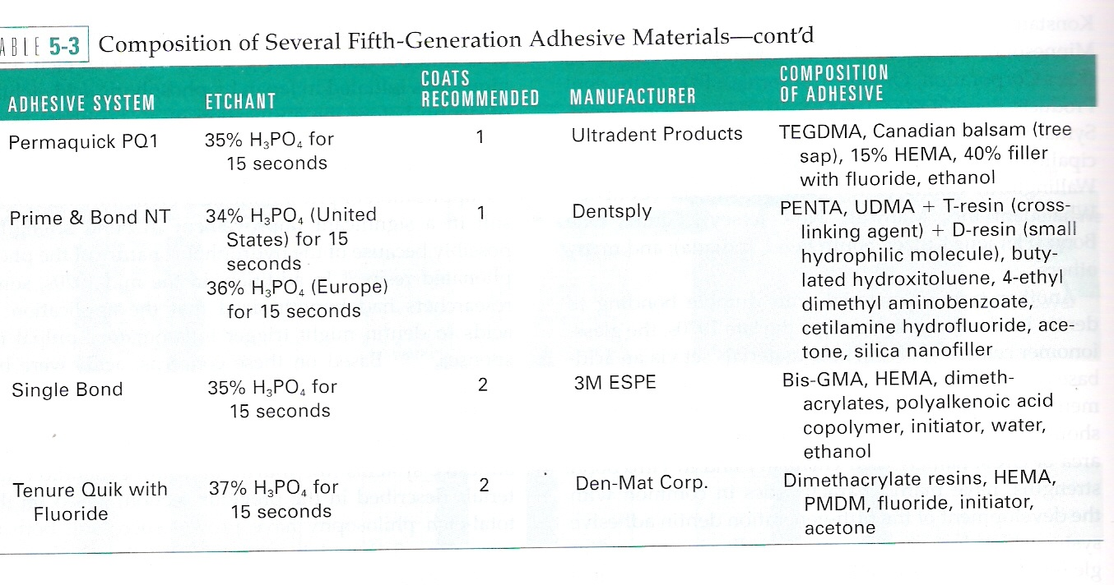
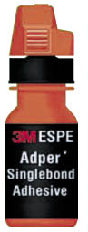
FIFTH GENERATION
Notes:
Is the successor of Prime bond 2.1. Contains nanofillers of diameter of 7 micrometers. These nanofillers help to form a uniform resin film that stabilizes the hybrid layer. The nanofillers serve as additional crosslinker by penetratring the channels between collagen fibrils to provide nanoretention
The first coat applied on etched dentin works as a primer- It increases surface free energy of dentin.
The second coat( and the third, and fourth and so on) acts as the fluid resin used in fourth generation materials- it fills the spaces between the dense network of collagen fibers.
When the manufacturer recommends only one coat, brushing it on for a seconds may serve simultaneously as primer and adhesive layers.

Slide 74
FIFTH GENERATION
Technique sensitive. Over drying or Over wetting can interfere with the effective bonding.
Good bond strength
Less post operative sensitivity
Less no of applications - easy to use

Slide 75
SIXTH GENERATION
Sixth Generation Bonding agents:
Self – etching primers
Late 1990s
Primer and etchant are combined in one step.( Self etching primers)
Type I Two step/ Non rinsing conditioner/ Self etch primer systems
Type II One step/ Self etching adhesives/ All in one systems

Slide 76
SIXTH GENERATION
+
+
Etchant
Primer
Adhesive
Self etching primer
Sixth Generation
Type ii
+
+
Etchant
Primer
Adhesive
1step self etch adhesives

Slide 77


SIXTH GENERATION

Slide 78


SIXTH GENERATION
Type I Two step/ Non rinsing conditioner/ Self etch primer systems:
NRC followed by Prime and Bond NT (Dentsply)
Clearfil SE Bond
Clearfil Liner Bond IIV.
Tryian( BISCO, Inc, Schaumburg,)
Simplicity( Apex Dental Materials, Inc, Sandwich, IL)
UniFil Bond(GC America, Alsip, IL)
OneCoat Self-Etching Bond(Coltene)
AdheSE( Ivoclar Vivadent)
Notes:
Self Etching Primers : These acidic primers includes a phoshonated resin molecule that performs two functions simultaneously etching and priming of enamel and dentine. They are not rinsed off. They donot remove smear layer.
Bonding mechanism of self etching primers is based on simultaneous etching and priming of enamel and dentin without rinsing, forming a continuum in the substrate and incorporating smear plugs into resin tags.
In addition to simplifying the bonding techniques the elimination of rinsing and drying steps reduces the possibility of over wetting or overdrying which can have a negative balance in adhesion.

Slide 79

SIXTH GENERATION
Notes:
Self Etching Primers : These acidic primers includes a phoshonated resin molecule that performs two functions simultaneously etching and priming of enamel and dentine. They are not rinsed off. They donot remove smear layer.
Bonding mechanism of self etching primers is based on simultaneous etching and priming of enamel and dentin without rinsing, forming a continuum in the substrate and incorporating smear plugs into resin tags.
In addition to simplifying the bonding techniques the elimination of rinsing and drying steps reduces the possibility of over wetting or overdrying which can have a negative balance in adhesion.

Slide 80
SIXTH GENERATION
Type II 6 ^{th} Generation Bonding agent :One step/ Self etching adhesives
Attempt to incorporate all the primary components into a single container.
Incorporating all components and having it remain stable is a significant challenge.
In reality, many of these are not all in- one systems at all but require premixing of chemical components (Prompt-L-Pop) or the use of chemically activating pellets or brushes that come with the kit (Touch & Bond, Brush & Bond).
Notes:
These products attempt to incorporate all the primary components of an adhesive system (etchant, primer, and bonding resin) into a single container. Incorporating all of the chemistries required in an adhesive system into a single bottle and having it remain stable over a reasonable period of time is a significant challenge. In reality, many of these are not all in- one systems at all but require premixing of chemical components (Prompt-L-Popb) or the use of chemically activating pellets or brushes that come with the kit (Touch & Bond,d Brush & Bond).

Slide 81


SIXTH GENERATION
PROMPT L-POP
It has 3 compartments:
Compartment 1: Methacrylated phosphoric acid, photo initiator, stabilizers
Compartment 2: Contains water, complex fluoride.
Compartment 3: Microbrushes
The blister is activated by squeezing compartment 1, thereby releasing its content into compartment 2 and freshly mixed solution is released onto the microbrush into compartment 3 by squeezing compartment 2.
Notes:
Features –
H₂O based self etching primer adhesive ;has sufficient bond strength
but etching of enamel less retentive than with phorphoric acid
Activation of Prompt L pop –
On applying to dentin, the smear layer gets dissolved and the demineralized dentin is loaded with prompt L pop monomers leading to the formation of a hybrid layer.

Slide 82


SIXTH GENERATION
BRUSH AND BOND
The brush contains chemically impregnated bristles which when come in contact with the liquid triggers a cocatalytic action and improves subsequent cure.
Chemically impregnated bristles which when come in contact with the liquid triggers a co catalytic action and improves subsequent cure.
Notes:
Features –
H₂O based self etching primer adhesive ;has sufficient bond strength
but etching of enamel less retentive than with phorphoric acid
Activation of Prompt L pop –
On applying to dentin, the smear layer gets dissolved and the demineralized dentin is loaded with prompt L pop monomers leading to the formation of a hybrid layer.

Slide 83


SIXTH GENERATION
ONE UP BOND
Single step application
Low film thickness- 10 Microns
Stable adhesion in moist or dry conditions.
Fluoride releasing

Slide 84

SIXTH GENERATION
TOUCH AND BOND
The acetone-based liquid contains the acidic monomer 4-META (4-methacryloxyethyl trimellitate anhydride, 13% concentration), which serves as an etchant and primer
The pledgets are impregnated with the co-initiator (sodium p-toluenesulfinate) that initiates a polymerization reaction when combined with the 4-META-containing liquid
Notes:
Features –
H₂O based self etching primer adhesive ;has sufficient bond strength
but etching of enamel less retentive than with phorphoric acid
Activation of Prompt L pop –
On applying to dentin, the smear layer gets dissolved and the demineralized dentin is loaded with prompt L pop monomers leading to the formation of a hybrid layer.

Slide 85
SIXTH GENERATION
Less effective bonding of enamel:
Initial bond might deteriorate with aging, which could lead to premature failures.
Bonding to Sclerotic and caries -problematic
Insufficient long term research.
No need to acid etch ,rinsing
Reduced post operative sensitivity
Simultaneous demineralization and resin infiltration.
Less sensitive to degree of wetness and dryness.
Low technique sensitivity
Notes:
No need to acid etch with phosphoric acid.
No post conditioning rinsing required.
Reduced post operative sensitivity
Simultaneous demineralization and resin infiltration.
Less sensitive to degree of wetness and dryness.
Single dose packaging possible. So less chance of cross infection.
Possibility for particle filled adhesive.
Low technique sensitivity
Less effective bonding of enamel:
Instrument enamel in some way.
Initial bond might deteriorate with aging, which could lead to premature failures.
Bonding to Sclerotic and caries affected dentin might be problematic
May inhibit set of self cure or dual cure resin materials.
Insufficient long term research.

Slide 86

SEVENTH GENERATION
They are truly all in one self etch adhesives that require no mixing.
All in one system
Eg:
I bond( Heraeus Kulzer).
G Bond( GC America).

Slide 87

SEVENTH GENERATION
I BOND
Heraeus Kulzer
- Single step no mix bonding system
  - Five in one solution :
    Etch
    Disinfect
    Desensitize
    Prime
    Bond
  Composition :
    Matrix – UDMA ; 4- META
    Solvents – Acetone ; water
    Photoinitiators – Camphoroquinone
Notes:
Disnfectant / Desnsitizer –
Glutaraldehyde
Stabilizers

Slide 88

SEVENTH GENERATION
G BOND
COMPOSITION –
- Advanced formulation of Phosphoric acid ester monomer,
- 4-MET monomer, nanofilled particles,
- Acetone & water as solvent used.
M.O.A –
This decalcifies the tooth, provides wetting property, diffuses monomer into the tooth structure, then polymerizes and hardens when light-cured and creates an ionic bond with the apatite in the tooth structure. Based on nano interaction technology
Notes:
Functions –
- 4 MET monomer provides a strong consistent bond to dentin.
- Phosphoric acid ester monomer provides consistent bond strength to enamel.

Slide 89

SEVENTH GENERATION
4 MET monomer :strong consistent bond to dentin
Phosphoric acid ester monomer : Consistent bond to enamel.
Nanointeraction technology
Non-conventional interface with the dentin – a “Nano Interaction Zone” (NIZ) with minimal decalcification and almost no exposure to collagen fibers.Ionic bond with hydroxyapatite of tooth structure,
Notes:
G-BOND forms a non-conventional interface with the dentin
“Nano Interaction Zone” (NIZ) with minimal decalcification and almost no exposure to collagen fibers.
GC s G bond: Dry, moist or wet, enamel or dentin GC’s G bond provides a strong consistent bond 4 MET monomer provides a strong consistent bond to dentin. Phosphoric acid ester monomer provides consistent bond strength to enamel.
Nanointeraction technology:
G-BOND forms a non-conventional interface with the dentin – a “Nano Interaction Zone” (NIZ) with minimal decalcification and almost no exposure to collagen fibers. This “nano” level reaction produces an insoluble calcium compound for a better bond less likely to deteriorate from enzymes contained in the mouth.
G-BOND’s Nano Interaction Technology creates a remarkably thin (less than 300 um) bonding layer that offers many advantages:
This “nano” level reaction produces an insoluble calcium compound for a better bond – less likely to deteriorate.
Creates a remarkably thin ( < 300 µm) bonding layer
Easy clean-up and removal of adhesive overflow
Completely coats all bonding surfaces even in an extremely shallow cavity - fewer voids
High surface tension makes it apply readily and stay put on all bonding surfaces
Bonding layer is not visible.
G Bond’s Nano Interaction technology, an advanced formulation of Phosphoric Acid Ester Monomer, 4-MET Monomer, nanofilled particles, and acetone and water solvent, decalcifies the tooth, provides a wetting property, diffuses monomer into the tooth structure, then polymerizes and hardens when light-cured and creates an ionic bond with the apatite in the tooth structure.
Completely coats all bonding surfaces with very few voids
High surface tension makes it readily applicable

Slide 90

Hurmuzlu F et al (2007) evaluated the microtensile bond strengths of a total etch, 2-step self-etch and single-step self-etch adhesives.
The results of bond strength were - Clearfil SE Bond (2 step) > 1-bottle adhesive system OptiBond Solo Plus (total etch system) > 1-bottle self-etching adhesive system iBond.
Feridun, Özdemir,, Ihsan H, Akin C, Seyda H. Bond strength of adhesives to dentin involving total and self-etch adhesives. Quintessence Int 2007;38:358.e206–212.

Slide 91
Asande A O et al determined the microshear bond strengths of five 'all-in-one' adhesives and two 2-step self-etching primer adhesives to dentin with different tubule orientations and to compare bond strengths between the adhesives.
Two 2-step self-etching primer adhesives
  (Clearfil SE Bond (CSE),
  Optibond Solo Plus SE Bond (Op. SE) and
Five all-in-one adhesives
  (Clearfil S(3) Bond (S(3)),
  Optibond All-in-One Bond (Op. AIO), G-Bond, Go!, and Xeno IV).
Asande A O, Francis B M, John T. Bonding of one-step and two-step self-etching primer adhesives to dentin with different tubule orientations. Acta Odontol Scand 2008 Jun;66(3):159-68.

Slide 92
Results showed that all-in-one adhesives (Op. AIO, G-Bond, Go, and Xeno IV) showed no significant differences in microshear bond strengths regardless of dentin depth (superficial or deep) or dentin tubule orientation.
CSE, Op. SE, and S showed significantly lower bond strengths to deep dentin with a tubule orientation perpendicular to the surface.
Asande A O, Francis B M, John T. Bonding of one-step and two-step self-etching primer adhesives to dentin with different tubule orientations. Acta Odontol Scand 2008 Jun;66(3):159-68.

Slide 93
Manuja Nair et al compared the shear bond strength of sixth generation and seventh generation bonding agents to dentin.
Sixth generation bonding agents, Adper SE Plus and Xeno III
Seventh generation bonding agents, Adper Easy One and Xeno V.
The highest value of shear bond strength was obtained from Adper Easy One system, while Adper SE Plus gave the lowest shear bond strength values
Manuja Nair, Joseph, Satheesh Kumar, Yadav Chakravarthy, Vel Krishna, Shivaprasad. Comparative evaluation of the bonding efficacy of sixth and seventh generation bonding agents: An In-Vitro study. Journal of Conservative Dentistry | Jan-Feb 2014 | Vol 17 , 1

Slide 94
EIGHTH-GENERATION
Self etching- self bonding.
A new category of composite resin restorative materials, which include what could be referred to as an “eighth-generation” bonding system, has just become available for use.
This new technology features a bonding agent which is contained within the composite resin restorative material.
A self-etching, self-adhering flowable composite technology eliminates the need for a separate bonding application step with composites for direct restorative procedures.
Surpass, vertise flow, futurabond.

Slide 95

BASED ON VAN MEERBEEL ET AL
Etch and rinse
Self-etch
Glass inomer adhesive
ETCH AND RINSE APPROACH
Conditioner or acid etchant
Primer or adhesive promoting agent
Actual bonding agent or adhesive agent

Slide 96

TOTAL ETCH APPROACH
Etch and rinse approach
Total etch- 3 steps
2 steps
Notes:
4 and 5

Slide 97
SELF ETCH APPROACH
Monomers into which carboxylic or phosphate acid groups are added.
Self etch approach
3 steps
2 steps

Slide 98
GLASS INOMER APPROACH
Self adhesive
Important when coarse cutting diamond is used or thick smear layer is produced
Polyalkenoic acid – 10-20 sec then rinsed, tooth air dried without dehydrating
Milder than phosphoric acid .
Bonding increases due to –
Cleaning effect- loose debris removed
Partial demineralization- surface area increased
Chemical interaction of polyalkenoic acid with residual hydroyappetite
Network of hydroxyapatite coated collagen fibrils interspread with pores is typically exposed up to 1um in depth.

Slide 99

BASED ON pH
Etching aggressiveness- strong, intermediary, mild
Strong
pH 1 or less
Weak bond- low pH
Mild
Enamel- deep demineralising- resembling phosphoric acid etching
Dentin- collagen exposed all hydroyapetite-dissolved
Hybrid layer- 3-4um
Water remains
pH 2
Superficial demineralisation-incomplete
Leaved hydroxyapetite- chemical interaction with monomers
Hybrid layer-less
Intermediary
pH -1.5
Demineralised top layer but partially demineralised base
Ex:Clearfil SE Panavia ED primer
Ex :Xeno III AdheSE primer, Optibond Solo Plus SE primer , I Bond
Ex: NRC, Adper Prompt
Notes:
Shap carpet appearance- lossley arranged collagen fibrils with individual fibrils seperated by interfibrillar spaces.

Slide 100
According to chemical composition ( Craig)
Polyurethanes(1-6 Mpa)
Polyacrylic acids(2-4 Mpa)
Organic phosphonates
4 META (3-7 Mpa)
HEMA+GA(11-17 MPa)
Ferric oxalate+ NPG GMA( 4-12.5 Mpa)
According to bond strengths
5-7 Mpa:
Scotch bond dual cure
Gluma
8-14 Mpa
Tenure
Mirage bond
17-20 Mpa
Scotch bond 2
Scotch bond multipurpose
All bond

Slide 101
According to treatment of smear layer
Removed:
Tenure
Mirage bond
Clearfil liner bond system
Modified:
All bond
Scotch bond 2
XR Bond
Preserved:
Scotch bond dual cure
Prima universal bond
According to their mode of curing:
Chemical cure:
Amalgabond plus
Light cure:
One bond
Gluma comfort bond
Dual cure:
Clearfil liner bond 2V
Prime and Bond NT
Text book of operative dentistry – Vimal sikri (3rd Edition).

Slide 102
CRITICAL STEPS IN BONDING
Isolation
Bonding to acid etched enamel requires a surface to allow the photopolymerizable hydrophobic bonding resin to be drawn by capillary attraction into the etched surface.
Internal wetness.
Caused by pulpal fluids that flow from pulp through dentinal tubules
External wetness
Ambient or environmental humidity
Hence methods of isolation- important

Slide 103
CRITICAL STEPS IN BONDING
Dentin and pulp protection
Non-adhesive liners and bases not recommended.
Calcium hydroxide-choice in deep cavities- pulp healing capacity. High solubilty- shouldn’t be etched.
Resin modified GIC- chemical coploymerization with adhesive resin and is resistant to acid etching.
Adhesive systems- pulp healing and have bacterial sealing but not recommended for pulp capping

Slide 104
CRITICAL STEPS IN BONDING
Universal enamel and dentin conditioning
Phosphoric acid - 30-40% phosphoric acid.
Applied for 15 sec
Scelortic dentin-longer
Rinsing thoroughly to remove- acid
Under drying
Over drying

Slide 105

OVER DRYING
When the etched dentin is air dried the collagen network will collapse and the microchannels opened by the removal of apatite systems will be closed from a compact coagulate that is impenetrable to resin.
Drying the dentin will produce a relatively impermeable amorphous layer:
  Denatured collagen
  Collapse of collagen layer
  Affects bonding
Hybridoid region – If surface air dried for more than 3 sec. Collapse of collagen resulting in improper penetration of primer & resin and thus ineffective hybrid layer reduced bond strength.
Notes:
The normal mineralized dentin could be dried without shrinking, acid etched dentin when dried shrinks about 65% vol. This is because stiffness of mineralized dentin is about 19,000MPa where as stiffness of acid etched dentin matrix is about 1Mpa. It is literally floating in rinsing water. Thus when there is collapse of the collagen fibril network after air drying, resin tags may still form, but hybrid layer formation does not occur.
.

Slide 106
OVER DRYING
Collapse and Re-expansion of Collagen :
Passive theory
Demineralized collagen network is suspended in H₂O with each fibril separated from one another by water filled spaces, when H₂O evaporates the collagen fibrils come close together in all dimensions resulting in passive collapse of collagen network.
Bonding theory
When H₂O evaporates there is collapse of collagen. At that moment, the collagen peptide may form intermolecular hydrogen bonds with the nearest neighboring collagen peptides which may contribute to further collapse of network.
Notes:
There are two possible explanations for the shrinkage of collagen →
Collapse of collagen

Slide 107

OVER DRYING
Various materials have been tested as rewetting agents:
Water: which does not rewet the surface rapidly.
Aqueous solutions of HEMA such as Aqua Prep( Bisco, Inc) or Gluma Desensitizer( Heraeus Kulzer). The latter also contains glutaraldehyde, which may stabilize the collagen layer, thus facilitating resin penetration.
Chlorhexidine
Primers with H₂O content of 20% or more are able to expand the collapsed collagen due to their “INTRINSIC RE-WETTING CAPACITY”.
Water based primers
Dry Bonding: refers to the bonding in which the acid etched dentin is dry and uses the adhesive systems that provide water based primers. These rehydrate and reexpand the collagen fibers , allowing the resin to infiltrate.

Slide 108
UNDERDRYING/OVERWETTING
Areas of the cavity preparation to pool too much water such as the axio gingival line angles of the proximal boxes.
When the primer and adhesives are applied, the solvent may diffuse into the water
Formation of resin tag impaired
Affecting the bond
Hence, water should be removed
Notes:
forcing the monomers to undergo phase changes to form, blisters and resin globules. Although the hybrid layer is formed, the adhesive did not form resin tags, but left the tubules in communication with microblisters filled with water.
These blisters may compress when the restoration in under occlusion causing post operative sensitivity by forcing the dentinal fluid towards the pulp. Perhaps the biggest advantage of the next two categories of adhesive systems is that their efficacy does not depend on the hydration of dentin, thus eliminating the ambiguity with the bonding techniques of how much is too wet and how much is too dry.

Slide 109
WET BONDING
In a moist bonding technique, the surface is not dried after etching and rinsing, and therefore collagen remains in position and behaves almost as a sponge.
But water –removed for effective bonding.
Acetone, ethanol come in contact with water
The boiling point is raised and the boiling point of water is lowered
Causes the evaporation of both water and acetone
The resin is left behind.
The acetone or ethanol solvent displaces water and carries the resins into the collagen.
Technique developed by Dr. John Kanca and Gwinnet in 1992.

Slide 110

WET/DRY BONDING
Enamel-dry preferred
Dentin – moisture needed to avoid collapse of collagen, shrink
Keep substrate dry and use water based primers thus re-expand collagen.
Shiny hydrated dentine- moist dentin
Pooled moisture removed by blotting or wiped off with slightly damp cotton pellet.

Slide 111
MICROLEAKAGE
Microleakage is the passage of bacteria and their toxins between restoration margins and tooth preparation walls.
Clinically, microleakage becomes important when one considers that pulpal irritation is more likely caused by bacteria than by chemical toxicity of restorative materials .
An adhesive restoration may not bond sufficiently to etched dentin to prevent gap formation at margins .
The smear layer alone may be a pathway for microleakage through the nanochannels within its core.

Slide 112
Deliperi S et al conducted a study to evaluate the efficacy of a total-etch and three self-etch adhesives in reducing microleakage.
  Group I: Xeno III one-step self-etch adhesive
  Group II: Prime & Bond NT total-etch adhesive
  Group III: i-Bond one-step self-etch adhesive and
  Group IV: Clearfil SE Bond two-step self-etch adhesive.
Clearfil SE Bond yielded more dye penetration at the occlusal than at the gingival wall
Deliperi S, Bardwell DN, Wegley C. Restoration interface microleakage using one total-etch and three self-etch adhesives. Oper Dent 2007 Mar-Apr;32(2):179-84.

Slide 113

NANOLEAKAGE
Presence of sub micron spaces within the hybrid layer in the absence of gap formation between resin composite and the hybrid layer
(Sano et al 1995)
Over etching
Collapse of collagen –air drying
acidic denaturation
Retained water
Poor polymerization
Phase separation.
Notes:
NANOLEAKAGE – LEAKAGE WITHIN THE HYBRID LAYER
Small porosities in the hybrid layer or at thr transiition between hybrid layer and mineralised dentine ,

Slide 114

NANOLEAKAGE
METHODS TO DETECT:
Presence of submicron spaces
- Too small for bacterial entry
- Allow diffusion of water, oral fluids and bacterial
enzymes.
Seen under SEM.
Detected using silver nitrate (50% aqueous solution)
In etch-and-rinse adhesive systems, nanoleakage is created by the discrepancy between dentin demineralization and adhesive impregnation along the resin–dentin interface

Slide 115


NANOLEAKAGE
Spotted pattern
Reticular pattern
Hybrid layer of self etch adhesives
Incomplete resin infiltration
Adhesive layer
Incomplete removal of water
Notes:
From bonding site

Slide 116

WATER TREES
Tay et al -transition initial nanoleakage
Heat of polymerization generated during light activation—upward convective movement of water from dentin ,vertically oriented water trees
In region over dentin tubules ---osmotically induced outward movement of water
The presence of water filled voids are disclosed by soaking the bonded specimens in silver nitrate solutions.

Slide 117

WATER TREES
Associated with porosities in the polymerised adhesive layer.
Polymerized resin impregnated with water.
Self etch adhesive- increased permeability in polymerised resin from which water was incompletely removed.
Residual water prevents complete polymerisation
Functional implications of water treeing
Functionally reduction in nanoleakage and water tree formation may be achieved when multiple coats of one step self-etch adhesives are applied to sound dentin .
If sufficient layer of adhesives is present phenomenon of water blistering is of minor implications
Notes:
Two theories have been proposed as regards genesis of water treeing phenomenon
Remnant water theory-according to it water trees were ‘‘left out’’ water that was incompletely removed from water in dentin adhesives.
However, this theory does not account for following aspects of water treeing formation
Uneven distribution
Substrate dependence
Reverse water trees
Secondary water trees
Water-flux theory
Fluid movement in dentin can be of three types viz evoporative, osmotic or connective water fluxes.
Evaporative is due to air drying and it occur irrespective of tooth vitality
Osmotic movement occur in the presence of high concentration of water soluble ionic monomer in the presence of water which induce osmotic water flux from deep dentin.
Both osmotic and evoporative fluxes results in permeation of water within the adhesive mixture, which explains the predilection of normally oriented water trees along the surface of dentin

Slide 118
Joao CF et al conducted a study to evaluate nanoleakage within the hybrid layer yielded by etch-and-rinse and self-etch adhesive systems, with different solvents and compositions.
They found that two-step self-etch adhesive system (AdheSE) might contribute for lower nanoleakage deposition and showed better performance in dentin adhesion.
Joao C F, Patricia T P .Influence of Solvents and Composition of Etch-and-Rinse and Self-Etch Adhesive Systems on the Nanoleakage within the Hybrid Layer. The Journal of Contemporary Dental Practice, July-August 2013;14(4):691-99.

Slide 119
ADDITIVES FOR DENTIN /ENAMEL ADHESION
Filler contents though in minute quantity play a vital role in dental adhesion.
The addition of fillers in total etch adhesives improves their bond strength.
In single step system silica fillers are often used as thickener to increase the viscosity, resulting in adequate film thickness. It also prevents over thinning and incomplete polymerization due to oxygen inhibition.
Recently adhesives with fluoride releasing properties are introduced

Slide 120
ADDITIVES FOR DENTIN /ENAMEL ADHESION
Polysiloxane encapsulated sodium fluoride particles are used as a source of fluoride.
Fluoride is introduced because of its anti-cariogenic activity
Certain adhesives uses dyes with the intention to clearly indicate the proper mixing of components .
Example- One up bond and Tyrian SPE
In One up bond the color changes from yellow to pink and when it is light cured the color fades.

Slide 121
BIOCOMPATIBILITY
Typically skin irritants.
HEMA is not considered biocompatible as a monomer.
local and systemic reactions.
Even with double gloves, contact with these aggressive solvents and monomers will produce actual skin contact in a few minutes.
Follow all reasonable precautions, and if unwanted contact occurs, immediately flush the affected areas with copious amounts of water and soap. Once the material is polymerized, there is very little risk of side effects.
Adverse pulpal reactions after a restorative procedure may not be caused by the material used in that procedure, but by bacteria remaining in, or penetrating the preparation

Slide 122
BIOCOMPATIBILITY
In some cases, adverse reactions
are caused by a combination of factors, such as the following:
Bacterial invasion of the pulp, either from the tooth preparation or from an existing carious lesion
Bacterial penetration into the pulp caused by a faulty restoration
Pressure gradient caused by excessive desiccation or by excessive pressure during cementation.
Traumatic injuries
latrogenic tooth preparation-excessive pressure, heat, or friction.
Stress derived from polymerization contraction of composites and adhesives.

Slide 123
APPLICATIONS OF BONDING AGENTS
Bonding of directly placed resin based restorative materials.
Bonding of indirectly placed restorative materials.
Bonding of ceramic restorations.
Bonding of amalgam restorations.
Bonding of prefabricated and cast posts.
Bonding orthodontic brackets.
Bonding periodontal splints
Repair existing restorations.
Sealing of pits and fissures of posterior teeth.
Treatment of cervical sensitive dentine.
Reattachment of fractured tooth fragments.
Reinforce fragile roots internally.
Seal apical restorations placed during endodontic surgery.

Slide 124
APPLICATIONS OF BONDING AGENTS
Bonding to amalgam
Agents that bond amalgam to cavity.
Amalgabond, panavia , optibond solo.
Bonding to indirect restorations
Bonding requires agents for both the tooth structure and the undersurfaces of the indirect restoration.
Desensitization
The adhesives block the dentinal tubules preventing transmission of pain and desensitizing the tooth.
4- META based adhesives.
Resin composite cements are usually used to fill the space between the two surfaces.
GLUMA, All bond.

Slide 125
APPLICATIONS OF BONDING AGENTS
Porcelain and ceramic repair
Etching of surface to clean and produce micromechanical relief
Cast restoration bonding
Roughening and etching the casting surfaces and the dentin surfaces.
GIC bonding
The phosphate and the calcium ions are released from hydroxyapatite and absorbed in unset cement.
Silanating the etched surface to enhance wetting and create chemical bond.
Apply bonding system and add composite.
Use bonding system on both the surfaces
Minimize cement thickness in both the joints.
intermediate layer between the ‘pure’ GIC and the pure hydroxyapatite; the so-called ‘ion-exchange’ layer.
Ionic bonding between the carboxyl ions from the cement acid and the calcium ions from the tooth structure

Slide 126
COMMON CLINICAL BONDING PROBLEMS
Problem | Solution
Dentin surface too dry | Use moist cotton pellet to rehydrate surface.
Dentin surface too wet | Gently blot dry to achieve glistening surface
Contamination with saliva and blood | Rinse, re etch if contamination is moderate or greater
Contamination with caries detector, handpiece lubricant or hemostatic agent | Rinse and reetch
Contamination by eugenol | Avoid eugenol containing provisional materials and temporary cements.
Remaining caries affected dentin | Remove caries

Slide 127
COMMON CLINICAL BONDING PROBLEMS
Surface does not glisten after application of primer | Apply additional coats of primer
Self cured composite debonds from adhesive | Use dual cure bonding agent with self cured composite or resin cement
Bonding agent under cured | Cure recommended time with properly maintained light curing unit, be sure the bonding agent is compabtible with light curing unit.
Recent bleaching procedure | Wait one week after bleaching.
Flourosed teeth | Double the etching time
Smooth single surface lesions lack of bonding | Create surface roughness and mechanical undercuts

Slide 128
BOND STRENGTH TESTING
The bond strength can be measured statically using a MACRO- or MICRO-test set-up, basically depending upon the size of the bond area.
The MACRO-bond strength, with a bond area larger than 3 mm² , can be measured in ‘shear’, ‘tensile’, or using a ‘push-out’ protocol.
MICRO-bond strength is typically measured in tensile, micro-tensile bond-strength testing (µTBS) was developed in 1994.
The bond area tested is much smaller compared to that of the ‘MACRO’ tests, being about 1mm² or less.

Slide 129



BOND STRENGTH TESTING

Slide 130

FAILURES IN BONDING
Can occur at various levels
between mineralised and demineralised dentin
between demineralised dentin and bonding agent
within layer of bonding agent
between bonding agent and composite resin.
Affected by –
dentin wetness
tooth flexure
size of lesion
substrate
material factors

Slide 131




















MEASURES TO IMPROVE BOND STRENGTH
Ethanol wet bonding
Glutaraldehyde
Inhibitors of collagenolytic enzymes
2
DEGRADATION
Collagen cross linking agents
Riboflavin
Chlorhexidine 0.2-2%
1
HYDROLYTIC
ENZYME
BOND...
Tjaderhane.l, Oper Dent 2015
3
AGING...
STRATEGIES
Carbodiimide
Tetracycline
Galardin (0.2 mM)
4
Proanthocyanidins
6
MMPS, CYSTEINE CAPTHEPSINS
MDPB
Remineralizing the hybrid layer
Biomimetic remineralization
5
Remineralizing
by adhesives containing bioactive particles
Benzalkonium chloride(0.5%)
DMSO
Fluoride containing adhesives
Template-non collagenous phospho -proteins
ACP nanoprecursors
Biodegradable polymers
Bioactive silicates

Slide 132


CONCLUSION
What we have to choose:
The choice may be Confusing.
It is easy for the clinician to believe that a new system is better over the old ones but this may not always be true.
SO:
Chemistry is more important than the company.
Technique is more important than the material.

Slide 133
REFERENCES
Sturdevant C.M, Theodore M. Roberson, Herald O.Heymann, Edward J. Swift; the art science of operative dentistry. Fundamental concepts of enamel and dental adhesion 235-268.
James B Summitt . Fundamentals of operative dentistry. 2nd edition.,. Karl F.Leinfelder. Dentin adhesives for the twenty-first century.
Nakabayashi . Hybridization of dental hard tissues by. Quintessence Publication
Kenneth.J.Anusavice –philips science of dental materials 11th edition.
Dental clinics of North America vol 45. Number 1. January 2001.
David H Pashley et al: The effects of dentin permeability on restorative dentistry, DCNA 46; 2002; 211-245..
Saraf K.K, Mishra S.K, Kumar A. Current perspective on self etching primers (SEPs) adhesives. Journal of conservative dentistry. Vol.7, no.4. Oct-Dec-2004.
Adhesion and its application with restorative materials. DCNA; vol. 37, No.3, July 1993.
Bonding to enamel and dentin : a brief history and state of the art, 1995 – Quintessence Int 1995; 26: 95-110.

Slide 134
REFERENCES
Feridun, Özdemir,, Ihsan H, Akin C, Seyda H. Bond strength of adhesives to dentin involving total and self-etch adhesives. Quintessence Int 2007;38:358.e206–212.
Asande A O, Francis B M, John T. Bonding of one-step and two-step self-etching primer adhesives to dentin with different tubule orientations. Acta Odontol Scand 2008 Jun;66(3):159-68.
Nazarian A. Simplifying Direct Composites With New Material Technology. Dentistry Today . January 2010;:128-130.
Perdigão J. Dentin bonding—Variables related to the clinical situation and the substrate treatment. Dental Materials . February 2010;26(2):e24-e37.
Deliperi S, Bardwell DN, Wegley C. Restoration interface microleakage using one total-etch and three self-etch adhesives. Oper Dent 2007 Mar-Apr;32(2):179-84.
Joao C F, Patricia T P .Influence of Solvents and Composition of Etch-and-Rinse and Self-Etch Adhesive Systems on the Nanoleakage within the Hybrid Layer. The Journal of Contemporary Dental Practice, July-August 2013;14(4):691-99.
Van Meerbeek B, Peumans M, De Munck J, et al. Relationship between bond-strength tests and clinical outcomes. Dental Materials February 2010;26(2):e100-e121

Slide 135


