Slide 1
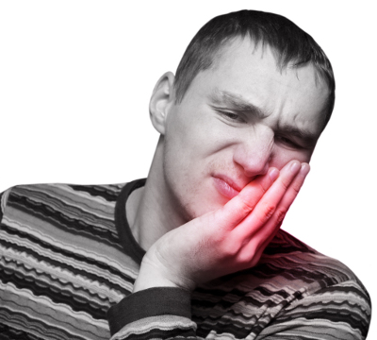
Dentin Hypersensitivity

Slide 2
contents
Introduction
Definitions
History
Epidemiology
Mechanism of sensitivity
  Innervation of dentin
  Theories of dentin sensitivity
  Variables affecting sensitivity
Etiology & predisposing factors
Clinical features
Measurement of sensitivity
Management
Conclusion
References

Slide 3
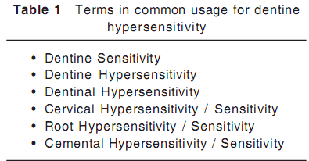
Synonyms

Slide 4
Definitions
Dentine hypersensitivity is characterised by short, sharp pain arising from exposed dentin in response to stimuli typically thermal, evaporative, tactile, osmotic or chemical and which cannot be ascribed to any other form of dental defect or pathology .
The Canadian Advisory Board on Dentine Hypersensitivity in 2002 suggested that it would be more correct to substitute ‘disease’ for ‘pathology’.
Hypersensitive dentin is an uncommonly sensitive or painful response of exposed dentin to an irritation (Grossman)
Dentinal hypersensitivity can be described as an adverse reaction or pain in one or more teeth resulting from either a thermal mechanism, or chemical stimulus (Clark)

Slide 5
HISTORY
Ya- tong ( pain in tooth ) treated in China since 2000yrs by applying “ xiao – shi” (niter or potssium nitrate).
3700 – 1550 BC - Egyptian papyrus ebers described tooth pain associated with erosion and gingivitis.
3000 BC- Egyptian medical papyrus used mixture of red & yellow vitriol and alum for ‘teeth that suffer.’
875 AD -Rhages, arabian physician recognised pain associated with gum recession in old age. He advised treatment with astringents.
1678 Leeuwenhoek described the ‘tooth canals in dentin’ after inventing microscope.

Slide 6
J. D. White presented theory of ‘Concussion’ given by Dr. Goddard which proposed that dentinal pain was due to movement of fluid in tubules
J . D. White referred to therapies of arsenous acidsilver nitrate, caustic potash, lunar potash,creosote and nitric acid.
1855 - Dr. Dwinelle gave theory that dentinal tubules were filled with fluid which acted as a medium for transmission of sensation in dentin.
1857 - Cartwright – when affected tooth struck, certain areas of tooth were ‘exquisitively sensitive’. This was treated with caustics – CuSO₄, mercury bichloride, AgNO₃, ZnCl₂, antimony chloride & arsenous acid.
1866 - Francis - “sensitive dentin – cause and treatment”. He gave use of cavity liners to promote secondary dentin formation. In severe cases, paste of arsenous acid, tannin and creosote.
1900 - Alfred Gysi - first suggested relieving hypersensitivity
by coagulating proteins within dentinal fluid.

Slide 7
1932 - Sensitex – desensitising solution by King’s speciality Co.
active ingredient – Chloralum oxychloride.
1940s - Emoform tooth paste - formaldehyde 1.4%, CaCO₃ 14%, magnesium carbonate 15%, & a mineralising salt
made of NaHCO₃ 3.4%, NaCl 1.45%, K₂SO₄ and Na₂SO₄.
1941 - Lukomsky first used sodium flouride.
1943 - Hiat and Bobby - paste of sodium flouride, white clay
and glycerin
1956 - Pawlowsky - gave use of strontium chloride
1962 - Brannstrom - Hydrodynamic theory
1974 - Hodosh - use of potassium nitrate

Slide 8
Epidemiology
Very common finding.
More common in the 20 – 40 yrs age with peak in the late 30s.
Higher incidence in females
More common in maxillary premolars and canines specially on the cervical aspect of buccal surfaces of the teeth.
Inverse relation with oral hygiene maintainance.

Slide 9
PREVALENCE
varies from 4 to 57 percent.
These variations are likely due to differences in the populations studied and the methods of investigation (for example, questionnaires or clinical examinations).
The prevalence of DH is between 60 and 98 percent in patients with periodontitis.
A majority of patients, however, do not seek treatment to desensitize their teeth because they do not perceive DH to be a severe oral health problem.

Slide 10
Innervation of pulp
Pulp richly innervated. 75% non myelinated fibres ( C ) , 25% myelinated fibres ( A )
Aα, Aβ, Aδ (depending upon their axon diameter & conduction velocity )
Aδ fibres | C fibres
responsible for brief, sharp well localised pain of dentin sensitivity. | responsible for poorly localised, dull burning ache of pulpal pain.
are relatively large in diameter with faster transmission of impulses | are small fibres which contain many peptides involved in pain sensation & inflammation
have low stimulation threshold | stimulation threshold is high

Slide 11
Stimulus to C fibres
release of vasoactive peptides (substance P, CGRP, neurokinins A & B )
vasodilatation and plasma extravasation and promote neurogenic inflammation
Promote & sustain dentin sensitivity
However, some times C fibres can cause sensitivity by process called ‘neurogenic inflammation’

Slide 12
MECHANISM OF DH.
Direct innervation theory
Odontoblast receptor
Fluid movement/hydrodynamic theory
Transducer theory
Gate control theory

Slide 13
Direct stimulation theory
  According to this theory, the stimuli directly acted upon the free nerve endings of the pulpal nerves which extended into the dentinal tubules and thus caused pain.
  Limitation –
    The nerves extended only upto about 100μ into the dentin.
    Topical application of local anesthetics do not abolish sensitivity.
  Hence this theory is not accepted

Slide 14
Modulation theory
  According to this theory, when an irritating stimulus is applied to dentin, the odontoblasts get injured and release neurotransmitters and vasoactive amines. These substances are then thought to activate the nerve fibres by increasing neuronal cAMP levels thus resulting in pain.

Slide 15
Transducer theory
odontoblasts could serve as receptors and that there must be synapses between pulpal nerves and odontoblasts.
Thus the odontoblatic processes which extend into the dentinal tubules are thought to relay the impulses to the nerves in the pulp via the synaptic junctions with them.
Limitations –
  the odontoblastic processes do not extend the whole width of dentin
  no synaptic junctions present
  no evidence of a neurotransmitter like acetylcholine ( which would be present if a true synapse were present )
  dentin remains to be sensitive in cases where the odontoblastic layer is damaged

Slide 16
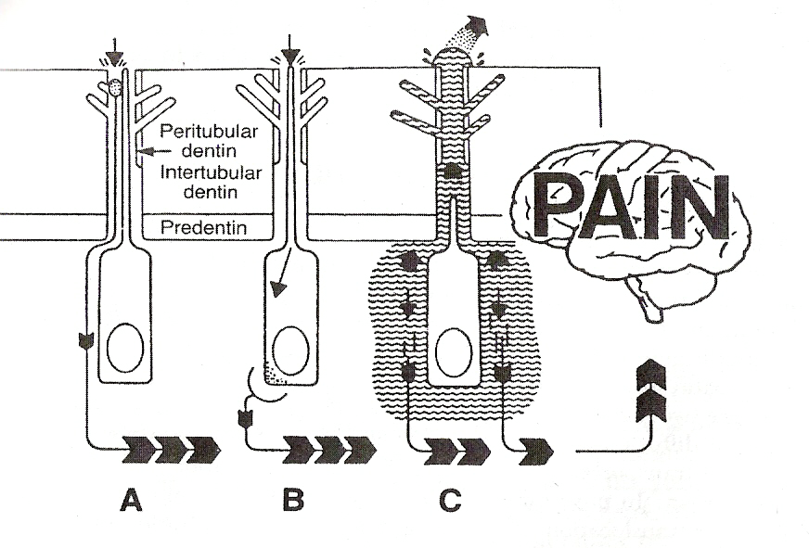

Slide 17
Gate control theory and vibration
  According to this, on application of a stimulus, all the nerves in pulp become activated.
  The larger myelinated fibres may get accomodated while the gates of the smaller C fibres remain open & become enhanced as the ‘ pain gates ’ of larger fibres are closed.
  Pain gates opened by anxiety and closed by distracting stimuli like audio analgesia.
  However not accepted because, the theory does not explain perception and transmission of the responses by the free nerve endings.

Slide 18
Hydrodynamic theory
First given by Fish in 1927 who called the dentinal fluid as the “dental lymph”. He proposed that, the movement of fluid can occur in either outward or inner direction based on pressure variations.
Actual hydrodynamic theory put forth by Brannstrom & Astrom in 1960s.

Slide 19
Dentine contains many thousands of microscopic tubular structures that radiate outwards from the pulp.
Tubules | Hypersensitive dentin | Non sensitive dentin
Number - ratio | 8 | 1
Diameter (micron) | 0.83 | 0.4

Slide 20
The various stimuli that are reported to cause this transmission of sensation are cold, hot, osmotic, electrical, dehydration, and chemical.
Berman describes this reaction as:
“The coefficient of thermal expansion of the tubule fluid is about ten times that of the tubule wall. Therefore, heat applied to dentin will result in expansion of the fluid and cold will result in contraction of the fluid, both creating an excitation of the ‘mechanoreceptor’.”

Slide 21
Cooling, drying, evaporation and hypertonic chemical stimuli that stimulate fluid to flow away from the pulp more effectively activate intradental nerves than do stimuli such as heating or probing that cause fluid to flow toward the pulp.

Slide 22
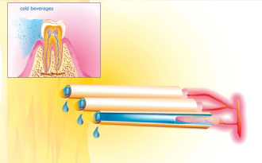

Slide 23
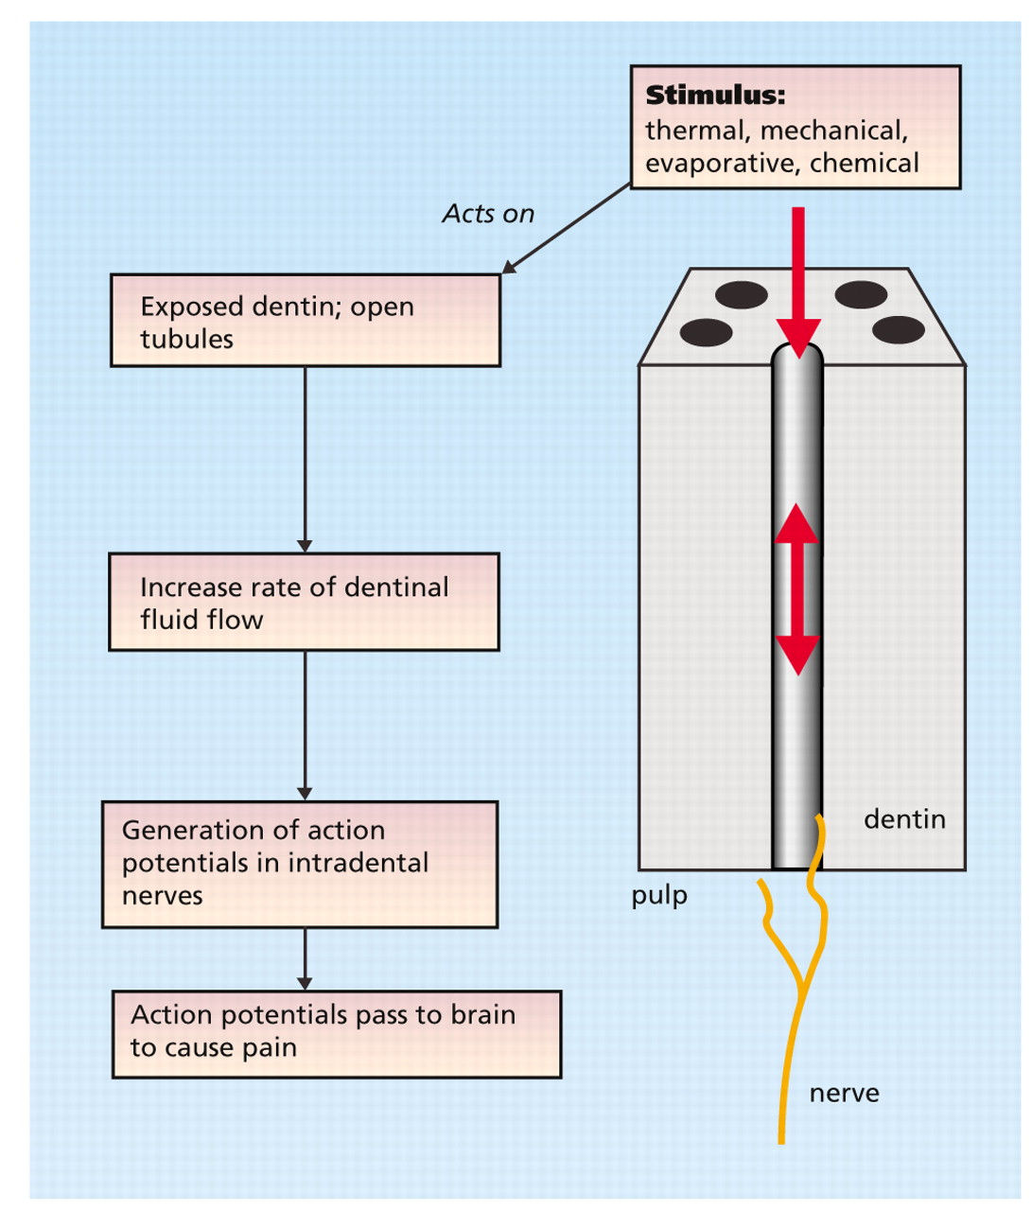

Slide 24
Factors affecting dentin permeability
1. Dentin thickness
  The permeability of the dentin increases as its thickness decreases.
  As the dentin is made thinner during cavity or crown preparation, tubules become shorter, hyper conductive and more sensitive.

Slide 25
2. Resistance to fluid movements
  Dentin can be shown to have three resistances to fluid movements.
    Surface resistance due to the presence of smear layer or smear plug accounting for 86% of the total resistance to the fluid movement.
    Pulpal resistance caused by the presence of the odontoblasts and their processes which constitutes only 7.5 percent of the total resistance.
    Intratubular resistance due to presence of collagen fiber and mineral constrictions which account for about 6.3% of total resistance.

Slide 26
3. Regional differences
  Dentin near pulp horns is more permeable (4500 tubules/mm², 2.5 mm in diameter) than dentin further away (1500 to 1900 tubules/mm², 0.8 mm in diameter) because the density and diameter of tubules are highest near pulp horns.
  Abnormal form of dentin provides much resistance to fluid movement. Sclerotic dentin under the carious lesion is insensitive to masticatory, thermal and osmotic stimuli.

Slide 27
4. Water content of the Dentin
  As the dentinal tubules are occupied by fluid which is 95% water (Pashley 1996), the surface areas occupied by dentinal tubules are approximately equal to the tubule water content.
  Area occupied by tubules at DEJ is approximately 1% of the total surface area of DEJ and 22% at the pulp. Therefore the wetness or water content of the dentin increases 20 fold from superficial to deep dentin. Sensitivity also increases from superficial to deep dentin.

Slide 28
  For hypersensitivity to occur, permeation of substances into the dentin is essential.
  This permeation of substances across dentin occurs by 2 mechanisms –
    1. diffusion – movement of substances from area of high conc to low conc.
    2. convection – fluid flows from area of higher hydrostatic pressure to lower hydrostatic pressure.
  According to hydrodynamic theory, it is the movement of the fluid which causes the stimulation of mechanoreceptors and pain. This fluid movement can be measured by measuring the hydraulic conductance of dentin. ( given by Poiseuille Hagen Equation )

Slide 29
Poiseuille Hagen Equation
Q = π ∆P r ⁴N
8ηL
Where,
Q – fluid flow
∆P - applied pressure ( hydrostatic or osmotic )
r⁴ - radius of tubule ( ± smear layer )
N - tubule density ( depth dependant)
η - viscosity of fluid ( temperature dependant )
L - remaining dentin thickness

Slide 30
The most important variable is the radius of the tubule.
If the radius of the tubule is reduced by half, the fluid flow through that tubule is reduced to 1/16th of its original value, if all other variables are kept constant.
Thus, the creation or dissolution of smear layers and smear plugs from the dentinal tubules has a profound influence on the hydraulic conductance of dentin and its sensitivity.

Slide 31
As saliva is saturated in calcium and phosphate with respect to most forms of insoluble calcium phosphate at normal salivary flow rates and pH, numerous physicochemical mechanisms tend to occlude the dentinal tubules with variety of crystal types.
This lowers the hydraulic conductance of the exposed dentin below levels that permit activation of mechano-receptors hydrodynamically.
The transudation of plasma and the macromolecules that it contains may tend to fill tissue spaces and perhaps even the pulpal ends of the tubules with fibrin, thereby decreasing the size of diffusion channels, decreasing dentin permeability and hence the rate of permeation of bacterial products from plaque to the pulp.

Slide 32
Etiology
Sensitivity of dentin is always associated with exposed dentin
  loss of enamel
  loss of cementum ( with gingival recession )
  bone loss
Development of dentin hypersensitivity –
  Two phases
    Lesion localisation (exposure of dentin )
    Lesion intitiation (opening of dentinal tubules )

Slide 33
ETIOPATHOGENESIS
2 phases
Lesion localization
Lesion initiation

Slide 34
Lesion localization
Lesion localization
Exposure of dentin
By loss of protectie covering
Attrition, abrasion, erosion or abfraction.
By gingival recessin

Slide 35
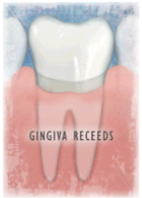
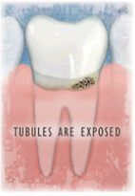
Common reasons for gingival recession
Inadequate attached gingiva
Prominent root
Tooth abrasion
Pocket reduction periodontal surgery
Oral habit- traumatic tooth picking
Excessive tooth cleaning
Excessive flossing
Gingival loss secondary to specific diseases, ie NUG, periodontitis, herpetic gingivostomatitis
Crown preparation

Slide 36
DIET SENSITIVITY:
Generally associated with a low pH material - fresh tomatoes, orange juice, cola drinks
10% of the teeth that do not have cementum covering all the dentine at the CEJ.
factor of lower overall patient pain threshold values.

Slide 37
RESTORATIVE SENSITIVITY:
Contamination of composites during placement or improper etching of the tooth leads to microleakage
Incorrect manipulation of GIC or ZnPo₄ cement
General pulpal insult from cavity preparation technique
Galvanic reaction to dissimilar metals

Slide 38
MEDICATION SENSITIVITY:
Due to medication that dry the mouth ( eg: antihistamines, antihypertensive)
Compromising the protective effects of saliva and aggravating diet related trauma or proliferating plaque.
Reduction in salivary flow due to aging or medications can lower the pH of the saliva below the level at which caries occurs and increase erosive lesions to exposed dentine.

Slide 39
BLEACHING SENSITIVITY:
Commonly associated with carbamide peroxide vital tooth bleaching and due to the byproducts of 10% carbamide peroxide readily passing through the enamel and dentin into the pulp .
Sensitivity takes the form of a reversible pulpitis caused from the dentin fluid flow and pulpal contact of the material, which causes osmolarity, without apparent harm to the pulp.

Slide 40
Lesion initiation.
NOT ALL EXPOSED DENTINE IS SENSITIVE.
For DH to occur, the lesion localization has to be initiated.
The tubular plugs and the smear layer are removed and the tubules are exposed to the external environment by abrasive or erosive agents.
Borges A, Barcellos D, Gomes C. Dentin Hypersensitivity- Etiology, Treatment Possibilities and Other Related Factors: A Literature review. World Journal of Dentistry 2012; 3: 60-67.

Slide 41
Conditions predisposing to hypersensitivity
  Attrition
  Abrasion
  Erosion
  occlusal disturbances leading to abfraction
  gingival recession
  recent periodontal treatment (repeated root planings, flap surgeries)
  plaque ( marginal leakage under restorations)

Slide 42
Clinical Manifestations
  Chronic condition with acute episodes of exacerbation ( stimulus )
  Sharp pain of short duration.
  Lasts as long as the stimulus is present.
  Characterised by good localisation
  Usually more sensitive to cold than warm
  Patient tends to avoid the stimulus
  No tenderness on percussion
  Radiographically, no periapical changes seen

Slide 43
HISTORY, EXAMINATION&
DIAGNOSIS
Medical History:
  Information regarding intrinsic causes of erosion such as vomiting, regurgitation, eating disorders like anorexia nervosa etc.
  Information regarding excessive use of acidic medicaments such as Vitamin C or aspirin.
  Dietary considerations such as frequent intake of acidic beverages and fruit drinks such as orange juice.

Slide 44
Dental History:
  History and the nature of the pain (sharp, dull or throbbing). The pain associated with dentinal hypersensitivity is typically short and sharp.
  The number and location of sensitive teeth and whether the same teeth are always involved.
  The area of tooth from which sensitivity originates.
  The intensity of pain and any changes – an increase, decrease or no change in the intensity of pain or application of stimulus.
  The frequency and duration of each episode.
  Other related events such as recent restorative or periodontal and hygiene treatments, change in oral hygiene aids or regimen or home bleaching.

Slide 45
CLINICAL EXAMINATION
  Tactile examination – with a dental explorer.
  Checking sensitivity with a gentle flow of air from the air-water syringe.
  Response to percussion.
  Sensitivity to biting pressure or upon release.
  Duration of pain after cessation of stimuli.
  Radiographic examination for caries or periapical pathology.
  Exposure of dentin due to gingival recession or loss of enamel.
  Evidence of cracked cusps, fractured or leaking restoration or occlusal interference and hyperfunction or bruxism.

Slide 46
Differential diagnosis :
  Cracked tooth syndrome
  Fractured restoration
  Post restoration sensitivity
  Dental caries
  Gingival inflammation
  Pulpitis
  Chipped teeth.

Slide 47
METHODS FOR ASSESSMENT AND EVALUATION OF HYPERSENSITIVITY
OBJECTIVE EVALUATION
SUBJECTIVE EVALUATION
MECHANICAL(TACTILE) STIMULI- EXPLORER,
VERBAL RATING SCALES,
CONSTANT PRESSURE PROBE,
CHEMICAL(OSMOTIC) STIMULI- HYPERTONIC SOLUTIONS EG. SODIUM CHLORIDE,
ELECTRICAL – ELECTRICAL PULP TESTERS, EVOPARATIVE –COLD AIR BLAST,
THERMAL – COLD
VISUAL ANALOGUE SCALES,
VERBAL DESCRIPTOR CHECK LISTS,
MC GILLWORD DESCRIPTORS,
HOSPITAL ANXIETYAND DEPRESSIONSCALE

Slide 48
Verbal rating scales
Keele (1948) described a four-point scale grading pain as slight, moderate, severe and agonizing. Verbal rating scales (VRS) offer a restrictive choice of words that may not represent the pain experience with significant precision for all patients. Recently, modification of this type of pain scale has been reported.
Examples of pain scores used in recent clinical studies: subjective evaluation following tactile and/or thermal stimulation.

Slide 49
Simple binary pain scale; pain before treatment, pain or no pain after treatment (Hansen 1992)
0 = No discomfort
1 = Mild discomfort
2 = Marked discomfort
3 = Marked discomfort that lasted > 10 s
[Gilliam and Newman 1993]
1 = No pain
2 = Discomfort only
3 = Pain
4 = Severe pain
5 = Unbearable pain (Gedalia et al. 1987)
0 = Tooth/subject does not respond to air stimulus.
1 = Tooth/subject responds to air stimulus but does not request discontinuation of stimulus.
2 = Tooth/subject responds to air stimulus and requests discontinuation or moves from stimulus.
3 = Tooth/subject responds to air stimulus considers stimulus to be painful and requests discontinuation of stimulus.

Slide 50
Drawbacks of Visual Scales
The mathematical interpretation of this scoring system has been challenged, in that the scores are arbitrarily assigned numerical values and the assigned scores are then analyzed as if these numbers reflect true quantitative differences in pain, rather than simple qualitative differences.

Slide 51
Visual analogue scales
A visual analogue scale is a line 10 cm in length, the extremes of the line representing the limits of pain a patient might experience from an external stimulus (no pain at one end and the most severe pain at the other end of the line). Patients are asked to place a mark on the 10 cm line, which indicates the intensity of their current, level of sensitivity or discomfort following application of test stimuli. VAS pain intensity can be shown either as an absolute score value or as a percentage of the maximum.
The advantages are - it is simple to understand and suitable for use in the evaluation of the stimulus response in dentin hypersensitivity. Furthermore, VAS offers the advantage of being a continuous scale, thereby providing quantitative measurements.

Slide 52
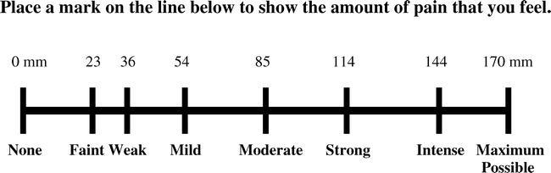

Slide 53
Seattle scale
Developed by: Washington university
Patient rating on labelled magnitude of 100mm scale (per tooth)
  Duration of pain
  Intensity of pain
  How to cope with feelings/sensation
  Describes the feelings/sensation

Slide 54
Yeaple scale
Applying increasing force to the exposed radicular dentin with a Yeaple’s probe
10-80gms increasing by 10gm till the patient feels the pain
Then calculating the threshold value

Slide 55
Chemical (Osmotic) stimulation
Popularized by Anderson.
Application of a hypertonic solution sets up a concentration gradient across the dentin and induces a fluid movement, this stimulates the receptors and hence produces hypersensitivity.
Calcium chloride, sodium chloride are commonly used

Slide 56
Electrical Stimulation..
With electrical stimulation, stimulus intensity needed to evoke a sensory response can be determined accurately.
Electric pulp tester have been used in clinical trials and some studies indicate that electrical thresholds of teeth are inversely correlated to degree of dentin hypersensitivity.

Slide 57
Evaporative(dehydrating) stimuli
use of an air as a noxious stimuli in testing for dentin hypersensitivity has been widely used.
considered a combined thermal and evaporative stimulus - room temperature air blasts have been used.
Short (1 second) air blasts have been recommended in order to avoid excess evaporation and consequent changes in as well as undesirable pulpal effects

Slide 58
Hydrostatic Pressure
Stimulation with elevated or reduced hydrostatic pressure has been used in animal experiments.
Fluid filtration, which would be an ideal stimulus, has not been used clinically because of technical difficulties.
Therefore, it has not been recommended for assessment of dentin hypersensitivity.

Slide 59
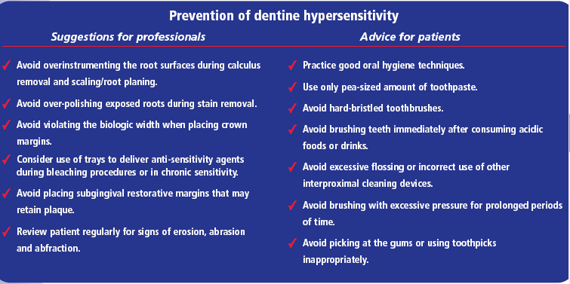

Slide 60
PREVENTION OF DENTIN HYPERSENSITIVITY
Prevention of dentin hypersensitivity should include identifying and eliminating predisposing etiologic factors such as endogenous or exogenous acids and toothbrush trauma.
The role erosive agents play in the development of DH is well-established.
Exogenous dietary sources like fruits, fruit juices and wine contain acids that can remove smear layers and open dentinal tubules.

Slide 61
Endogenous acids arising from gastric acid reflux or regurgitation also can produce DH, which characteristically affects palatal surfaces.
Tooth brushing with an abrasive toothpaste can abrade the dentin surface and may open up dentinal tubules if combined with erosive agents.
Patients should avoid tooth brushing for at least two to three hours after consuming acidic foods or drinks to reduce the deleterious co effects of acids and abrasion.

Slide 62
Most patients are unable to remember details of their food and drink consumption.
They should be asked to keep a daily diet diary in which they record their food and drink consumption over a period of consecutive days spanning a week and weekend.
The diary may reveal changes in the patient’s diet that may contribute to DH.
The diary also could present an opportunity for practitioners to review their patients’ oral hygiene practices.

Slide 63
Control of predisposing factors
Proper history about
  any parafunctional habits
    use of occlusal splints,
    correction of occlusal disturbances
  diet history
    avoid acidic food,
    treatment of digestive disorders
    rinsing mouth with liquid antacid
Correct brushing techniques
  avoid hard toothbrushes,
  high abrasive toothpastes &
  excessive force.
  dentrifice with silica as abrasive preferred.

Slide 64
Treatment Strategies
Dentinal tubules can be covered
Dentinal tubules can be pluged
Desensitization of the nerve tissues within tubules

Slide 65
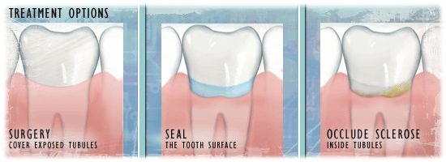
Treatment

Slide 66
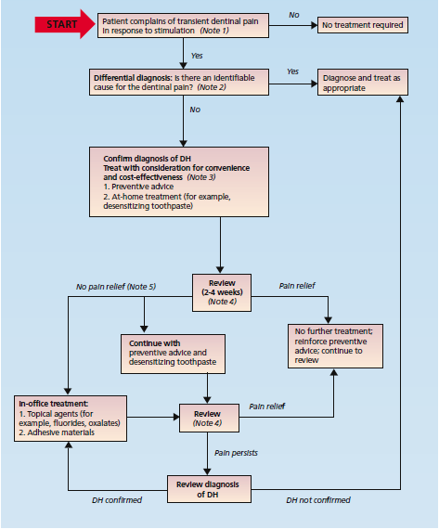

Slide 67
Tubule occlusion can be achieved by
A) Endogenous desensitization / Natural means
B) Exogeneous materials
A) Endogenous desensitization or naturally occurring tubular occlusion
  Natural processes contributing to tubular occlusion include formation of smear layer.
  Formation of mineral deposits (dentinal sclerosis) within the tubules.
  Formation of tertiary dentin by the pulp.
  Calculus formation on the surface dentin.

Slide 68
Exogenous materials used for tubular occlusion include:
  Topically applied agents
  Toothpaste constituents
  Varnishes
  Dentin bonding agents
  Composite resins
  Glass ionomer cements
  Compomers
  LASERS

Slide 69
Management
  Control of the predisposing factors
  Over the counter dentrifice for use at home
  In office treatment
    burnishing of dentin
    nerve desensitization
    anti inflammatory agents
    blocking the tubules
    plugging tubules with ions /salts
    use of protein precipitants
    restorations and dentin sealers
    periodontal soft tissue grafting
    Crowns
    endodontic treatment
    exodontia

Slide 70
Classifying treatments for DH can be challenging because its modes of action often are unknown.
It can be simpler to classify treatments according to their mode of delivery.
Treatments can be self-administered by the patient at home or be applied by a dental professional in the dental office.
At-home methods tend to be simple and inexpensive and can treat simultaneously generalized DH affecting many teeth.
In-office treatments are more complex and generally target DH localized to one or a few teeth.
These various treatment options can be graded by their complexity

Slide 71
In office treatments for hypersensitive dentine
Treatment agents that do not polymerize
  Varnishes/precipitants
    Shellacs
    5% sodium fluoride varnish
    1% NaF, 0.4% SnF2, 0.14% HF solutions
    3% mono potassium –monohydrogen oxalate
    6% acidic ferric oxalate
    Calcium phosphate preparations
    Calcium hydroxide
  Primers containing HEMA
    5% glutaraldehyde, 35% HEMA in water
    35% HEMA in water
Treatment agents that undergo setting or polymerization reactions
  Conventional glass ionomer cement
  Resin reinforced glass ionomer/compomers
  Adhesive resin primers
  Adhesive resin bonding systems
Use of mouthguards
Iontophoresis
Lasers

Slide 72
Treatment Options
1. Desensitize the nerve
a. potassium nitrate
2. Cover the dentinal tubules
a. periodontal surgery/grafting
b. composite/glass ionomer restoration
c. crown placement
3. Plug (sclerose) the dentinal tubules:
i. ions/salts:
a. stannous fluoride

Slide 73
b. sodium fluoride/stannous fluoride combination
c. potassium oxalate
d. ferrous oxide
e. strontium chloride
ii. precipitates - proteins/amino acids
a. glutaraldehyde :hypothesized to precipitate or coagulate proteins/amino acids
iii. resins
a. dentin sealers
b. methyl methacrylat
4. Laser

Slide 74
Burnishing of dentin
Burnishing of dentin :
  Done with a toothpick or orangewood stick ------------ formation of smear layer -------- partially occludes dentinal tubules
  Reduction of dentin permeability found to be better when burnished with dry orangewood stick compared to burnishing in combination with glycerin or glycerin and sodium flouride.
  Found to reduce fluid movement by 50 – 80 %

Slide 75
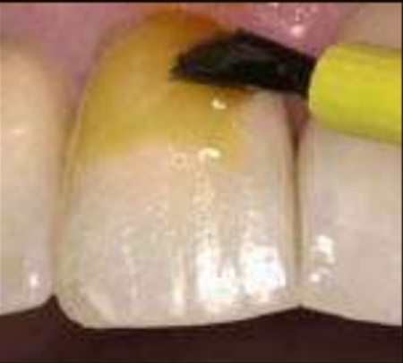
Varnishes
Varnishes are commonly used useful in-office measures to treat DH. Copal varnish can be applied to cover the exposed dentinal surface. But its effect is for short term and is not recommended for long term management of DH. To improve its efficacy, removal of smear layer is advocated. Also, the varnishes can act as a vehicle for fluoride. The fluoride varnishes can be acidulated to increase the penetration of ions.

Slide 76
desensitising agent
Ideal properties – Grossman
  They should be non irritant to the pulp
  Should be relatively painless on application
  Should be easy to apply
  Should be rapid in action
  Should be permanently effective
  Should be consistently effective
  Should not discolour the teeth

Slide 77
CLASSIFICATION OF DESENSITIZING AGENTS
    Potassium oxalate
    Calcium phosphate
    Calcium carbonate
    Bio active glasses (SiO₂–P₂O₅–CaO–Na₂O)
  Dentine adhesive sealers
    Fluoride varnishes
    Oxalic acid and resin
    Glass ionomer cements
    Composites
    Dentin bonding agents
  Lasers
    Neodymium:yttrium aluminum garnet (Nd-YAG) laser
    GaAlAs (galium-aluminium-arsenide laser)
    Erbium-YAG laser
  Homeopathic medication
    Propolis
Mode of administration
  At home desensitizing agents
  In-office treatment
On the basis of mechanism of action
Nerve desensitization
  Potassium nitrate
Protein precipitation
  Gluteraldehyde
  Silver nitrate
  Zinc chloride
  Strontium chloride hexahydrate
  Plugging dentinal tubules
    Sodium fluoride
    Stannous fluoride
    Strontium chloride

Slide 78
Chemical agents Corticosteroids Silver nitrate
Strontium chloride Formaldehyde
Calcium hydroxide Potassium nitrate Fluorides
Sodium citrate Iontophoresis with 2% Sodium fluoride Potassium oxalate.
Physical agents Composites Resins Varnishes Sealants
Soft tissue grafts
Glass-ionomer cements
Lasers

Slide 79
NERVE DESENSITIZATION BY DESENSITIZING AGENTS
Desensitizing agents do not produce immediate relief &must be used for several days or even weeks to produce results
Desensitizing agents can be applied by the patient at home or by the dentist or hygienist in the dental office
The most likely mechanism of action is the reduction in the diameter of the dentinal tubules so as to limit the displacement of fluid in them

Slide 80
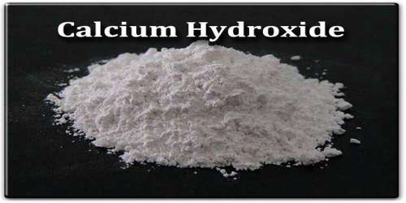
Calcium hydroxide
Produces immediate effect which is short lived
Mechanism of action
  physical protection of dentin surface. increases peritubular dentin mineralisation & thus decreases permeability.
  occludes tubules by binding of Ca ions to protein radicals.
Method of use
  mixed with sterile water and applied onto the dried area. After 5 min, paste removed and tooth rinsed.
  Burnishing of the paste advised by Hiatt & Johansen.
Disadvantages
  short acting
  requires multiple applications
  irritation to gingiva

Slide 81
Potassium salts
Toothpastes containing potassium nitrate have been used since 1980.
Since then, pastes containing potassium chloride or potassium citrate have been made available.
Potassium ions are thought to diffuse along dentinal tubules and decrease the excitability of intra dental nerves by altering their membrane potential.
The efficacy of potassium nitrate to reduce DH, however, is not supported strongly by the literature, according to Poulsen and colleagues.

Slide 82
Two studies support the desensitizing effectiveness of pastes containing potassium citrate.
Many toothpastes contain other ingredients such as fluorides (for example, sodium monofluoro-phosphate, sodium fluoride, stannous fluoride) and antiplaque agents in conjunction with desensitizing and abrasive agents.
Further studies are needed to determine that these various ingredients do not interfere with each other.

Slide 83
Potassium nitrate ( 5 % )
Introduced by Hodosh in 1974, Highly effective home therapy.
Mechanism of action
  a ) Potassium nitrate through dentinal tubules to the nerve K ions depolarise the nerve and prevent it’s repolarisation Prevent transmission of the pain signals to brain.
  b ) oxidising effect
  c ) blocking of tubules by crystallisation

Slide 84
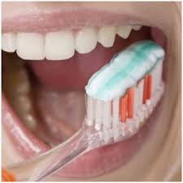
Desensitizing toothpastes/dentifrices
Tooth-pastes are the most widely used dentifrices for delivering over-the-counter desensitizing agents.
The first desensitizing toothpastes to appear on the market claimed either to occlude dentinal tubules (those that contained strontium salts and fluorides) or destroy vital elements within the tubules (those that contained formaldehyde).

Slide 85
Now, most desensitizing toothpastes contain a potassium salt such as potassium nitrate, potassium chloride or potassium citrate,
Though one study reported that a remineralizing toothpaste containing sodium fluoride and calcium phosphates reduced DH.

Slide 86
Toothpaste application
Practitioners should educate patients on how to use dentifrices and monitor their toothbrushing techniques.
Dentifrices should be applied by toothbrushing.
Correct brushing techniques
  avoid hard toothbrushes,
  high abrasive toothpastes &
  excessive force.
  dentrifice with silica as abrasive preferred.

Slide 87
Mouthwashes and chewing gums
Studies have found that mouthwashes containing potassium nitrate and sodium fluoride, potassium citrate or sodium fluori deor a mixture of fluorides can reduce DH.
In only one of these studies, however, was the effect of the active mouthwash significantly greater than that of the control product.
Another study concluded that a chewing gum containing potassium chloride significantly reduced DH, but the study did not include a control group.

Slide 88
DH severity should be reassessed two to four weeks after commencement of treatment to determine the effectiveness of the first level of desensitizing treatment .
If at-home care fails to reduce DH compared with baseline levels, the next level of treatment, an in-office method should be started. Desensitizing agents intended for at-home use by patients generally are simple to administer.
Dental professionals can deliver a wider range of more complex and more potent desensitizing treatment.

Slide 89
As alternatives with more accessible cost and simpler techniques of hypersensitivity treatment which aim at producing an occlusive effect on the dentin tubules, blocking the hydrodynamic flux,there are the application of fluoridated varnish, restorative or adhesive systems, e.g
silver nitrate,
formalin,
zinc chloride,
calcium hydroxide,
strontiumchloride,
potassium oxalate (PEREIRA22, 1995),
propolis (MAHMOUD et al.17, 1999)
potassium nitrate (TOUYZ & STERN25, 1999).

Slide 90
STRONTIUM CHLORIDE
It has been effectively and widely used to reduce hypersensitivity.
It has been suggested that strontium deposits are produced by an exchange with calcium in the dentin resulting in recrystallisation in the form of a strontium apatite complex.

Slide 91
Strontium chloride hexahydrate ( 10 % )
Mechanism of action
  also a protein precipitant.
  adsorbed onto dentin & blocks outer organic matrix of root surface.
  strontium ions are exchanged with Ca of dentin ------- recrystallisation in form of strontium apatite complex, promote calcification and cause blockage of tubules.
  at higher conc, may dampen neural impulses
Disadvantage
  detrimental to pulp.

Slide 92
Silver nitrate
Introduced in 1920s.
Mechanism of action
  precipitates proteins within tubules.
  with formalin, precipitated silver chloride which reduces dentinal fluid flow. ( by Greenhill and Pashley )
Disadvantage
  potentially harmful to pulp and gingiva
  staining of tooth

Slide 93
Formaldehyde (1.2 – 1.4 %)
Used in 1950s
Mechanism of action
  precipitates salivary proteins in dentinal tubules
Disadvantages
  very strong tissue fixatives
  need utmost caution not to come in contact with gingiva.
For in office use, 40 % formalin applied topically.
Grossman - desensitising agent of choice as no staining

Slide 94
Sodium citrate and pluronic acid
Mechanism of action
  polyglycol has ability to precipitate salivary & dentinal proteins
Dibasic sodium citrate in pluronic acid F-124 ( Protect ) - most safe and effective as given by ADA.
Shown to reduce dentinal fluid flow by 19%.

Slide 95
Corticosteroids
These are anti inflammatory agents. Exact mechanism not known. Thought to induce mineralisation of the peritubular dentin.
Topically applied prednisalone successful in reducing thermal sensitivity.

Slide 96
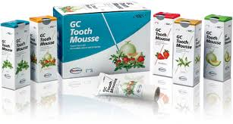
Casein phosphopeptide–amorphous calcium phosphate
A relatively new product.
Thought to reduce sensitivity by plugging of the dentinal tubules.
Recently, milk protein casein has been used to develop a remineralizing agent (GC Tooth Mousse). The casein phosphopeptide (CPP) contains phosphoseryl sequences which get attached and stabilized with amorphous calcium phosphate (ACP).
The stabilized CPP–ACP prevents the dissolution of calcium and phosphate ions and maintains a supersaturated solution of bioavailable calcium and phosphates.Various studies have shown that CPP–ACP can effectively remineralize the enamel subsurface lesions.By virtue of its remineralizing capacity, it has also been proposed by the manufacturers that it can also help in prevention and treatment of DH.

Slide 97
Oxalates
Potassium oxalate and ferric oxalate solutions used.
Mode of action
  these react with Ca ion in dentinal fluid ---------- form insoluble calcium oxalate crystals
Commonly used oxalates -
  ferric oxalate 6 %
  Di potassium oxalate 30 %
  monohydrogen monopotassium oxalate 3 %
Advantages
  inexpensive, easy to use, well tolerated by patients.
  Khox – Protect
  Ferric oxalate – sensodyne sealants

Slide 98
Flourides
Used in various forms.
Mechanism of action
  Flouride ions reduce the diameter of tubules by peritubular precipitation
  Flouride ions replace the calcium ions in the hydroxyapatite crystals to form flourapatite which is more resistant to acids and relatively insoluble.
  When used by iontophoresis, stimulates synthesis of secondary dentin.

Slide 99
Stannous flouride
used either in an aqueous solution OR in glycerin
gelled with carboxymethylcellulose
Acts by occlusion of dentinal tubules
  increase mineral content & form a calcific barrier
  it may get precipitated on surface of tubules

Slide 100
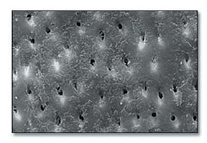
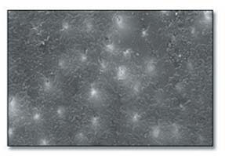
Open tubules following treatment
with non-sensitivity fluoride toothpaste.
Closed tubules following treatment
with SnF2 dentifrice.

Slide 101
Sodium monoflorophosphate
0.76 % MFP used in dentrifices.
Mechanism of action
  MFP hydrolysed in presence of hydroxyapatite, near the surface of the crystals ------- Flouride ions then incorporated into crystals
No action on dentinal tubules – remain patent.

Slide 102
Sodium flouride
Introduced by Lukomsky in 1941
Hoyt & Bibby - 33 % sodium flouride
2 % NaF used following pretreatment with 10 % strontium chloride increase the efficacy.
2 % NaF can be used with iontophoresis or as topical agent.

Slide 103
Flouride iontophoresis
Introduced by Hiatt and Johansen in 1972
It is a process of influencing ionic motion by an electric current.
Used with sodium flouride, causes immediate relief .
But, the symptoms gradually recur in about 6 months.
Mechanism of action – exactly not known.
  Murphy et al - desensitisation due to formation of secondary dentin by electric current
  Gangarosa & Park - iontophoresis caused parasthesia by reversibly altering sensory mechanism of pain conduction
  Iontophoresis thought to increase conc and depth of penetration of flouride ions into tubules

Slide 104
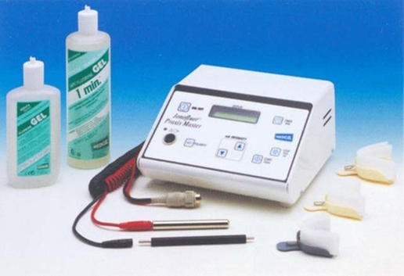
Procedure -
  Following complete isolation with cotton rolls & plastic strips, negative electrode attached to dentin and positive to patient’s face or arm and then current passed after application of flouride with a brush.
  Recently, tray technique used. A sophisticated electronic unit with constant current circuit and a more powerful voltage of about 40 V used. It also has a flexible electrode system and the tray helps in better insulation of gingival tissue.

Slide 105
IONOTOPHORESIS
Iontophoresis is a technique using a small electric charge to deliver a medicine or other chemical through the skin.
Basically an injection without the needle.
The technical description of this process is a non-invasive method of propelling high concentrations of a charged substance, normally medication or bioactive agents, transdermally by repulsive electromotive force using a small electrical charge applied to an iontophoretic chamber containing a similarly charged active agent and its vehicle.

Slide 106
To clarify, one or two chambers are filled with a solution containing an active ingredient and its solvent, termed the vehicle.
The positively charged chamber, termed the anode will attract a negatively charged chemical, while the negatively charged chamber, termed the cathode, will attract a positively charged chemical into the skin.

Slide 107
Iontophoresis is well classified for use in transdermal drug delivery. Unlike transdermal patches, this method relies on active transportation within an electric field.
In the presence of an electric field electro migrationand electro osmosis are the dominant forces in mass transport
These movements are measured in units of chemical flux, commonly µmol/cm²h

Slide 108
MECHANISM OF ACTION OF IONOTOPHORESIS
The mechanism of action of iontophoresis have been proposed as: a) rapid formation (7-28 days) of reparative dentine following application of current,
b) the alteration of the sensory nerve condution by the electrical currents, and c)fluoride ion, when introduced into dentinal tubule via iontophoresis, can reduce dentine permeability.
The third mechanism has been supported the most by literatures. Iontophoretic fluoride desensitization occurred by two mechanism: the intratubular microprecipitation of CaF2 affecting dentine permeability and an effect of fluoride on the neural transduction mechanism.

Slide 109
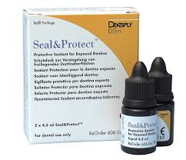
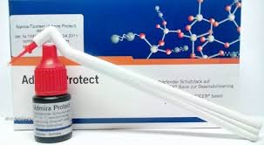
Resins & adhesives
Dayton, Brannstrom & Nordenval - immediate and long lasting blockage upto one year.
acts by physical protection of the dentin.
Materials used
  dentin bonding agents
  Varnish
  glass ionomer cements
  Composites
Useful in cases of specific and localised hypersensitivity.

Slide 110
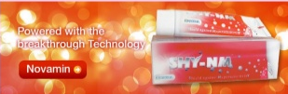
Bioglass
Bioglass was developed to stimulate the formation of new bone.It is used in orthopedics to cover the implants to promote union between implant and bone.It has been used in dentistry to fill up the osseous defects during periodontal surgery.It has been reported that a formulation of bioglass can promote infiltration and remineralization of dentinal tubules.The basic component is silica, which acts as a nucleation site for precipitation of calcium and phosphate. SEM analysis has shown that bioglass application forms an apatite layer, which occludes the dentinal tubules. The use of bioglass in management of DH has been shown by some products such as NovaMin (NovaMin Technology Inc., FL, USA).

Slide 111
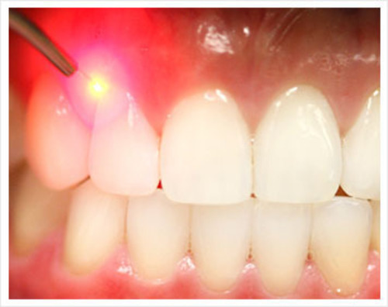
Lasers
The first laser used for treatment of hypersensitivity was Nd : YAG laser by Matsumito in 1985.
Lasers used for treatment of hypersensitivity are divided into –
  Low output lasers –
    He – Ne laser
    Ga Al A lasers
  Middle output lasers –
    Nd : YAG laser
    CO2 laser

Slide 112
He – Ne laser :
First used by Senda et al in 1985.
Mode of use -
  This is used with an output power of 6mW.
  Can be used either in pulsed mode with 5 Hz or in continuous mode.
Efficacy - 5.2 – 100 %
Action
  increases the threshold for the action potential of the nerves by about 33 %.
  no effect on enamel or dentin surface
  does not affect the Aδ or C fibres directly.
Advantage
  no danger of skin burns or damage to cells.

Slide 113
Ga Al A laser :
introduced for treatment of hypersensitivity by Matsumito in 1985.
Mode of use
  used with output power of 30 mW in a continuous wavemode for 0.5 – 3 min.
  different wavelengths of 780, 830 or 900 nm can be used.
Efficacy - 30 – 100 % effective
Action
  analgesic effect due to depression of impulse transmission
  exact mechanism not known

Slide 114
Nd : YAG laser :
first used by Matsumito in 1985.
Mode of use
  used with output power of 1 – 2 mW.
  use of black ink as absorption enhancer done to prevent deep penetration of Nd : YAG laser into pulp.
Efficacy - 5.2 – 100 %
Action
  cause laser induced occlusion of dentinal tubules
  direct nerve analgesia ( interferes with Na – K pump, changes cell membrane permeability and alters the endings of sensory axons )
  also has a suppressive action by blocking depolarisation of both Aδ and C fibres.

Slide 115
CO2 laser :
first used by Moritz et al in 1996.
Mode of use
  used with output power of 0.5 and 1 mW in continuous wave mode for 0.5 – 5 sec.
Efficacy - 59 – 100 %
Action
  by occlusion of dentinal tubules

Slide 116
ELECTROSURGERY
Treatment of hypersensitivity by electrosurgery has been advocated by Oringer in 1975.
However, the postoperative complications included irritation and pain due to pulpal injury by excessive heat generation are the major draw back.

Slide 117
REGENERATIVE PROCEDURES
Finally, the use of gingival graft on recession defect has been documented successfully.
Regenerative procedures using resorbable membrane, free gingival graft for root coverage, connective tissue graft have provided successful result in terms of both functional and esthetics.

Slide 118
The major draw back is the selection criterias for each procedures, the technique sensitive, and the cost of treatment.
Nevertheless, when can be done, periodontal plastic surgery is the best and ideal treatment in providing a long lasting result and esthetically pleasing.
The clinical goal to treat hypersensitive dentin is to provide a permanent seal of dentin tubules.
The seal can be established by any of the above methods and if done correctly, will provide the therapeutic effects.

Slide 119
Patient must recognized in some situation the condition may recur and require several application or retreatment.
Patient oral hygiene must be emphasized to reduce the plaque accumulation in the area.
The dentist also required to evaluate Patient systemic condition, nutritional diet, and be able to communicate with the patient on issues regarding his or her periodontal health and its correlation to the dentinal hypersensitivity.

Slide 120
Conventional glass ionomer cements and resin-modified GIC
One of the first clinical evaluations of the use of glass ionomers for the treatment of hypersensitive dentine in cervical abrasion lesions was reported by Low (1981). The cervical lesions were etched with 50% citric acid for 30- 45 s, then rinsed and dried prior to placement of the glass ionomer cement. Although the method of evaluating sensitivity was not described and no controls were used, the author reported complete loss of hypersensitivity in 89.7% of all patients.

Slide 121
Adhesive Resin Bonding Systems
Has been used with success and most of them contained fluoride in them. The mechanism of action is due to the formation of resin tags thereby occluding the tubule orifice. Mainly involves multiple applications (twice weekly for 4 weeks) of a fluoride-containing, light cured resin.

Slide 122
Use of mouthguards
The use of a mouth guard-type appliance to deliver potassium nitrate desensitizing agent was first reported by Reinhart et al. (1990). They had only partial success in that they obtained a significant reduction in sensitivity only after 2 weeks of treatment, but not 1, 3 or 4 weeks of treatment with 10% KNO₃ gel. The lack of effectiveness of 10% of KNO₃ may have been due to the short daily treatment time of 5 min. They used glycerin to give the KNO₃ a gel- like consistency. These solutions are very hygroscopic and hypertonic. Had the KNO₃ been made up as an aqueous solution that was subsequently gelled, the results might have been better.
Many clinicians who are bleaching patients teeth with the ‘mouthguard’ technique report that the sensitivity that sometimes develops after a few days of bleaching can be successfully treated with 5% KNO₃ toothpaste or gel in the same tray (Haywood, 1996). These treatments are usually done overnight. No controlled clinical trials have been done to confirm the efficacy of this technique, but it is something that should be considered for patients who have multiple sensitive teeth that do not respond to conventional treatments.

Slide 123
RESTORATIVE MANAGEMENT OF THE WORN DENTITION
indicated:
  The patient feels that the appearance of the teeth is unacceptable.
  Normal function is disrupted due to the loss of tooth tissue and/or ongoing pulp sensitivity.
  There is progressive tooth wear that may result in pulp necrosis.
Conventional fixed restorations
Removable inlay/overlay Prostheses
Minimal Preparation adhesive restorations
  Composite, GIC, Resin modified GIC, Compomers

Slide 124
MANAGEMENT STRATEGY
Take a detailed clinical and dietary history.
Differentially diagnose the condition from other dental pain conditions.
Identify and manage etiological and predisposing factors.
In case of mild-to-moderate sensitivity, advice at-home desensitizing therapy.
If there is no relief or in case of severe sensitivity, initiate in-office treatment.
In extreme cases, if patient does not respond to the therapy and there are individual teeth exhibiting the symptoms, then endodontic therapy can be initiated.
A regular review should be made with an emphasis on prevention of the condition.

Slide 125
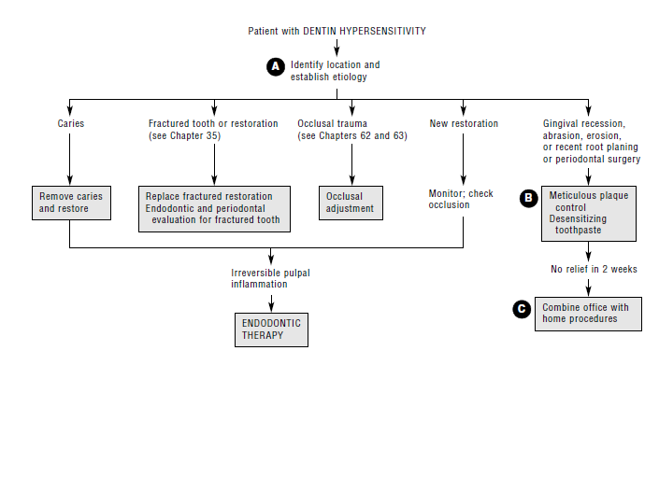

Slide 126
CONCLUSION
Professionals should appreciate the role causative factors play in localizing and initiating hypersensitive lesions.
It is important to identify these factors so that prevention can be included in the treatment plan.
Active management of DH usually will involve a combination of at-home and in-office therapies.
Root dentin hypersensitivity frequently develops as an uncomfortable& sometimes difficult eliminate to treat,subsequent to scaling&root planing procedures in periodontal therapy.

Slide 127
References:
1. STURDEVANTS ART AND SCIENCE OF OPERATIVE DENTISTRY 5TH EDITION
2. ART AND SCIENCE OF OPERATIVE DENTISTRY MARZOUK
3.FUNDAMENTAL OF OPERATIVE DENTISTRY CONTEMPORARY APPROACH-JAMES.B.SUMMIT,J WILLIAM ROBIN,RICHARD SCHWARTZ II EDITION
4.ART & SCIENCE OF OPERATIVE DENTISTRY-STURDEVANT, IV EDITION
5.OPERATIVE DENTISTRY-GILLMORE,LUND BALES,VERNETTI IV EDITION
6.ATLAS OF OPERATIVE DENTISTRY-WILLIAM .W .HOWARD, II EDITION

