Slide 1


Slide 2
CONTENTS
Introduction
Definition
Classification
  Non- Operating dental auxiliaries
  Operating dental auxiliaries
  Duties of each Auxiliary
  Frontier Auxiliaries
  New Auxiliary types
  Conclusion

Slide 3
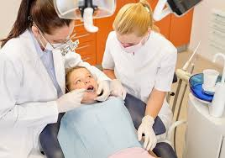
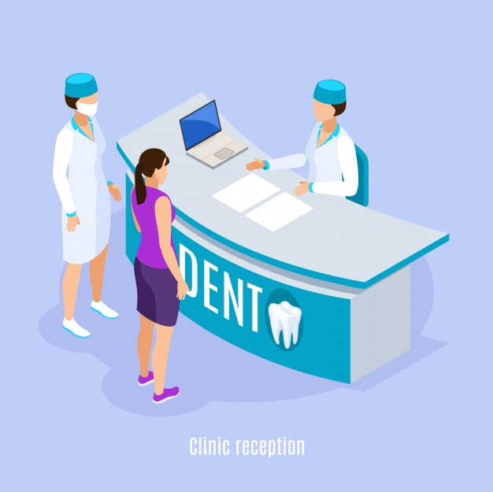
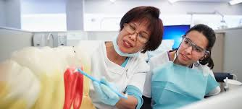
DENTAL AUXILIARIES
Dental auxiliary is a generic term for all persons who assist the dentist in treating patients.
• Britain-“DENTAL ANCILLARIES”.
• “Auxiliary” – being helpful, subsidiary
• “Ancillary” – subservient, subordinate.

Slide 4
DEFINITION
DENTAL AUXILIARY :
A dental auxiliary is a person who is given responsibility by a dentist so that he or she can help the dentist to render dental care, but who is not himself/herself qualified with dental degree.
BY: SLACK (1960)

Slide 5
CLASSIFICATION
Classification by WHO
NON-OPERATING
CLINICAL:- Person who assists the dentist in his clinical work but does not carry out any independent procedures.
LABORATORY:- Person who assists the dentist by carrying out certain technical laboratory procedures.
OPERATING
Person who is not being a professional is permitted to carry out certain treatment procedures in the mouth under direction and supervision of a dentist.

Slide 6
CLASSIFICATION
Revised classification: ( WHO)
Non-operating auxiliaries
  Dental surgery assistant
  Dental secretary/ receptionist
  Dental laboratory technician
  Dental health educator
Operating auxiliaries
  School dental nurse
  Dental therapist
  Dental hygienist
  Expanded function dental auxiliaries

Slide 7
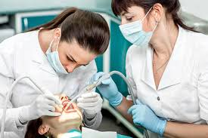
DENTAL SURGERY ASSISTANT
Is a non-operating auxillary who assists the dentist or dental hygienist in treating patients, but who is not legally permitted to treat patients independently.
Duties:
Reception of the patient.
Preparation of the patient for any treatment he or she may need.

Slide 8
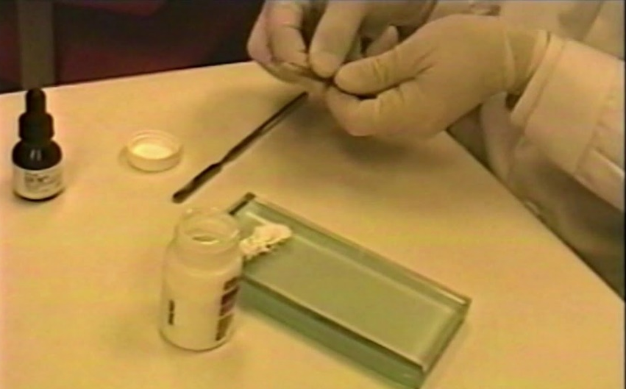
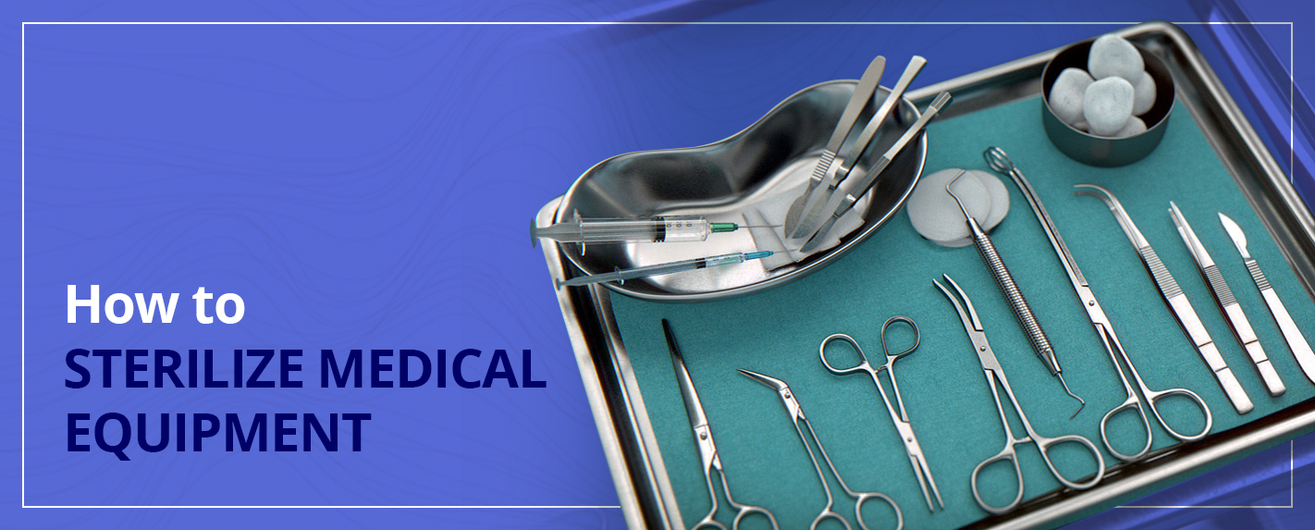
Care of the patient after treatment until he or she leaves.
Instruction of the patient, where necessary, in the correct use of the tooth brush.

Slide 9
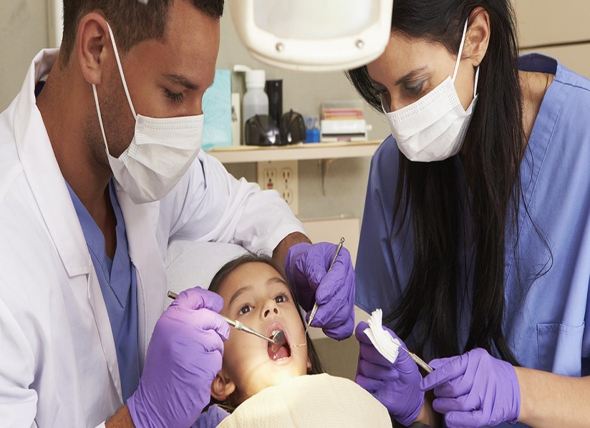
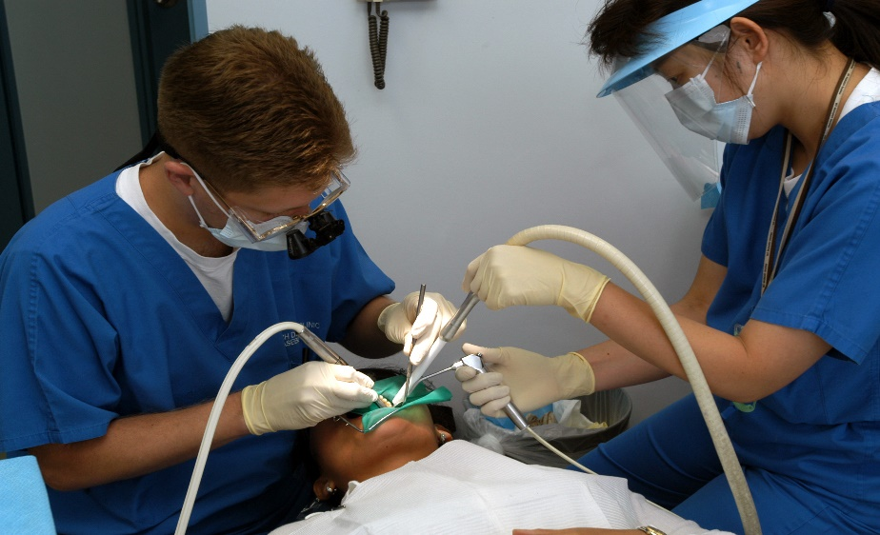
The art of seating both the dentist and the dental assistant in such a way that both are within easy reach of the patient's mouth
Four-handed dentistry :

Slide 10
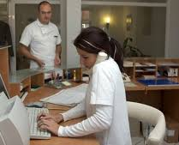
DENTAL SECRETARY/ RECEPTIONIST
The person who assists the dentists with his secretarial work and patient reception duties.

Slide 11
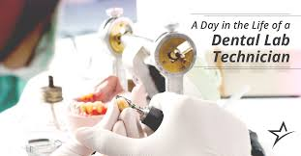
DENTAL LABORATORY TECHNICIAN
This category of the personnel have also been known as dental mechanics.
Duties:
Casting of models from impressions made by the dentist.
Fabrication of the dentures, splints, orthodontic appliances, inlays, crowns and special trays.

Slide 12
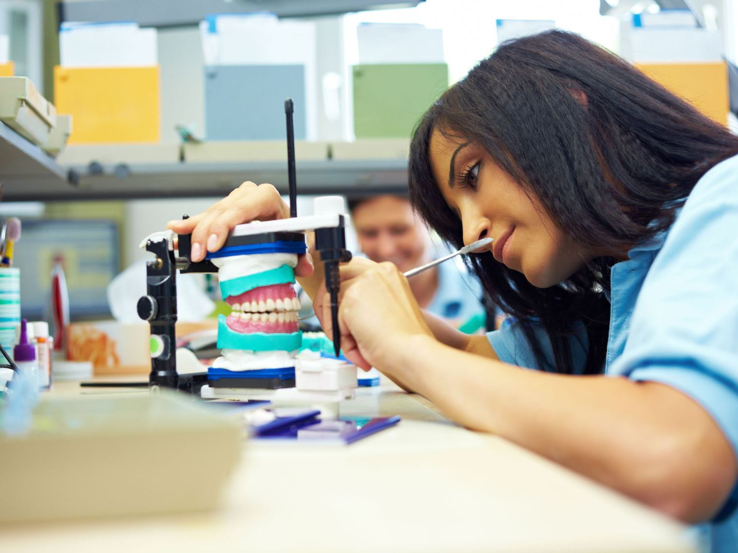
Dental mechanic is a person, who makes or repairs dental appliances and dentures including inlay, crown and bridge work. He shall , restrict his activities to purely mechanical laboratory work at the instance of the registered dental surgeon. He shall not do any chairside work. -The Dental Council of India

Slide 13
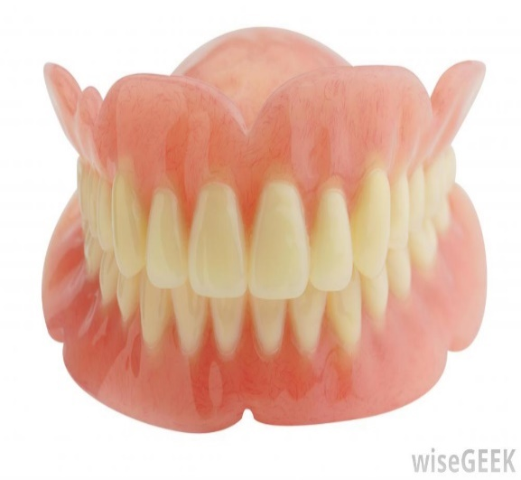
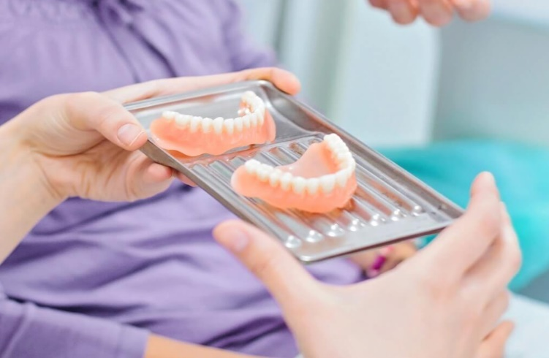
DENTURIST
Tasmania, a state in Australia, was the first place where technicians were legally permitted to provide a prosthetic service.
Denmark uses the term 'Denturist' to describe a special category of dental technician who sits at an examination, to enable him to prescribe, make and fit removable dentures without supervision.
In the state of Maine, denturists are permitted to take impressions and fit dentures but only under the directions of a dentist

Slide 14
The ADA defines denturism as “ the fitting and dispensing of dentures illegally to public”.
The ADA has vigorously opposed the denturist movement at the political level.
The Association's principal argument is that denturists are unqualified to treat patients and that poor-quality care and even actual harm could result to patients.
The WHO Expert Committee on Auxiliary Dental Personnel (1959) has recommended that only qualified dentists may work directly on patients

Slide 15
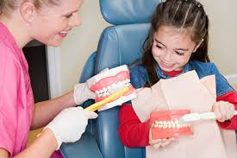
DENTAL HEALTH EDUCATOR
Is a person who instructs in the prevention of dental diseases and who may also be permitted to apply preventive agents intra orally.
Ex:- Fluoride mouth rinsing programs

Slide 16
OPERATING AUXILIARIES

Slide 17
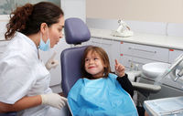
  SCHOOL DENTAL NURSE
Dental nurse scheme was established in wellington, New Zealand in 1921 due to extensive dental disease found in army recruits during world war 1.
The man who influenced its formation was T. A. Hunter.

Slide 18
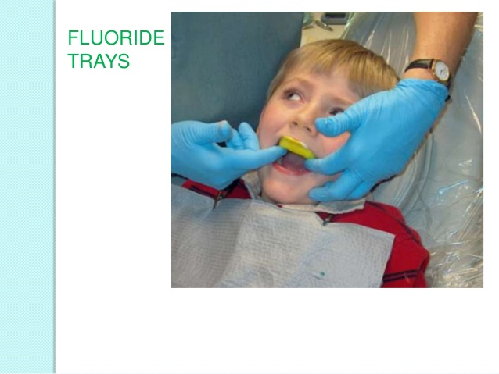
DUTIES:
Oral examination
Prophylaxis
Topical fluoride application
Advice on dietary fluoride supplements
Administration of local anesthetic
Cavity preparation
Pulp capping
Extraction of primary teeth.
Individual patient instruction in tooth brushing and oral hygiene.
Classroom and parent-teacher dental health education.
Referral of patient to private practitioners for more complex services, such as extraction of permanent teeth, restoration of fractured permanent incisors and orthodontic treatment.

Slide 19
DENTAL THERAPIST
This is an operating auxiliary, who is permitted to carry out to the prescription of a supervising dentist, certain specified preventive and treatment measures including the preparation of cavities and restoration of teeth.

Slide 20
DUTIES:
Clinical caries diagnosis
Taking radiograph and Interpretation of x-rays
Cavity preparation in deciduous and permanent teeth
Vital pulpotomies under rubber dam in deciduous teeth
Extraction of deciduous teeth under local anesthesia

Slide 21
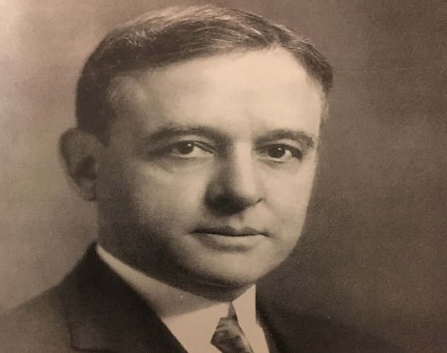
DENTAL HYGIENIST
Dental hygienist is a person, not being a dentist or a medical practitioner; who does oral prophylaxis, gives instructions in oral hygiene and preventive dentistry, assists the dental surgeon in chairside work and manages dental office. He/she shall work under the supervision of dental surgeon. (Dental council of India)
Dr. fones is considered as the father of dental hygiene.

Slide 22
Duties:
Screening or preliminary examination
Cleaning of mouth and teeth
Instructions in oral hygiene.
Topical application of fluorides, sealants and other prophylactic solutions.

Slide 23
EXPANDED FUNCTION DENTAL AUXILIARIES
An EFDA is also referred as
  Expanded function dental assistant
  Expanded function dental hygienist
  Technotherapist
  Expanded duty dental auxiliary

Slide 24
Duties :
Placing and removing of rubber dams.
Placing and removing temporary restorations.
Placing and removing matrix bands.
Condensing and carving amalgam restorations in previously placed teeth.
Placing of acrylic restorations in previously prepared teeth.

Slide 25
Four levels of training and qualification were recognised for EFDA:
Certified dental assistant ( Training:8 months)
Preventive dental assistant ( Training: 3-6 weeks)
Dental hygienist ( Training: 8 months)
Dental hygienist with expanded duties ( Training: 4months)

Slide 26
FRONTIER AUXILIARIES
In developed countries, dentists remain in the urban centers and a large number of areas are too distant from public or private dental offices for the inhabitants to receive regular comprehensive care or emergency pain relief.
Simple dental prophylaxis can be performed
Dental health education
Dental first-aid can be rendered in cases with pain
Fluoride rinse programs and
Simple denture repairs

Slide 27
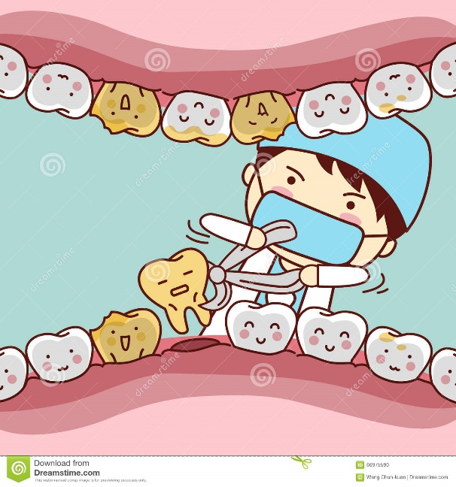
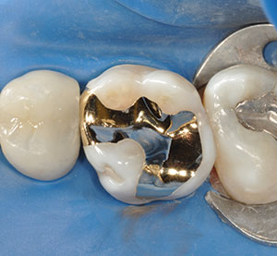
NEW AUXILIARY TYPES
WHO (1959) has suggested two new types of dental auxiliaries:
The dental licentiate
The dental aide.
Dental licentiate : He is a semi-independent operator, trained for 2 years.

Slide 28
They perform
Dental prophylaxis.
Cavity preparations and fillings of primary and permanent teeth.
Extractions under local anesthesia
Drainage of dental abscesses.
Treatment of the most prevalent diseases of supporting tissues of the teeth.
Early recognition of more serious dental conditions.

Slide 29
Dental aide
This type of auxiliary personnel performs duties which include, elementary first - aid procedures for the relief of pain
Extraction of teeth under local anesthesia
Control of hemorrhage
Recognition of dental disease which is important enough to justify transportation of the patient to a center where proper dental care is available.

Slide 30
PREVIOUS QUESTIONS
Define and Classify dental auxiliaries? Write about Dental hygienist and his role in dental clinics and scope in public health program? 8M
Define dental auxiliaries. Write about functions of dental auxiliaries? 8M
Classify dental auxiliaries. write in detail about functions of school dental nurse? 4M
Classify dental auxiliaries. Role played by auxiliaries on oral health care delivery? 4M
Expanded function dental auxiliaries? 4M
Dental therapist? 2M
School dental nurse? 2M
Dental hygienist? 2M

Slide 31
Thank You

