Slide 1
Cysts of The
Oro-Facial Region

Slide 2
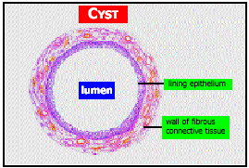
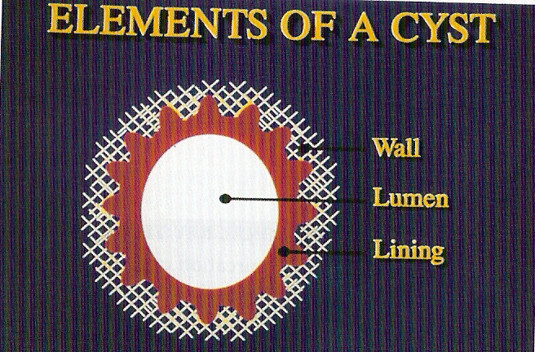
CYST
Greek Word KYSIST meaning BLADDER
KRAMER 1974

Slide 3
DEFINITION
Cyst is an entity that constitutes an epithelium lined sac filled with fluid or semi-fluid material.
- Killey & Kay (1966)
A cyst is an abnormal cavity in hard or soft tissues which contains fluid, semi-fluid, or gas and is often encapsulated and lined by epithelium.
- Killey & Kay (1966)
A cyst is a pathologic cavity having fluid, semi-fluid or gaseous contents that are not created by the accumulation of pus; frequently, but not always, is lined by epithelium.
- Kramer (1974)

Slide 4
CLASSIFICATION
Cysts of the jaws, oral and facial soft tissues
Intraosseous cysts Cysts of the maxillary antrum Soft tissue cysts
Epithelial cysts Non-epithelial cysts/Pseudocysts
Odontogenic cysts Non-ododntogenic cysts
Developmental cysts Inflammatory cysts
Odontogenic Non-odontogenic Retention cysts
Developmental Parasitic cysts Heterotropic cysts

Slide 5
CYSTS OF THE JAWS
I. Epithelial
A. Developmental
a. Odontogenic
      Odontogenic keratocyst
      Dentigerous cyst
      Eruption cyst
      Gingival Cyst of Infants
      Lateral Periodontal Cyst
      Gingival Cyst of Adult
      Botryoid Odontogenic Cyst
      Glandular Odontogenic Cyst
      Calcifying Epithelial Odontogenic Cyst

Slide 6
b. Non- Odontogenic
  Nasopalatine duct (incisive canal ) cyst
  Nasolabial (nasoalveolar ) cyst
  Median palatine, median alveolar and median mandibular cysts
  Globulomaxillary cyst

Slide 7
B. Inflammatory
  Radicular cyst, apical & lateral
  Residual cyst
  Paradental cyst and mandibular infected buccal cyst
  Inflammatory collateral Cyst

Slide 8
II. Non – Epithelial
Solitary bone cyst
Aneurysmal bone cyst

Slide 9
CYSTS ASSOCIATED WITH
MAXILLARY ANTRUM
Benign mucosal cyst of the maxillary antrum
Postoperative maxillary cyst (Surgical ciliated cyst of the maxilla)

Slide 10
CYSTS OF THE SOFT TISSUE OF THE MOUTH, FACE AND NECK
Cysts of the salivary glands
  Mucous extravasation cyst
  Mucous retention cyst
Dermoid and Epidermoid cysts
Branchial cleft (Lympho epithelial)cyst
Thyroglossal duct cyst
Anterior median lingual cyst
Cystic hygroma
Nasopharyngeal cysts

Slide 11
DEVELOPMENTAL ODONTOGENIC CYSTS

Slide 12
DEVELOPMENTAL ODONTOGENIC CYSTS
A cyst in which the lining of the lumen is derived from the epithelium involved in the tooth development
Epithelial Cell Rest of Serres
Remnants of Reduced Enamel Epithelium
Epithelial Cell Rest of Malassez

Slide 13
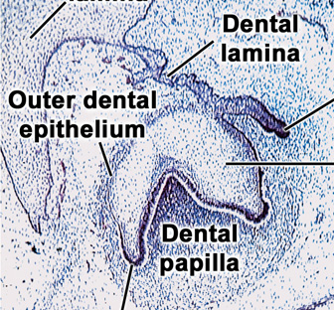
CLASSIFICATION BY TISSUE OF ORIGIN
EPITHELIAL CELL REST OF SERRES
Odontogenic Keratocyst
Lateral Periodontal Cyst
Gingival Cyst of Adults
Gingival Cyst of New born
Glandular Odontogenic Cyst
REMNANTS OF REDUCED ENAMEL EPITHELIUM
Dentigerous Cyst
Eruption Cyst
EPITHELIAL CELL REST OF MALASSEZ
Radicular cyst
Residual Cyst
A Textbook of Oral Pathology 5th Ed Shafer’s

Slide 14
THEORY'S OF CYST EXPANSION
Epithelial proliferation
    local proliferation
    Collagenase activity
    Low grade infection
Osmolality – INCRAESED
Bone resorption -PROSTAGLANDINS-PGE2 ,PGI2

Slide 15
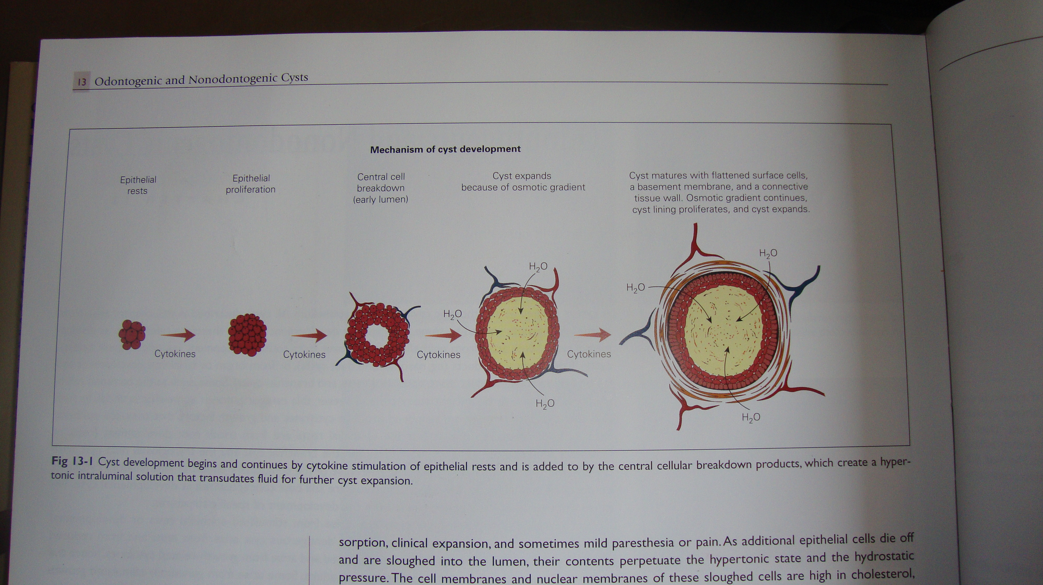

Slide 16
PATHOGENESIS
CYST INITIATION
- Stimulus
Inflammatory cysts- Infection
CYST FORMATION
Formation of cavity lined by stratified squamous epithelium could occur by a no. of mechanisms:
by accumulation of purulent exudate in the form of a microabscess involved one of the proliferating strands of epithelium.
Stimulated epithelium proliferated to form a sphere of cells.
Epithelial cells become oriented in relation to their source of nutrition and the adjacent connective tissue. Thus in the normal situation they cover a surface and are finally desquamated.

Slide 17
CYST ENLARGEMENT
The attraction of fluid into the cystic cavity.
The retention of the fluid within the cavity.
The production of a raised internal hydrostatic pressure.
The resorption of surrounding bone with an increase in the size of the bone cavity.
Harris (1974), described the theories of cyst enlargement :
Mural growth
a) Peripheral cell division
b) Accumulation of cellular content
Hydrostatic enlargement
a) Secretion
b) Transudation & exudation
Bone resorbing factor
CYST REGRESSION by extraction or by marsupilization

Slide 18
DEVELOPMENTAL ODONTOGENIC CYSTS
ODONTOGENIC KERATOCYST
Robinson (1945) was the first to use the term ‘primordial cyst to describe this cyst
Philipsen then coined the term ‘OKC’ from the histopathological appearance.
PATHOGENESIS
Developmental anomaly.
Arises from odontogenic epithelium derived from dental lamina or its remnants.

Slide 19
CLINICAL FEATURES:
Age- 2nd-3rd decade; bimodal- 2nd peak in 5th decade.
Sex- Males > Females.
Race- Blacks > Whites.
Site- Mandible > Maxilla.
Mandible- angle extending for varying distance into
ramus & body.
Maxilla- in maxillary sinus, globulomaxillary area;
Can occur anywhere in the mandible and maxilla.

Slide 20
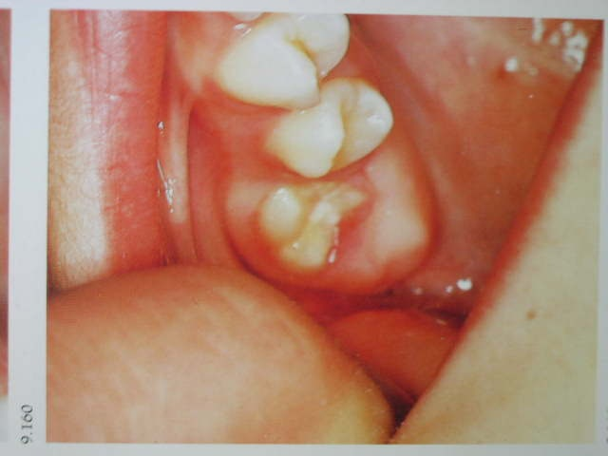
CLINICAL PRESENTATION
Pain, swelling or discomfort.
Occasionally, paraesthesia of lower lip or teeth.
Pathological fracture
Usually symptomless till it reaches a large size or infected.
Maxillary cysts may get infected when small and thus maybe detected earlier.
Displacement of adjacent teeth.
Usually, no bony expansion till it reaches a large size by spreading through the medullary space.
Multiple OKCs in Nevoid basal cell carcinoma syndrome.

Slide 21
Cyst contents
-Inspissated dirty white material like pus but without an offensive smell.
- Contains keratin.
- Total protein content- <4gm/dl
RADIOGRAPHIC FEATURES
Small, ovoid or round radiolucent areas
Unilocular radiolucenies- with smooth periphery or scalloped margin
Multilocular variety

Slide 22

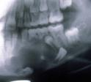


Slide 23
HISTOPATHOLOGICAL FEATURES
  Cyst lining- thin, keratinised stratified squamous epithelium, 5-8 cell layer thick, no rete pegs
  Keratin formed maybe parakeratin,where nuclei persists and orthokeratin, where nuclei absent.
  Parakeratinised variant has higher incidence of recurrence.
  Corrugated appearance of parakeratotic layer.
  Nuclei of columnar basal cells in parakeratotic lining oriented away from basement membrane and intensely basophilic. This is an important distinguishing feature from other keratinising jaw cysts.
  Desquamated keratin in cyst cavity.
  Thin capsule containing daughter cysts, strands of odontogenic epithelium.

Slide 24
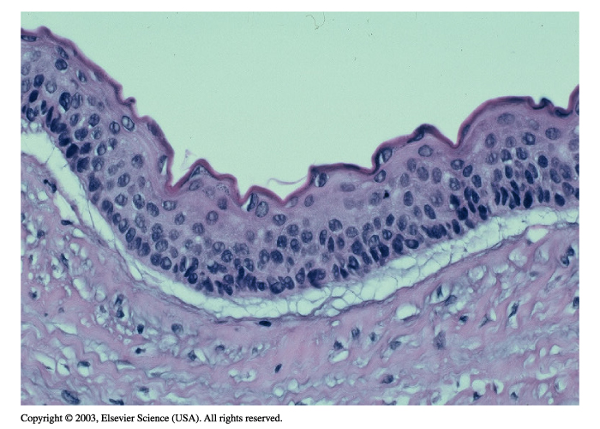
HISTOPATHOLOGICAL FEATURES

Slide 25
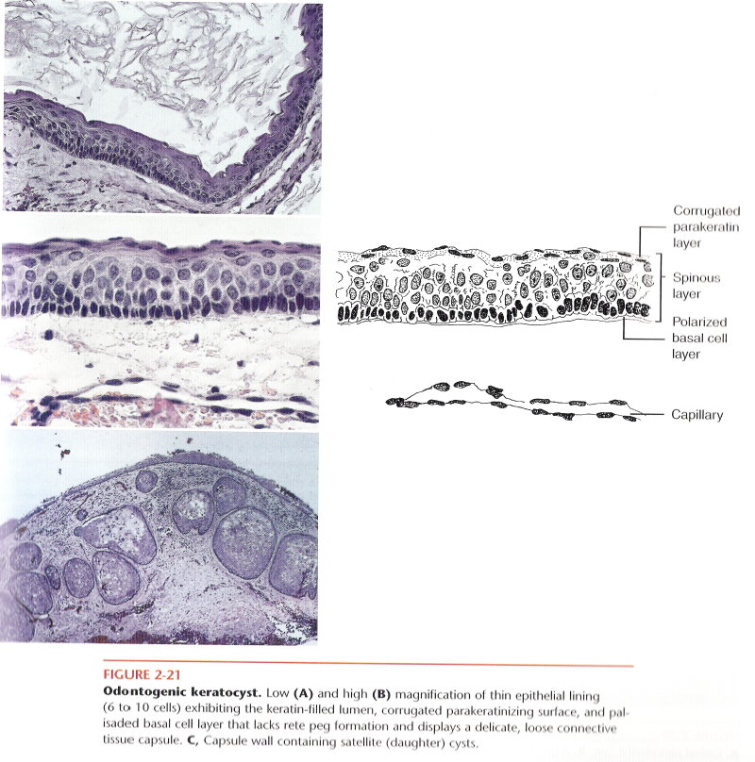
SATELLITE CYSTS

Slide 26
RECURRENCE
  High tendency to recur.
  Aggressive nature first reported by Pindborg andHansen (1963).
  Recurrence rate- 5 to 62% occurring within 5 years.
  Reasons for recurrence:
      High mitotic activity.
      Presence of satellite cysts.
      Thin and fragile cystic lining.
      Cysts can arise from basal cells of oral mucosa.
      Patients with nevoid basal cell carcinoma syndrome.

Slide 27
TREATMENT:
Bramley (1971,1974), outlined the surgical management of OKCs :
Small single cysts with regular spherical outline- Enucleation with intraoral approach.
Larger or less accessible cysts with regular spherical outline - Enucleation with extraoral approach.
Unilocular lesions with scalloped or loculated periphery and small multilocular lesions - Marginal excision.
Large multilocular lesions with or without cortical perforation - Resection followed by primary or secondary reconstruction with reconstruction plates or bone grafting procedures.

Slide 28
INTRALESIONAL ADJUNCTIVE THERAPY: CHEMICAL FIXATION
- With carnoy’s solution: mixture of absolute alcohol, chloroform, glacial acetic acid, and ferric chloride.
- This mixture penetrates bone to a predictable and time-dependent depth without injuring the neurovascular structures.
- A 5-min application penetrates bone to a depth of 1.54mm, nerve to a depth of 0.15mm, and mucosa to a depth of 0.51mm.

Slide 29
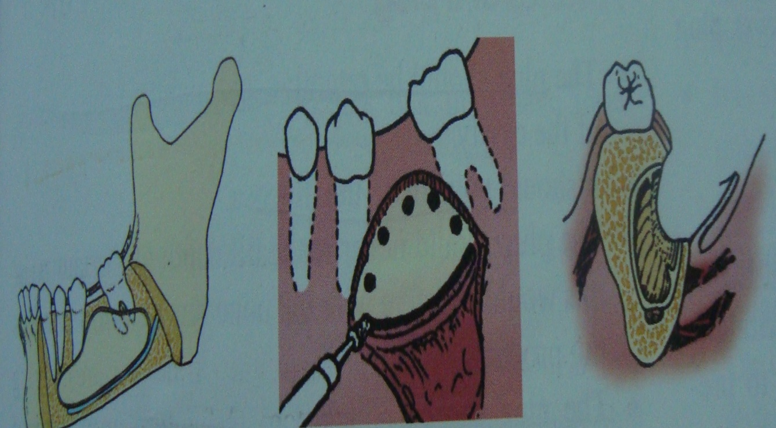
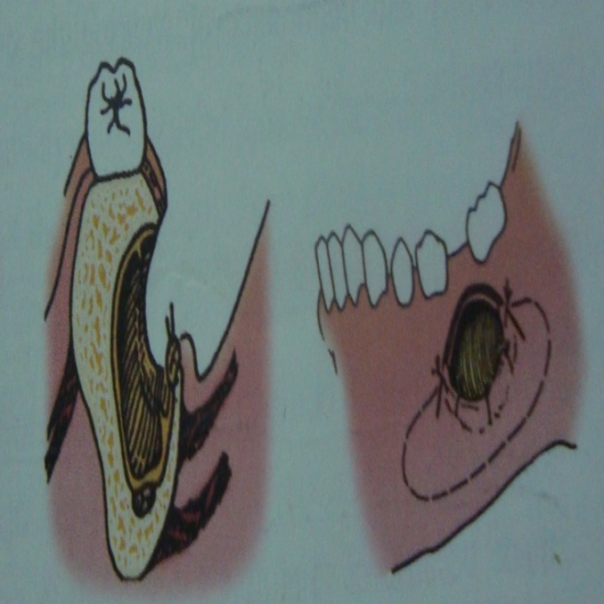
MARSUPIALAZATION
It refers to creating a surgical window in the wall of the cyst and evacuation of its contents.
This decreases the intracystic pressure and promotes shrinkage of the cyst and bone fill.

Slide 30
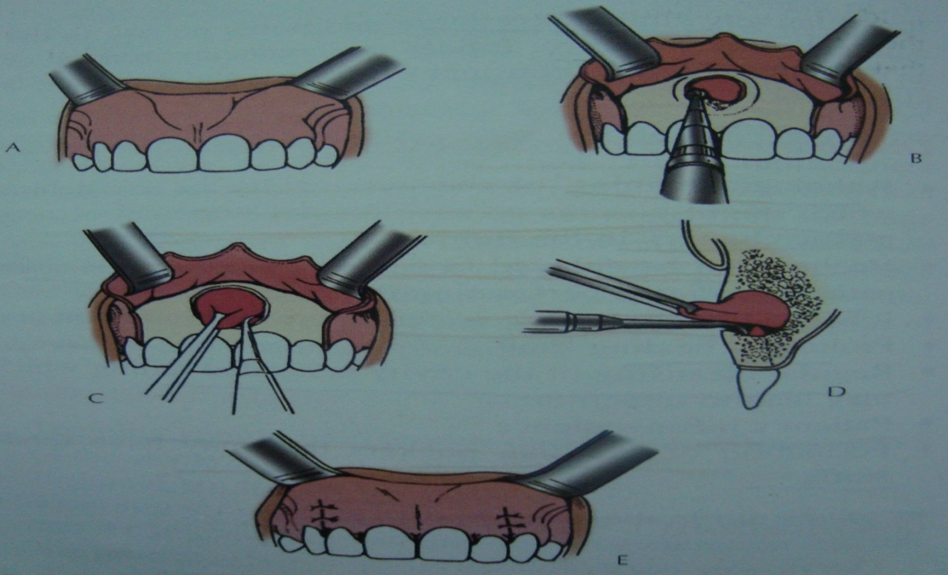
ENUCLEATION
Complete removal of cyst with cystic lining
Closure of cystic cavity by a mucoperiosteal flap
Space fills up with blood clot, which will eventually organize and form normal bone.

Slide 31
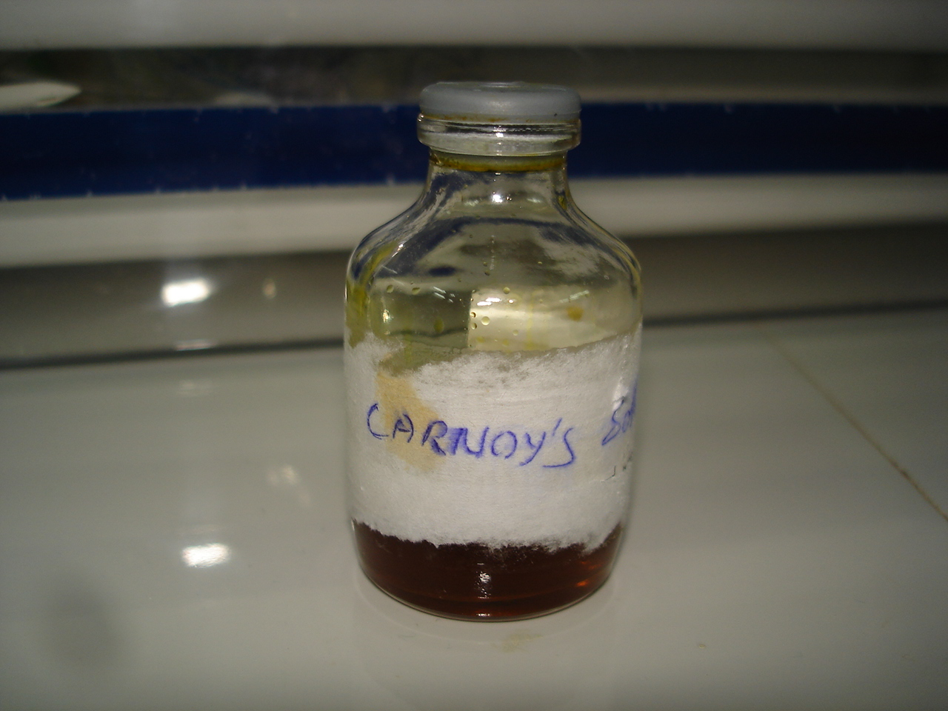
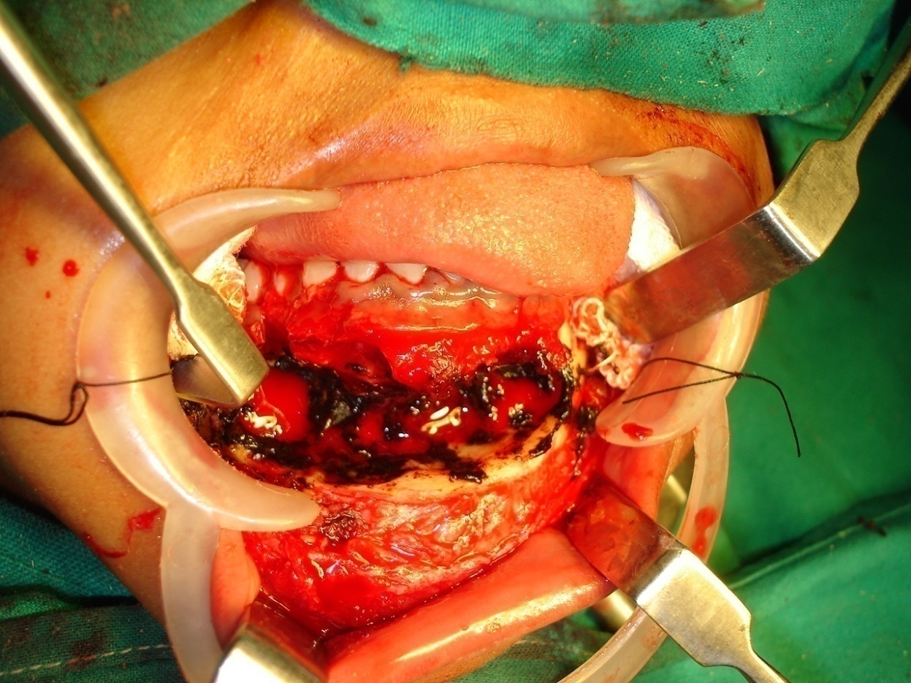
CHEMICAL CAUTERIZATION

Slide 32
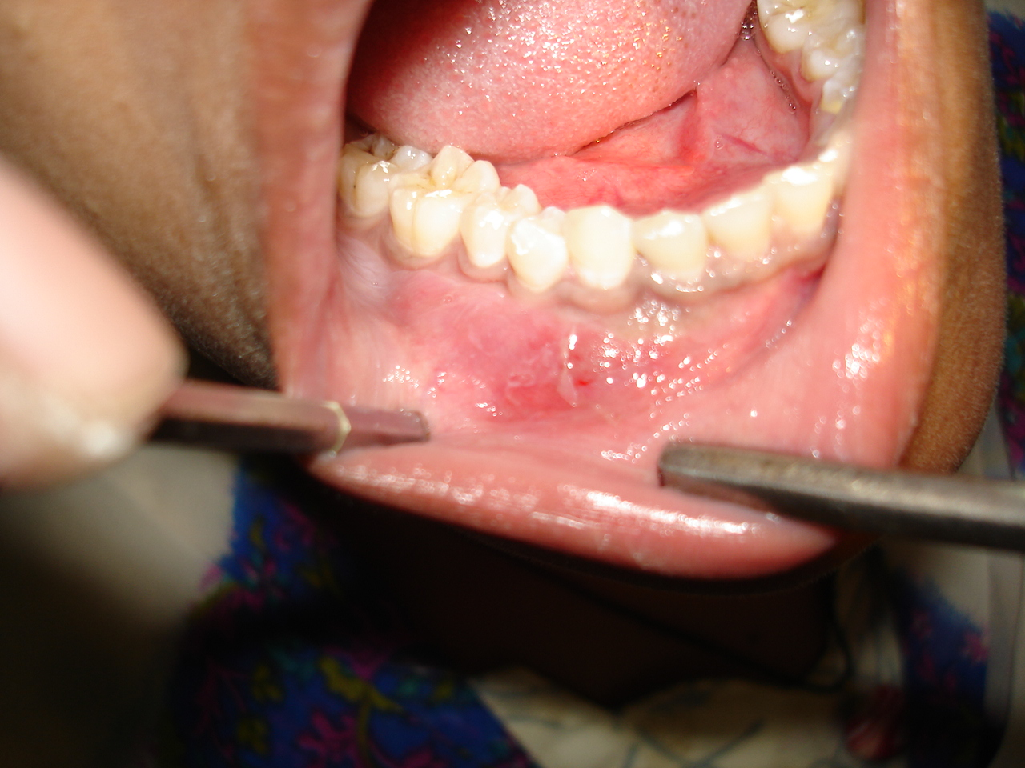
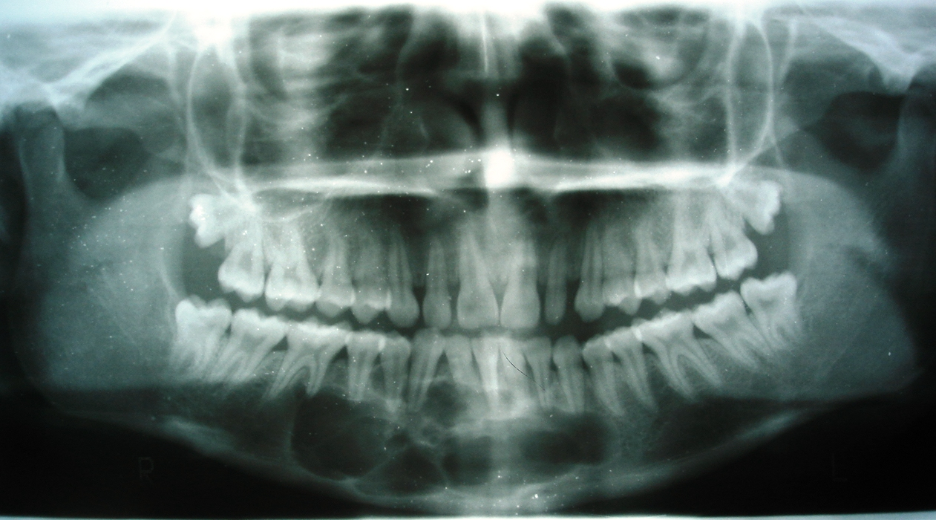
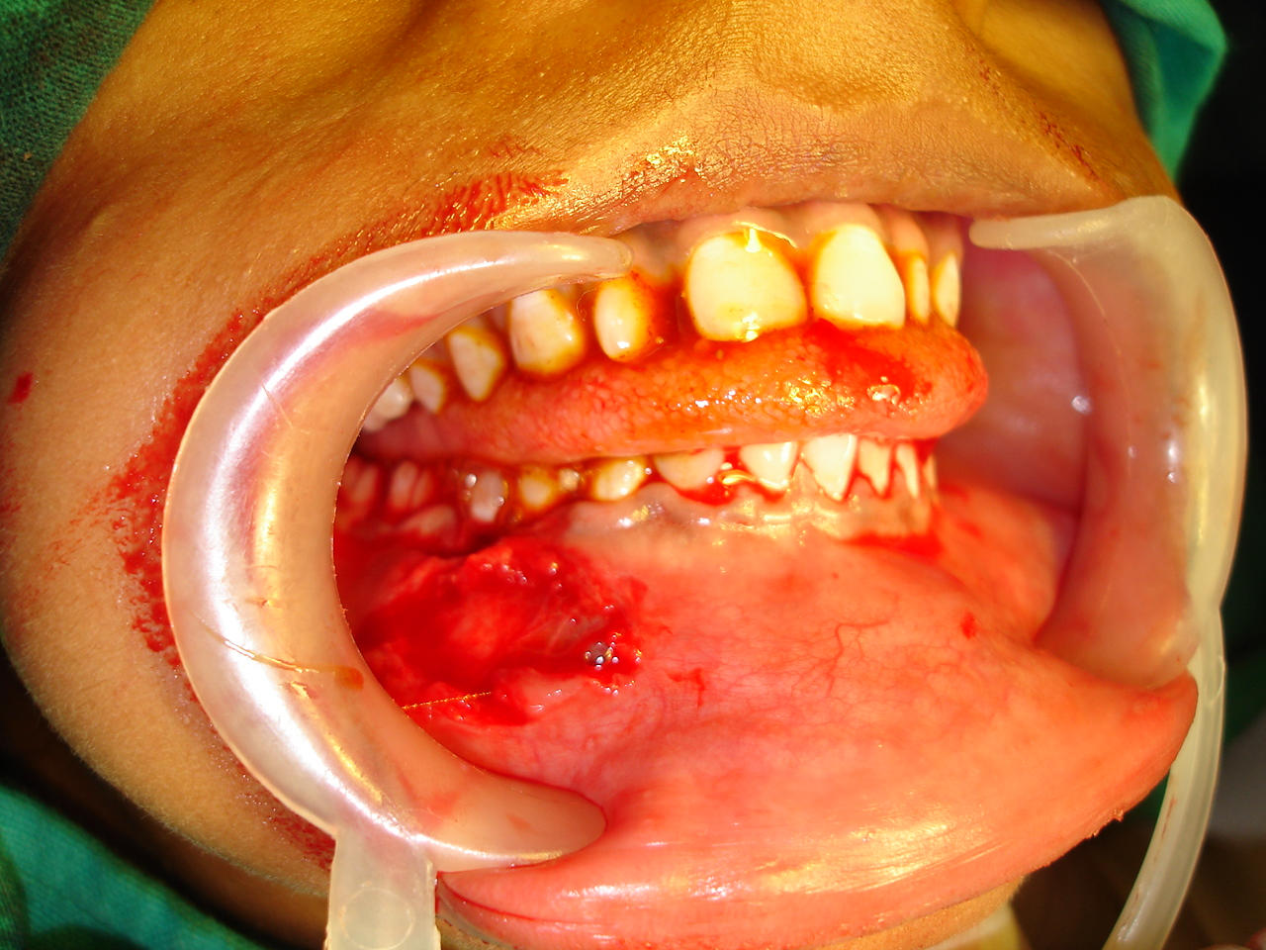
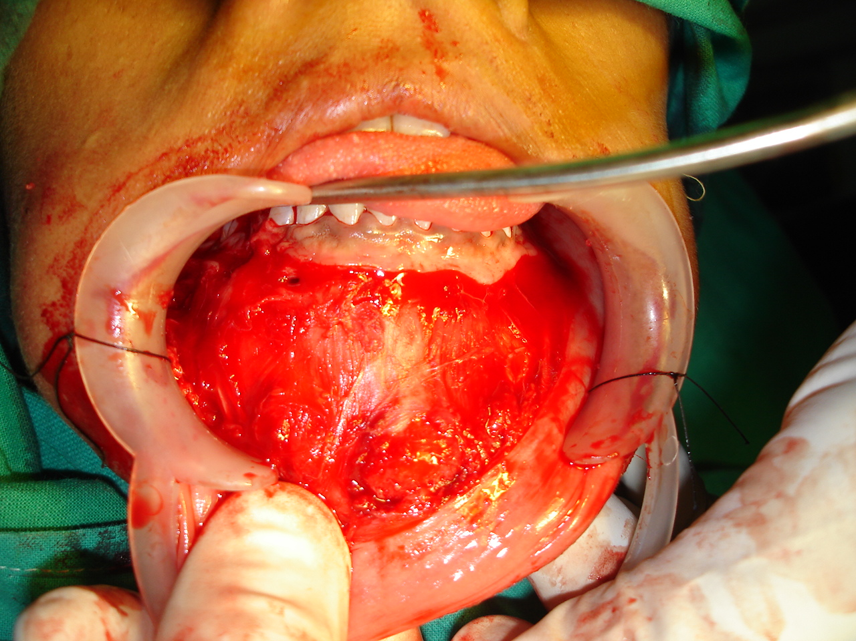
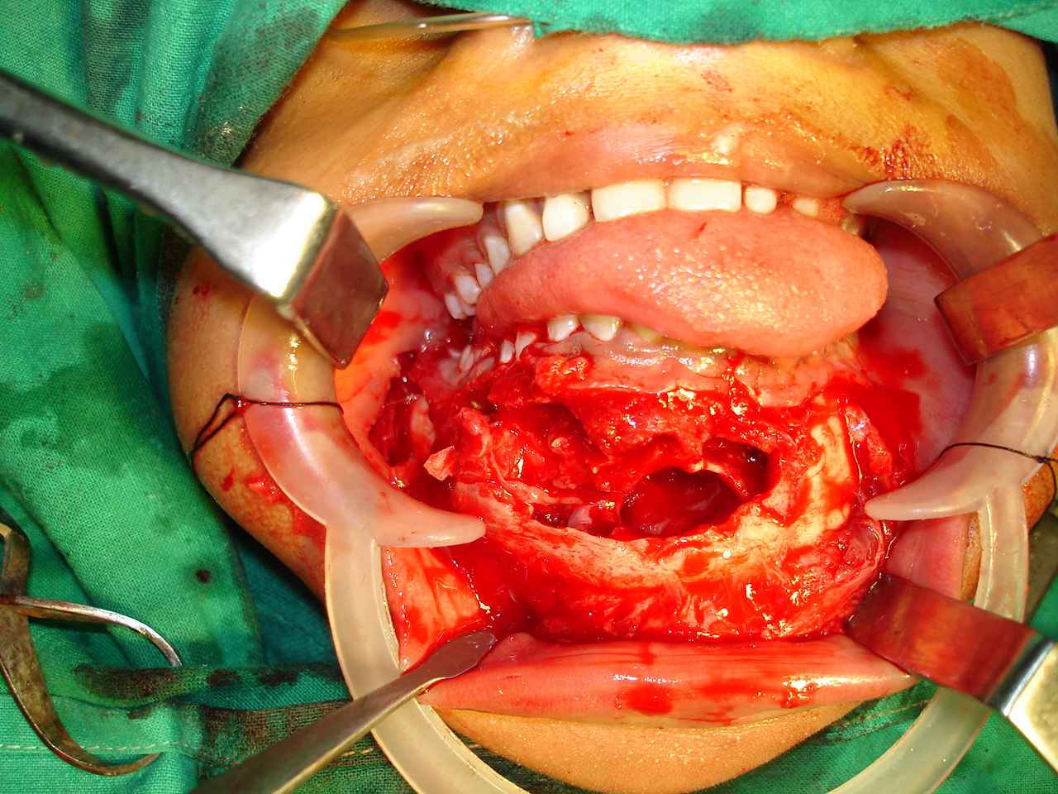
CASE PHOTOS

Slide 33
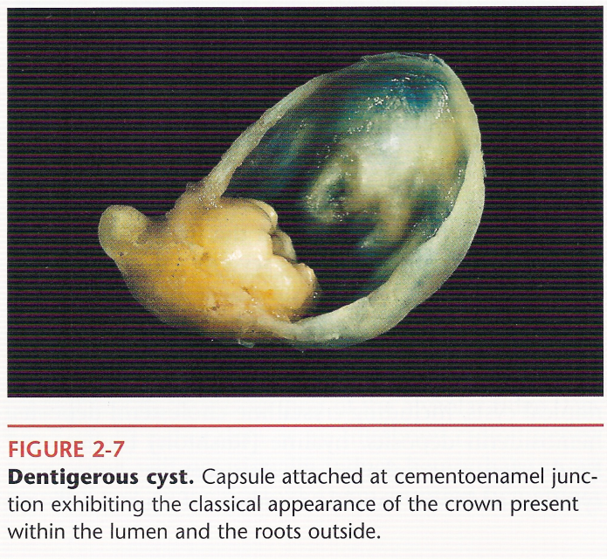
DENTIGEROUS CYST
defined as one which encloses the crown of an unerupted tooth and is attached to the neck.
PATHOGENESIS:
accumulation of fluid between reduced enamel epithelium and tooth crown after crown formation is completed.
CLINICAL FEATURES:
Age- 2nd to 3rd decade
Sex- Males > Females
Race-Whites > Blacks
Site - Mandible > Maxilla
      Mand. III molar ( D/d- Ameloblastoma)
      Max. canine ( D/d- Adenomatoid odontogenic tumour)
      Mand. Premolar, Max. III molar, Supernumerary.

Slide 34
CLINICAL PRESENTATION
Slowly enlarging swelling
Resorption of roots of adjacent teeth.
Bone expansion with facial asymmetry.
Displacement of teeth, pain.
Cyst contents-
--Yellowish fluid containing cholesterol crystals

Slide 35
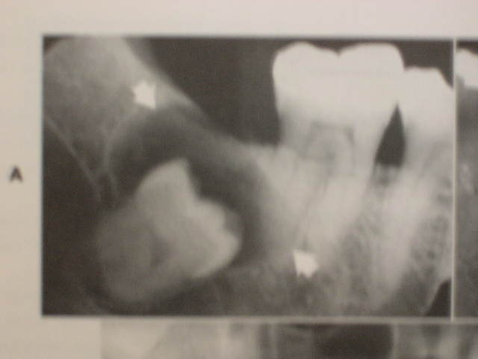
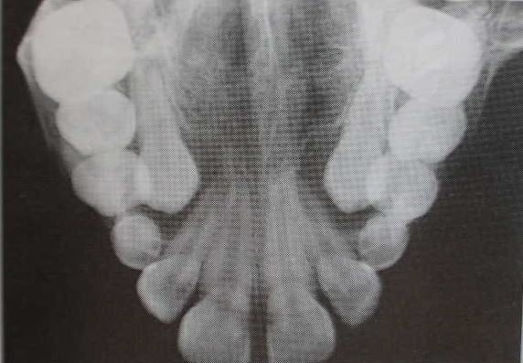
RADIOGRAPHIC FEATURES
  Radiolucent area associated with unerupted tooth crown.
  3 varieties- Lateral, Coronal, Circumferential.
  Usually unilocular, rarely multilocular.

Slide 36
POTENTIAL COMPLICATIONS:
Ameloblastoma
Epidermoid carcinoma
Mucoepidermoid carcinoma
TREATMENT
Enucleation
Marsupialisation.

Slide 37
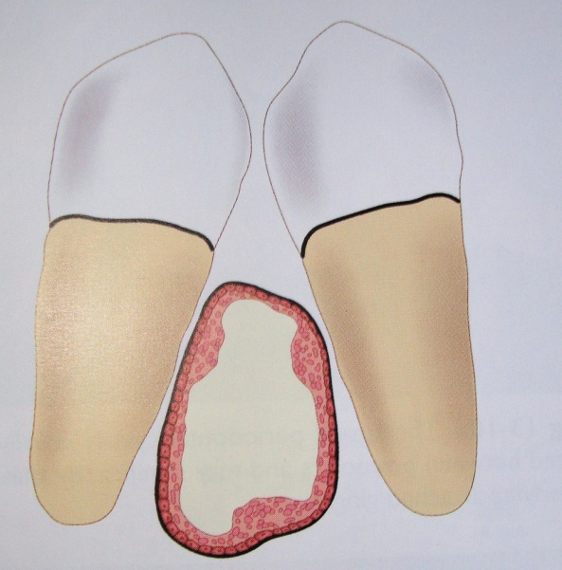
LATERAL PERIODONTAL CYST
- Those cysts which occur in the lateral periodontal position .
PATHOGENESIS
-from reduced enamel epithelium, remnants of dental lamina & cell rests of Malassez.
-CLINICAL FEATURES
Age- 2nd-7th decades
Sex- Males > Females.
Site- (1) Mandibular premolar area.
(2) Anterior region of maxilla.
Clinical presentation
      Symptomless, discovered during routine radiographic examination.
      Gingival swelling may occur on facial aspect. (D/d- Gingival cyst)
      Associated teeth- vital unless otherwise involved.

Slide 38
RADIOGRAPHIC FEATURES
Well defined round or oval radiolucent area with sclerotic margin.
Cyst lies between apex and cervical margin of tooth.
Mostly <1cm in diameter; may be larger involving entire root length.
(D/d- collateral variety of primordial cyst)
HISTOPATHOLOGICAL FEATURES
Cyst lining- non-keratinised squamous or cuboidal epithelium 1-5 cell thick.
Presence of localised plaques in lining.
TREATMENT
Surgical enucleation
RECURRENCE
None.

Slide 39
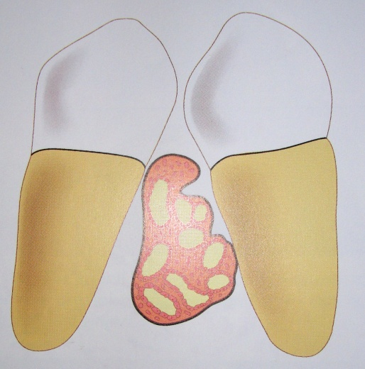
BOTYROID ODONTOGENIC CYST
- Name proposed by Weathers & Waldron (1973), as the gross specimen resembles a cluster of grapes.
- Radiologically & histologically similar to lateral periodontal cyst.
- Microscopically very thin fibrous connective tissue septa will be seen.

Slide 40
CALCIFYING ODONTOGENIC CYST: GORLIN CYST
first described by Gorlin and associates (1962)
PATHOGENESIS
Remnants of dental lamina
- Stellate reticulum
- Reduced enamel epithelium.
Epithelial lining has the ability to induce formation of dental tissues in the adjacent connective tissue wall.

Slide 41
CLINICAL FEATURES:
- No sex predilection
SITE
- Ant. part of mandible.
CLINICAL PRESENTATION
- symptomless, discovered accidentally.
- swelling - most frequent complaint
- peripheral or intraosseous lesion
- intraosseous lesion produces hard, bony expansion.
-saucer shaped bony depression seen in cysts arising
close to periosteum.
- displacement of teeth maybe seen.

Slide 42
RADIOLOGICAL FEATURES:
- when small, cyst seen between roots of teeth.
- periphery- well demarcated or irregular.
-usually unilocular.
- irregular calcified bodies of varying size and opacity maybe seen in radiolucent area.
- cyst maybe associated with a complex odontome or an unerupted tooth.
- resorption of roots of adjacent teeth maybe seen.
- cortical perforation maybe evident.

Slide 43
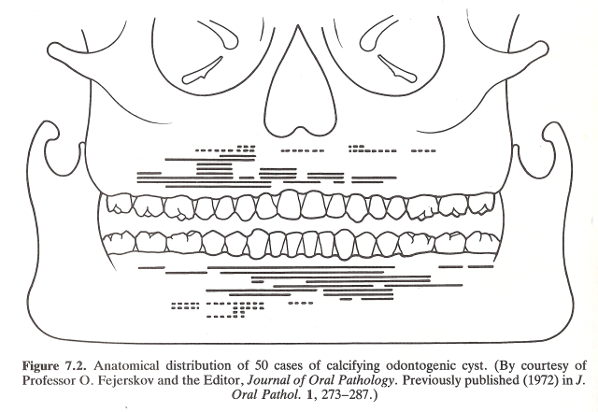
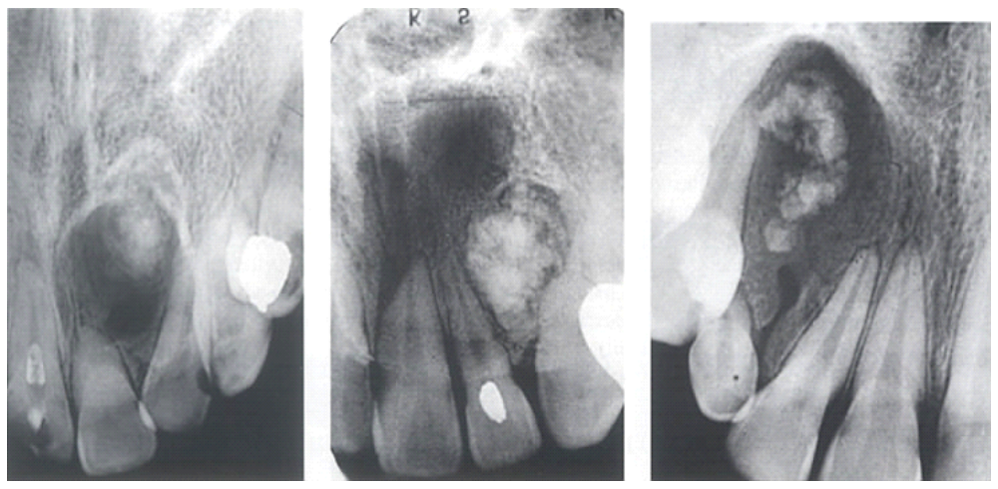

Slide 44
HISTOPATHOLOGY:
Ghost cells seen, which can evoke a foreign body reaction with the formation of multinucleated giant cells in the connective tissue wall.
TREATMENT:
Enucleation.

Slide 45
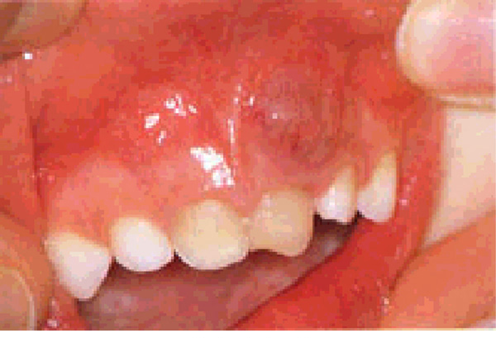
Inflammatory odontogenic cysts
RADICULAR CYST:
Is one which arises from the epithelial residues in the periodontal ligament as a result of inflammation.
Also referred to as:
-Periapical (periodontal) radicular cyst
-Lateral (periodontal) radicular cyst

Slide 46
CLINICAL FEATURES
Age- 3rd-4th decade
Sex- Males > Females.
Site- Maxillary anterior teeth.
CLINICAL PRESENTATION
Symptomless unless infected.
Associated with non-vital teeth.
May complain of slowly enlarging swelling.
Initially bony hard swelling, as cyst increases in size bony covering becomes thin and swelling exhibits ‘springiness’, later fluctuation.
Cyst content
- Uninfected cystic fluid is straw colored or brownish containing cholesterol clefts.
- Small amount of keratin flakes maybe seen.
- In long- standing infection, a dirty white casseous material or frank pus maybe expressed.

Slide 47
RADIOLOGICAL FEATURES:
Well-circumscribed unilocular radiolucency at apex or lateral aspect of tooth.
HISTOPATHOLOGICAL FEATURES:
- Inflammatory infiltrate of polymorphonuclear leucocytes seen in lining.
- Epithelial lining may show presence of Rushton bodies, mucus or ciliated cells.
.

Slide 48
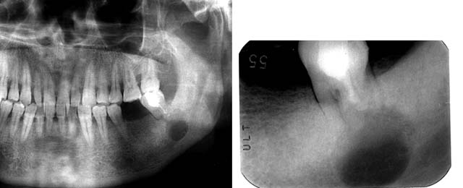
TREATMENT:
- Enucleation with primary closure.
- Associated non-vital teeth maybe extracted or endodontically treated.
- Very small cysts can be removed through tooth socket.
- Marsupialisation and decompression

Slide 49
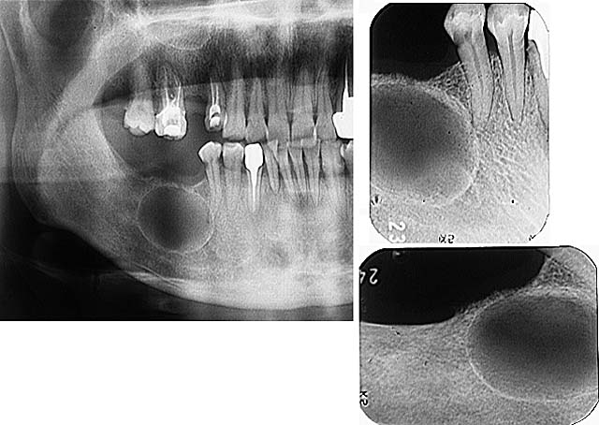
- Is a radicular cyst that remains behind in the jaws after the removal of the offending tooth.
CLINICAL FEATURES:
SITE:
- Greater in maxilla typically seen in edentulous sites
CLINICAL PRESENTATION:
- Asymptomatic, discovered on radiographic examination.
- Pathologic fractures or signs of encroachment on associated structures in case of large residual cysts.
HISTOPATHOLOGIC FEATURES:
- Similar to underlying process that was present.
TREATMENT:
- Similar to radicular cyst.
RESIDUAL CYST

Slide 50
GENERAL PRINCIPLES OF TREATMENT
REASONS FOR TREATMENT OF BENIGN CYSTS OF THE ORAL CAVITY
Cysts tend to increase in size
Cysts tend to get infected
Cysts weaken the jaw and can cause pathological fracture.
Some cysts can undergo malignant changes and it is not possible to be certain about a cystic lesion unless the tissue is examined histologically.
Cysts can prevent eruption of teeth

Slide 51
CLINICAL PRESENTATION
Most cysts are discovered accidentally on radiographs.
In case of a smooth, rounded expansion of the jaw bones a cyst should be suspected until proved otherwise.
A change in the fitting of dentures in the presence of a swelling.
Absence of a tooth from its place in the arch
Presence of a carious, discoloured, fractured or heavily filled tooth related to the swelling, suggestive of apical periodontal cyst.
Tilting of the crowns of teeth suggests that their roots have been displaced by the expansion of a cyst or tumour.
On extraction of a tooth with a sizeable radicular cyst, cystic fluid may escape from the socket.
Infected cysts may present as painful, tender swellings and may have discharging sinuses.

Slide 52
Percussion of teeth overlying a solitary bone cyst produces a dull, hollow sound.
Dentigerous cyst are mainly associated with impacted third molars, canines and premolars.
Static bone cavity is located beneath the inferior alveolar canal.
OKCs are most commonly in the lower III molar area and extending into the ramus.

Slide 53
Large cysts usually deflect the neurovascular bundle, paresthesia and anaesthesia are rare.
Infected cysts may cause some degree of neuropraxia.
As a cyst enlarges, a smooth, hard, painless prominence is generally seen on the labial side.
Expansion of the lingual aspect alone can occur with an odontogenic cyst in the ramus or III molar region.
Expansion of both cortical plates is generally indicative of a lesion rather than a cyst.
Egg-shell crackling is a term used to descibe the fragile outer shell of bone that has thinned out due to the expansion and the sensation and sound produced on palpation is like egg-shell crackling.
Fluctuation is elicited when the cystic lining lies immediately beneath the mucosa.

Slide 54
RADIOGRAPHIC EXAMINATION
Periapical radiographs provide a clear and accurate image of small cystic lesions.
Occlusal films of the maxilla will disclose amoutn of palatal bone destruction by a cystic process.
Occlusal view of mandible will reveal expansion of inner or outer cortical plates.
Extraoral radiographs, provide the full extent of the lesion and help in assessing the damage caused to the adjacent structures, e.g. lateral oblique views, OPG,.

Slide 55
PA mandible view helps to reveal both lateral and medial expansion of the ramus.
CT scans maybe helpful in the assessment of large cystic lesions and multicystic lesions.

Slide 56
RADIOPAQUE DYES
When the size and relations of a cyst are in doubt, its contents maybe aspirated and radiopaque dye injected prior to further radiography.
To follow the progress of regression of a marsupialised lesion.
Radiopaque dyes used- lipiodol, triosil.

Slide 57
ASPIRATION
-- Valuable diagnostic aid
-- Helps to distinguish:
-Maxillary cyst from maxillary sinus.
-Cystic lesion and solid tumour mass.
-Aneurysmal bone cyst from central cavernous hemangioma
-Helps to distinguish various cysts.
BIOPSY
-- Valuable diagnostic aid in the differential diagnosis of the cyst or its differentiation from tumour.
-- Biopsy prior to surgery is done for large lesions and when doubt exists.

Slide 58
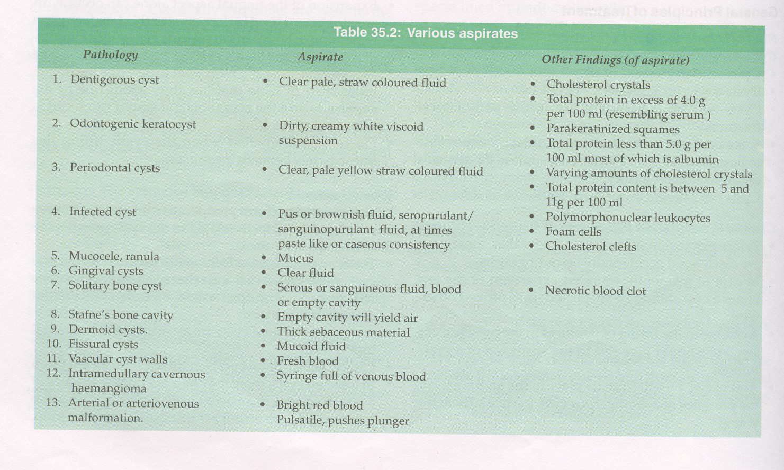

Slide 59
OPERATIVE PROCEDURES
Cysts of the jaws maybe treated by one of the following basic methods:
MARSUPIALISATION
    Partsch I
    Partsch II(combined marsupialisation and
    enucleation)/Waldron’s method
    Marsupialisation by opening into nose or antrum.
ENUCLEATION
    Enucleation and packing
    Enucleation and primary closure
    Enucleation and primary closure with reconstruction/bone grafting

Slide 60
MARSUPIALISATION / DECOMPRESSION
PRINCIPLE-
It refers to creating a surgical window in the wall of the cyst and evacuation of its contents.
This decreases the intracystic pressure and promotes shrinkage of the cyst and bone fill.
INDICATIONS
In young children with developing tooth germs
In elderly, debilitated patient.
Proximity of cyst to vital structures.
When cyst impedes tooth eruption, marsupialisation facilitates the eruption of the unerupted tooth or any other developing tooth that have been displaced.
Large cysts, where enucleation could cause pathological fracture.
When apices of many adjacent erupted teeth are involved within a large cyst.

Slide 61
ADVANTAGES
Simple procedure
Spares vital structures
Allows eruption of teeth.
Prevents, oronasal, oroantral fistulae.
Prevents pathological fractures.
Reduces operating time.
Reduces blood loss.
Helps shrinkage of cystic lining.
Allows endosteal bone formation to take place.
Alveolar ridge is preserved.

Slide 62
DISADVANTAGES
Pathologic tissue is left in situ.
Histologic examination of entire cystic lining cannot be done.
Prolonged healing time.
Prolonged follow-up visits.
Periodic irrigation of cavity.
Regular adjustments of plug.
Periodic changing of pack.
Inconvenience to patient.
Secondary surgery maybe needed.
Formation of slit-like pockets that may harbor foodstuffs.
Risk of invagination and new cyst formation.

Slide 63
ENUCLEATION
PRINCIPLE
Complete removal of cyst with cystic lining
Closure of cystic cavity by a mucoperiosteal flap
Space fills up with blood clot, which will eventually organize and form normal bone.
INDICATIONS
Treatment of OKCs.
Cysts with high recurrence rate.
Small cysts.

Slide 64
ADVANTAGES
Primary closure of wound.
Rapid healing.
Post-operative care reduced.
Thorough examination of entire cystic lining can be done.
DISADVANTAGES
In young persons the unerupted teeth associated with the cyst, will be removed with enucleation.
Pathologic fractures, when large cysts are enucleated.
Damage to adjacent vital structures.
Pulpal necrosis.

Slide 65
COMPLICATION OF CYSTIC LESIONS
Pathological fracture
Infection
Post-operative wound dehiscence.
Loss of vitality of teeth.
Neuropraxia in infected cysts.
Post-operative infection.
Recurrence in some cysts.
Dysplastic, neoplastic or malignant changes.

Slide 66
THANK YOU

