Slide 1
CLASSIFICATION OF MALOCCLUSION
Dr. Madhubhaskar bommasani
Department of orthodontics

Slide 2
Contents
Introduction
Malocclusion definition
❖ Definition of classification in orthodontics
❖ Need/purpose/uses of classification
❖ Methods of recording and measuring malocclusion/various methods of classification of malocclusion
❖ Angle’s classification of malocclusion
❖ Merits and demerits of Angle’s classification/validity of Angle’s classification
❖ Modifications of Angle’s classification
❖ Lischer’s modification
❖ Dewey’s modification
❖ Simon’s classification
❖ Incisor classification/British standard classification of incisor relationship
❖ Ackerman–Proffit classification
❖ Quantitative methods of classification of malocclusion

Slide 3
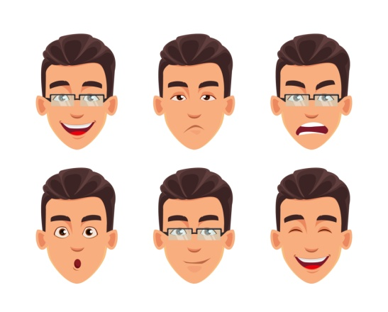


Introduction
Face has infinite variations of its constitution and expression.
Ethnic isolation on one side and on the other side, heterogeneous mixing of people from across the globe, the gene-environment interaction and the genetic mix up which led to the ‘new look’ faces, where in jaw size, dentition and occlusion are significant components.

Slide 4
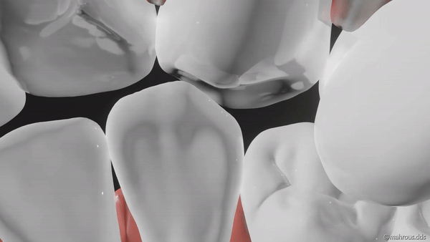
OCCLUSION
The evaluation and definition of occlusion is determined by the intra-arch dental alignment and arch forms, interarch relationship of individual tooth and their harmony with underlying skeleton bases, i.e. maxilla, mandible and cranium.
The soft tissues integument and attachments including functional components should harmonize to produce ‘optimum aesthetics’ and ‘function’.

Slide 5
MALOCCLUSION
Malocclusion is a condition in which there is a departure from the
normal relation of teeth to the other teeth in the same arch and/or
to the teeth in the opposing arch (White TC, Gardiner JH and
Leighton B).
Occlusion is determined by the intra-arch dental alignment and
arch forms, interarch relationship of individual tooth and their
harmony with underlying skeleton bases, i.e. Maxilla, mandible and
cranium.

Slide 6
Need for classifying malocclusion
Classification in orthodontics is concerned with the recognition of deviation from a quantitative and qualitative biological norm.
Diagnosis and treatment planning
Visualizing and understanding the problem
Communication.
Comparison of malocclusions.
Effectiveness of appliance.
In order to have a system of classification, standards should be set up that represents the normalcy. The deviation from the accepted norms should also be grouped into various small divisions and categories

Slide 7
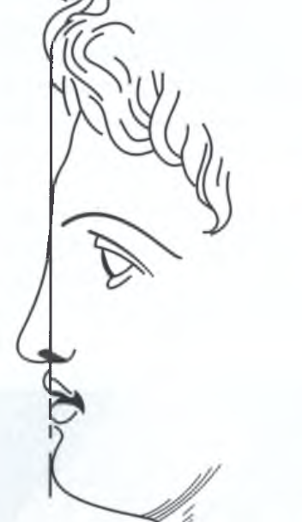
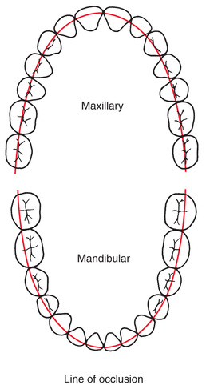

Slide 8
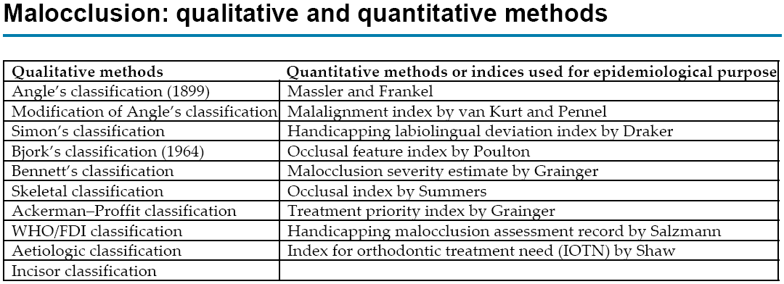
Methods for measuring malocclusion

Slide 9
George Carabelli (1842) of Vienna described relationships of the upper and lower dental arches in systematic manner and coined the term edge-to-edge bite and overbite.
Mordex normalis: normal occlusion
Mordex rectus: edge to edge
Mordex apertus: open occlusion
Mordex prorsus: protruding occlusion
Mordex retrosus: retruding occlusion
Mordex tortuosus: zig-zag occlusion.

Slide 10
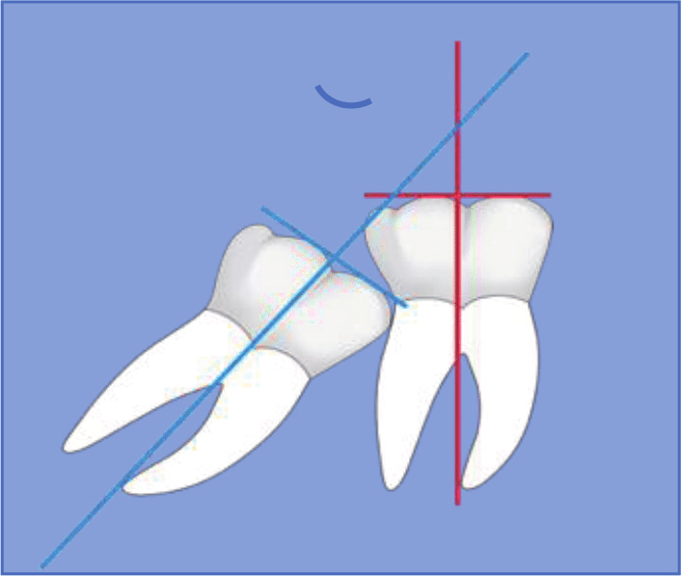
Classification of malocclusion
Intra-arch malocclusion
Angle used following nomenclature to describe deviations
from normal tooth positions:
1. Buccal or labial occlusion: A tooth outside of the line of occlusion.
2. Lingual occlusion: When the tooth is inside this line
3. Mesial occlusion: The tooth is farther forward (mesially) than normal
4. Distal occlusion: If the tooth is backward (distally) than normal.

Slide 11
5. Torso-occlusion; If the tooth is turned on its axis.
6. Infra-occlusion: Teeth not sufficiently elevated in their sockets.
7. Supra-occlusion: Those that occupy positions of great elevation.
8.Rotations :refer to tooth movements around its long axis.
9.Transposition: This term describes a condition where two teeth have exchanged places.

Slide 12
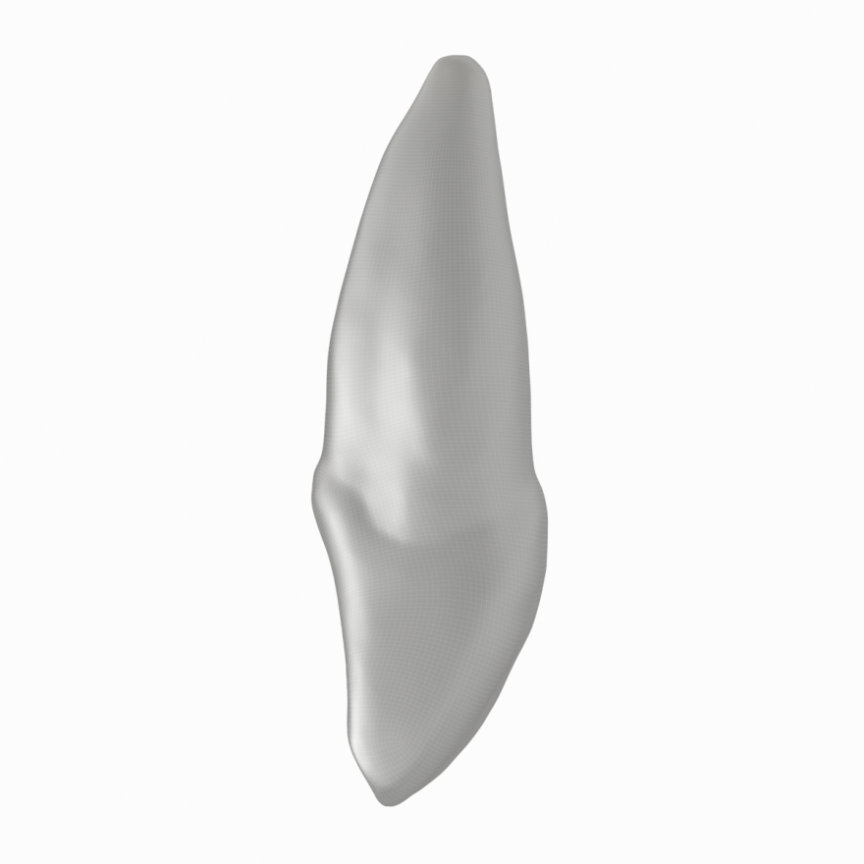
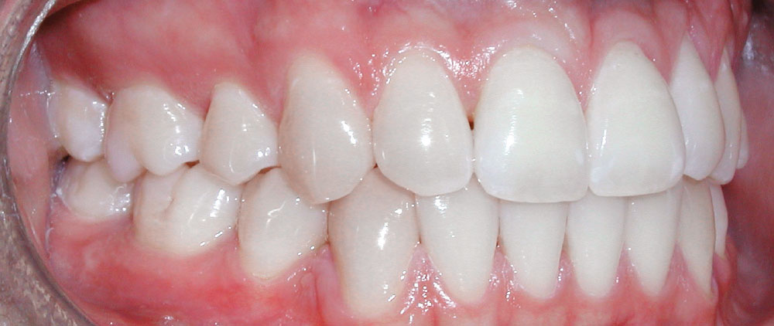
Buccal and palatal inclination & displacement
Palatal
Buccal

Slide 13
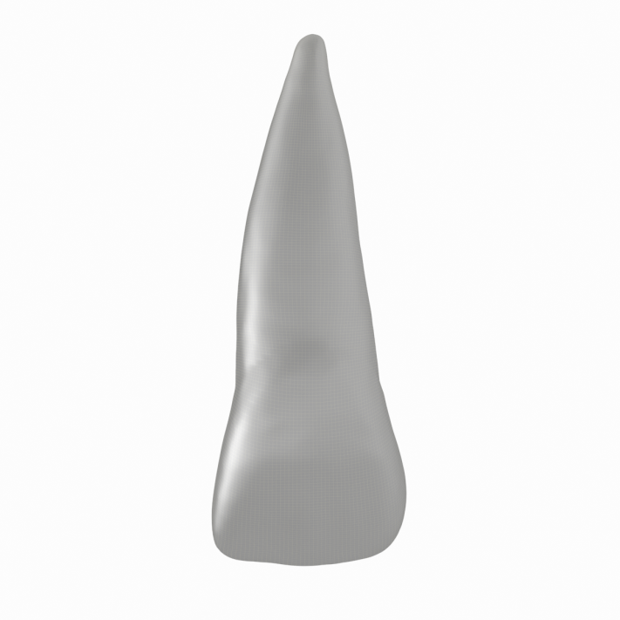
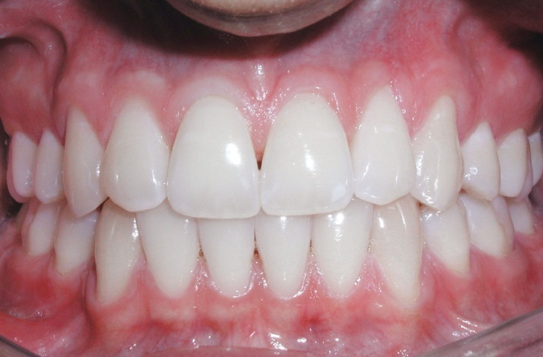
Mesio-distal inclination & displacement
Mesial
Distal

Slide 14
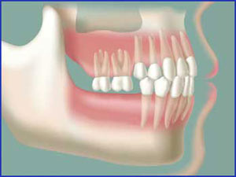
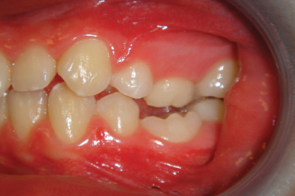
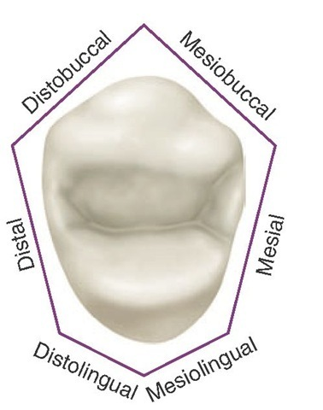
Supra, infraocclusion & rotation

Slide 15
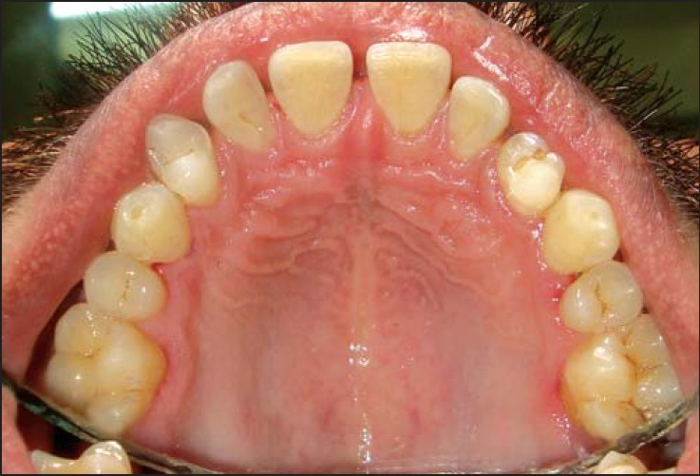
Transposition

Slide 16
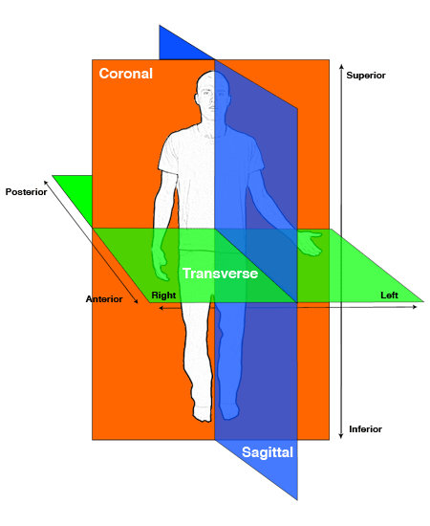
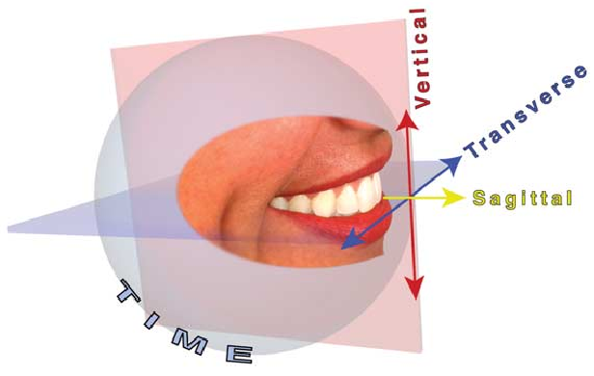
Interarch malocclusion
These can be in sagittal, vertical or transverse planes.

Slide 17
Saggital plane malocclusion.
  Pre normal occlusion :lower arch is placed more forwardly.
  Post-normal occlusion: lower arch is more distally placed .

Slide 18
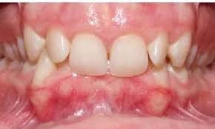
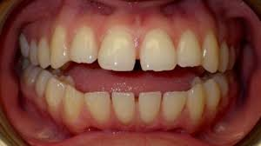
Vertical plane malocclusion
Deep bite or increased overbite.
This refers to a condition where there is an excessive vertical
overlap between upper and lower anterior teeth.
Open bite. It is a condition where there is no vertical overlap
between upper and lower teeth .

Slide 19
Transverse plane malocclusions
Transverse plane malocclusions include various types of
crossbites and scissor bites.
Crossbite
The term crossbite refers to abnormal transverse relationship between upper and lower arches.
A crossbite may affect a single tooth or a group of teeth or an entire arch.
It may affect anterior or posterior teeth alone, or both in combination. Posterior crossbites can be unilateral or bilateral.
Scissors bite.
It refers to a condition in which the mandibular arch is contained within the maxillary arch.

Slide 20
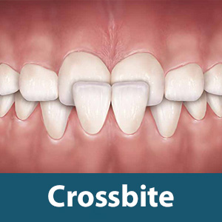
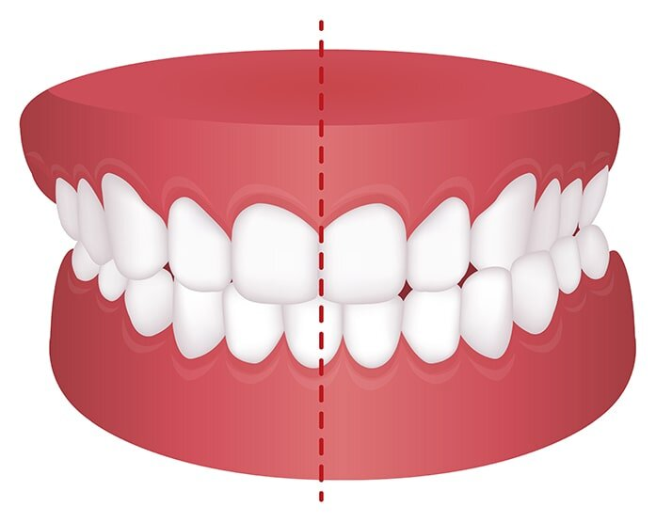

Slide 21
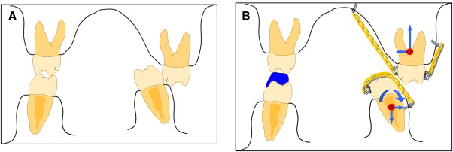
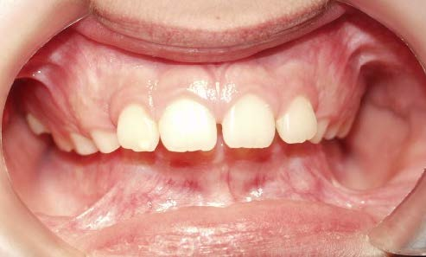
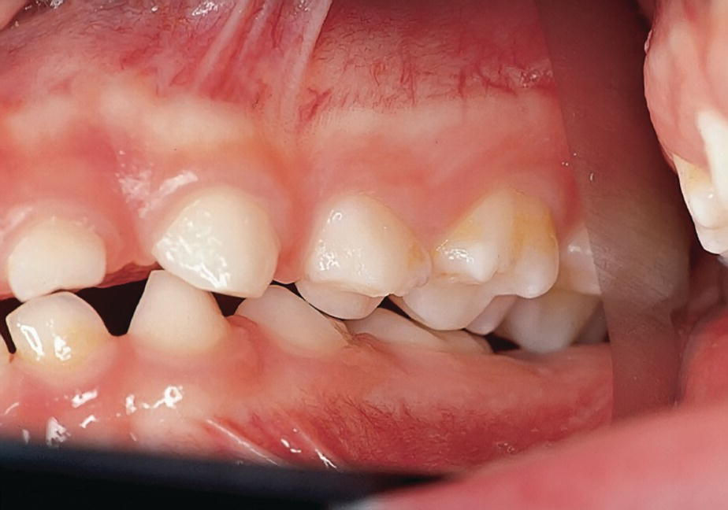
Scissor bite

Slide 22
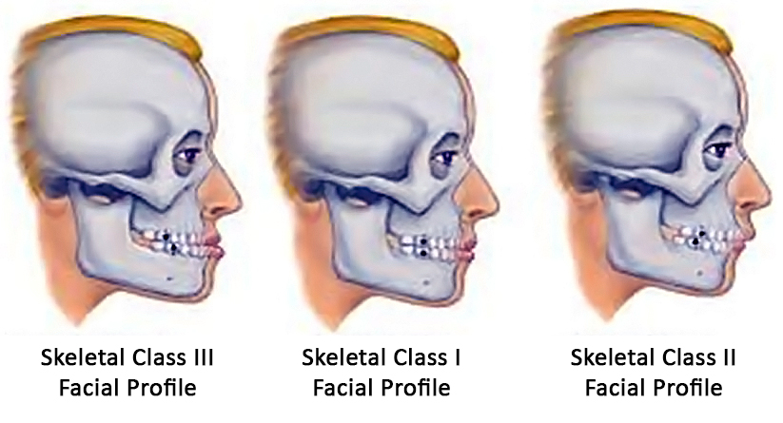
Skeletal classification

Slide 23


Slide 24
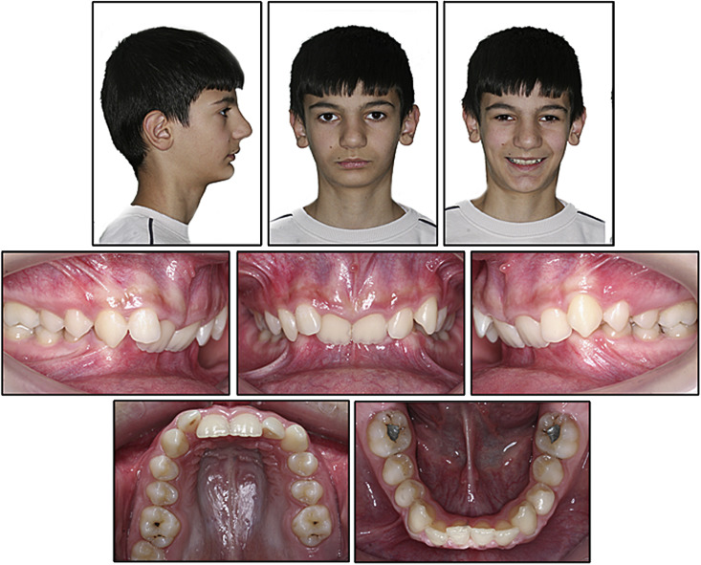

Slide 25
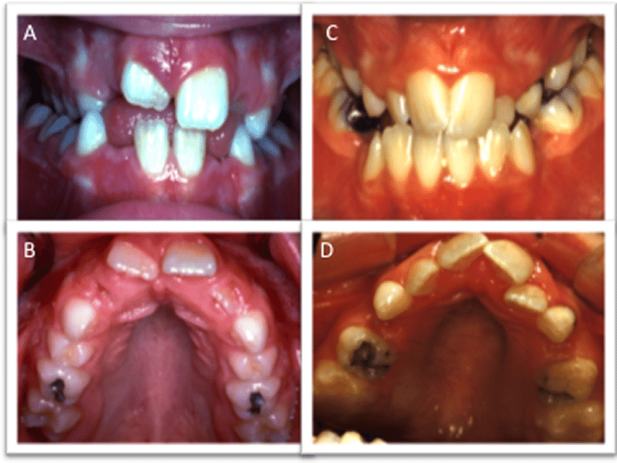

Slide 26
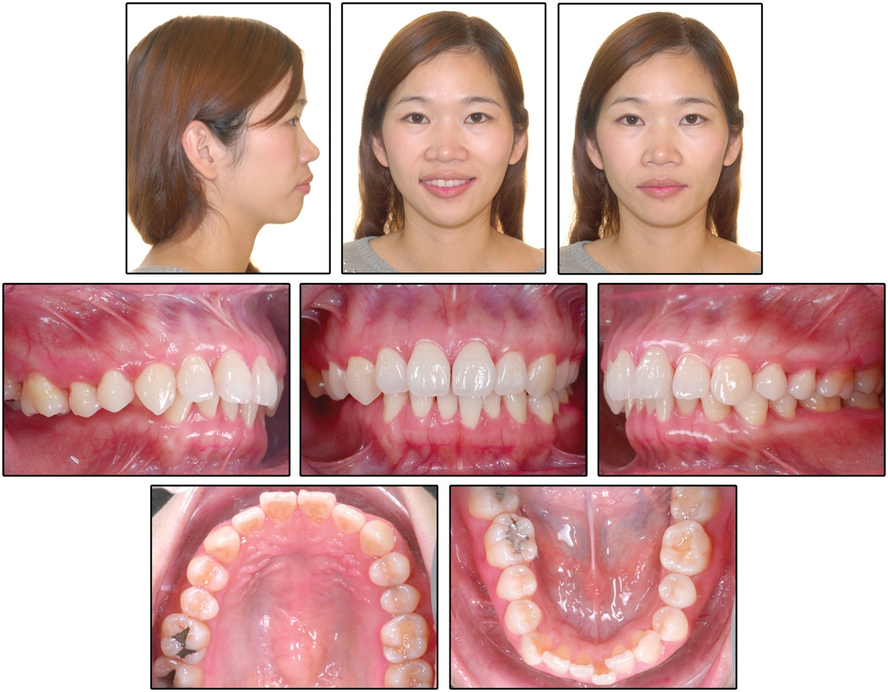

Slide 27
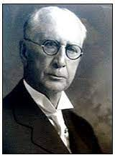
Angle’s classification of malocclusion
Introduction
➤ Angle’s system of classification is based on the anteroposterior
relationship of the teeth with each other.
➤ Edward Hartley Angle introduced this classification with the
concept of key of occlusion and line of occlusion.
➤ Maxillary first permanent molar is considered to be the key of
occlusion and Angle stated that the position of the maxillary first
permanent molar is relatively constant.

Slide 28
The Upper First Molars as a Basis of Diagnosis in Orthodontics’ “key to occlusion”
1. Are the largest teeth
2. Are the firmest in their attachment
3. Have a key location in the arches
4. Help to determine the dental and skeletal vertical proportions due to length of their crowns
5. Occupy normal position in the arches far more often than any other teeth because they are the first permanent teeth and are less restrained in taking their position
6. More or less control the positions of other permanent teeth
7. Have the most consistent timing of eruption
8. Determine the interarch relationship of all teeth upon their eruption and ‘locking’ with the mandibular first molars.

Slide 29
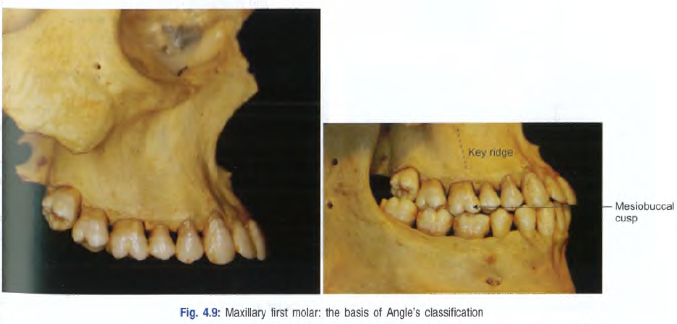
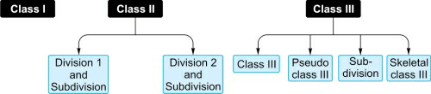

Slide 30
Angles class -I
Molar relation:
The mesiobuccal cusp of the upper first molar occludes with the
mesiobuccal groove of the lower first molar.
Canine relation:
The mesial incline of the upper canine occludes with the distal
incline of the lower canine whereas the distal incline of the upper
canine occludes with mesial incline of lower first premolar.
Line of occlusion:
Line of occlusion will be altered in the maxillaryand mandibular
arches

Slide 31
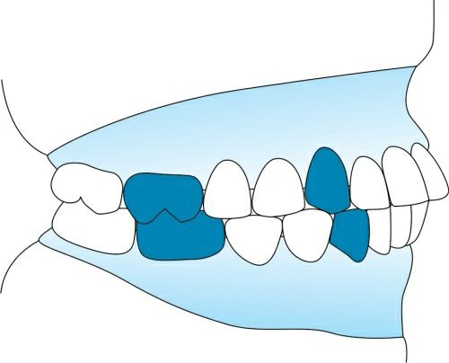
Individual tooth irregularities, like crowding, spacing, rotations,
absence of tooth, will be seen.
Interarch problems, like deep bite, open bite, proclination or increased overjet, crossbite will be present.
Class I bimaxillary protrusion
Class I bimaxillary malocclusion is a condition where both the key
of occlusion and line of occlusion are not altered, but the upper and
lower anteriors are proclined and exist usually in an edge–edge
relationship.

Slide 32
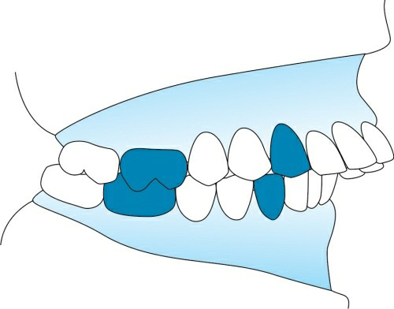
Angles class II
Molar relation: Lower dental arch is distally positioned in
relation to upper arch. The distobuccal cusp of the upper first
permanent molar occludes with the mesiobuccal groove of the
lower first permanentmolar.
Class II canine relation:
The distal incline of upper canine occludes with mesial incline
of lower canine.
Line of occlusion: Altered
1. V-shaped or constricted maxilla
2. Proclined maxillary incisors
3. Lip trap
4. Exaggerated curve of Spee
5. Deep bite

Slide 33
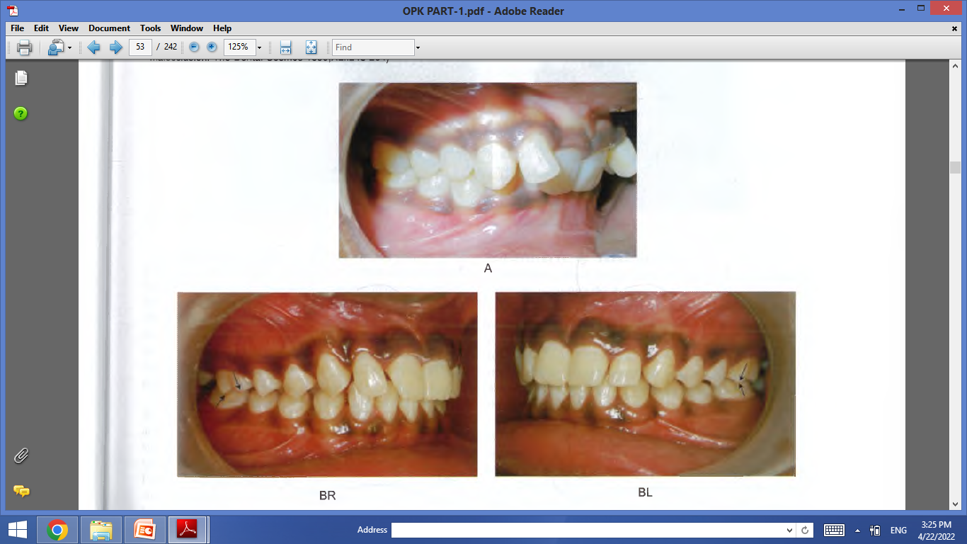
Class II division 1 subdivision: Condition where the class II molar relationship is unilateral or present only on one side with normal class I molar occlusion on the other side.

Slide 34
Angle’s class II division 2 malocclusion.
Class II molar relation: Lower dental arch is distally positioned in
relation to upper arch. The distobuccal cusp of the upper first molar
occludes with the mesiobuccal groove of the lower first molar.
Class II canine relation: The distal incline of the upper canine
occludes with the mesial incline of the lower canine.
Line of occlusion: Altered.
Other features:
➤ Characteristic lingual inclination of upper central incisor alone or
central and lateral incisors together.
➤ Canine overlaps the retroclined incisors .
➤ Closed bite will be present.
➤ Square-shaped arch.
➤ Exaggerated curve of Spee.

Slide 35
Class II division 2 subdivision: Condition when the class II molar relation exists on only one side with normal molar relation on theother side.

Slide 36
Class III molar relation
The lower dental arch is in anterior relation to the maxillary arch.
Mesiobuccal cusp of the upper first permanent molar occludes with the
interdental space between the lower first and second permanent molars.
Class III canine relation: Upper canine occludes with the
interdental space between the lower first and second premolars.
Line of occlusion: May or may not be altered.
Other features are:
➤ Reverse overjet or anterior crossbite
➤ Maxillary anterior crowding
➤ Posterior crossbite

Slide 37
Class III subdivision: Condition in which class III molar relation
is present only on one side with normal molar relation on the other
side.
True class III: This is a skeletal malocclusion.
The reasons for skeletal class III malocclusion are
➤ Retrognathic maxilla
➤ Prognathic mandible
➤ Combination of both
In this class III, molar relation exists both in centric occlusion and rest position.

Slide 38
Pseudo-class III/habitual class III:
This is not a true class III malocclusion.
Due to occlusal prematurities, when the mandible moves from rest position to occlusion, it slides forwards into a pseudo-class III position.
2. These patients show normal molar relationship in rest position.
3. In centric occlusion, they show class III relation.
4. Cephalogram in both rest position and occlusion helps to differentiate between true class III and pseudo-class III malocclusion.

Slide 39
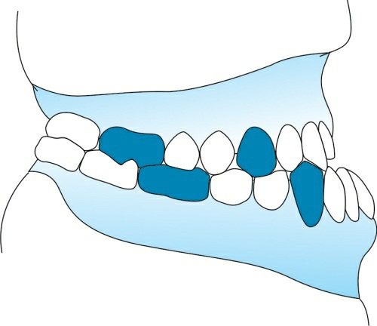

Slide 40
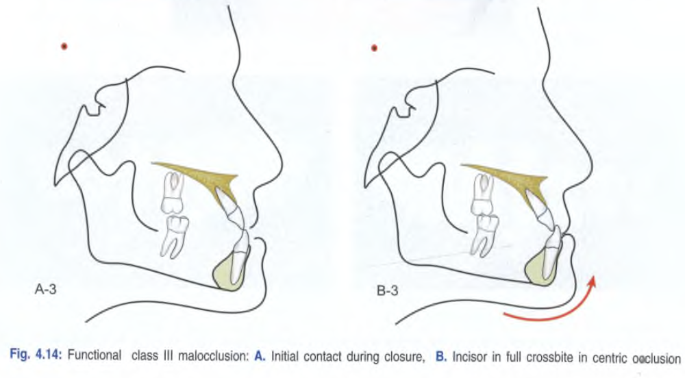

Slide 41
Merits
1. Angle’s system of classification is the most traditional and oldest system still in use.
2. Most practical and easy to comprehend method of classification.
3. Most popular.
4. Easy to communicate.
5. Widely used for teaching purpose.

Slide 42
Demerits
1. Disregarded the relationship of the teeth to the face.
2. Malocclusion is a three-dimensional problem, but Angle considered only sagittal dimension.
3. The position of the maxillary first permanent molar is not stable as
stated by Angle.
4. Muscle malfunction and growth of bones were overlooked. These
factors influence the molar position.
5. Classification is not applicable when first permanent molars are
missing.

Slide 43
6. Not applicable in deciduous dentition.
7. When there is migration of first molar, classification is not feasible.
8. Aetiology of the malocclusion is not known.
9. Skeletal problems are not given consideration.
10. Differentiation between dentoalveolar and skeletal malocclusion is not possible.
11. The classification considers only static occlusion.

Slide 44
Modifications of angle’s classification
There are two modifications of Angle’s classification:
(1) Lischer’s modification and (2) Dewey’s modification.
Lischer’s modifications
1. Lischer introduced the following names to Angle’s classification.
Neutroclusion – class I
Distoclusion – class II
Mesiocclusion – class III

Slide 45
2. Lischer also introduced nomenclature to describe malpositions of individual tooth. It
consists of adding the suffix ‘version’ -deviation from the normal position.
  • Mesioversion – mesial to the normal position.
  • Distoversion – distal to the normal position.
  • Linguoversion – lingual to the normal position.
  • Labioversion/buccoversion – towards the lip or cheek.
  • Infraversion – away from the line of occlusion.
  • Supraversion – crossing the line of occlusion.
  • Axiversion – wrong axial inclination.
  • Torsiversion – rotated on its long axis.
  • Transversion – transposition – wrong position in the arch.

Slide 46
Dewey’s modification
Martin Dewey divided Angle’s classes I and III into further types:
➤ Class I is divided into five types.
➤ Class III is divided into three types.
➤ Class II has no types.

Slide 47
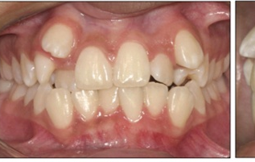
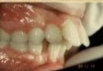
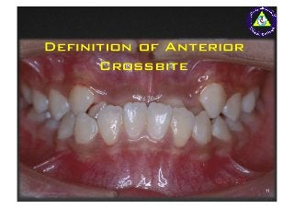
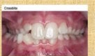
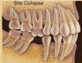
Class I
➤ Type 1: Crowded maxillary anterior teeth; canines may be
abnormally positioned; other individual tooth
irregularities present.
➤ Type 2: Proclined or labioversion of maxillary incisors.
➤ Type 3: Linguoversion of maxillary incisors; anterior
crossbite present.
➤ Type 4: Incisors and canines are normally positioned.
Molars and premolars are in buccoversion.
Posterior crossbites are seen.
➤ Type 5: Mesioversion of molars; molars have moved mesially
due to premature loss of teeth anterior to molar.

Slide 48
Class III
Type1: Well-aligned teeth and dental arches; edge–edge relationship
exists.
Type 2: Crowded mandibular incisors; normally placed lower incisors
behind the upper incisors.
Type 3: Crowded maxillary incisors; underdeveloped maxilla; anterior
crossbite present.

Slide 49
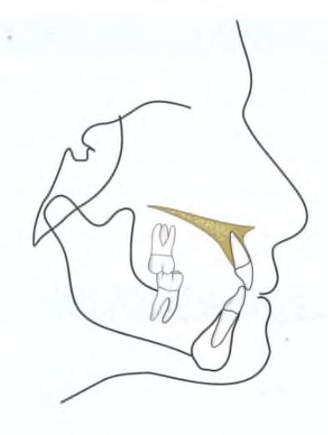
Skeletal classification
Skeletal classification is a working classification that has
evolved over the years with clinical experience. In fact, it
derives basis from the classic Angle’s classification and
Strang’s interpretation of the former.
Skeletal class I: Orthognathic face
features may be:
1. Straight profile
2. Normal ANB angle : 2° ± 2
3. Normal facial angle (Downs): 82° to 95° (mean 87.3D)
4. Angle of convexity (Downs): +10° to -8.5°(mean 0D)

Slide 50
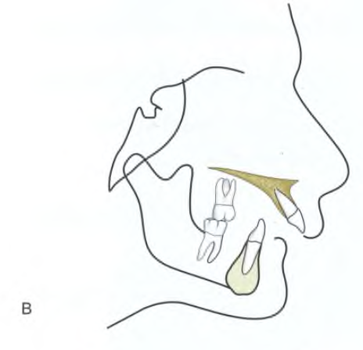
Skeletal class II: Retrognathic face that may be due to
prognathic maxilla or retrognathic mandible (Fig. 4.15B).
Important features may be:
1. Convex profile
2. Increased ANB
3. Reduced facial angle
4. Increased angle of convexity
5. Severe backward rotation of the mandible may also be present.

Slide 51
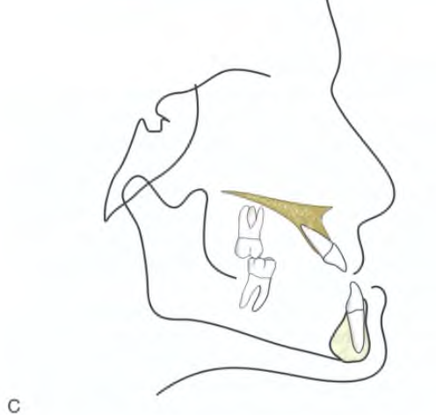
Skeletal class III: Prognathic face that may be due to
prognathic mandible or retrognathic maxilla (Fig. 4.15C).
Important features may be:
1. Concave profile
2. Prominent chin
3. Decreased ANB
4. Increased facial angle
5. Reduced angle of convexity.

Slide 52
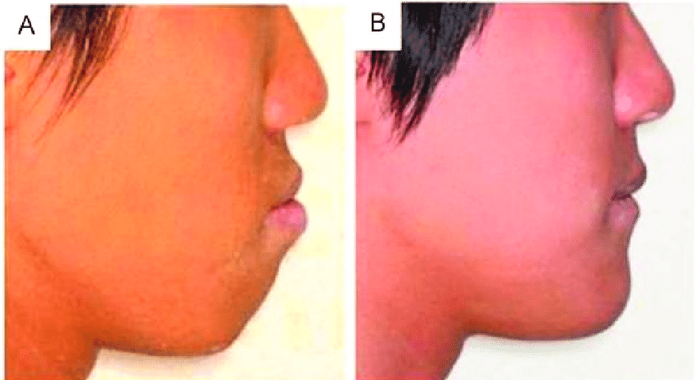
Bimaxillary protrusion: It is another type of malocclusion
in which both the jaw bases are placed ahead with respect
to the anterior cranial base. Here both SNA and SNB
angles are increased but the angle ANB is in the normal
range.

Slide 53
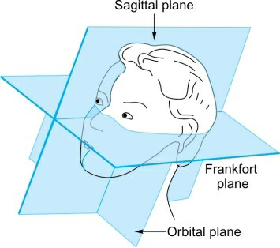
Simon’s classification
In Simon’s classification, the dental arches are related to three
anthropologic planes.
Since malocclusion is a three-dimensional problem, Simon devised this method of classification orienting dental arch to three different planes.
It is a craniometric form of classification.
Attraction vs abstraction
Protraction vs retraction
Contraction vs distraction
Law of canines
The orbital plane passes through
the distal aspect of canine.
This is called ‘law of canines’.

Slide 54
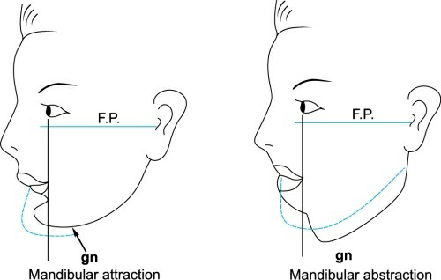
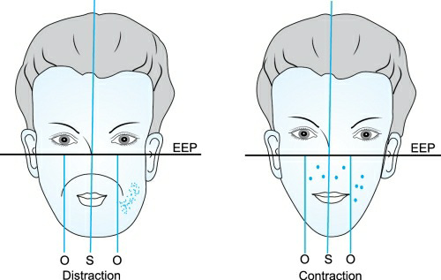

Slide 55
Limitations of Simon’s classification
The basis of using canine as a stable reference landmark was
rather much weaker than first molar.
The maxillary canines are the last teeth to erupt in the arch and therefore, likely to be disturbed by several environmental factors therefore not to always occupy a stable position.

Slide 56
Bennets classification
Classified malocclusion based on the etiology
Class I-abnormal position of one or more teeth due to local cause.
Class II –abnormal formation of a part or whole of either arch due to developmental defect of bone.
class III- abnormal relation between upper and lower arches and between either arches and facial contour.

Slide 57
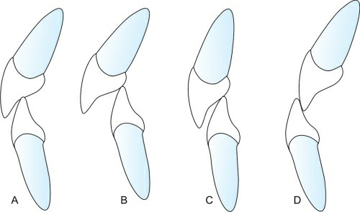
British Standards Institute’s incisor relationship classification (1983)
(A) Class I incisor relationship, (B) class II division 1 incisor relationship, (C) class II division 2 incisor relationship and (D) class III incisor relationship.

Slide 58
Class I.
The lower incisor edges occlude with or lie immediately below
the cingulum of the upper central incisors.
Class II.
The lower incisor edges lie posterior to the cingulum prominence
of the upper incisors. Div -1 proclined, Div-2 retroclined upper
anteriors
Class III.
The lower incisor edges lie anterior to the cingulum prominence
of the upper incisor. The overjet is reduced or reversed

Slide 59
Ackerman–proffit classification
➤ Ackerman and Proffit introduced a new method of classification to overcome the drawbacks of traditional Angle’s classification.
➤ This is an all inclusive method of categorizing malocclusion.
➤ This system included Angle’s classification and five characteristics of malocclusion within a Venn diagram.

Slide 60
Step 1
  Group 1: This is also called the universal group and consists of malalignment and asymmetry within the dental arches
Step 2
  Group 2 (Profile): The soft tissue profile is considered here.
Step 3
  Group 3(type) Deviations in the transverse plane
Step 4
  Group 4(class) Deviations in the anteroposterior sagittal plane.

Slide 61
Step 5
  Group 5 (Bite): Deviations in the vertical plane
  Group 6: Deviations in the transverse and sagittal planes
  Group 7: Deviations in the sagittal and vertical planes
  Group 8: Deviations in the vertical and transverse planes
  Group 9: Deviations in the transverse, sagittal and vertical planes

Slide 62
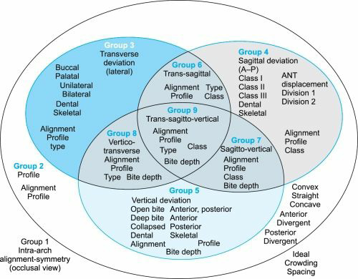

Slide 63

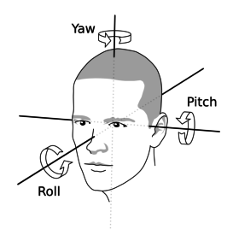


Pitch ,Roll ,Yaw

Slide 64


Slide 66


