Slide 1
CHILD PSYCHOLOGY
Dr. Aron Arun Kumar Vasa
Professor
Dept. of Pedodontics

Slide 2
CONTENTS
INTRODUCTION
DEFINITIONS
IMPORTANCE OF STUDYING PSYCHOLOGY
THEORIES OF CHILD PSYCHOLOGY
CONCLUSION
REFERANCE

Slide 3
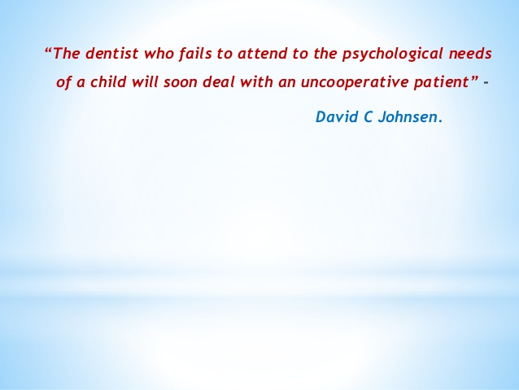

Slide 4

INTRODUCTION
BODY DOES WHAT MIND SAYS
“For all behavioral act of a person there is a force
behind what is known as mind or psyche”

Slide 5
DEFINITIONS
Psychology science dealing with human nature, function and phenomenon of his soul in the main. Its the study of human mind & its functions
Child psychology science that deals with the mental power or an interaction between the conscious and subconscious element in a child
Emotion a feeling or mood manifesting into motor and glandular activity.
Behavior is any change observed in the functioning of the organism.

Slide 6
PSYCHOLOGY -Science of behavior -concerned with studying & predicting behavior, | BEHAVIOR -Is the general term for any type of action -behavior follows psychology

Slide 7
Importance of studying child psychology
Provides information about
child's behavior and psychological growth
psychological scales for appraising a child’s developmental status
certain norms of behavior and growth for comparative purposes
understanding of basic psychological processes like learning, motivation, maturation and socialization
new trends and fads in child care & training
Guides psychological growth of children who experience difficulty in adjusting to others

Slide 8
WHY IN DENTISTRY?
To understand the child & know his problem
To deliver treatment effectively
To establish effective communication with child and parents
To gain confidence of child and parents
To teach and motivate them about importance of primary and preventive care
To plan out effective treatment
To provide comfortable and satisfactory treatment

Slide 9
THEORIES PROPOSED ON CHILD PSYCHOLOGY
THREE GROUPS
I. Psychodynamic theories
Psychosexual theory --- Freud -1905
Psychosocial theory ---Eric Erikson - 1963
Cognitive theory ---Piaget – 1952
II. Behavioral theories
Classical conditioning --- Pavlov - 1927
Operant conditioning --- Skinner - 1938
Hierarchy of needs --- Maslow - 1963
Social learning theory --- Bandura - 1954

Slide 10
III. OTHER THEORIES
Separation individualization – Margaret Mahler
Attachment theory – John Bowlby
Theory of moral development – Kohlberg L.

Slide 11
Classification
Behavioral Theories
Cognitive Theories
Developmental Theories
Humanist Theories
Personality Theories
Social Psychology Theories
Learning Theories

Slide 12
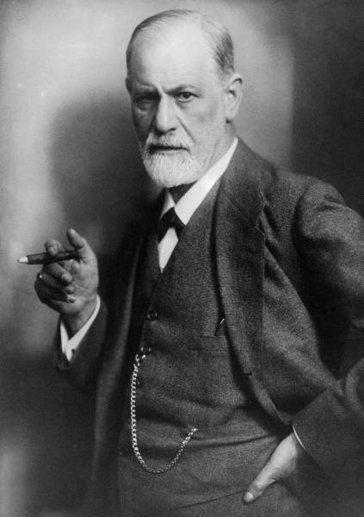
PSYCHOANALYTICAL THEORY
DR. SIGMUND FREUD 1856-1939
Founder of classic psychoanalysis
Oldest of eight children
1887-1897 work on hysterical patients---
to develop psychoanalysis
Based theory on personal experiences

Slide 13
Interpretation of dreams –1900 - HIS WORKS
Topographic model of mind
Instinct or drive theory
Stages of psychosexual development
Structural theory of mind
Theory of anxiety

Slide 14
ORIGIN AND CHARACTERISTICS OF THE THEORY
* not a deductive theory
* not a statistical theory
* not based on experiments
Rather: A comprehensive metaphor or model of personality development that grew out of Freud's clinical work with patients, based mostly on the analysis of free associations, dreams, slips of tongue, and other unconscious behaviors .

Slide 15
Freud believed that personality develops through a series of childhood stages during which the pleasure-seeking energies of the id become focused on certain erogenous areas.
This psychosexual energy, or libido, was described as the driving force behind behavior.

Slide 16
Instincts – inborn tendencies
Libido – sexual energy – that force by which the sexual instinct is represented in the mind – Pleasure principle – goal of life gain pleasure and avoid pain
Ego instincts s
Life & Death instincts – accounts for aggressive drive – to die or to hurt themselves or others
Aggressive drives – powerful determinants of peoples actions - sadism
Concept of narcissism – self love

Slide 17
Sigmund Freud’s theory of drives
Sigmund Freud’s theory of drives evolved throughout the course of his life and work. He initially described a class of drives known as the life instincts and believed that these drives were responsible for much of our behaviour.

Slide 18
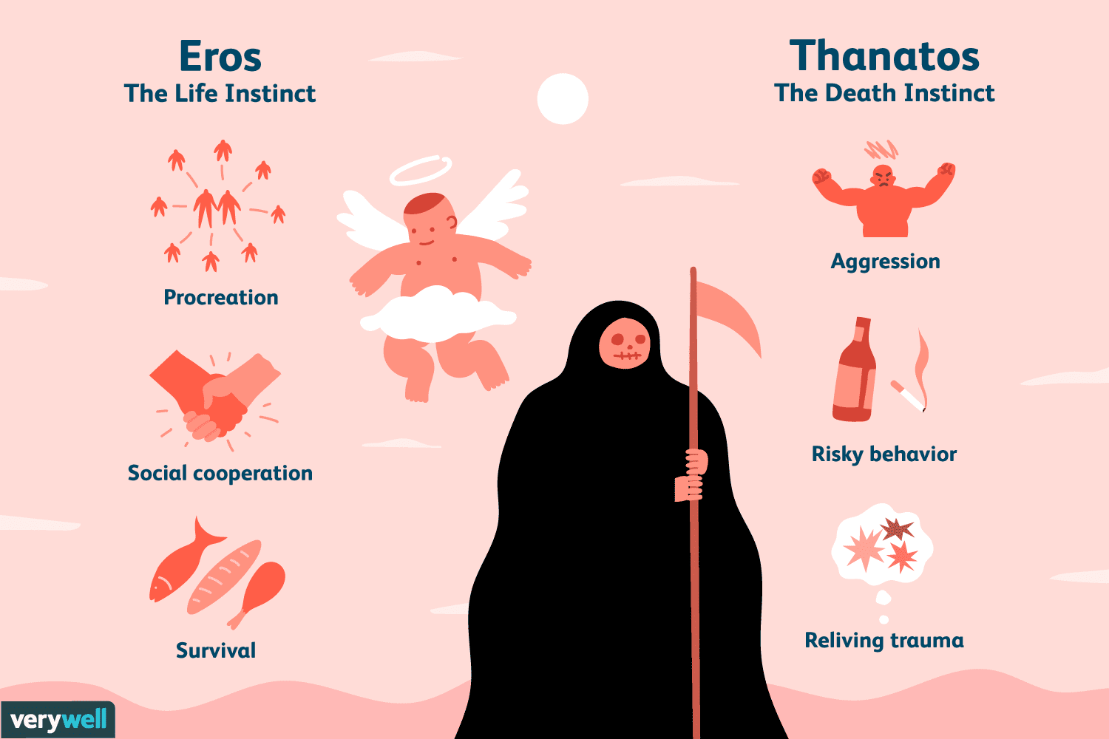

Slide 19
Life Instincts (Eros)
Sometimes referred to as sexual instincts, the life instincts are those which deal with basic survival, pleasure, and reproduction. These instincts are essential for sustaining the life of the individual as well as the continuation of the species.

Slide 20
Death Instincts (Thanatos)
The concept of the death instincts was initially described in Beyond the Pleasure Principle, in which Freud proposed that “the goal of all life is death.” Freud believed that people typically channel their death instincts outwards. Aggression, for example, arises from the death instincts. Sometimes these instincts towards destruction can be directed inwards, however, which can result in self-harm or suicide.

Slide 21
THE DRIVING FORCES OF PERSONALITY TWO POWERFUL BIOLOGICAL INSTINCTS:
EROS (LIFE) AND THANATOS (DEATH)
positive, life-sustaining: destructive:
eating, sex, respiration, aggression,
body needs masochism
(pleasure from pain suffering)

Slide 22
The Structure of Personality/Psychic Triad
ID — basic need -The Demanding Child
  Ruled by the pleasure principle. It which brings happiness
EGO — The Traffic Cop – consciousness
  Ruled by the reality principle
SUPEREGO — The Judge – social conscience
  Ruled by the moral principle
  Culture and family restrictions
Notes:
22

Slide 23
The Structure of Personality/Psychic Triad
ID
EGO
Super Ego

Slide 24
Structural Theory of Mind
Superego Perfection principle; Internal censor;
Conscience; “Ought nots”, “Should nots”;
Judgmental. Internalized standards, guilt.
Ego Reality principle; Seeks realistic and
acceptable ways to satisfy the Id (delaying,
planning, modifying impulse); Deliberate,
conscious, rational.
Id Pleasure principle; Passions, instincts,
emotions, wants; Seeks immediate
gratification; Impulsive. Primary, inborn,
unconscious.

Slide 25



ID
EGO
SUPEREGO

Slide 26
The Id
The id is the only component of personality that is present from birth. This aspect of personality is entirely unconscious and includes of the instinctive and primitive behaviors. According to Freud, the id is the source of all psychic energy, making it the primary component of personality.
The Ego
The ego is the component of personality that is responsible for dealing with reality. According to Freud, the ego develops from the id and ensures that the impulses of the id can be expressed in a manner acceptable in the real world. The ego functions in both the conscious , preconscious , and unconscious Mind.
The ego operates based on the reality principle , which strives to satisfy the id's desires in realistic and socially appropriate ways. The reality principle weighs the costs and benefits of an action before deciding to act upon or abandon impulses. In many cases, the id's impulses can be satisfied through a process of delayed gratification--the ego will eventually allow the behavior, but only in the appropriate time and place.
The ego also discharges tension created by unmet impulses through the secondary process , in which the ego tries to find an object in the real world that matches the mental image created by the id's primary process.
The Superego
The last component of personality to develop is the superego. The superego is the aspect of personality that holds all of our internalized moral standards and ideals that we acquire from both parents and society--our sense of right and wrong. The superego provides guidelines for making judgments. According to Freud, the superego begins to emerge at around age of five.

Slide 27
The Interaction of the Id, Ego and Superego
According to Freud, the key to a healthy personality is a balance between the id, the ego, and the superego.
With so many competing forces, it is easy to see how conflict might arise between the id, ego and superego. Freud used the term ego strength to refer to the ego's ability to function despite these dueling forces. A person with good ego strength is able to effectively manage these pressures, while those with too much or too little ego strength can become too unyielding or too disrupting.

Slide 28
The ego ideal includes the rules and standards for good behaviors. These behaviors include those which are approved of by parental and other authority figures. Obeying these rules leads to feelings of pride, value and accomplishment.
The conscience includes information about things that are viewed as bad by parents and society. These behaviors are often forbidden and lead to bad consequences, punishments or feelings of guilt and remorse.
The superego acts to perfect and civilize our behavior. It works to suppress all unacceptable urges of the id and struggles to make the ego act upon idealistic standards rather that upon realistic principles. The superego is present in the conscious, preconscious and unconscious.

Slide 29
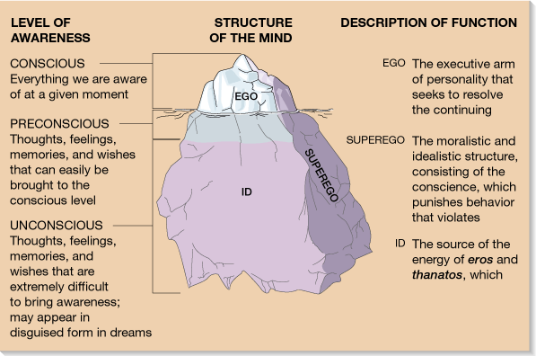

Slide 30
PSYCHOSEXUAL STAGES OF DEVELOPMENT
Five Stages of Development
    Oral Stage (0- 1.5 yrs)
    Anal Stage (1.5- 3 yrs)
    Phallic Stage (3 - 5 yrs)
    Latency Period (5 - puberty)
    Genital Stage (puberty(11-13 ) onwards)

Slide 31
If these psychosexual stages are completed successfully, the result is a healthy personality. If certain issues are not resolved at the appropriate stage, fixation can occur. A fixation is a persistent focus on an earlier psychosexual stage. Until this conflict is resolved, the individual will remain "stuck" in this stage. For example, a person who is fixated at the oral stage may be over-dependent on others and may seek oral stimulation through smoking, drinking, or eating.

Slide 32
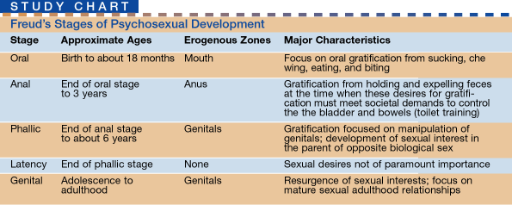

Slide 33
ORAL STAGE : BIRTH TO 1.5 YEAR
Erogenous zone in focus - mouth
Gratifying activities:
Interaction with environment: mother's breast is not only is the source of food – represents her love and care and feeling of safety. Satisfy drive of hunger and thirst by breast or bottle
Insufficient and forceful feeding----oral fixation
If fixated after weaned:
Over Dependency
Over Attachment

Slide 34
Symptoms of oral fixation---- smoking, constant chewing of gums, pens, pencils, nail biting, overeating, drinking, sarcasm (the biting personality)
Excessive optimism and pessimism, demandingness, envy and jealousy.
Successful resolution-----trust on others, self reliance and self trust.

Slide 35
Erogenous Zone: Mouth
During the oral stage, the infant's primary source of interaction occurs through the mouth, so the rooting and sucking reflex is especially important. The mouth is vital for eating, and the infant derives pleasure from oral stimulation through gratifying activities such as tasting and sucking. Because the infant is entirely dependent upon caretakers (who are responsible for feeding the child), the infant also develops a sense of trust and comfort through this oral stimulation. The primary conflict at this stage is the weaning process--the child must become less dependent upon caretakers. If fixation occurs at this stage, Freud believed the individual would have issues with dependency or aggression. Oral fixation can result in problems with drinking, eating, smoking or nail biting.

Slide 36
ANAL STAGE: 1.5 - 3 YEARS
Erogenous zone in focus: Anus
Gratifying activities:
Interaction with the environment.
Neuromuscular Control: Pleasure of reducing tension by defecating & urinating (Id)
control over sphincters
Toilet training – get superego to impose societal norms
  Self-control
  Freedom of action
  Objectives – attempts to achieve autonomy and independence

Slide 37
Anal fixation—
anal expulsive personality - unclean
anal retentive personality – very clean
Anal erotism.
Anal sadism.
Successful resolution---
personal autonomy
independence
initiative
cooperation

Slide 38
Erogenous Zone: Bowel and Bladder Control
During the anal stage, Freud believed that the primary focus of the libido was on controlling bladder and bowel movements. The major conflict at this stage is toilet training--the child has to learn to control his or her bodily needs. Developing this control leads to a sense of accomplishment and independence. According to Freud, success at this stage is dependent upon the way in which parents approach toilet training. Parents who utilize praise and rewards for using the toilet at the appropriate time encourage positive outcomes and help children feel capable and productive. Freud believed that positive experiences during this stage served as the basis for people to become competent, productive and creative adults. However, not all parents provide the support and encouragement that children need during this stage.

Slide 39
Some parents' instead punish, ridicule or shame a child for accidents. According to Freud, inappropriate parental responses can result in negative outcomes. If parents take an approach that is too lenient, Freud suggested that an anal-expulsive personality could develop in which the individual has a messy, wasteful or destructive personality. If parents are too strict or begin toilet training too early, Freud believed that an anal-retentive personality develops in which the individual is stringent, orderly, rigid and obsessive.

Slide 40
PHALLIC STAGE: 3 – 6 YEARS
Erogenous zone in focus: genital
Gratifying activities: masturbation and genital fondling.
Interaction with environment -- attraction with opposite sex parent and envy and fear of same sex parent.
Oedipus Complex
Electra complex
Emerging gender identity
Phallic fixation—
Boys ---anxiety and guilt feelings about sex, fear of castration, narcissism.
Girls ---envy and inferioritys

Slide 41
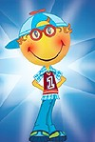

OEDIPUS COMPLEX:
(castration anxiety)
ELECTRA COMPLEX:
(Penis envy)

Slide 42
During the phallic stage, the primary focus of the libido is on the genitals. At this age, children also begin to discover the differences between males and females.
Freud also believed that boys begin to view their fathers as a rival for the mother’s affections. The Oedipus complex describes these feelings of wanting to possess the mother and the desire to replace the father. However, the child also fears that he will be punished by the father for these feelings, a fear Freud termed castration anxiety.

Slide 43
The term Electra complex has been used to described a similar set of feelings experienced by young girls. Freud, however, believed that girls instead experience penis envy. Eventually, the child begins to identify with the same-sex parent as a means of vicariously possessing the other parent. For girls, however, Freud believed that penis envy was never fully resolved and that all women remain somewhat fixated on this stage. Psychologists such as Karen Horney disputed this theory, calling it both inaccurate and demeaning to women. Instead, Horney proposed that men experience feelings of inferiority because they cannot give birth to children.

Slide 44
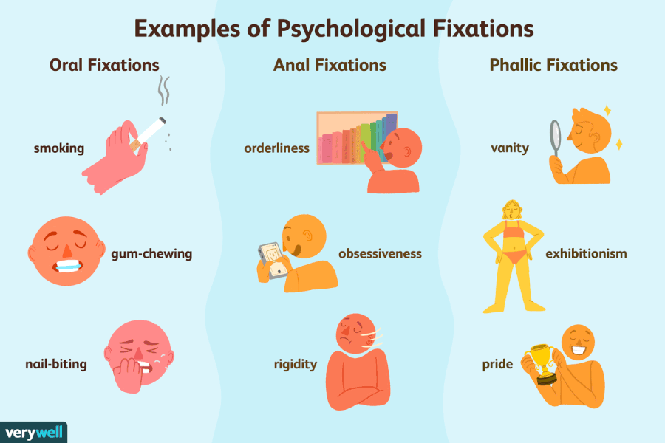

Slide 45
LATENCY PERIOD: 5-11 YEARS OF AGE
No erogenous zones
Time between resolution of Oedipus complex and puberty (superego)
Interaction with environment---
-focus on other aspects of life, mastery of skills
-time for learning and adjusting to social environment (school)
-same sex friendship,
-sports

Slide 46
Erogenous Zone: Sexual Feelings Are Inactive
During the latent period, the libido interests are suppressed. The development of the ego and superego contribute to this period of calm. The stage begins around the time that children enter into school and become more concerned with peer relationships, hobbies and other interests. The latent period is a time of exploration in which the sexual energy is still present, but it is directed into other areas such as intellectual pursuits and social interactions. This stage is important in the development of social and communication skills and self-confidence.

Slide 47
GENITAL STAGE - ADOLESCENCE (11-13YRS)
TO ADULTHOOD
Erogenous zone in focus: Genital.
Gratifying activities:
Divided into – preadolescent, early adolescent. middle, late, post adolescent periods
Renewed sexual interest and desire, Normal sexual relations, Marriage, Child-rearing
Separation from parents, Mature sense of personal identity
Social and cultural interactions
No fixation

Slide 48
Erogenous Zone: Maturing Sexual Interests
During the final stage of psychosexual development, the individual develops a strong sexual interest in the opposite sex. This stage begins during puberty but last throughout the rest of a person's life. Where in earlier stages the focus was solely on individual needs, interest in the welfare of others grows during this stage. If the other stages have been completed successfully, the individual should now be well-balanced, warm and caring. The goal of this stage is to establish a balance between the various life areas.

Slide 49
Ego-Defense Mechanisms
  Are normal behaviors which operate on an unconscious level and tend to deny or distort reality
  Help the individual cope with anxiety and prevent the ego from being overwhelmed
  Have adaptive value if they do not become a style of life to avoid facing reality
Notes:
49

Slide 50
What Exactly Is EGO Defense Mechanism?
Defense mechanisms are thought to safeguard the mind against feelings and thoughts that are too difficult for the conscious mind to cope with.

Slide 51

Types of Defense Mechanisms
To protect the ego against the painful and threatening impulses arising from the id we distort the reality
The processes that distort the reality for the ego are called defense mechanisms

Slide 52
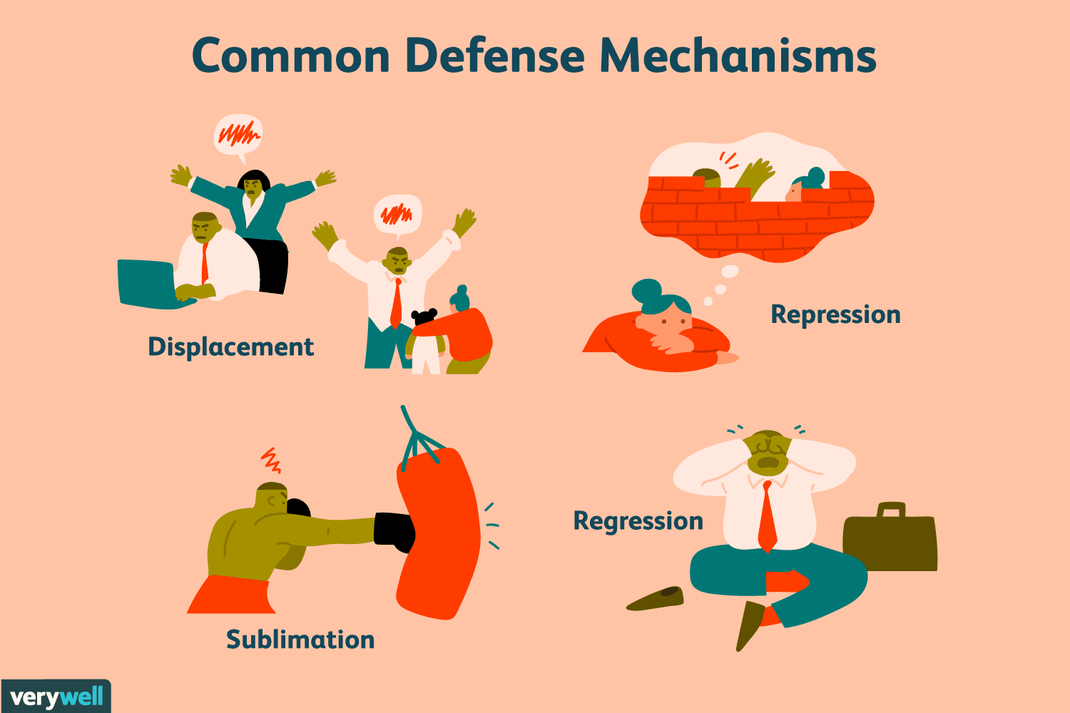

Slide 53
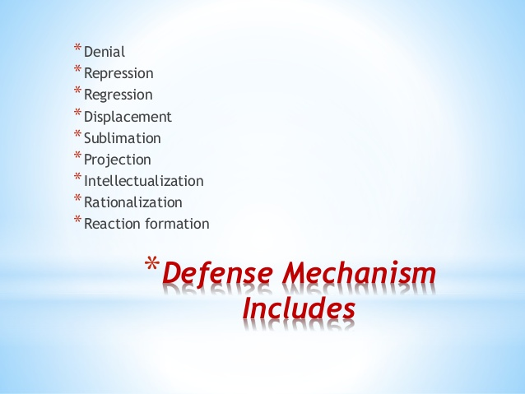

Slide 54
How Do Defense Mechanisms Work?
In Sigmund Freud's model of personality, the ego is the aspect of personality that deals with reality. While doing this, the ego also has to cope with the conflicting demands of the id and the superego.
In order to deal with anxiety, Freud believed that defense mechanisms help shield the ego from the conflicts created by the id, superego, and reality.

Slide 55
Displacement
Displacement involves taking out our frustrations, feelings, and impulses on people or objects that are less threatening.
Eg. Have you ever had a really bad day at work and then gone home and taken out your frustration with family and friends?

Slide 56
Denial
Denial is an outright refusal to admit or recognize that something has occurred or is currently occurring. People living with drug or alcohol addiction often deny that they have a problem, while victims of traumatic events may deny that the event ever occurred

Slide 57
Repression and Suppression
Repression is another well-known defense mechanism. Repression acts to keep information out of conscious awareness. However, these memories don't just disappear; they continue to influence our behavior. For example, a person who has repressed memories of abuse suffered as a child may later have difficulty forming relationships.
Sometimes we do this consciously by forcing the unwanted information out of our awareness, which is known as suppression. In most cases, however, this removal of anxiety-provoking memories from our awareness is believed to occur unconsciously.

Slide 58
Sublimation
Sublimation is a defense mechanism that allows us to act out unacceptable impulses by converting these behaviors into a more acceptable form. For example, a person experiencing extreme anger might take up kick-boxing as a means of venting frustration.
Freud believed that sublimation was a sign of maturity that allows people to function normally in socially acceptable ways.

Slide 59
Projection
Projection is a defense mechanism that involves taking our own unacceptable qualities or feelings and ascribing them to other people.﻿ For example, if you have a strong dislike for someone, you might instead believe that they do not like you. Projection works by allowing the expression of the desire or impulse, but in a way that the ego cannot recognize, therefore reducing anxiety.

Slide 60
Intellectualization
This defense mechanism allows us to avoid thinking about the stressful, emotional aspect of the situation and instead focus only on the intellectual component.
For example, a person who has just been diagnosed with a terminal illness might focus on learning everything about the disease in order to avoid distress and remain distant from the reality of the situation.

Slide 61
Rationalization
Rationalization is a defense mechanism that involves explaining an unacceptable behavior or feeling in a rational or logical manner, avoiding the true reasons for the behavior.
For example, A student might blame a poor exam score on the instructor rather than their own lack of preparation.

Slide 62
Regression
When confronted by stressful events, people sometimes abandon coping strategies and revert to patterns of behavior used earlier in development.
Behaviors associated with regression can vary greatly depending upon which stage at which the person is fixated.
According to Freud, an individual fixated at the oral stage might begin eating or smoking excessively, or might become very verbally aggressive. A fixation at the anal stage might result in excessive tidiness or messiness.

Slide 63
Reaction Formation
Reaction formation reduces anxiety by taking up the opposite feeling, impulse, or behavior.
﻿ An example of reaction formation would be treating someone you strongly dislike in an excessively friendly manner in order to hide your true feelings.

Slide 64
Other Defense Mechanisms
Acting out: Coping with stress by engaging in actions rather than acknowledging and bearing certain feelings
Aim inhibition: Accepting a modified form of their original goal (e.g., becoming a high school basketball coach rather than a professional athlete)
Altruism: Satisfying internal needs through helping others
Avoidance: Refusing to deal with or encounter unpleasant objects or situations

Slide 65
Compensation: Overachieving in one area to compensate for failures in another
Dissociation: Becoming separated or removed from one's experience
Fantasy: Avoiding reality by retreating to a safe place within one's mind
Humor: Pointing out the funny or ironic aspects of a situation
Passive-aggression: Indirectly expressing anger
Undoing: Trying to make up for what one feels are inappropriate thoughts, feelings, or behaviors (e.g., if you hurt someone's feelings, you might offer to do something nice for them in order to assuage your anxiety or guilt)

Slide 66
Contributions of Freud
First personality & psychotherapy theory
Emphasis on sexuality as influence
Importance of early childhood experience
Concept of unconscious
Animal nature of man
Scientific approach to mental health on continuum from physical health

Slide 67
LIMITATIONS OF FREUD’S WORK
Pessimistic and deterministic approach to personality
Pathology based theory
Over emphasis to infantile sexuality
No controlled studies-poor research
Overemphasis on differences between men and women
Unconcerned with interpersonal relations, individual identity and adaptation over one’s lifetime

Slide 68
Evaluating Freud’s Psychosexual Stage Theory
• The theory is focused almost entirely on male development with little mention of female psychosexual development.
• His theories are difficult to test scientifically. Concepts such as the libido are impossible to measure, and therefore cannot be tested. The research that has been conducted tends to discredit Freud's theory.
• Future predictions are too vague. How can we know that a current behavior was caused specifically by a childhood experience? The length of time between the cause and the effect is too long to assume that there is a relationship between the two variables.
• Freud's theory is based upon case studies and not empirical research. Also, Freud based his theory on the recollections of his adult patients, not on actual observation and study of children.

Slide 69
CHILD PSYCHOLOGY
Dr. Aron Arun Kumar Vasa
Professor
Dept. of Pedodontics

Slide 70
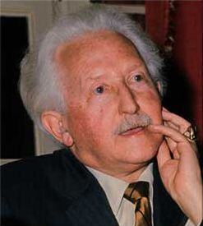
Psychosocial theory-Eric H. Erikson
Born in 1902 in Frankfurt. childhood and society in 1950)
Epigenetic principle --- development occurs in sequential, clearly defined stages and each stage must be resolved satisfactorily for development to proceed smoothly
If not ---- failure in the form of physical, cognitive, social, or emotional maladjustment
Accepted Freud's concepts
Concluded that human personality is determined not only by childhood experiences but also from those of adulthood

Slide 71
Erikson's Theory
Erik Erikson (1902–1994) was a stage theorist who took Freud's controversial theory of psychosexual development and modified it as a psychosocial theory. Erikson emphasized that the ego makes positive contributions to development by mastering attitudes, ideas, and skills at each stage of development.

Slide 72
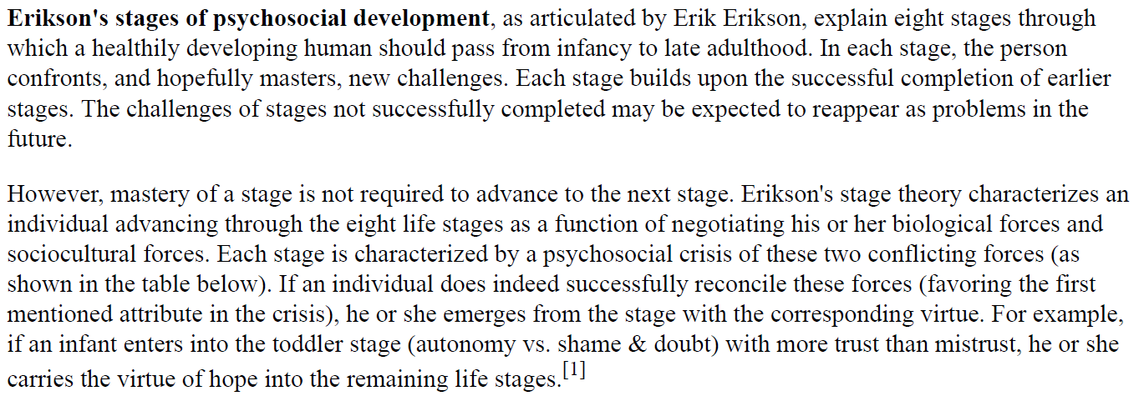

Slide 73
ERIKSON'S STAGES (CRISES) OUTCOME
AGE (yrs) + -
0 - 1 Basic trust vs. mistrust
1 - 3 Autonomy vs. shame and doubt
3 - 5 Initiative vs. guilt
6 - 11 Industry vs. inferiority
Adolescence Identity vs. role confusion
(11-21)
Young (21-40) Intimacy vs. isolation
adulthood
Middle (40-65) Generativity vs. stagnation
adulthood
Old age(>65) Ego integrity vs. despair

Slide 74
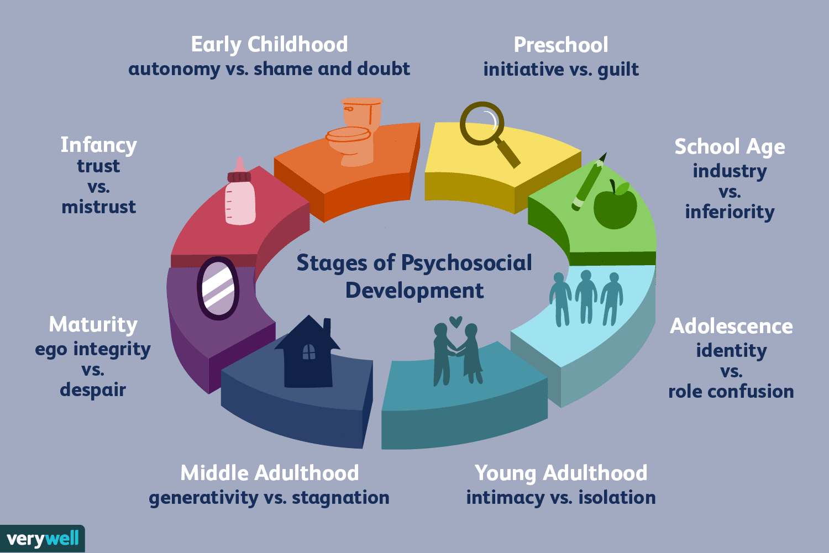

Slide 75
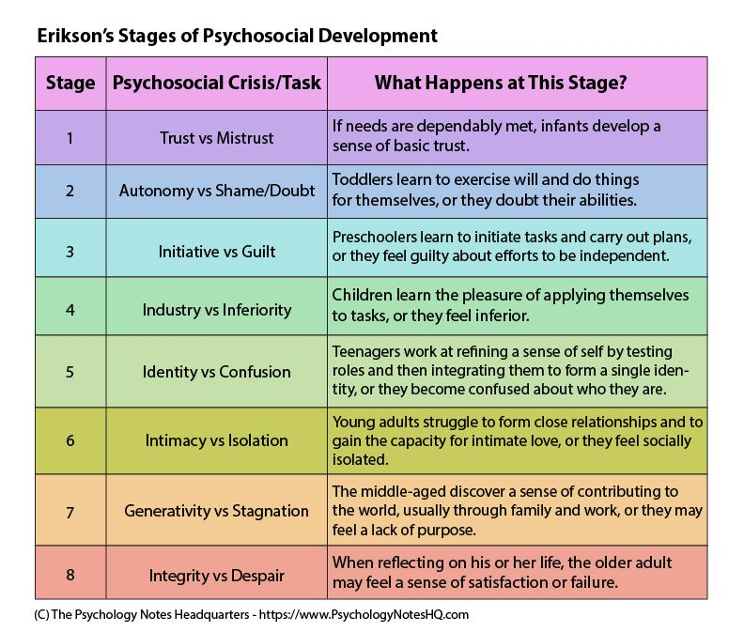

Slide 76
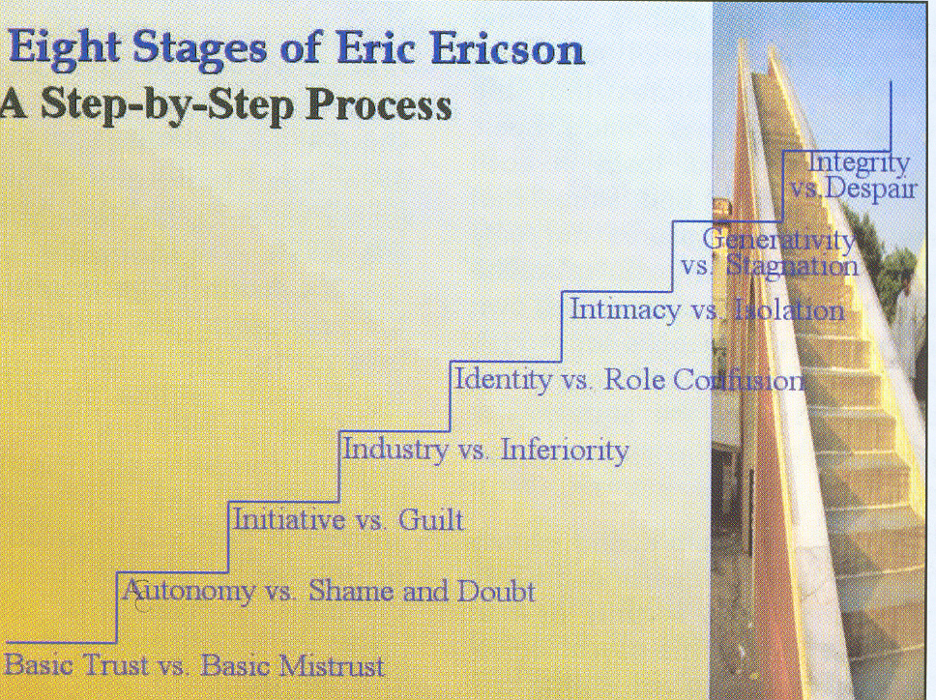

Slide 77
Stage 1 - Basic Trust vs. Mistrust (0-1yrs)
Crisis: Trust vs Mistrust
Discription: infants depends upon mother or caregivers
Dependency on mother --Developing trust is the first task of the ego
+ outcome ---secure attachment with parents and environment
The child will let mother out of sight without anxiety and rage because she has become an inner certainty as well as an outer predictability.

Slide 78
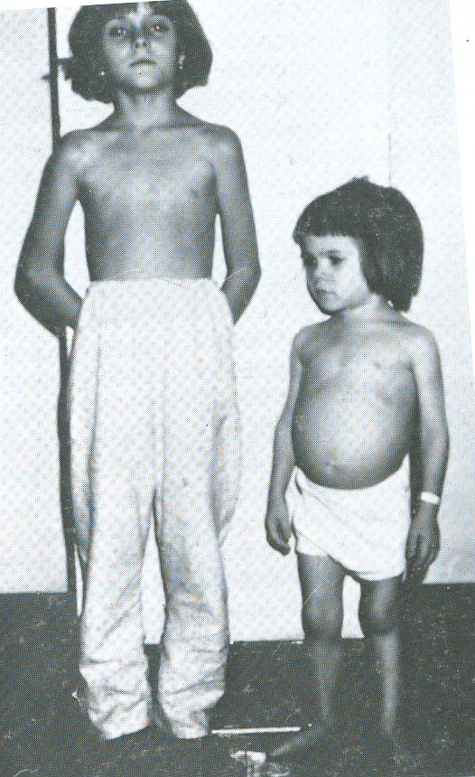
maternal deprivation syndrome
-^{ve} outcome--- inattentive mother
maternal deprivation syndrome
increased separation anxiety
The balance of trust with mistrust depends largely on the quality of maternal relationship
Both girls are of age 7 yrs

Slide 79
Stage 2 - Autonomy vs. Shame and Doubt (1-3yrs)
Crisis: autonomy vs doubt
Discription: Toddler learns to talk, walk, use toilets (control over sphincters) and do things for themselves ---self control, confidence
Positive outcome: Reassurance develops confidence
Negative outcome: If denied autonomy the child will turn angry and shamed

Slide 80
Parental over control---muscular and anal impotence—doubt
Shame develops with the child's self-consciousness.
Terrible two And troublesome three
Dental visit – make him feel more important, let mother be with

Slide 81

Stage 3 - Initiative vs. Guilt (3-6yrs)
Crisis: initiative vs guilt.
Description: Initiate motor and intellectual activities, quality of undertaking, planning, and attacking a task for the sake of being active and on the move.
Depends on how much freedom child will get & intellectual curiosity is satisfied
Play with peers and learn to interact with environment

Slide 82
Feels guilt over the goals contemplated, feels unable to be independent
Develops sibling rivalry
The castration complex occurring in this stage is due to the child's erotic fantasies.
Dental visit- more curious about dentist’s office, they will tolerate being separated from mother

Slide 83

Stage 4 - Industry vs. Inferiority (6-11yrs)
School ---- organized program of learning, ability to work and acquire skills
The fundamentals of technology are developed – learn the pleasure of work completion and pride of doing well
To lose the hope of such "industrious" association may pull the child back to the more isolated, less conscious, inferiority --- if discriminated, compared in schools

Slide 84
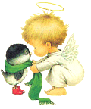
Dental visit – easy to treat, try to please dentist and parents
Peer group influence

Slide 85

Stage 5 - Identity vs. Role Confusion (or "Diffusion") (12-21yrs)
Who am I ? --- to answer - healthy resolution of earlier conflicts
The adolescent is newly concerned with how they appear to others.
Ego identity ( confidence that the inner sameness and continuity) as evidenced in the promise of a career.
Imaginary Audiance

Slide 86
Preoccupation with appearance hero worship and ideology
If not adolescent sink into confusion ,inability to make decision & choices, settle on a school or occupational identity is disturbing.
Most orthodontic treatment carried out in this age – more conscious about appearance

Slide 87
Stage 6 - Intimacy vs. Isolation (21-40yrs)
Crisis: intimacy vs isolation.
Discription:To love and to work.
Involved in intense and long term relations
The avoidance of these experiences leads to isolation and self-absorption.
Now true genitality can fully develop.

Slide 88
Negative outcome:The counterpart of intimacy is distantiation, which is the readiness to isolate and destroy forces and people whose essence seems dangerous to one's own.
Inability to develop identity---fear a committed relationship
The danger at this stage is isolation which can lead to severe character problems.

Slide 89
Stage 7 - Generativity vs. Stagnation (40-65yrs)
Generativity is the concern in establishing and guiding the next generation. Fruitful parenting
Look outside oneself & care for others
Simply having or wanting children doesn't achieve Generativity.
Adults need children as much as children need adults.

Slide 90

Socially-valued work and disciples are also expressions of Generativity.
If not --- self concern, isolation absence of intimacy

Slide 91
Stage 8 - Ego Integrity vs. Despair(>65yrs)
Ego integrity is the ego's accumulated assurance of its capacity for order and meaning. It is the sense of satisfaction
Despair is a loss of hope producing misanthropy and disgust ---- signified by a fear of one's own death, as well as the loss of self-sufficiency, and of loved partners and friends.
Healthy children, Erikson tells us, won't fear life if their elders have integrity enough not to fear death.

Slide 92
Differences B/W Psychosexual & Psychosocial Theories
Freud | Proposed by | Erikson
Evil | Nature of the child | Good
Nature/ culture | Driving force of development | Nurture
Passive | The child's role in development | Active explore
5 stages (psychosexual) | Course of development | 8 stages
Parents | Important agents | Multiple agents (parents, peers, teachers, friends, lovers, spouses)
0 to adolescence | Developmental scenario | Life span

Slide 93
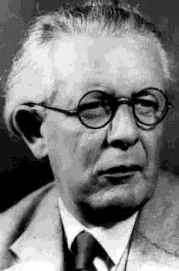
Cognitive Theory – Jean Piaget (1896-1980)
Genetic epistemology – study of acquisition, modification & abstract ideas and abilities.
Intelligence is the ability to adapt to the environment
Cognitive development occurs in a series of stages ---epigenesis

Slide 94
Jean Piaget
Piaget was born in Switzerland in the late 1800s and was a precocious student, publishing his first scientific paper when he was just 11 years old. His early exposure to the intellectual development of children came when he worked as an assistant to Alfred Binet and Theodore Simon as they worked to standardize their famous IQ test.

Slide 95
Jean Piaget
Much of Piaget's interest in the cognitive development of children was inspired by his observations of his own nephew and daughter. These observations reinforced his budding hypothesis that children's minds were not merely smaller versions of adult minds.
Up until this point in history, children were largely treated simply as smaller versions of adults. Piaget was one of the first to identify that the way that children think is different from the way adults think.

Slide 96
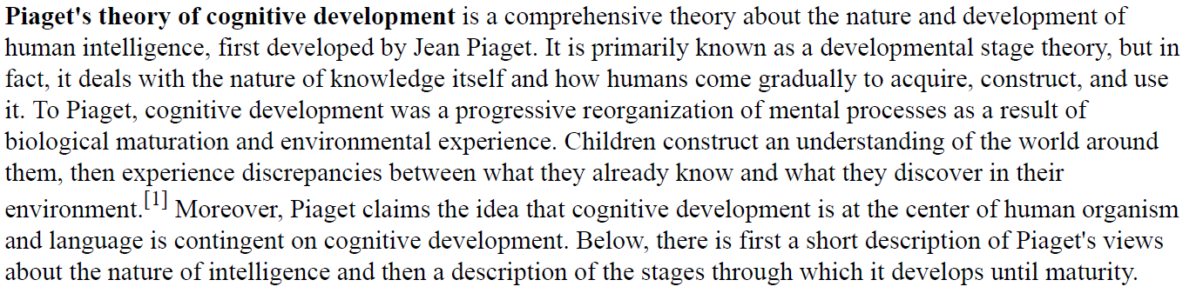

Slide 97

Cognitive organization or adaptation occurs through –
1. assimilation
2. accommodation
Assimilation -- people take in new experiences through their own system of knowledge, a process comparable to eating and digesting food, which then becomes part of life.
cognitive structures -- a classification for sensations and perception
Ex. All flying objects are birds

Slide 98
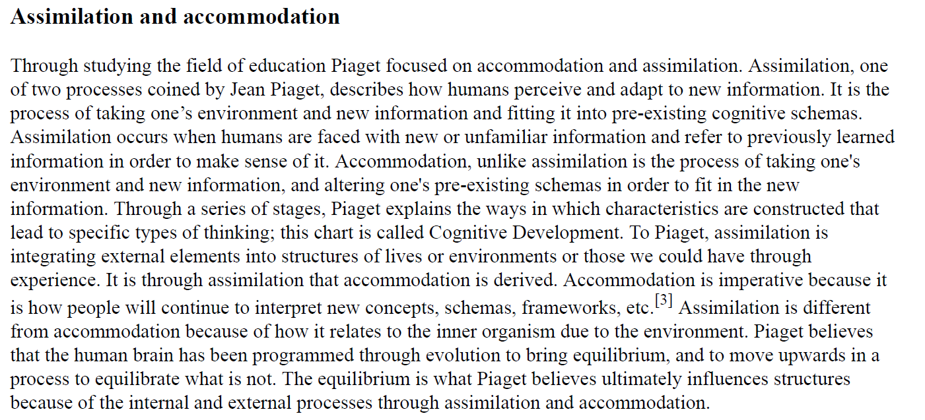

Slide 99
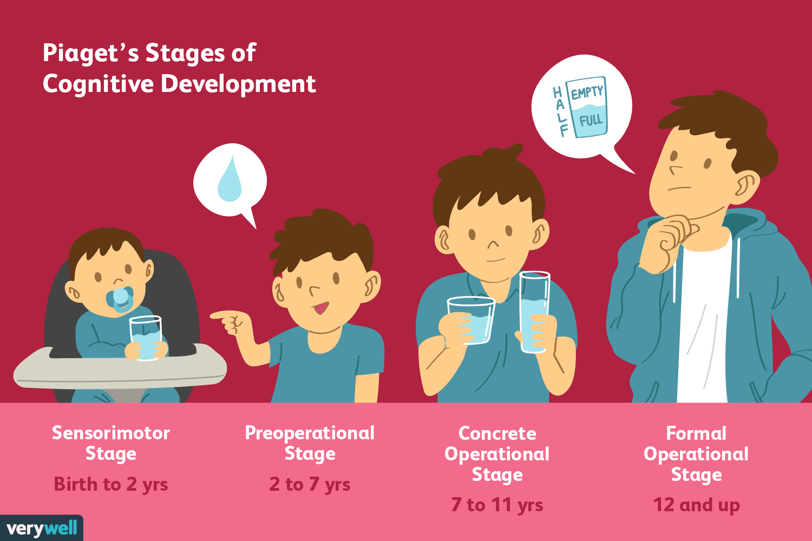

Slide 100

STAGES OF COGNITIVE DEVELOPMENT
Sensorimotor stage – 0-2yrs
Preoperational stage – 2-7yrs
Concrete operational stage – 7-11yrs
Formal operational stage – beyond 11yrs

Slide 101
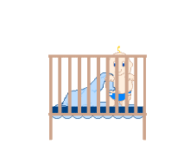
Sensorimotor stage – 0-2yrs
develops rudimentary concepts of objects - objects in the environment are permanent; do not disappear when the child is not looking at them.
Simple modes of thought that are the foundation of language development
Communication between a child at this stage and an adult is extremely limited because of the child’s simple concepts and lack of language capabilities.
Little ability to interpret sensory data and a limited ability to project forward or backward in time.

Slide 102
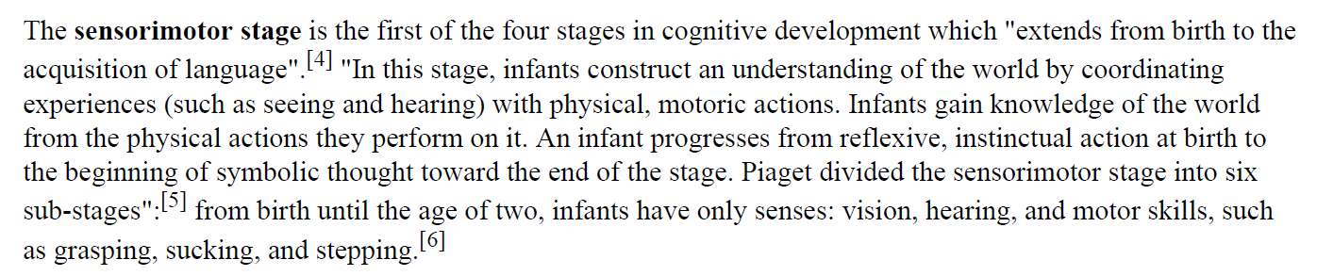

Slide 103

Preoperational stage – 2-7yrs
Good language development
capacity to form mental symbols – represent things and events not present, children learn to use words to symbolize these absent objects.
understand the world in the way they sense it through 5 primary senses. Concepts - not seen, heard, smelt, tasted or felt – ex. Time and health are difficult for these children to grasp

Slide 104
Egocentrism -- child is incapable of assuming another person’s point of view, make them feel more important
Centering – giving mirror to observe
Animism -- investing inanimate objects with life. symbolic fantasy, play and language
Animism can be used to the dental team’s advantage by giving dental instruments and equipment life –like names and qualities.
Constructivism – child acquires reality by touching, exploring, observing---TSD
Cognitive equilibrium – answer to questions asked,

Slide 105
Conservation
Reversibility
Conservation of Length (6-7 years)
Conservation of Liquids

Slide 106
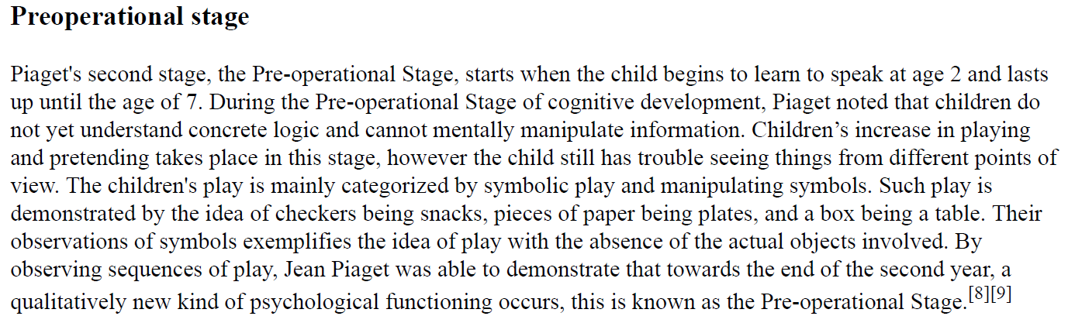

Slide 107

Stage of concrete operations -7-11yrs
Good answering capacity
Decline of egocentrism
Decline of animism
Much more like adults but not
Easy to treat

Slide 108
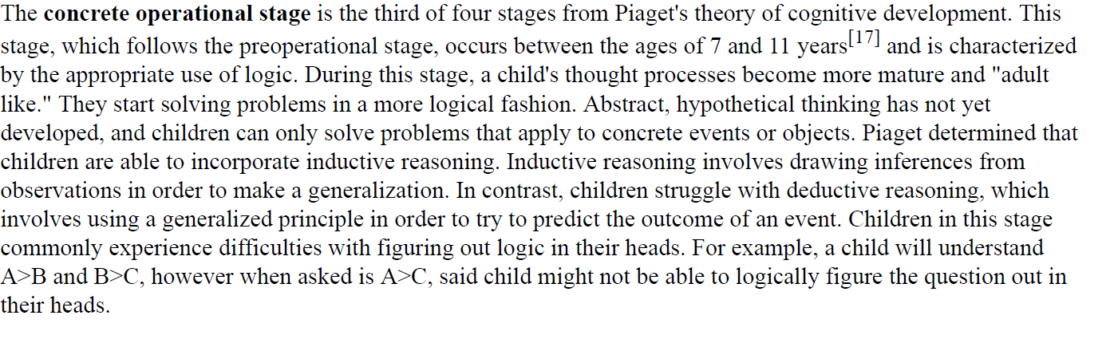

Slide 109

Period of formal operations – 11yrs & above
Good communication skill
Should be treated as adult
Concept of imaginary audience (Elkind) – constantly on stage
Personal fable – uniqueness makes a patient ignore threats to health
Easy to treat if interested

Slide 110
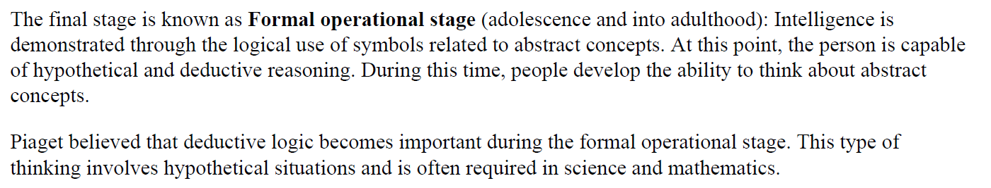

Slide 111
CHILD PSYCHOLOGY
Dr. Aron Arun Kumar Vasa
Professor
Dept. of Pedodontics

Slide 112

Theories proposed on Child Psychology
Psychodynamic theories
-psychosexual theory --- Freud -1905
-psychosocial theory ---Eric Erikson1963
-cognitive theory ---Piaget – 1952
Behavioral theories
-classical conditioning --- Pavlov - 1927
-operant conditioning --- Skinner – 1938
-social learning theory --- Bandura – 1954
-hierarchy of needs --- Maslow - 1963
Miscellaneous theories
-separation & individualization --- M Mahler
-attachment theory --- J Bowlby
-childrenese --- H Ginnott

Slide 113
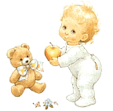
BEHAVIORAL LEARNINGTHEORY
Learning :--Relatively permanent change in the behavior that occurs as a result of experience.
Behavior is the result of an interaction between innate or instincts and learning after birth.

Slide 114
Behaviourism / Behavioural Psychology
Behaviourism, also known as behavioural psychology, is a theory of learning based on the idea that all behaviours are acquired through conditioning. Conditioning occurs through interaction with the environment. Behaviourists believe that our responses to environmental stimuli shape our actions.

Slide 115
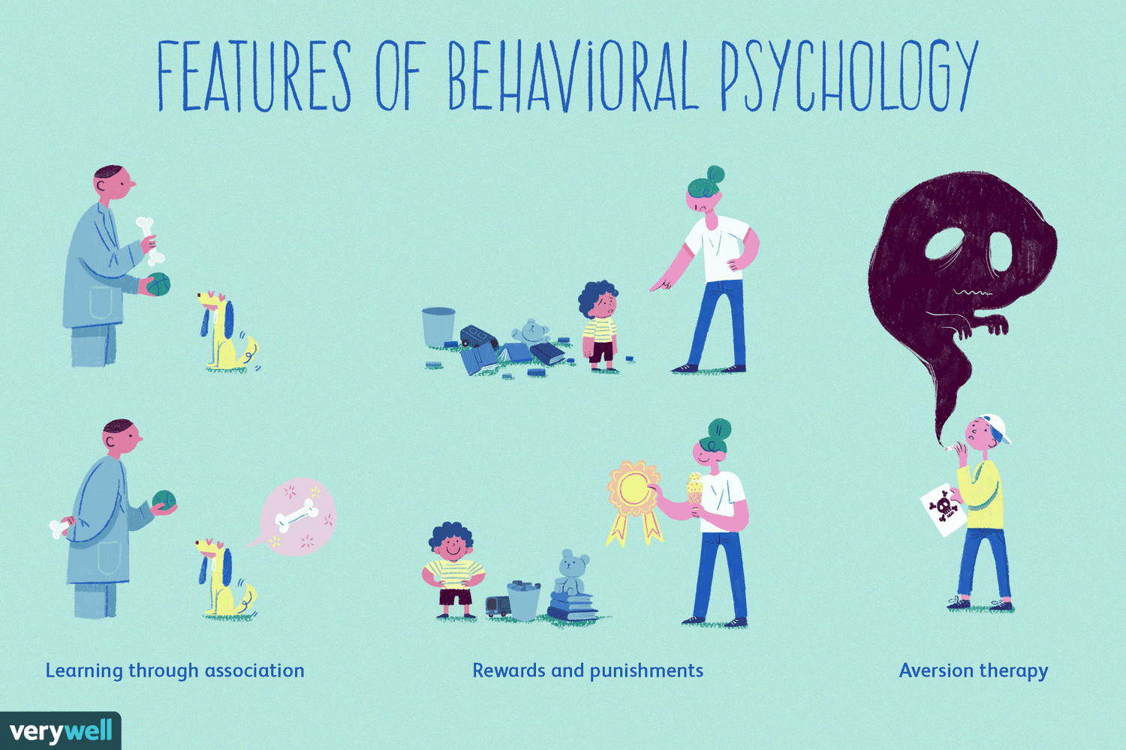

Slide 116
Behaviourism / Behavioural Psychology
Strengths
Focuses on observable, measurable behaviours
Scientific and replicable
Useful for modifying behaviours in the real-world
Useful applications in therapy, education, parenting, child care
Weaknesses
Does not account for biological influences
Does not consider moods, thoughts, or feelings
Does not explain all learning

Slide 117
Behaviourism / Behavioural Psychology
One of the major benefits of behaviorism is that it allowed researchers to investigate observable behavior in a scientific and systematic manner. However, many thinkers believed it fell short by neglecting some important influences on behavior.

Slide 118
Behaviourism / Behavioural Psychology
Freud, for example, felt that behaviorism failed by not accounting for the unconscious mind's thoughts, feelings, and desires that influence people's actions. Other thinkers, such as Carl Rogers and the other humanistic psychologists, believed that behaviorism was too rigid and limited, failing to take into consideration personal agency.

Slide 119
Behaviourism / Behavioural Psychology
More recently, biological psychology has emphasized the power of the brain and genetics play in determining and influencing human actions.
The cognitive approach to psychology focuses on mental processes such as thinking, decision-making, language, and problem-solving.
In both cases, behaviourism neglects these processes and influences in favour of studying just observable behaviours.

Slide 120
Classical conditioning - Ivan Pavlov
Stimulus Response Theory - SR Theory
Classical conditioning operates by a simple process of association of one stimulus with other---learning by association
Experiment---Presentation of food to a hungry dog

Slide 121
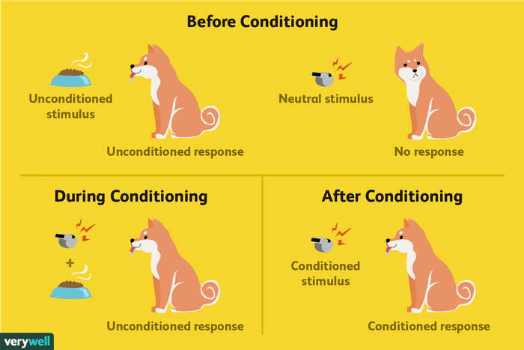

Slide 122
Classical Conditioning
It's important to note that classical conditioning involves placing a neutral signal before a naturally occurring reflex. In Pavlov's classic experiment with dogs, the neutral signal was the sound of a tone and the naturally occurring reflex was salivating in response to food. By associating the neutral stimulus with the environmental stimulus (presenting of food), the sound of the tone alone could produce the salivation response.

Slide 123
How Does Classical Conditioning Work?
Classical conditioning basically involves forming an association between two stimuli resulting in a learned response. There are three basic phases of this process
Phase 1: Before Conditioning
Phase 2: During Conditioning
Phase 3: After Conditioning

Slide 124
Phase 1: Before Conditioning
The first part of the classical conditioning process requires a naturally occurring stimulus that will automatically elicit a response. Salivating in response to the smell of food is a good example of a naturally occurring stimulus.
During this phase of the processes, the unconditioned stimulus (UCS) results in an unconditioned response (UCR).﻿﻿ For example, presenting food (the UCS) naturally and automatically triggers a salivation response (the UCR).
At this point, there is also a neutral stimulus that produces no effect - yet. It isn't until this neutral stimulus is paired with the UCS that it will come to evoke a response.
Let's take a closer look at the two critical components of this phase of classical conditioning.

Slide 125
Phase 1: Before Conditioning
The unconditioned stimulus is one that unconditionally, naturally, and automatically triggers a response.
﻿﻿ For example, when you smell one of your favorite foods, you may immediately feel very hungry. In this example, the smell of the food is the unconditioned stimulus.
The unconditioned response is the unlearned response that occurs naturally in response to the unconditioned stimulus.﻿ In our example, the feeling of hunger in response to the smell of food is the unconditioned response.

Slide 126

Phase 1: Before Conditioning

Slide 127
Phase 2: During Conditioning
During the second phase of the classical conditioning process, the previously neutral stimulus is repeatedly paired with the unconditioned stimulus. As a result of this pairing, an association between the previously neutral stimulus and the UCS is formed. At this point, the once neutral stimulus becomes known as the conditioned stimulus (CS). The subject has now been conditioned to respond to this stimulus.

Slide 128
Phase 2: During Conditioning
The conditioned stimulus is previously neutral stimulus that, after becoming associated with the unconditioned stimulus, eventually comes to trigger a conditioned response.﻿﻿ In our earlier example, suppose that when you smelled your favorite food, you also heard the sound of a whistle. While the whistle is unrelated to the smell of the food, if the sound of the whistle was paired multiple times with the smell, the sound would eventually trigger the conditioned response. In this case, the sound of the whistle is the conditioned stimulus.

Slide 129

Phase 2: During Conditioning

Slide 130
Phase 3: After Conditioning
Once the association has been made between the UCS and the CS, presenting the conditioned stimulus alone will come to evoke a response even without the unconditioned stimulus. The resulting response is known as the conditioned response (CR).
The conditioned response is the learned response to the previously neutral stimulus. In our example, the conditioned response would be feeling hungry when you heard the sound of the whistle.

Slide 131

Phase 3: After Conditioning

Slide 132
1. Neutral stimulus (NS-Bell)
2. Unconditional stimulus (US-Food)
3.Unconditional response (UR-Salivation)
4. Conditional stimulus (CS)
5. Conditional response (CR)

Slide 133
Key Principles of Classical Conditioning
Behaviourists have described a number of different phenomena associated with classical conditioning. Some of these elements involve the initial establishment of the response while others describe the disappearance of a response. These elements are important in understanding the classical conditioning process.
Five key principles of classical conditioning:

Slide 134
Five key principles of classical conditioning
1. Acquisition
2. Extinction
3. Spontaneous Recovery
4. Stimulus Generalization
5. Stimulus Discrimination

Slide 135
1. Acquisition
Acquisition is the initial stage of learning when a response is first established and gradually strengthened.
﻿﻿ During the acquisition phase of classical conditioning, a neutral stimulus is repeatedly paired with an unconditioned stimulus.
After an association is made, the subject will begin to emit a behaviour in response to the previously neutral stimulus, which is now known as a conditioned stimulus.
It is at this point that we can say that the response has been acquired.

Slide 136
2. Extinction
Extinction is when the occurrences of a conditioned response decreases or disappears. In classical conditioning, this happens when a conditioned stimulus is no longer paired with an unconditioned stimulus.

Slide 137



Extinction
Before extinction
Extinction process
After extinction

Slide 138
3. Spontaneous Recovery
Sometimes a learned response can suddenly re-emerge even after a period of extinction. Spontaneous recovery is the reappearance of the conditioned response after a rest period or period of lessened response.
For example, imagine that after training a dog to salivate to the sound of a bell, you stop reinforcing the behaviour and the response eventually becomes extinct.

Slide 139
3. Spontaneous Recovery
After a rest period during which the conditioned stimulus is not presented, you suddenly ring the bell and the animal spontaneously recovers the previously learned response.
If the conditioned stimulus and unconditioned stimulus are no longer associated, extinction will occur very rapidly after a spontaneous recovery.

Slide 140
4. Stimulus Generalization
Stimulus generalization is the tendency for the conditioned stimulus to evoke similar responses after the response has been conditioned.
For example, if a dog has been conditioned to salivate at the sound of a bell, the animal may also exhibit the same response to stimuli that are similar to the conditioned stimulus.
In John B. Watson's famous Little Albert Experiment, for example, a small child was conditioned to fear a white rat. The child demonstrated stimulus generalization by also exhibiting fear in response to other fuzzy white objects including stuffed toys and Watson own hair.

Slide 141

Stimulus generalization

Slide 142
5. Stimulus Discrimination
Discrimination is the ability to differentiate between a conditioned stimulus and other stimuli that have not been paired with an unconditioned stimulus.
For example, if a bell tone were the conditioned stimulus, discrimination would involve being able to tell the difference between the bell tone and other similar sounds. Because the subject is able to distinguish between these stimuli, he or she will only respond when the conditioned stimulus is presented.

Slide 143
Classical Conditioning Examples
It can be helpful to look at a few examples of how the classical conditioning process operates both in experimental and real-world settings.
One of the most famous examples of classical conditioning was John B. Watson's experiment in which a fear response was conditioned in a boy known as Little Albert.﻿﻿ The child initially showed no fear of a white rat, but after the rat was paired repeatedly with loud, scary sounds, the child would cry when the rat was present. The child's fear also generalized to other fuzzy white objects.

Slide 144
Classical Conditioning Examples
Let's examine the elements of this classic experiment. Prior to the conditioning, the white rat was a neutral stimulus. The unconditioned stimulus was the loud, clanging sounds and the unconditioned response was the fear response created by the noise. By repeatedly pairing the rat with the unconditioned stimulus, the white rat (now the conditioned stimulus) came to evoke the fear response (now the conditioned response).

Slide 145
Classical Conditioning Examples
This experiment illustrates how phobias can form through classical conditioning. In many cases, a single pairing of a neutral stimulus (a dog, for example) and a frightening experience (being bitten by the dog) can lead to a lasting phobia (being afraid of dogs).

Slide 146
The Dental PHOBIA
First visit
white coat pain of injection
(neutral stimulus) (unconditioned stimulus)
pain of injection fear and crying
(unconditioned stimulus) (response)
Second visit
sight of white coat pain of injection
(conditioned stimulus) (uncond. stimulus)
pain of injection fear and crying
(unconditioned stimulus) (response)

Slide 147
Conditioned by previous physician visit
Generalization of dental clinic and physician’s office
Reinforcement --- repeated experiences
Extinction----if not repeated, occurs by discrimination
Discrimination----opposite of generalization

Slide 148
Operant conditioning: B.F Skinner
Operant conditioning is a method of learning that occurs through rewards and punishments for behaviour. Through operant conditioning, an individual makes an association between a particular behaviour and a consequence (B F Skinner, 1938).
Burrhus Frederic Skinner

Slide 149
Operant conditioning: B.F Skinner
The work of Skinner was rooted in a view that classical conditioning was far too simplistic to be a complete explanation of complex human behaviour. He believed that the best way to understand behaviour is to look at the causes of an action and its consequences. He called this approach operant conditioning.

Slide 150
Operant conditioning: B.F Skinner
Skinner is regarded as the father of Operant Conditioning, but his work was based on Thorndike’s (1898) law of effect. According to this principle, behavior that is followed by pleasant consequences is likely to be repeated, and behavior followed by unpleasant consequences is less likely to be repeated.

Slide 151
Operant conditioning: B.F Skinner
Skinner introduced a new term into the Law of Effect - Reinforcement. behavior which is reinforced tends to be repeated (i.e., strengthened); behavior which is not reinforced tends to die out-or be extinguished (i.e., weakened).

Slide 152
Operant conditioning: B.F Skinner
Skinner (1948) studied operant conditioning by conducting experiments using animals which he placed in a 'Skinner Box' which was similar to Thorndike’s puzzle box.

Slide 153
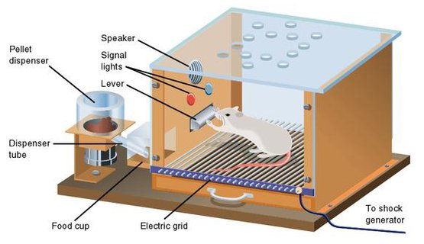
'Skinner Box'

Slide 154
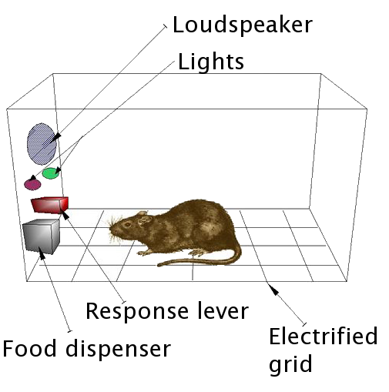
'Skinner Box’

Slide 155
'Skinner Box’
A Skinner box, also known as an operant conditioning chamber, is an enclosed apparatus that contains a bar or key that an animal can press or manipulate in order to obtain food or water as a type of reinforcement. ... Skinner himself did not refer to this device as a Skinner box, instead preferring the term "lever box."

Slide 156
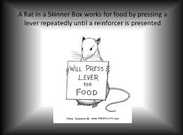
'Skinner Box’

Slide 157
'Skinner Box’ – Experiment 1
Positive Reinforcement
As the first step to his experiment, he placed a hungry rat inside the Skinner box. The rat was initially inactive inside the box, but gradually as it began to adapt to the environment of the box, it began to explore around. Eventually, the rat discovered a lever, upon pressing which; food was released inside the box. After it filled its hunger, it started exploring the box again, and after a while it pressed the lever for the second time as it grew hungry again. This phenomenon continued for the third, fourth and the fifth time, and after a while, the hungry rat immediately pressed the lever once it was placed in the box. Then the conditioning was deemed to be complete.

Slide 158
'Skinner Box’ – Experiment 1
Positive Reinforcement
Here, the action of pressing the lever is an operant response/behavior, and the food released inside the chamber is the reward. The experiment is also known as Instrumental Conditioning Learning as the response is instrumental in getting food.
This experiment also deals with and explains the effects of positive reinforcement. Upon pressing the lever, the hungry rat was served with food, which filled its hunger; hence, it’s a positive reinforcement.

Slide 159
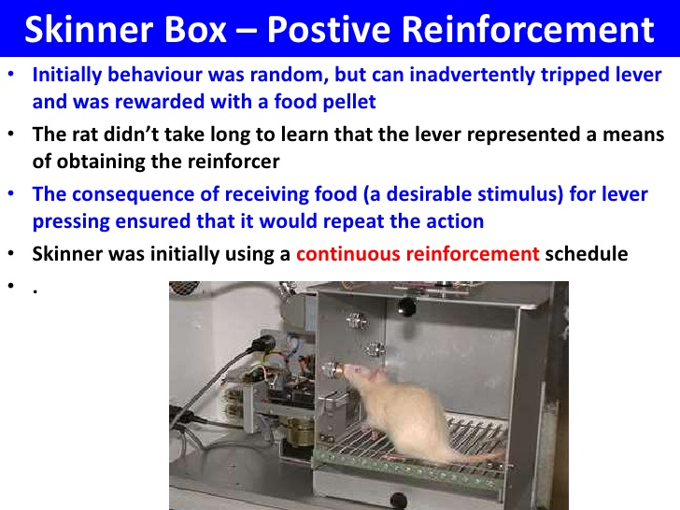
'Skinner Box’

Slide 160
'Skinner Box’ – Experiment 2
Negative Reinforcement
B.F. Skinner also conducted an experiment that explained negative reinforcement. Skinner placed a rat in a chamber in the similar manner, but instead of keeping it hungry, he subjected the chamber to an unpleasant electric current. The rat having experienced the discomfort started to desperately move around the box and accidentally knocked the lever. Pressing of the lever immediately seized the flow of unpleasant current. After a few times, the rat had smartened enough to go directly to the lever in order to prevent itself from the discomfort.

Slide 161
'Skinner Box’ – Experiment 2
Negative Reinforcement
The electric current reacted as the negative reinforcement, and the consequence of escaping the electric current made sure that the rat repeated the action again and again. Here too, the pressing of the lever is an operant response, and the complete stop of the electric current flow is its reward.

Slide 162
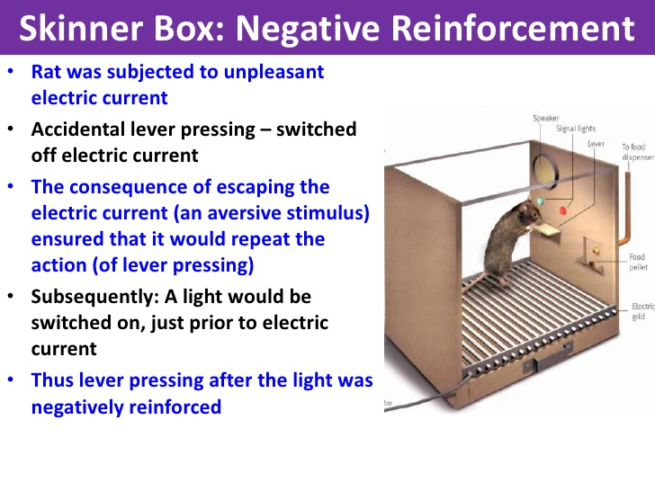
'Skinner Box’

Slide 163
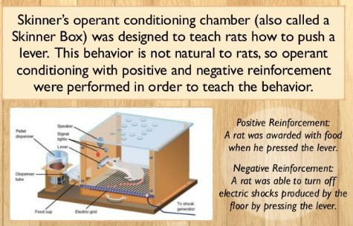
'Skinner Box’

Slide 164
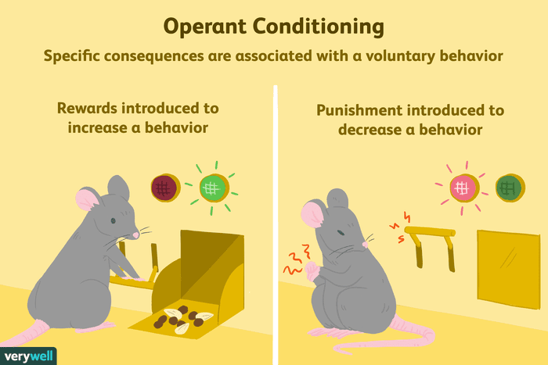
'Skinner Box’

Slide 165
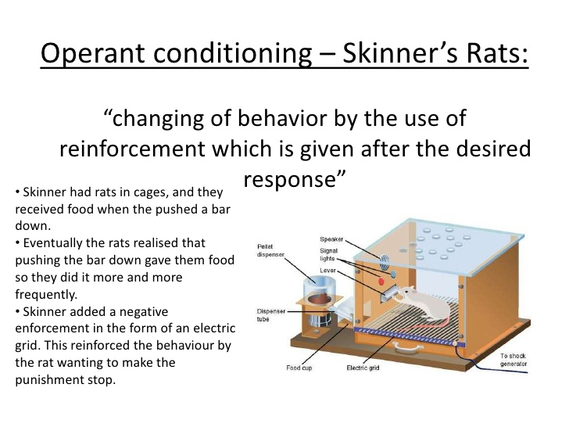
'Skinner Box’ – Experiments
Conclusion

Slide 166
'Skinner Box’ – Experiments
Conclusion
Both the experiments clearly explain the working of operant conditioning. The important part in any operant conditioning learning is to recognize the operant behavior and the consequence resulted in that particular environment.

Slide 167
Operant conditioning: B.F Skinner
Most complex behavior can be explained by this theory
Related to trial and error learning
Viewed as significant extension of classical conditioning theory
A person or animal attempts to solve a problem by trying different actions until one proves successful.

Slide 168
Three main basic principles
Operant behaviors are voluntary
The consequence of a behavior is in itself a stimulus that can affect future behavior. pleasant or unpleasant consequence
Teach new behaviors – behavior shaping—

Slide 169
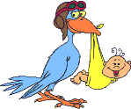
STIMULUS → RESPONSE → CONSEQUENCE
Classical conditioning - a stimulus leads to a response
Operant conditioning - a response becomes a further stimulus.
A reinforcer is not necessarily a reward nor is a punisher necessarily painful

Slide 170
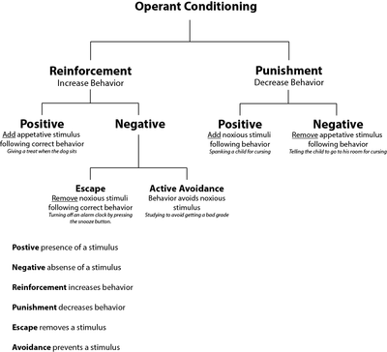

Slide 171
Four basic types of operant conditioning:
Positive reinforcement---if a pleasant consequence follows a response
Ex. reward for co-operation
Negative reinforcement---withdrawal of an unpleasant stimulus after a response
Ex. Stopping treatment if crying
Omission (time out)---removal of a pleasant stimulus after a particular response
Ex. Taking out of favorite toy, sending mother out
Punishment ---when an unpleasant stimulus is presented after a response
Ex. Driving a car slowly

Slide 172
-→1 & 2 are more suitable for dental office -
1. Positive Reinforcers --immediate
Unlearned reinforcers are food, candy toys
Token reinforcer for habit therapy
Activity which the child likes (permission to leave the dental chair) if the child does as you desire,he then may do that which he desires
Social reinforcer (giving attention, praise, smiling, ) non verbal communication—during treatment
2. Negative reinforcers
Halting treatment b’coz of behavioral resistance is likely to reinforce undesirable behavior

Slide 173
3 & 4 should be used sparingly with some caution (aversive learning) – Punishers
-Voice control, HOME, time out are mild forms of punishments
-Physical restraints

Slide 174
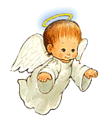
Authoritative dentist →
- have clear, consistent rules & being warm & supportive
-child – dentist interaction – eye to eye contact
-clear instructions in firm voice
-reinforce co-op. behavior
-engage parents in establishing rules
-informed consents-to gain trust & confidence
One should ask the child whether he is ready for the treatment, given choice to select the tooth to be restored

Slide 175
CHILD PSYCHOLOGY
Dr. Aron Arun Kumar Vasa
Professor
Dept. of Pedodontics

Slide 176
Theories proposed on Child Psychology
Psychodynamic theories
-psychosexual theory --- Freud -1905
-psychosocial theory ---Eric Erikson1963
-cognitive theory ---Piaget – 1952
Behavioral theories
-classical conditioning --- Pavlov - 1927
-operant conditioning --- Skinner – 1938
-social learning theory --- Bandura – 1954
-hierarchy of needs --- Maslow - 1963
Miscellaneous theories
-separation & individualization --- M Mahler
-attachment theory --- J Bowlby
-childrenese --- H Ginnott

Slide 177
SOCIAL LEARNING THEORY / OBSERVATIONAL LEARNING THEORY- ALBERT BANDURA
Albert Bandura proposed a social learning theory which suggests that observation and modelling play a primary role in this process.

Slide 178
SOCIAL LEARNING THEORY / OBSERVATIONAL LEARNING THEORY- ALBERT BANDURA
Learning is a remarkably complex process that is influenced by a wide variety of factors. As most parents are probably very much aware, observation can play a critical role in determining how and what children learn.
﻿ As the saying goes, kids are very much like sponges, soaking up the experiences they have each and every day.

Slide 179
SOCIAL LEARNING THEORY / OBSERVATIONAL LEARNING THEORY- ALBERT BANDURA
According to him behavior is acquired through observation and imitation.
Social learning theory explains human behavior in terms of continuous reciprocal interaction between cognitive, behavioral, and environmental influences
General principles
  learning occurs without change in behavior
  cognition play a role in learning

Slide 180
SOCIAL LEARNING THEORY / OBSERVATIONAL LEARNING THEORY- ALBERT BANDURA
Scope and applications-
--to understand aggression and psychological disorders (BANDURA ,1973)
--Behavior modeling and modifications (BANDURA, 1969)
--concept of self-efficacy in a variety of contexts (Bandura,1997)
Eg. Adds. about tooth paste & brush
-modeling a mode of behavior management
Bobo doll experiment

Slide 181
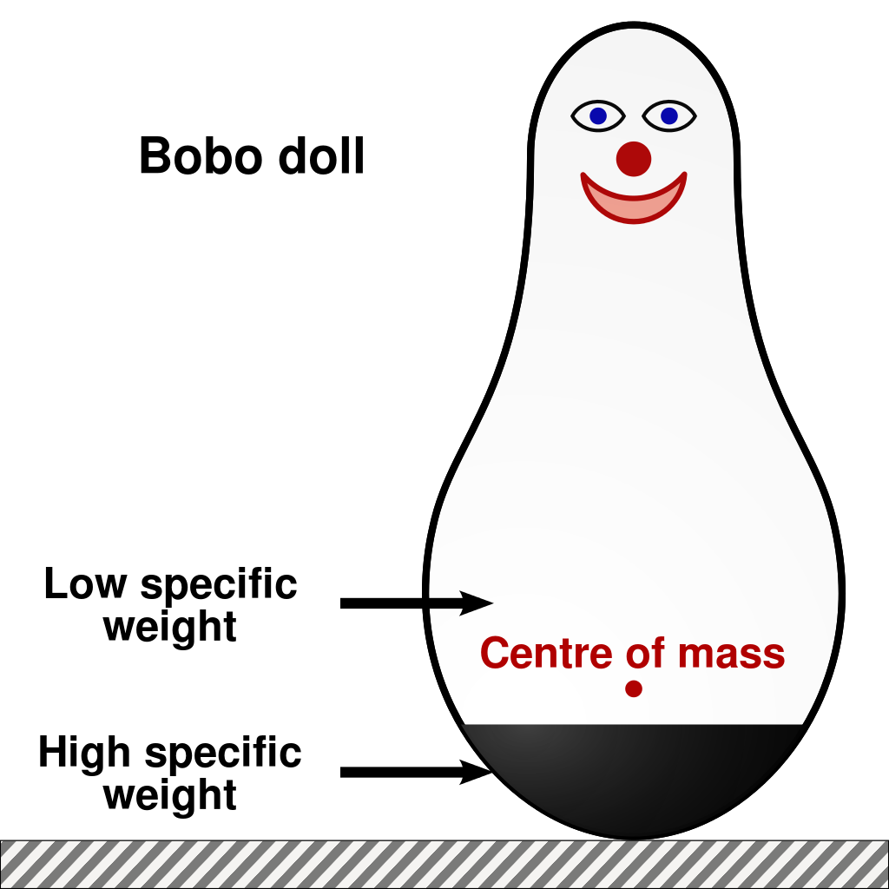
BOBO DOLL

Slide 182

BOBO DOLL EXPERIMENT
Does the violence that children observe in television programs, movies, and video games lead them to behave aggressively? This is a hot question today, but it was also of great interest in the 1960s when a psychologist led an experiment known as the Bobo doll experiment to determine how kids learn aggression through observation.

Slide 183
BOBO DOLL EXPERIMENT
The participants for the experiment were 36 boys and 36 girls enrolled at the Stanford University Nursery School. The children ranged in age between 3 and almost 6 years, and the average participant age was 4 years 4 months.
There were a total of eight experimental groups. Out of these participants, 24 were assigned to a control group that would not be exposed to adult models. The rest of the children were then divided into two groups of 24 participants each.

Slide 184
BOBO DOLL EXPERIMENT
One of the experimental groups would be exposed to aggressive models, while the other 24 children would be exposed to non-aggressive models.
These groups were divided again into groups of boys and girls. Each of these subgroups was then divided so that half of the participants would be exposed to a same-sex adult model and the other half would be exposed to an opposite-sex adult model.
Before conducting the experiment, Bandura also assessed the children's existing levels of aggression. Groups were then matched equally so that they had average levels of aggression.

Slide 185
BOBO DOLL EXPERIMENT
A lab experiment was used, in which the independent variable (the type of model) was manipulated in three conditions:
Aggressive model is shown to 24 children
Non-aggressive model is shown to 24 children
No model shown (control condition) - 24 children

Slide 186
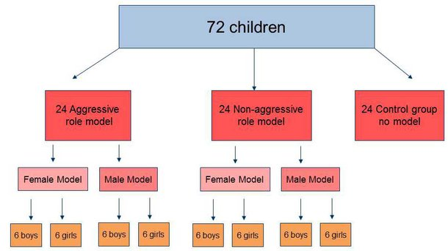
BOBO DOLL EXPERIMENT

Slide 187
BOBO DOLL EXPERIMENT
Each child was tested individually to ensure that behaviour would not be influenced by other children. The child was first brought into a playroom where there were a number of different activities to explore.
The experimenter then invited an adult model into the playroom and encouraged the model to sit at a table across the room from the child that had similar activities. Over a ten minute period, the adult models began to play with sets of tinker toys. In the non-aggressive condition, the adult model simply played with the toys and ignored the Bobo doll for the entire period. In the aggressive model condition, however, the adult models would violently attack the Bobo doll.

Slide 188
BOBO DOLL EXPERIMENT
"The model laid the Bobo on its side, sat on it, and punched it repeatedly in the nose. The model then raised the Bobo doll, picked up the mallet, and struck the doll in the head. Following the mallet aggression, the model tossed the doll up in the air aggressively and kicked it about the room. This sequence of physically aggressive acts was repeated three times, interspersed with verbally aggressive responses.“
In addition to physical aggression, the adult models also used verbally aggressive phrases such as "Kick him" and "Pow." The models also added two non-aggressive phrases: "He sure is a tough fella" and "He keeps coming back for more."

Slide 189
BOBO DOLL EXPERIMENT
After the ten-minute exposure to the adult model, each child was then taken to another room that contained a number of appealing toys including a doll set, fire engine, and toy airplane. The children were permitted to play for a brief two minutes, then told they were no longer allowed to play with any of these tempting toys. The purpose of this was to build up frustration levels among the young participants.

Slide 190
BOBO DOLL EXPERIMENT
Finally, each child was taken to the last experimental room. This room contained a number of "aggressive" toys including a mallet, a tether ball with a face painted on it, dart guns, and, of course, a Bobo doll. The room also included several "non-aggressive" toys including crayons, paper, dolls, plastic animals, and trucks. Each child was then allowed to play in this room for a period of 20 minutes while raters observed the child's behaviour from behind a one-way mirror and judged each child's levels of aggression.

Slide 191
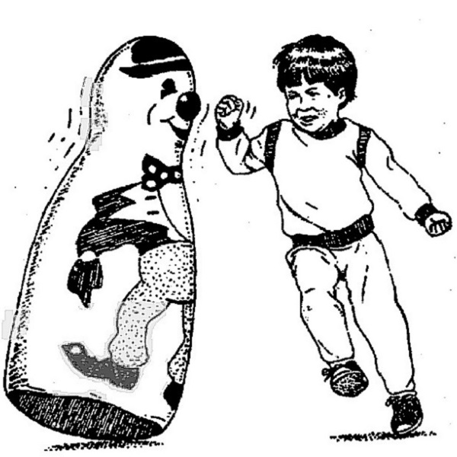
BOBO DOLL EXPERIMENT

Slide 192
Results of the Bobo Doll Experiment
Children exposed to the violent model tended to imitate the exact behaviour they had observed when the adult was no longer present.
Bandura and his colleagues had also predicted that children in the non-aggressive group would behave less aggressively than those in the control group. The results indicated that while children of both genders in the non-aggressive group did tend to exhibit less aggression than the control group, boys who had observed an opposite-sex model behave non-aggressively were more likely than those in the control group to engage in violence.

Slide 193
Results of the Bobo Doll Experiment
There were important gender differences when it came to whether a same-sex or opposite-sex model was observed. Boys who observed adult males behaving violently were more influenced than those who had observed female models behaving aggressively. Interestingly, the experimenters found in same-sex aggressive groups, boys were more likely to imitate physical acts of violence while girls were more likely to imitate verbal aggression.
The researchers were also correct in their prediction that boys would behave more aggressively than girls. Boys engaged in more than twice as many acts of physical aggression than the girls.

Slide 194
What Bandura's Results Suggest
The results of the Bobo doll experiment supported Bandura's social learning theory. Bandura and his colleagues believed that the experiment demonstrates how specific behaviours can be learned through observation and imitation. The authors also suggested that "social imitation may hasten or short-cut the acquisition of new behaviours without the necessity of reinforcing successive approximations as suggested by Skinner."
According to Bandura, the violent behaviour of the adult models toward the dolls led children to believe that such actions were acceptable. He also suggested that as a result, children may be more inclined to respond to frustration with aggression in the future.

Slide 195
What Bandura's Results Suggest
In a follow-up study conducted in 1965, Bandura found that while children were more likely to imitate aggressive behaviour if the adult model was rewarded for his or her actions, they were far less likely to imitate if they saw the adult model being punished or reprimanded for their hostile behaviour.

Slide 196
Criticisms of the Bobo Doll Experiment
Because the experiment took place in a lab setting, some critics suggest that results observed in this type of location may not be indicative of what takes place in the real world.
The study might suffer from selection bias. All participants were drawn from a narrow pool of students who share the same racial and socioeconomic background. This makes it difficult to generalize the results to a larger, more diverse population.
Since data was collected immediately, it is also difficult to know what the long-term impact might have been.

Slide 197
Criticisms of the Bobo Doll Experiment
Acting violently toward a doll is a lot different than displaying aggression or violence against another human being in a real world setting.
It has also been suggested that children were not actually motivated to display aggression when they hit the Bobo doll; instead, they may have simply been trying to please the adults.
Some critics argue that the study itself was unethical. By manipulating the children into behaving aggressively, they argue, the experimenters were essentially teaching the children to be aggressive.

Slide 198
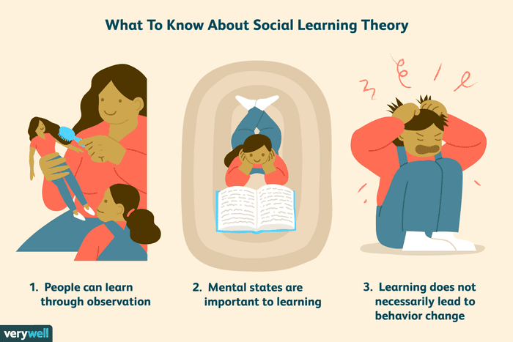

Slide 199
Things You Should Know About Social Learning Theory
There are three core concepts at the heart of social learning theory.
First is the idea that people can learn through observation.
Next is the notion that internal mental states are an essential part of this process.
Finally, this theory recognizes that just because something has been learned, it does not mean that it will result in a change in behaviour.

Slide 200
People Can Learn Through Observation
Bandura identified three basic models of observational learning:
A live model, which involves an actual individual demonstrating or acting out a behaviour.
A verbal instructional model, which involves descriptions and explanations of a behaviour.
A symbolic model, which involves real or fictional characters displaying behaviours in books, films, television programs, or online media.

Slide 201
People Can Learn Through Observation
In one of the best-known experiments in the history of psychology, Bandura demonstrated that children learn and imitate behaviours they have observed in other people. The children in Bandura’s studies observed an adult acting violently toward a Bobo doll. When the children were later allowed to play in a room with the Bobo doll, they began to imitate the aggressive actions they had previously observed.

Slide 202
Mental States Are Important to Learning
Just observing someone else's actions is not always enough to lead to learning. Your own mental state and motivation play an important role in determining whether a behaviour is learned or not.
Bandura noted that external, environmental reinforcement was not the only factor to influence learning and behaviour. He described intrinsic reinforcement as a form of internal rewards, such as pride, satisfaction, and a sense of accomplishment.

Slide 203
Learning Does Not Necessarily Lead to a Change in Behaviour
We are able to learn things even though that learning might not be immediately obvious. While behaviourists believed that learning led to a permanent change in behaviour, observational learning demonstrates that people can learn new information without demonstrating new behaviours.

Slide 204
How Does Observational Learning Happen?
It is also important to note that not all observed behaviours are effectively learned. Why not? Factors involving both the model and the learner can play a role in whether social learning is successful. Certain requirements and steps must also be followed.
The following steps are involved in the observational learning and modelling process:
Attention
Retention
Motor Reproduction
Motivation / Reinforcement

Slide 205
Attention
Attention: In order to learn, you need to be paying attention. Anything that distracts your attention is going to have a negative effect on observational learning. If the model is interesting or there is a novel aspect of the situation, you are far more likely to dedicate your full attention to learning.
One should perceive & attend to significant features of modeled behavior

Slide 206
Retention
Retention: The ability to store information is also an important part of the learning process. Retention can be affected by a number of factors, but the ability to pull up information later and act on it is vital to observational learning.
Coding the information into long term memory

Slide 207
Motor Reproduction
Reproduction: Once you have paid attention to the model and retained the information, it is time to actually perform the behaviour you observed. Further practice of the learned behaviour leads to improvement and skill advancement.
Observer must learn and posses the physical capabilities of the modeled behavior

Slide 208
Motivation / Reinforcement
Motivation: Finally, in order for observational learning to be successful, you have to be motivated to imitate the behaviour that has been modelled.
Reinforcement and punishment play an important role in motivation. While experiencing these motivators can be highly effective, so can observing others experiencing some type of reinforcement or punishment. For example, if you see another student rewarded with extra credit for being to class on time, you might start to show up a few minutes early each day.
Positive reinforcements such as rewards (consequences)

Slide 209
Motivation / Reinforcement
Types of environmental reinforces
        a model
        third person
        imitated behavior itself leads to reinforcement
        consequences of model’s behavior
Behaviors learnt through modeling
    at home
    in schools
    surroundings
Parents, friends, prior experiences – have positive or negative outcome

Slide 210
Effects of modelling on behavior
Teaches new behavior
Influences the frequency of previously learned behavior
As a behavior shaping technique
Whether a child will actually perform an acquired behavior depends upon several factors.
  characteristics of role model
  consequences of the behavior
  motor ability to perform

Slide 211
A Few Applications for Social Learning Theory
Social learning theory can have a number of real-world applications. For example, it can be used to help researchers understand how aggression and violence might be transmitted through observational learning. By studying media violence, researchers can gain a better understanding of the factors that might lead children to act out the aggressive actions they see portrayed on television and in the movies.

Slide 212
A Few Applications for Social Learning Theory
Social learning can also be utilized to teach people positive behaviours. Researchers can use social learning theory to investigate and understand ways that positive role models can be used to encourage desirable behaviours and to facilitate social change.

Slide 213
APPLICATIONS IN DENTISTRY
One should explain the procedure to the child
Make him/her observe other person showing desired behavior (live or audiovisual)
Ask him to imitate the desired behavior
Reinforce the same
Children have never been good listeners to elders, but they never fail to IMITATE them

Slide 214
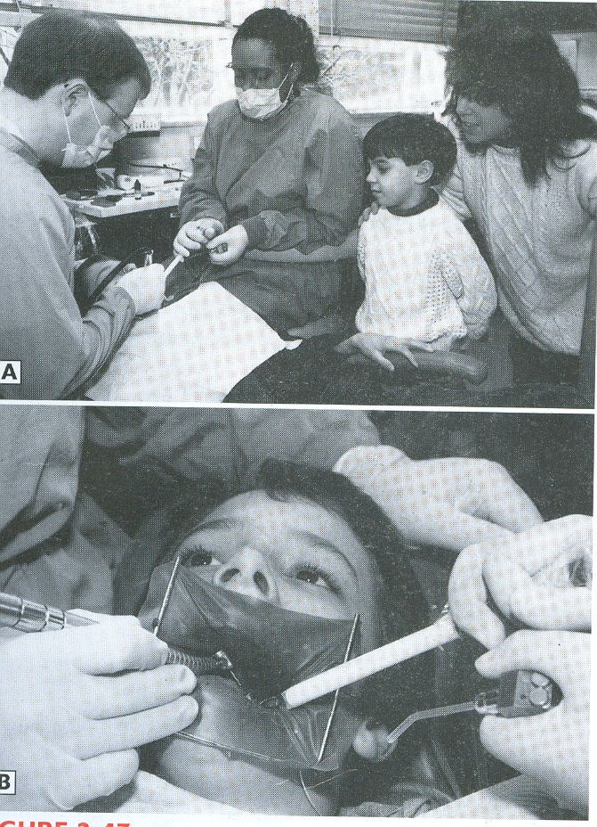
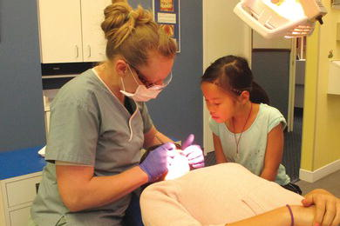
Observational learning or Modeling

Slide 215
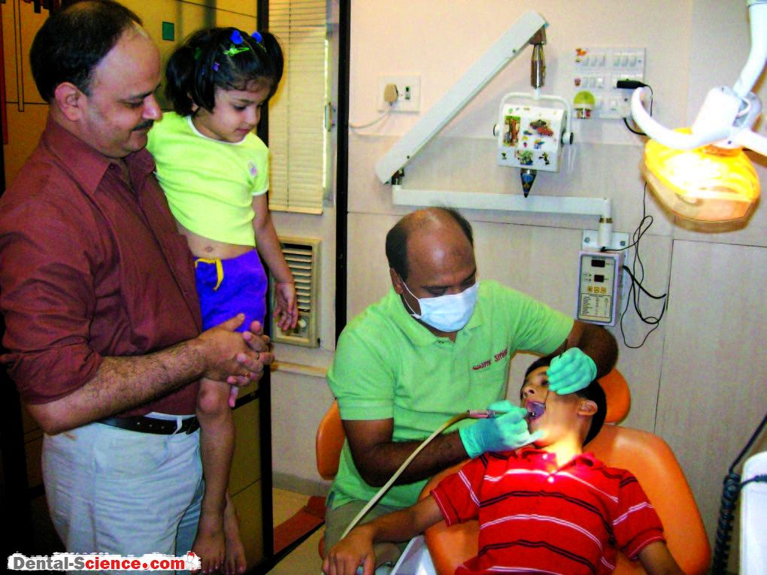

Observational learning or Modeling

Slide 216
HIERARCHY OF NEEDS
What motivates human behaviour? Maslow's hierarchy of needs is one of the best-known theories of motivation. According to humanist psychologist Abraham Maslow, our actions are motivated in order to achieve certain needs

Slide 217
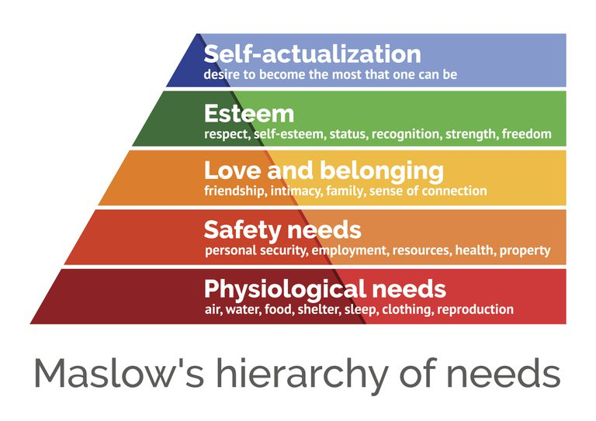

Slide 218
HIERARCHY OF NEEDS
Abraham Harold Maslow was born April 1, 1908 in Brooklyn, New York
He established Hierarchy of needs by observing basic needs of individuals.
He believed that violence exists to fulfill the basic needs

Slide 219
HIERARCHY OF NEEDS
Maslow first introduced his concept of a hierarchy of needs in his 1943 paper "A Theory of Human Motivation" and his subsequent book Motivation and Personality. This hierarchy suggests that people are motivated to fulfil basic needs before moving on to other, more advanced needs.
In this theory, higher needs in the hierarchy begin to emerge when people feel they have sufficiently satisfied the previous need.

Slide 220
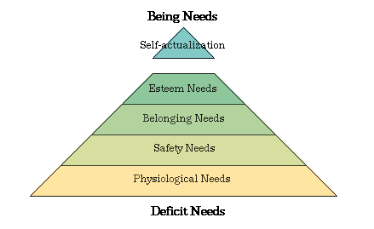
HIERARCHY OF NEEDS

Slide 221
HIERARCHY OF NEEDS
As a humanist, Maslow believed that people have an inborn desire to be self-actualized, that is, to be all they can be. In order to achieve these ultimate goals, however, a number of more basic needs must be met such as the need for food, safety, love, and self-esteem.
As people progress up the pyramid, needs become increasingly psychological and social. Soon, the need for love, friendship, and intimacy becomes important. Further up the pyramid, the need for personal esteem and feelings of accomplishment take priority.
If these needs are not fulfilled – deficit needs

Slide 222
Physiological Needs
The basic physiological needs are probably fairly apparent—these include the things that are vital to our survival. Some examples of physiological needs include:
Food
Water
Breathing
Homeostasis
In addition to the basic requirements of nutrition, air and temperature regulation, the physiological needs also include such things as shelter and clothing. Maslow also included sexual reproduction in this level of the hierarchy of needs since it is essential to the survival and propagation of the species.

Slide 223
Security and Safety Needs
As we move up to the second level of Maslow’s hierarchy of needs, the requirements start to become a bit more complex. At this level, the needs for security and safety become primary. People want control and order in their lives, so this need for safety and security contributes largely to behaviours at this level.
Some of the basic security and safety needs include:
Financial security
Heath and wellness
Safety against accidents and injury

Slide 224
Security and Safety Needs
Finding a job, obtaining health insurance and health care, contributing money to a savings account, and moving into a safer neighbourhood are all examples of actions motivated by the security and safety needs.
Together, the safety and physiological levels of the hierarchy make up what is often referred to as the basic needs.

Slide 225
Social Needs
The social needs in Maslow’s hierarchy include such things as love, acceptance, and belonging. At this level, the need for emotional relationships drives human behaviour. Some of the things that satisfy this need include:
  Friendships
  Romantic attachments
  Family
  Social groups
  Community groups
  Churches and religious organizations

Slide 226
Social Needs
In order to avoid problems such as loneliness, depression, and anxiety, it is important for people to feel loved and accepted by other people. Personal relationships with friends, family, and lovers play an important role, as does involvement in other groups that might include religious groups, sports teams, book clubs, and other group activities.

Slide 227
Esteem Needs
At the fourth level in Maslow’s hierarchy is the need for appreciation and respect. When the needs at the bottom three levels have been satisfied, the esteem needs begin to play a more prominent role in motivating behaviour.
At this point, it becomes increasingly important to gain the respect and appreciation of others. People have a need to accomplish things and then have their efforts recognized.
In addition to the need for feelings of accomplishment and prestige, esteem needs include such things as self-esteem and personal worth. People need to sense that they are valued and by others and feel that they are making a contribution to the world. Participation in professional activities, academic accomplishments, athletic or team participation, and personal hobbies can all play a role in fulfilling the esteem needs.

Slide 228
Esteem Needs
People who are able to satisfy the esteem needs by achieving good self-esteem and the recognition of others tend to feel confident in their abilities. Those who lack self-esteem and the respect of others can develop feelings of inferiority.
Together, the esteem and social levels make up what is known as the psychological needs of the hierarchy.

Slide 229
Self-Actualization Needs
At the very peak of Maslow’s hierarchy are the self-actualization needs. "What a man can be, he must be," Maslow explained, referring to the need people have to achieve their full potential as human beings.
The need for self-actualization is "the desire to become more and more what one is, to become everything that one is capable of becoming."
People who have everything can maximize their potential. They can seek knowledge, peace, esthetic experiences, self-fulfillment, oneness with God, etc.

Slide 230
Self-Actualization Needs
"It may be loosely described as the full use and exploitation of talents, capabilities, potentialities, etc. Such people seem to be fulfilling themselves and to be doing the best that they are capable of doing... They are people who have developed or are developing to the full stature of which they are capable."
Self-actualizing people are self-aware, concerned with personal growth, less concerned with the opinions of others, and interested in fulfilling their potential.

Slide 231
Self-Actualization Needs
The qualities; They are reality centered, problem centered, respect self and others accompanied with strong ethics - only 2% of people
Some criticisms :his methodology in picking a small number of people E.g. Gandhi, Abraham Lincoln

Slide 232
Criticisms of Maslow’s Hierarchy of Needs
Maslow's theory has become wildly popular both in and out of psychology. The fields of education and business have been particularly influenced by the theory. While popular, Maslow's concept has not been without criticism.
Needs Do Not Necessarily Follow a Hierarchy
The Theory Is Difficult to Test

Slide 233
Needs Do Not Necessarily Follow a Hierarchy
While some research showed some support for Maslow's theories, most research has not been able to substantiate the idea of a needs hierarchy.

Slide 234
The Theory Is Difficult to Test
Other criticisms of Maslow's theory note that his definition of self-actualization is difficult to test scientifically. His research on self-actualization was also based on a very limited sample of individuals, including people he knew as well as biographies of famous individuals that Maslow believed to be self-actualized.

Slide 235
Why Was Maslow's Hierarchy of Needs so Influential?
Regardless of these criticisms, Maslow’s hierarchy of needs represents part of an important shift in psychology. Rather than focusing on abnormal behaviour and development, Maslow's humanistic psychology was focused on the development of healthy individuals.

Slide 236
Separation-Individuation Theory of Child Development (Mahler)
Mahler is regarded as one of the main contributors to the field of ‘ego psychology’, a school of thought which evolved from Sigmund Freud’s Structural Model (id-ego-superego). Her aim was not to develop a novel theory, but to broaden the scope of pre-existing theories. Her studies focus primarily on mother-infant interactions within the first three years of life, thereby filling a void in psychodynamic stage theories, such as Freud’s psychosexual stages of development, and Erikson’s psychosocial stages of development.

Slide 237
Separation-Individuation Theory of Child Development (Mahler)
According to Mahler, successful completion of the developmental stages in the first few years of life results in separation and individuation. Separation refers to an internal process of mental separation from the mother, while individuation refers to a developing self concept. Although interrelated, it is possible for one to develop more than the other, largely depending on the mother’s attitude towards the child.
Her work largely observational in nature.
Relationship between the obligatory physical development of an infant and the accompanying obligatory psychological development of infants during the first 3 yr of life.

Slide 238
Separation-Individuation Theory of Child Development (Mahler)
Stages of Development
Normal autistic stage: (0-1 month)
Normal symbiotic stage: (1-5 months)
Separation-Individuation stage: (5-24 months)
  Differentiation/Hatching: (5-9 months)
  Practicing: (9-14 months)
  Rapprochement: (14-24 months)
  Object constancy: (24+ months)

Slide 239
1. Normal autistic stage
(0-1 month)
At the very beginning of life, the infant is primarily focused on himself/herself, uninterested in external stimuli. The mother is viewed as an intrinsic part of the infant, devoid of a separate existence. The primary goal at this point, is to achieve a state of equilibrium, while lacking the understanding that the satisfaction of needs may come from an external source.

Slide 240
2. Normal symbiotic stage
(1-5 months)
At this phase, the infant vaguely acknowledges the mother’s existence, not as a unique entity, but as the main source of need-satisfaction. The fulfilment of the infant’s physiological needs becomes intertwined with psychological desires and thus serves as the basis upon which future relationships will be formed. Crucial to successful progression through the next stages are the availability and the ability of the mother to adapt successfully to the infant’s needs.

Slide 241
3. Separation-Individuation stage
(5-24 months)
In this final stage a significant transition occurs in two overlapping realms. In separation, the infant develops an understanding of boundaries of the self, and thus the mother is increasingly viewed as an individual. Meanwhile, individuation marks the development of a sense of self. This consists of four sub-stages:

Slide 242
3a: Differentiation/Hatching: (5-9 months)
The infant’s primary focus begins to transform from internally focused to externally focused, although the primary point of reference continues to be the mother. This internal process is exemplified by milestones in motor development which physically allow increased separation, such as crawling. The infant becomes increasingly interested in discovering his mother (e.g. how she looks or smells) rather than trying to become symbiotically unified with her.

Slide 243
3b: Practicing: (9-14 months)
Capacity for separation continues to develop with increased autonomous functions, particularly walking. Although able to explore freely, the child still regards the mother as unified with him/her and thus explores his/her surroundings while keeping within an optimal distance. The child’s experience of the world he or she discovers is influenced by the mother’s reactions and by her availability to sooth when experiences may be frightening or painful.

Slide 244
3c: Rapprochement: (14-24 months)
At this point the child’s desire to achieve independence is marred by a fear of abandonment. Therefore, the child seeks to maintain proximity to the caretaker while engaging in exploration. This stage is essential to the development of a stable sense of self. This includes three sub- stages:
Beginning: The child returns to the caretaker in order to share experiences and excitement. There is an overarching felon of omnipotence and exuberance.

Slide 245
3c: Rapprochement: (14-24 months)
Crisis: The child recognizes his/her limitations versus the desire to be all powerful and self sufficient. The child is torn in choosing between physical and emotional proximity to the caretaker or independence. This stage is characterized by temper tantrums and helplessness and thus the need for emotional availability of the mother increases.
Solution: The child reaches a healthy medium between the two extremes due to language and superego development. If the crisis is not resolved well, there will be an increase in extreme clinging or shunning behaviour.

Slide 246
3d: Object constancy
(24+ months)
Successful completion of this phase marks the development of an internalized mental model of the mother, which unconsciously accompanies and supports the child even when they are physically separated. In addition, a sense of individuality begins to develop. The degree of ambivalence in the internalized model implicates the formation of a healthy self concept and self-confidence.

Slide 247


SUMMARY
Infancy 0-1.5yrs Oral phase Basic trust vs. basic mistrust | -Careful introduction to dental office -Dentist must be confident and experienced
Early childhood 1.5-3yrs Anal phase Autonomy vs. shame and doubt | -Requires an introductory visit ( fear of unknown ) -Attained treatment maturity -Able to sit still – for 10-20 min -Understands simple instructions and explanations for TSD-Praise the child’s abilities -Non-verbal communication-Parent may remain near

Slide 248


SUMMARY
Late childhood 3-5yrs Phallic stage Initiative vs. guilt | -Able to Concentrate for 30 min -Understands instructions and explanations for TSD -Praise the child’s abilities & appearance -Non-verbal communication -Parent may remain near-
Early school age 5-12yrs Latency Industry vs. inferiority | Realistic view of treatment Explain the procedure Reassure
Adolescence 12-and above Genital stage Identity vs. role confusion | Motivation Peer influence

Slide 249
Conclusion
Dentistry for children can be demanding, tumultuous, and frustrating; at the same time, it can be enriching, satisfying, and memorable. Dentistry for children who display disruptive behaviors places unique demands on a dentist, requiring him or her to incorporate additional skills and knowledge.
The knowledge of psychological growth & development can provide the dentist with personal reward. knowledge of the type of behavior to expect from children of certain ages can aid the dentist with his work and help the child avoid trauma. Thus providing an optimal experience for both

