Slide 1

g
Good morning

Slide 2
PLAQUE CONTROL METHODS

Slide 3
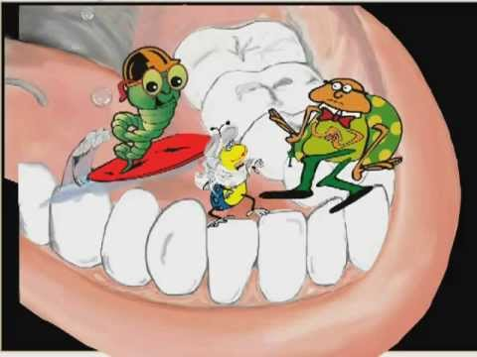
PLAQUE ?
Dental plaque is defined as a highly specific variable structural entity formed by sequential colonization of microorganism on the tooth surface, epithelium and restorations.

Slide 4

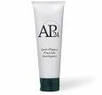
Plaque control
It is the removal of microbial plaque and the prevention of its accumulation on the teeth and adjacent gingival tissues. It also deals with the prevention of calculus formation.

Slide 5
Objectives of Plaque control
To reduce the number of micro organisms on the teeth. This reduces factors of irritation and inflammation.
One of the causes of halitosis may be removed.
Gingival stimulation.

Slide 6
CHEMICAL PLAQUE CONTROL
Plaque & gingivitis
Exhibit substantivity
Pathogenic growth
Exhibit substantivity
Ideal requisites
Should decrease plaque & gingivitis
Prevent pathogenic growth
Should prevent development of resistant bacteria
Should be biocompatible
Should not stain teeth or alter taste
Should have good retentive properties
Should be economic
Ideal requisites
Biocompatible
Stain teeth or alter taste
Economic
Development of resistant bacteria
Good retentive properties

Slide 7
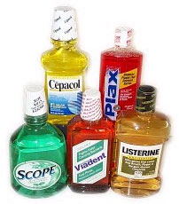
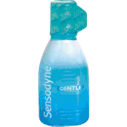
CLASSIFICATION
CHEMICAL PLAQUE CONTROL AGENTS
First Generation
Eg: Antibiotics, Phenol,quarternary Ammonium Compounds & Sanguinarine
Second Generation
Eg: Bisbiguanides,(chlorhexidine)
Third Generation
Eg: Delmopinol

Slide 8
FIRST GENERATION AGENTS
TRICLOSAN
Phenol derivative
Used as a topical antimicrobial agent
Broad spectrum of action including both gram positive and gram negative bacterias
It also includes mycobacterium spores and Candida species

Slide 9
MECHANISM OF ACTION
triclosan
Triclosan
Act on cytoplasmic membrane
Induce leakage of cellular constituents
Bacteriolysis

Slide 10
triclosan
Included in tooth paste to reduce plaque formation
Delay plaque formation
It inhibits formation of prostaglandins & leukotrienes there by reduces the chance of inflammation

Slide 11
QUARTERNARY AMMONIUM COMPOUNDS
Cationic antiseptics & surface active agents
Effective against gram positive organisms
Eg: Benzanthonium chloride, Benzalleonium chloride and cetylpyredinium

Slide 12
4.SANGUINARINE
It is a benzophenanthredine alkaloid
It is most effective against gram –ve organisms
Used in mouth rinse
Sanguinaria Canadensis

Slide 13

ANTIBIOTICS
Vancomycin
Erythromycin
Niddamycin
Kanamycin
Disadvantages
Bacterial resistance

Slide 14

BISBIGUANIDES
CHLORHEXIDINE GLUCONATE(0.2%)
C22H30Cl2N10
It is a cationic bisbiguanide
Effective against gram +ve, gram –ve organisms, fungi, yeasts and viruses
Exhibit antiplaque & antibacterial properties

Slide 15
CHLORHEXIDINE GLUCONATE(0.2%)
MECHANISM OF ACTION
Antiplaque action of chlorhexidine
Prevents pellicle formation by blocking acidic groups on salivary glycoproteins there by reducing glycoprotein adsorption on to the tooth surface
Prevents adsorption of bacterial cell wall on to the tooth surface
Prevents binding of mature plaques

Slide 16
Antibacterial action of chlorhexidine
Bacteriostatic at low concentrations- PIN CUSHION EFFECT
Bacterial cell wall(-ve charge)
Reacts with +ve charged chlorhexidine molecule
Integrity of cell membrane altered
CHX binds to inner membrane phospholipids & increase permeability
Vital elements leak out & this effect is reversible

Slide 17
CHLORHEXIDINE GLUCONATE
Increased concentration of chlorhexidine
Progressive greater damage to membrane
Larger molecular weight compounds lost
Coagulation and precipitation of cytoplasm
Free chx molecule enter the cell & coagulates proteins
Vital cell activity ceases
Cell death

Slide 18
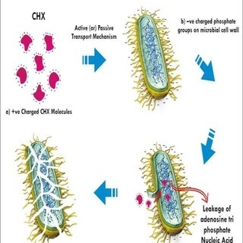
PIN CUSHION EFFECT
The dicationic CHX molecule, attaches to the tooth surface (pellicle) by one action, to the bacteria attempting to colonize the tooth surface with the other.
This prolongs the CHX action.

Slide 19
Adverse Effects Of Chlorhexidine
Brownish staining of tooth or restorations
Loss of taste sensation
Rarely hypersensitivity to chlorhexidine has been reported
Stenosis of parotid duct has also been reported

Slide 20
CHLORHEXIDINE GLUCONATE
Indications
As an adjunct to mechanical plaque control
Secondary prevention after periodontal surgery
In patients with intermaxillary fixation
As plaque control method in physically and mentally challenged individuals
In medically compromised patients with predisposition to oral candidiasis

Slide 21
CHLORHEXIDINE GLUCONATE
Indications
In high-risk caries patients, it has synergistic effect with fluoride.
In patients suffering with minor recurrent apthous ulcers. But, it is of little value in established major apthous ulcers.
Patients wearing removable and fixed orthodontic appliances.
Helpful for patients undergoing dental implant treatments.

Slide 22

DELMOPINOL
Inhibits plaque growth and reduces gingivitis
Mechanism of action
Interfere with plaque matrix formation & also reduces bacterial adherence
It causes weak binding of plaque to tooth, thus aiding in easy removal of plaque by mechanical procedures
It is therefore indicated as a pre brushing mouth rinse

Slide 23
DELMOPINOL
Adverse effect of delmopinol
Staining of tooth & tongue
Taste disturbances
Mucosal soreness & erosion

Slide 24
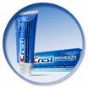
DENTIFRICES
Dentifrice is a substance used with a tooth brush for the purpose of cleaning the accessible surfaces of the tooth
It contains
    Therapeutic agent such as fluoride to inhibit caries
    Antimicrobial agents- chlorhexidine, cetrimide
    Anticalculus agent - zn-chloride

Slide 25
The main function of toothpaste
Minimizing build up of plaque
Strengthening teeth against caries
Cleaning the teeth by removing stains
Removing food debris
Freshening the mouth

Slide 26
COMPOSITION
DENTIFRICES
Polishing/ abrasive agents
      Ca carbonate
      Dicalcium phosphate dihydrate
      Alumina
      Silica
Functions
Mild abrasive action aids in illuminating plaque
Removes stained pellicle, restores natural luster, enhances enamel whiteness

Slide 27
DENTIFRICES
2.Binding/ thickening agents
    Water soluble agents
      Alginates, Sodium carboxy methyl cellulose etc
    Water insoluble agents
      Colloidal silica, Magnesium aluminium salts etc
Functions
Controls stability & consistency of tooth paste
3.Detergents/ surfactants
  Sodium lauryl sulfate
Functions
  Produces foam & removes food debris
  Antimicrobial property

Slide 28
DENTIFRICES
4. Humectants
    Sorbitol, glycerine, polyethylene glycol
Function
    reduces the loss of moisture from tooth paste
5. Flavoring agents
    Peppermint oil, spearmint oil, oil of wintergreen
Function
    Render the product pleasant to use & leaves a fresh taste in mouth after use

Slide 29
Triclosan, Delmopinol, Metallic ions, Zinc citrate trihydrate.
Antibacterial agents
Anticaries agents
Active agents
Anticalculus agents
Desensitizing agents
Sodium monoflurophosphate, sodium fluoride, stannous fluoride.
Fluoride
Pyrophosphates, Zinc citrate, Zinc chloride, Gautrez acid( copolymer of methyl vinyl ether, malic anhydrite)
Sodium fluoride, Potassium nitrate, Strontium chloride.

Slide 30
DENTIFRICES
Recent developments in dentifrices
Tooth paste for children
Natural tooth paste (herbal)
Whitening tooth paste
Breath freshening tooth paste
Sodium bicarbonate tooth paste

Slide 31


DISCLOSING AGENTS
A disclosing agent is a preparation in liquid, tablet or lozenge from which contains a dye or other coloring agents
A disclosing agent is used for identifying bacterial plaque
When applied to the teeth, the agents imparts its colour to soft deposits but can be rinsed easily from clean tooth surface

Slide 32
DISCLOSING AGENTS
IDEAL PROPERTIES
Intensity of colour
Duration of intensity
Taste
Irritation to mucous membrane
Diffusibility
Astringent and antiseptic property

Slide 33
DISCLOSING AGENTS
AGENTS USED FOR DISCLOSING PLAQUE
Iodine preparations
    Skinners iodine solution
    Diluted tincture of iodine
Mercurochrome preparations
    Mercurochrome soln 5
    Flavored mercurochrome disclosing solution
Bismark brown & Basic fuschin
Mebromin
Erythrosine
Fast green
Fluoresin
Two tone solutions

Slide 34
THANK YOU

