Slide 1
Cephalometrics
Dr. madhubhaskar bommasani
MDS -orthodontics

Slide 2
Introduction
Definition
Uses of cephalogram
Principal of cephalometric analysis
Goals of cephalometrics
Types of cephalograms
Cephalometric imaging system
Tracing technique
Cephalometric landmarks
Cephalometric planes

Slide 3
Measurement analysis :
  Downs analysis
  Steiner analysis
  Tweed analysis
  Wits appraisal
Limitations of cephalograms
Sources of errors in cephalometrics
Conclusion
References

Slide 4
Introduction
Origin: ‘Cephalo’ means head and ‘Metric’ is measurement
Measurement of the head from shadows of bony and soft tissue landmarks on the roentgenographic image, known as the Roentgenographic Cephalometry.
Spawned by the classic work of Broadbent in United States and Hofrath in Germany, cephalometrics has enjoyed wide acceptance

Slide 5
Definition
“The scientific measurement of the bones of the cranium and face, utilizing a fixed, reproducible position for lateral radiographic exposure of skull and facial bones” -- Moyers
“ A scientific study of the measurements of the head with relation to specific reference points; used for evaluation of facial growth and development, including soft tissue profile” -- Grabers

Slide 6
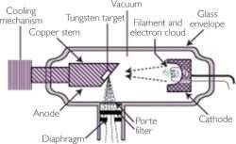
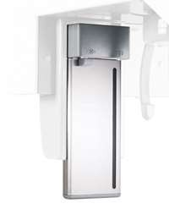
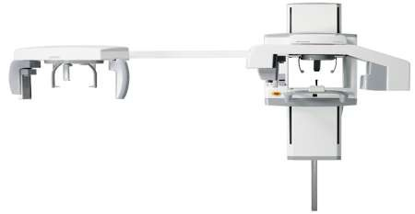
Cephalometric imaging system
X- ray apparatus
An image receptor
Cephalostat

Slide 7
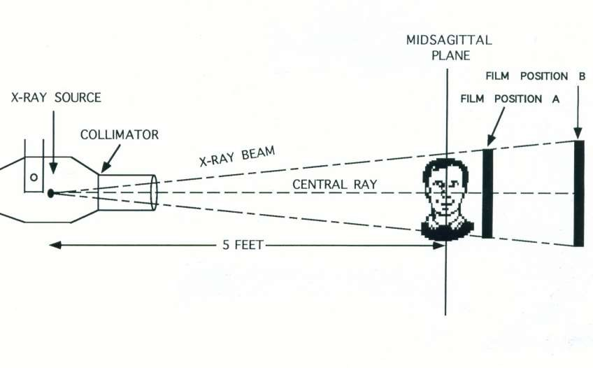

Slide 8
Uses
In orthodontic diagnosis & treatment planning
In classification of skeletal & dental abnormalities
In establishing facial types
In evaluation of treatment results
In predicting growth related changes & changes associated with surgical treatment
Valuable aid in research work involving the cranio- dentofacial region
Assessment of Cervical Vertebrae Maturity Indicator (CVMI)
-- Moyers

Slide 9
Principle of Cephalometric analysis
To compare the patient with a normal reference group, so that differences between the patient’s actual dentofacial relationships and those expected for his/her racial or ethnic groups are revealed
-- Jacobson

Slide 10
Goals of Cephalometrics
To evaluate the relationships, both horizontally and vertically, of the five major functional components of the face:
The cranium and the cranial base
The skeletal maxilla
The skeletal mandible
The maxillary dentition and the alveolar process
The mandibular dentition and the alveolar process
-- Jacobson

Slide 11
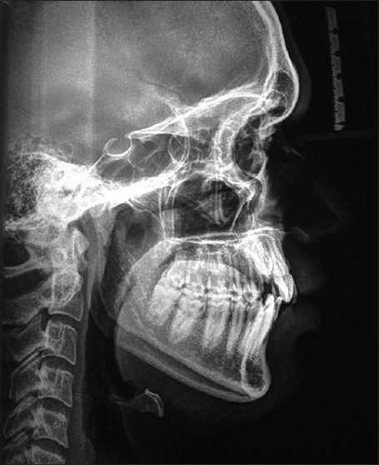
Lateral cephalogram
Also referred to as lateral “cephs”
Taken with head in a standardized reproducible position at a specific distance from X-ray source
Uses :
Important in orthodontic growth analysis
Diagnosis & Treatment planning
Monitoring of therapy
Evaluation of final treatment outcome

Slide 12
Posteroanterior (p-a) cephalometric radiograph
Image Receptor and Patient Placement:
Image receptor is placed in front of the patient, perpendicular to the midsagittal plane and parallel to the coronal plane
The patient is placed so that the canthomeatal line is perpendicular to the image receptor

Slide 13
Position of The Central X-Ray Beam:
Central beam is perpendicular to the image receptor, directed from the posterior to anterior parallel to the patient’s midsagittal plane and is centered at the level of bridge of the nose.
Resultant Image: the midsagittal plane should divide the image into two symmetric halves.

Slide 14
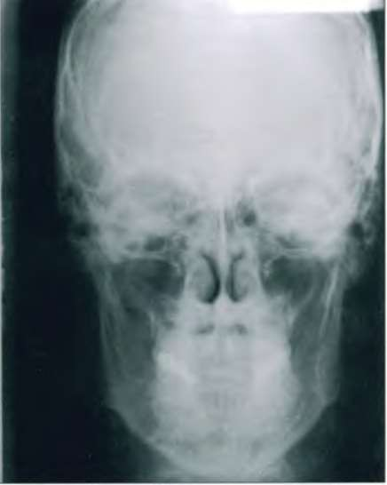
Uses :
Provides information related to skull width
Skull symmetry
Vertical proportions of skull, craniofacial complex & oral structures
For assessing growth abnormalities & trauma

Slide 15
A conspicuous point on a cephalogram that serves as a guide for measurement or construction of planes – Jacobson
2 types :
Anatomic: represent actual anatomic structure of the skull eg – N, ANS, pt A, Pr, Id, pt B, Pog, Me etc
Constructed: constructed or obtained secondarily from anatomic structures in the cephalogram eg– Gn, Go, Ptm, S

Slide 16
Requisites for a landmark
Should be easily seen on the roentgenogram
Be uniform in outline
Easily reproducible
Should permit valid quantitative measurement of lines and
angles
Lines and planes should have significant relationship
to the vectors of growth

Slide 17
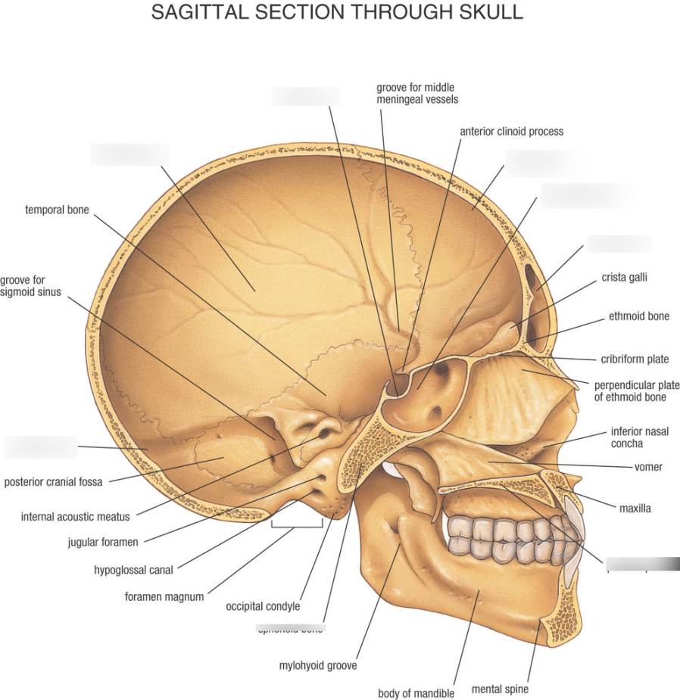
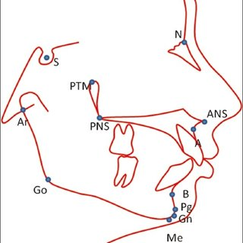
Landmarks
Sella (S) - The center of Pituitary Fossa
Nasion (N) – The most anterior point of the nasofrontal suture in the mid sagittal plane

Slide 18
Anterior Nasal Spine (ANS) – The anterior most midsagittal point on the tip of sharp bony process of maxilla
Subspinale (A) – The deepest midsagittal point on the concavity between Anterior Nasal Spine and Prosthion
Supramentale (B) – The deepest point in mid sagittal plane on the concavity between infradentale and pogonion
Key ridge: lower most point of infra temporal fossa

Slide 19
Pogonion (Pg) – Most anterior mid sagittal point on the contour of the chin
Menton (Me) – Most inferior point on the inferior contour of the chin
Gnathion (Gn) – Constructed by bisecting the Facial plane and tangent to lower border of mandible
Pterygomaxillary fissure (Ptm) –The most posterior point on the anterior contour of the maxillary tuberosity

Slide 20
Posterior Nasal Spine (PNS) – The most posterior point on the contour of the palate.
Articulare (Ar) – The intersection of sphenoid and the posterior border of the condyle
Gonion (Go) – constructed by bisecting the posterior ramal plane and mandibular plane.

Slide 21

Mandibular Plane (MP) – It is the line joining Gonion and Gnathion
Nasal Floor (NF) – A plane constructed by joining ANS and PNS

Slide 22
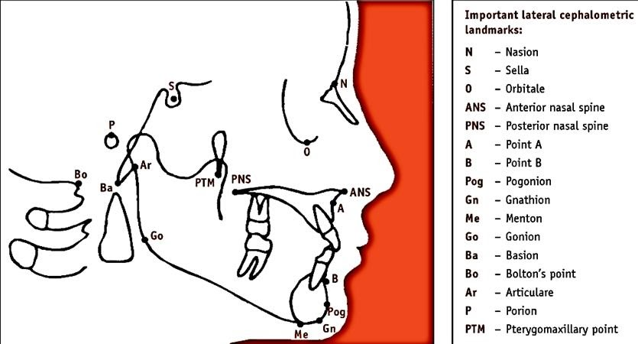
Bolton point

Slide 23
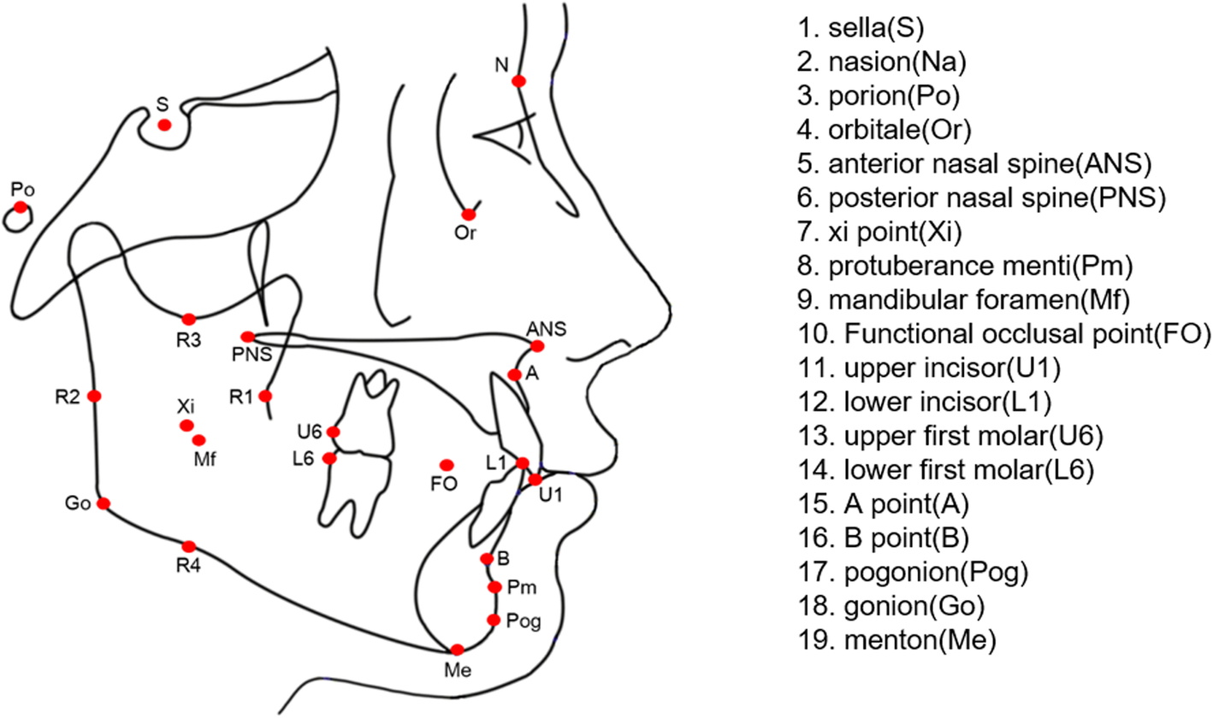
\

Slide 24


Slide 25
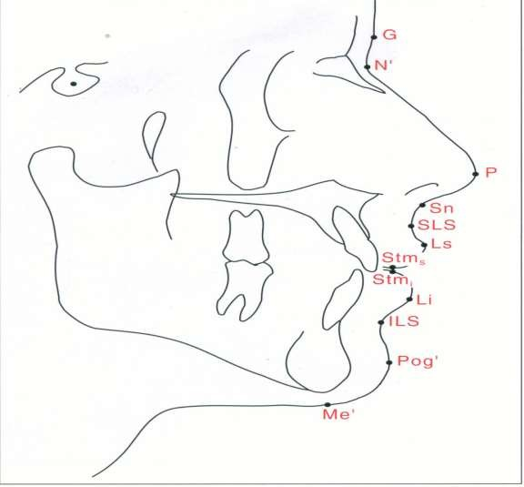
Soft tissue landmarks

Slide 26
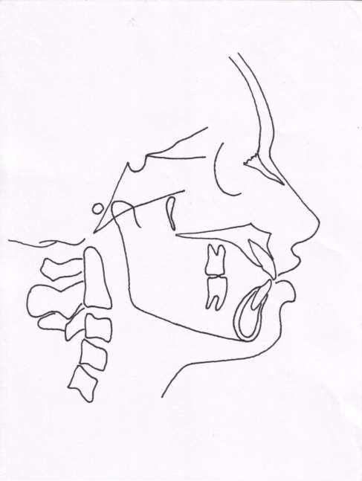
Horizontal planes
Se-Na
FH plane
Palatal plane
Occlusal plane
Mandibular plane
Basal plane

Slide 27
Mandibular plane: Different definitions are given in different analysis
Tweed- Tangent to lower border of the mandible
Downs analysis – extends from Go to Me
Steiner’s anlysis – extends from Go to Gn
Go
Gn Me

Slide 28
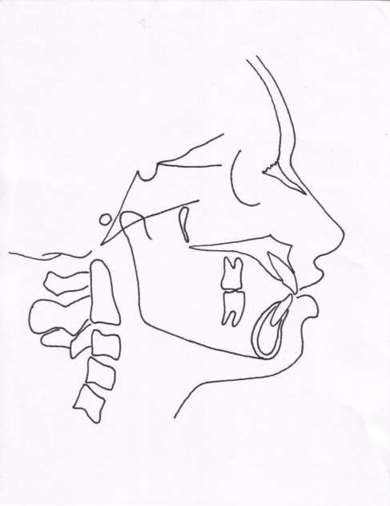
Vertical planes
Facial plane
A-Pog line
Facial axis
E. plane (Esthetic plane)
N
Ptm
A
E plane
Pog Gn

Slide 29
STEINER ANALYSIS
Developed by Steiner CC in 1930 with an idea of providing maximal information with the least no. of measurements
Divided the analysis into 3 parts
Skeletal
Dental
Soft tissue

Slide 30
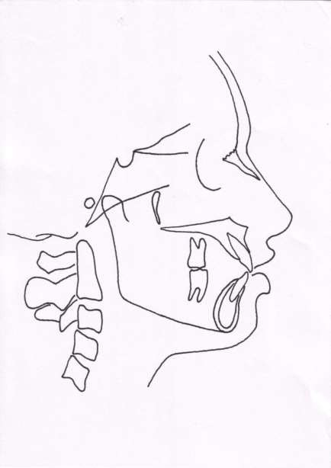
Skeletal analysis
S.N.A angle
Indicates the relative antero-posterior positioning of maxilla in relation to cranial base
>82° -- prognathic maxilla (Class 2)
< 82°– retrognathic maxilla (class 3)
N
S
A
Mean value -- 82°

Slide 31
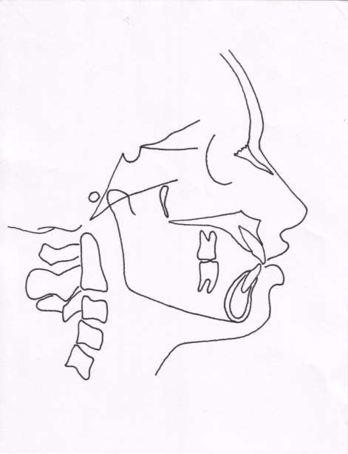
S.N.B angle
Indicates antero-posterior positioning of the mandible in relation to cranial base
> 80°-- prognathic mandible
< 80°-- retrusive mandible
N
S
B
Mean value-- 80°

Slide 32

A.N.B angle
Denotes relative position of maxilla & mandible to each other
N
A
B
Mean value = 2°
> 2° –- class 2 skeletal tendency
< 2°–- skeletal class 3 tendency

Slide 33
Mandibular plane angle
Gives an indication of growth pattern of an individual
N
S
< 32° -- horizontal growing face
> 32°– vertical growing individual
Mean value = 32°

Slide 34
Occlusal plane angle
Mean value = 14.5°
N
S
Indicates relation of occlusal plane to the cranium & face
Indicates growth pattern of an individual

Slide 35
Dental analysis
Upper incisor to N-A(angle)
Normal angle = 22°
Angle indicates relative inclination of upper incisors
Increased angle seen in class 2 div 1 malocclusion

Slide 36
N
A
Upper incisor to N-A ( linear)
Helps in asssessing the upper incisor inclination
Normal value is 4 mm
Increase in measurement
– proclined upper incisors

Slide 37
Inter-incisal angle
Mean value = 130 to 131°
< 130 to 131° -- class 2 div 1 malocclusion or a class 1 bimax
> 130 to 131° – class 2 div 2 malocclusion

Slide 38
Lower incisor to N-B (angle)
Indicates inclination of lower central incisors
>25 °-- proclination of lower incisors
< 25 °– retroclined incisors

Slide 39
Lower incisor to N-B (linear)
Helps in assessing lower incisor inclination
Increase in measurement indicates proclined lower incisors
Normal value– 4mm

Slide 40
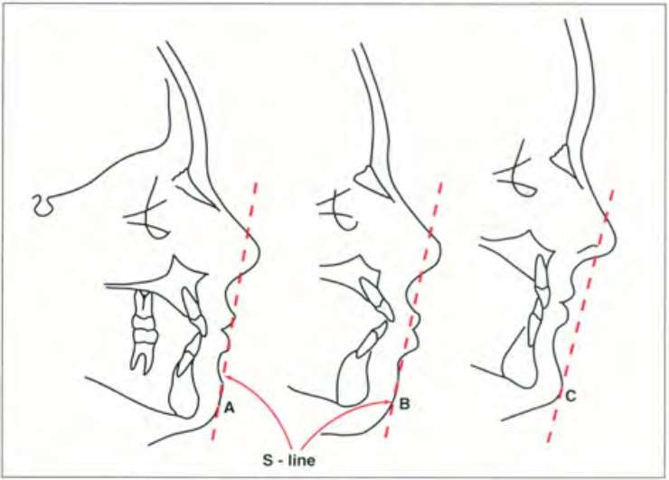
Soft tissue analysis
S line

Slide 41
DOWN’S ANALYSIS
Given by WB Downs, 1925
One of the most frequently used cephalometric analysis
Based on findings on 20 caucasian individuals of 12-17 yrs age group belonging to both the sexes
Consists of 10 parameters of which 5 are skeletal & 5 are dental

Slide 42
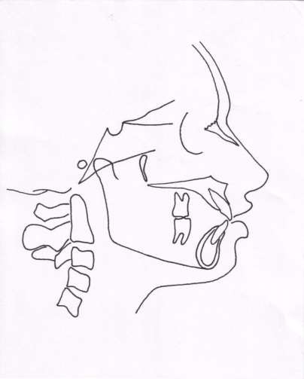
Skeletal parameters :
Facial angle
N
FH plane
Pog
Average value is 87.8°, Range 82-95°
Gives an indication of anteroposterior positioning of mandible in relation to upper face
Magnitude increases in skeletal class 3 cases, decreases in skeletal class 2 cases

Slide 43
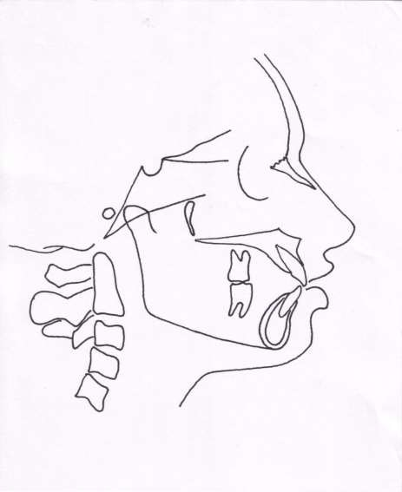
Angle of convexity
Reveals convexity or
concavity of skeletal profile
Average value 0°, Range = -
8.5 to 10°
Positive angle or increased angle – prominent maxillary denture base relative to mandible
Decreased angle , negative
angle – prognathic profile

Slide 44
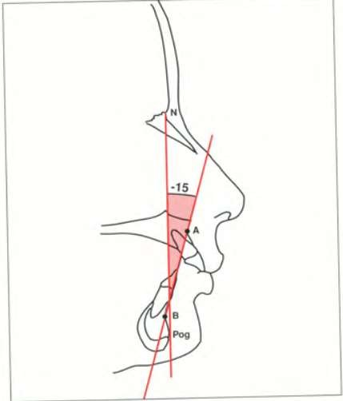
A-B plane angle
Mean value = -4.6°, Range
= -9 to 0°
Indicative of maxillary mandibular relationship in relation to facial plane
Positive angle in class 3 malocclusion

Slide 45
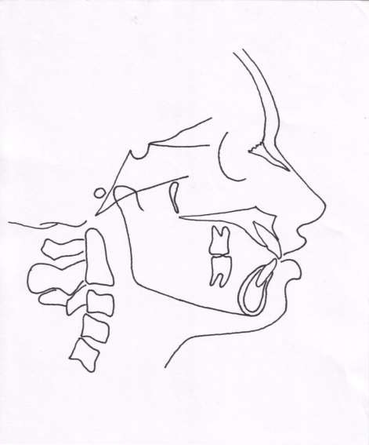
Mandibular plane angle
Mean value = 21.9°, Range
= 17 to 28°
Increased mandibular plane angle suggestive of vertical grower with hyperdivergent facial pattern

Slide 46
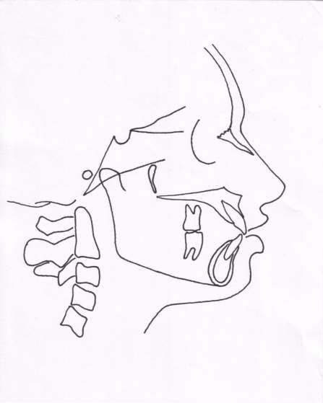
Y- axis (growth axis)
Mean value = 59° , range = 53 to 66°
Angle is larger in class 2 facial patterns than in class 3 patterns
Indicates growth pattern of an
individual
Angle greater than normal – vertical growth of mandible
Angle smaller than normal – horizontal growth of mandible

Slide 47
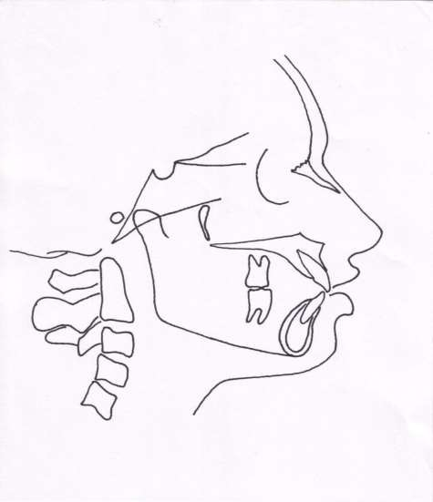
Dental parameters
Cant of occlusal plane
Mean value = 9.3° , Range = 1.5 to 14°
Gives a measure of slope of occlusal plane relative to FH plane

Slide 48
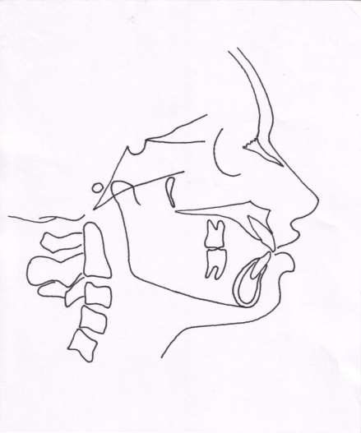
Inter- incisal angle
Average reading = 135.4° , range = 130 to 150.5°
Angle decreased in class 1 bimaxillary protrusion & class 2 div 1 malocculsion
Increased in class 2 div 2 case

Slide 49
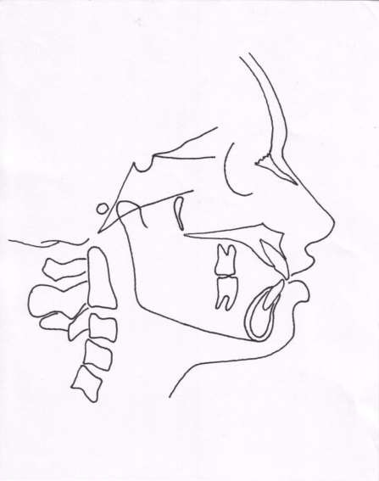
Incisor occlusal plane angle
Average value = 14.5°, range =
3.5 to 20°
Increase in the angle is suggestive of increased lower incisor proclination

Slide 50

Incisor mandibular plane angle
Mean angulation is 1.4, range
= -8.5 to 7°
Increase in angle is indicative of lower incisor proclination

Slide 51
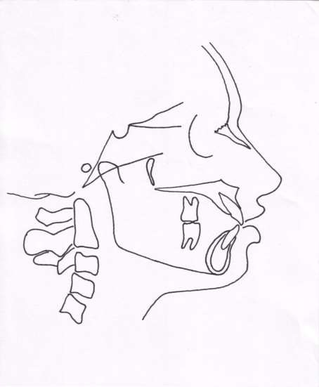
Upper incisor to A-Pog line
Average distance is 2.7mm (range -1 to 5 mm)
Measurement is more in patients with upper incisor proclination

Slide 52
Drawbacks
Too many landmarks
Too many measurements
Time consuming

Slide 53
TWEED ANALYSIS
Given by Tweed CH, 1946
He developed this from 95 subjects
Used 3 planes to establish a diagnostic triangle --
  Frankfurt horizontal plane
  Mandibular plane
  Long axis of lower incisor
Determines position of lower incisor

Slide 54
FMPA = 25 °
FH plane
IMPA = 90 °
FMIA = 65 °
Mand plane

Slide 55
WITS APPRAISAL
It is a measure of the extent to which maxilla & mandible are related to each other in antero- posterior or sagittal plane
Used in cases where ANB angle is considered not so reliable due to factors such as position of nasion & rotation of jaws

Slide 56
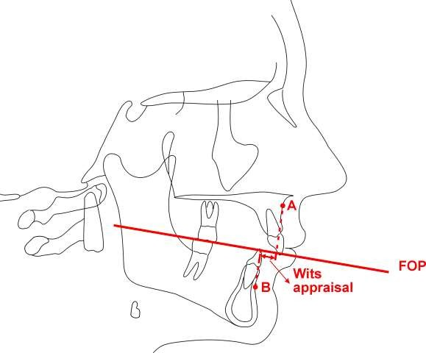
In males point BO is ahead of AO by 1mm
In females point AO & BO coincide
In skeletal class 2 tendency BO is usually behind AO( positive reading)
In skeletal class 3 tendency BO is located ahead of AO ( negative reading)

Slide 57
Limitations
It gives two dimensional view of a three dimensional object
It gives a static picture which does not takes time into consideration
The reliability of cephalometrics is not always accurate
Standardization of analytical procedures are difficult

Slide 58
Sources of error in Cephalometry
Error Radiographic projection errors | Causes of error | How to minimize the error
A) Magnification: Enlargement | X ray beams are not parallel with all points of the object | By using a long focus- object distance & a short object- film distance
B) Distortions: Head being 3D causes different magnifications at different depths of field | Landmarks & structures not situated in the midsaggital plane are usually bilateral & may cause dual images in radiographs | May be overcome by recording the midpoint of 2 images
 | Rotation of patient’s head in any plane of space in cephalostat may produce linear/angular distortions | By standardized head orientation using ear rods, orbital pointer & forehead rest

Slide 59
Error : Errors within the measuring system | Causes of error | How to minimize the error
Error may occur in the measurement of various linear & angular measurements | Human error may creep in during the tracing measurements | Use of computerized plotters & digitizers to digitize the landmarks & carry out the various linear & angular measurements has proved to be more accurate

Slide 60
Error : Errors in landmarks identification | Causes of error | How to minimize the error
A) Quality of radiographic image | Poor definition of radiographs may occur due to use of old films & intensifying screen although radiation dose is reduced | Recommended films should be used to avoid poor definition radiographs
 | Movement of object, tube or film may cause a motion blur | Stabilizing the object, tube, film. By increasing the current exposure time is reduced, minimizing motion blur
 | Blurring of radiograph due to scattered radiation that fogs the film | Can be reduced by use of grids

Slide 61
Error : Errors in landmarks identification | Causes of error | How to minimize the error
B) Precision of landmark definition & reproducibility of landmark location | May occur if landmark is not defined accurately, causes confusion in identification of landmark | Landmarks have to be accurately defined. Certain landmarks may require special conditions to identify which should be strictly followed
 | In general certain landmarks are difficult to identify such as porion | Good quality radiography
C) Operator bias | Variations in landmarks identification between operators | Advisable for the same person to identify & trace the patients

Slide 62
Conclusion
The future of cephalometrics depends on the three dimensional analysis, their accuracy, validity and reproducibility
Still the value of the information and insight given by these traditional analyses should not be ignored or taken lightly

Slide 63
Reference
Radiographic Cephalometrics – Alex Jacobson
Orthodontic Cephalometry – Athanasios E Athanasiou
Contemporary Orthodontics – WilliamProffit
Practice Of Orthodontics, Volume 1 & Volume 2 A. Salzmann
Clinical Orthodontics, Volume 1 - Charles H Tweed
Orthodontics, The art & science – SI Balajhi
An Atlas on CEPHALOMETRIC LANDMARKS – Basavaraj Subhaschandra Phulari

