Slide 1
Case HISTORY and intraoral examination

Slide 2
CONTENTS
Introduction
Diagnostic aids
Case history
Personal information
Chief complaint
Prenatal history
Birth history
Postnatal history
Parafunctional habits
Medical history
Dental history
Family history
Intraoral examination
Soft tissue examination
Hard tissue examination
References

Slide 3
INTRODUCTION:-
Dia – gnosis – Greek word
Dia – Apart and Gnosis – to come to know
Definition-
“The act / process of identifying or determining the nature
and cause of a disease or injury through evaluation of patient history , examination and review of laboratory data.”
Orthodontic diagnosis deals with recognition of the various characteristics of the malocclusion. It involves collection of pertinent data in a systemic manner to help in the identifying the nature and cause of the problem.

Slide 4
Diagnostic aids
Diagnostic aids – comprehensive orthodontic diagnosis is established by use of certain clinical implements called diagnostic aids.
Diagnostic aids are classified as:-
Essential diagnostic aids
Non Essential/Supplemental diagnostic aids

Slide 5
Essential diagnostic aids
These are essential for diagnosis of an orthodontic case. Ideally before starting the case , a clinician must possess these aids:-
Case history
Clinical examination
Study models
Certain radiographs: Opg, lateral ceph, IOPA
Facial photographs

Slide 6
Supplemental Diagnostic Aids
These may be required only in certain cases and may require specialized equipment, which might not be available in every dental clinic.
Specialized radiographs
Occlusal view of maxilla/mandible
Emg examination of muscle activity
Hand wrist radiographs
CT scan
MRI
Endocrine test

Slide 7
CASE HISTORY

Slide 8
CASE HISTORY
Primary diagnostic tool
Most effective way to diagnose
Involves eliciting & recording of relevant information from the patient and parent to aid in overall diagnosis of the case.

Slide 9
Objective:
1. Knowledge Sharing: Enables patient to communicate symptoms , feelings & fears & the sequence of events leading to current complaint.
2. Rapport building: Enables the dentist to establish a rapport with the patient.

Slide 10
Personal Information

Slide 11
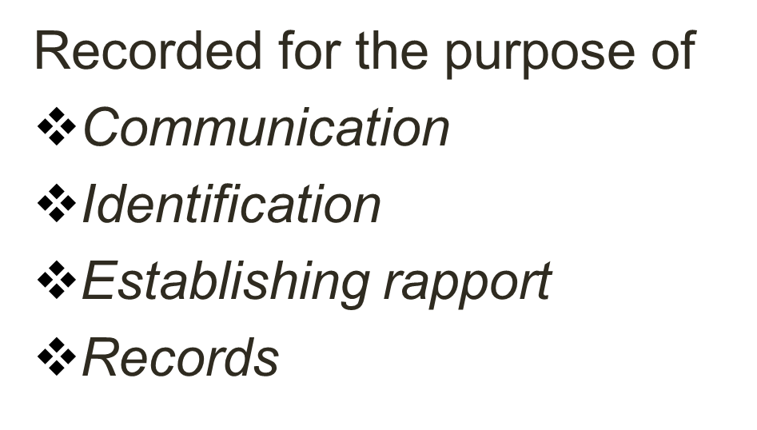
PERSONAL INFORMATION
Includes the basic data for communication and access.
Name:-

Slide 12
Age & Date of birth
Chronological age of patient should be noted.
Aids in diagnosis, treatment planning & growth prediction.
Helps compare dental & skeletal age - growth & development is normal in the child.
Clarification and explanation of age related conditions e.g. ugly duckling stage, growth spurts.

Slide 13
Gender
Helps in treatment planning
Growth Milestones: Girls mature earlier than boys.
    Growth spurt
    Eruption of teeth
    Onset of puberty
Certain diseases are gender specific
eg:-males – attrition , leukoplakia, lymphomas.
Females –iron deficiency anemia ,recurrent aphthous ulcers ,
Sjogren's syndrome

Slide 14
CLINICAL SIGNIFICANCE OF GROWTH SPURT
1. Differentiate growth changes are normal or pathologic.
2. Treatment of skeletal discrepancies is more advantages in mixed dentition.
3. Arch expansion is carried out in maximum growth period.
4. orthognathic surgeries should be carried after growth ceases.
5. Pubertal growth spurt offers best time in cases like predictability ,treatment direction time and management.

Slide 15
Out Patient number
Helps in maintaining the records
Day to day management of patient
Compilation of disease profile for statistical analysis
Planning of resources

Slide 16
Address, Phone and e-mail
Helps in future correspondence.
Scheduling appointments.
Helps ascertain socio-economic status of the patient.

Slide 17
Occupation
Helps in estimating socioeconomic status of individual.
Guides the kind of appliance to be given.
Gives an insight into the etiology of disease ( life style ,eating habits regularity of check up) e.g.
1. tailors have notching of incisors
2. lifeguards have erosions due to high chlorine.

Slide 18
Religion & Ethnic origin
Prevalence: some of the diseases are
more prevalent in specific ethnic groups
Eg classIII in afghans and Kashmiris ,classII in Americans and deep bite in gujratis.
Dietary habits: Type of diet may vary thus indirectly affecting dental health
Eg :-1.nomadic tribes had less caries rate and more attrition of teeth due to eating uncooked food
2.high caries rate in children due to eating fast foods(refined foods).
Treatment scheduling- Identify festive period when people of particular religion are reluctant to undergo treatment

Slide 19
Chief Complaint

Slide 20
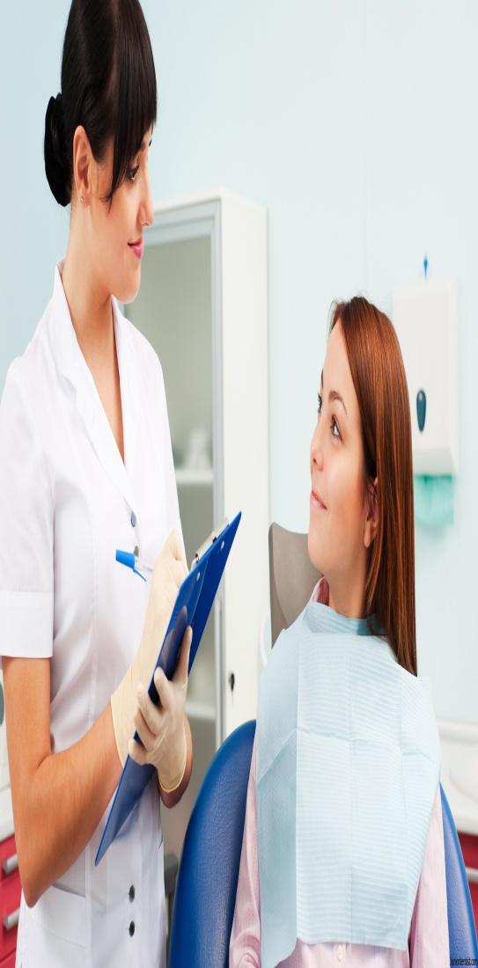
Chief Complaint
Mention the condition (symptoms) the patient feels he/ she is suffering from.
Most important part of history taking as it helps the clinician in identifying the concerns of the patient.
Recorded in patient’s own words.

Slide 21
Chief Complaint
Noted in the order of their relative importance as mentioned by the patient.
  Impaired dento-facial appearance & diminished sense of social
  well being
  Impaired function
  Impaired oral health

Slide 22
Follow up questions
When patient enquire about whether he/ she needs orthodontic treatment, a series of follow up questions could be asked:-
“What bothers you most about your teeth or your appearance ”What do you want the treatment to do for you?”
Such questions clarifies what is of utmost importance to the patient
In case of children, parent’s perception of malocclusion should also be noted. It helps in setting treatment objectives & satisfying family in general.

Slide 23
PRENATAL HISTORY

Slide 24
PRENATAL HISTORY
Nutritional disorders in the mother, drugs taken, diseases & accidents of mother during pregnancy can hamper the normal growth and development of child.
Drug induced deformities
  Thalidomide ( teratogenic agent ) - phocomelia
  Tetracycline – yellowish discolorations
Injury or trauma
  oro-facial deformities
Diseases
  German measles – cleft lip and palate

Slide 25
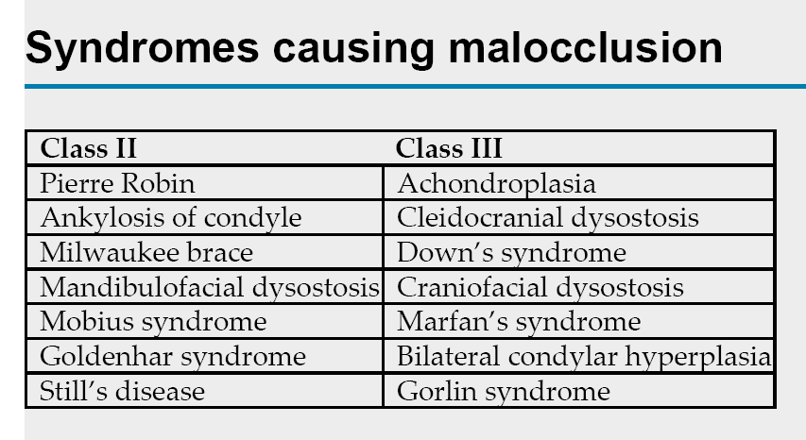

Slide 26
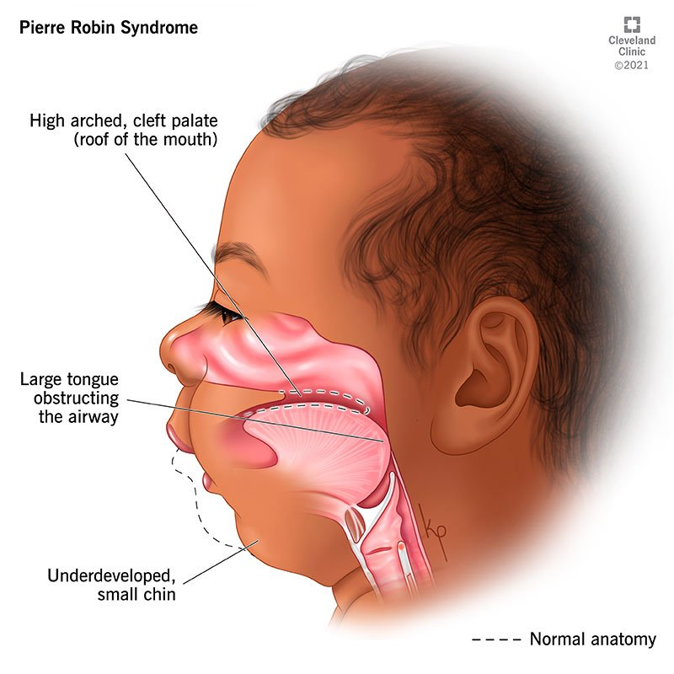
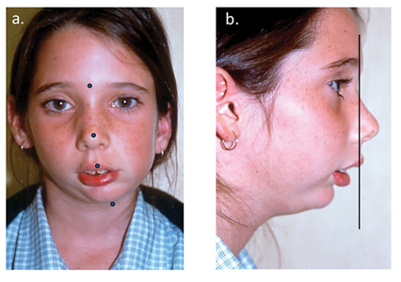
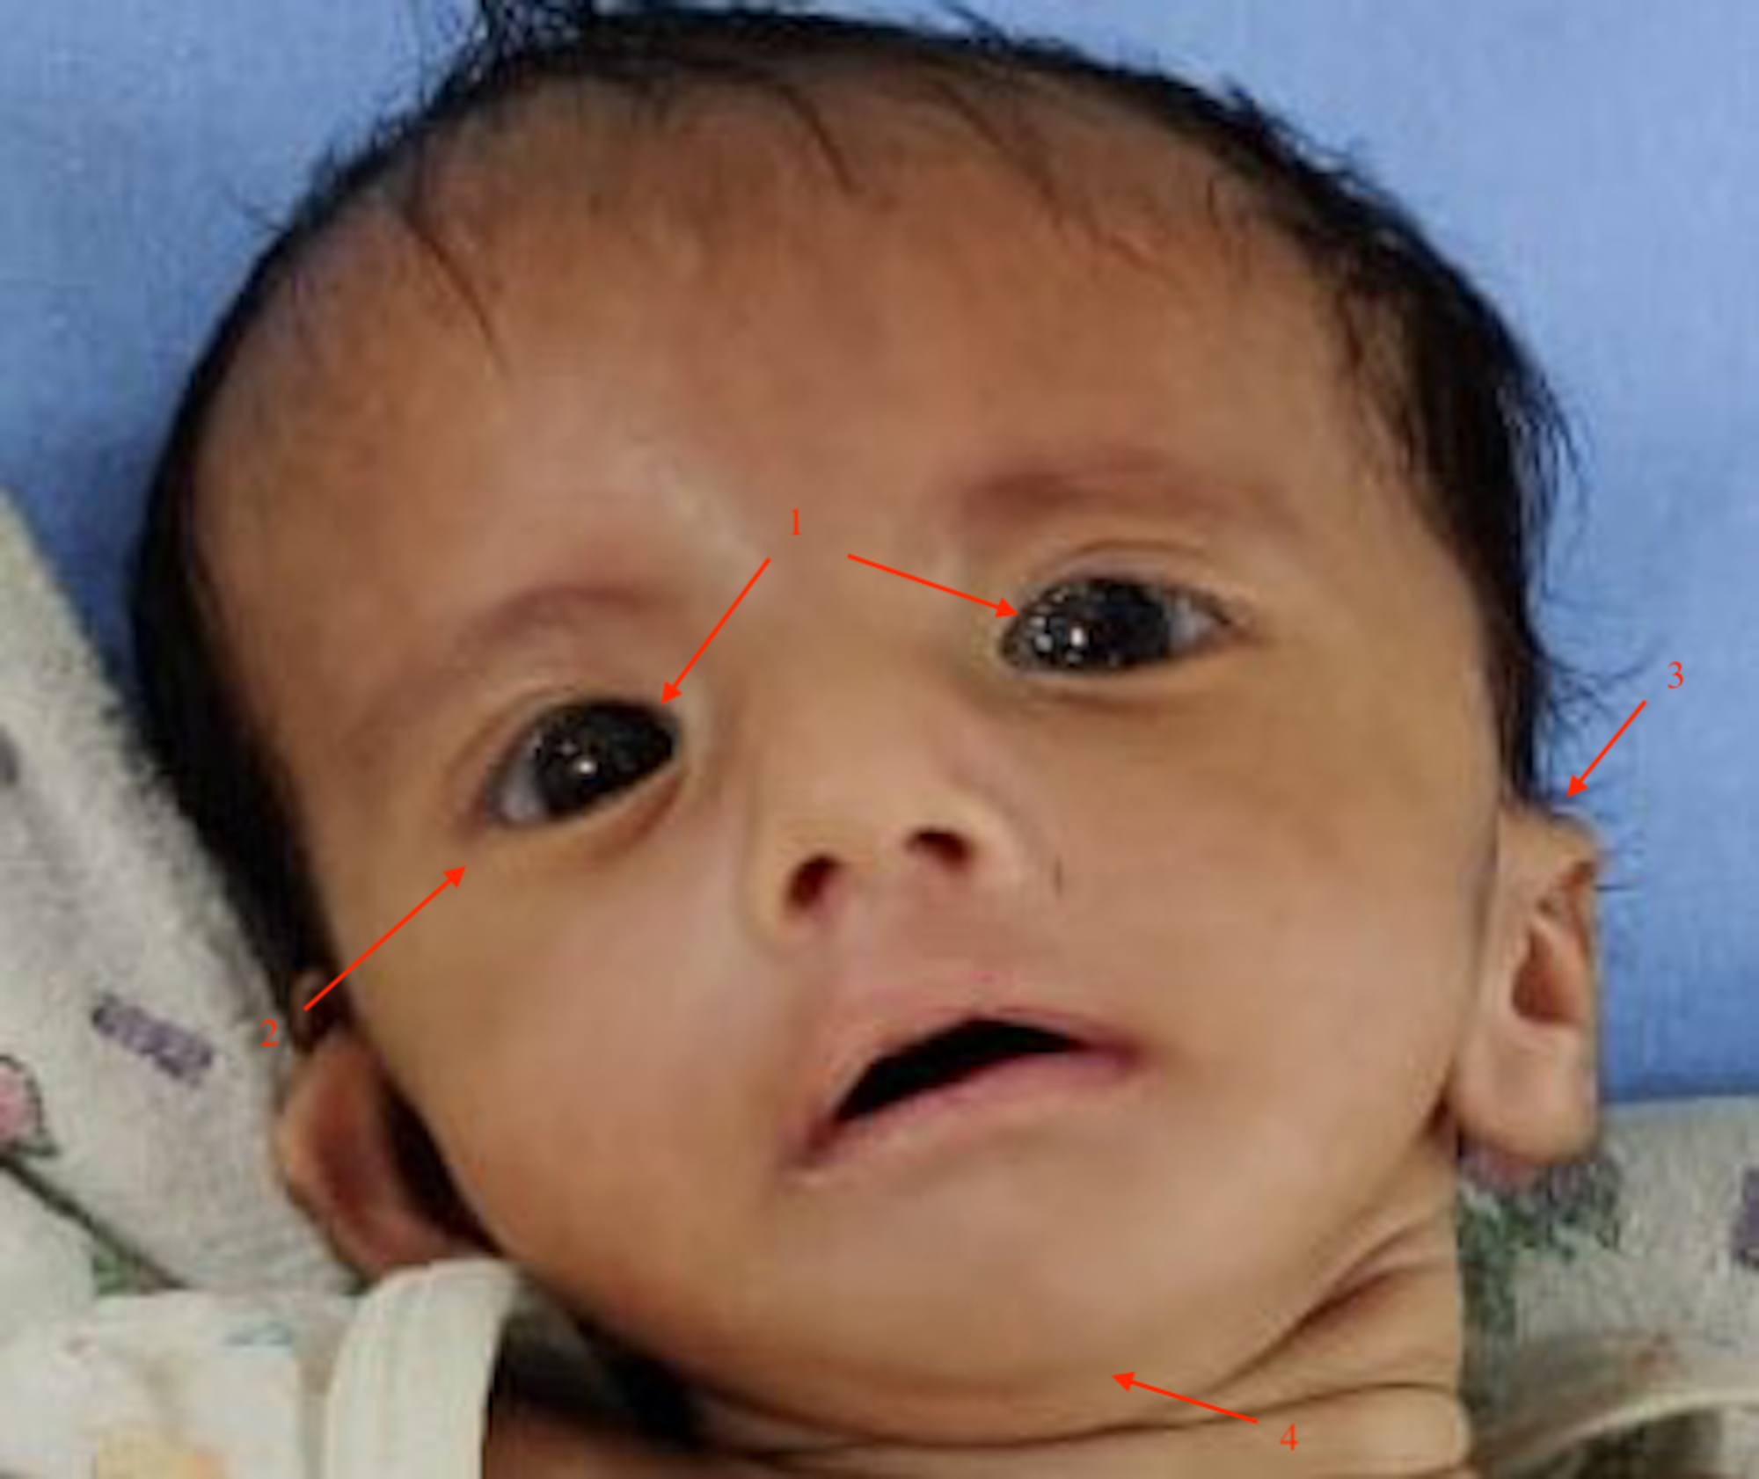
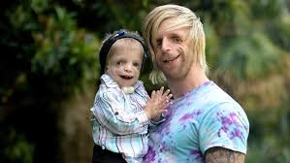
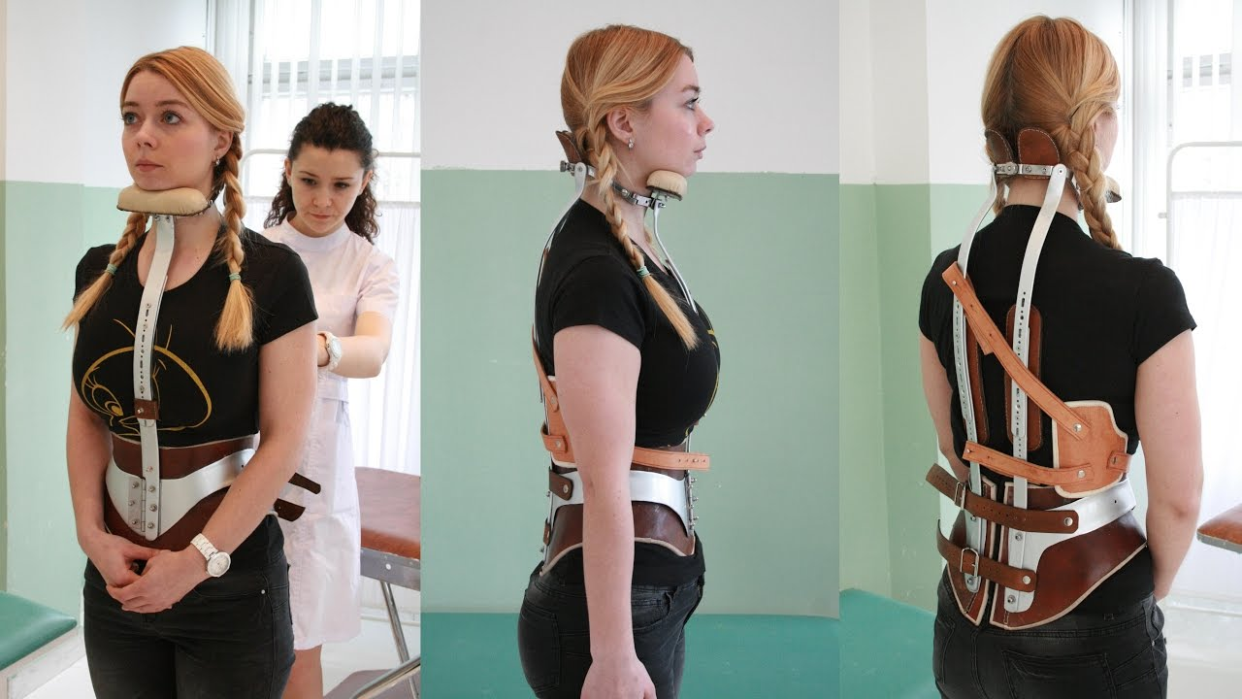

Slide 27
Syndromes affecting dentofacial development associated with mandibular deficiency and class II malocclusion
syndromes | features
Pierre Robin syndrome | Micrognathia , cleft palate , glossoptosis
Treacher Collins Syndrome | Downward slanting palpebral fissures , micrognathia ,

Slide 28
Syndromes associated with mid facial deformity and class III relationship
Syndromes | Features
Apert Syndrome | Craniosynostosis , proptosis , hypertelorism , syndactly of hands
Down’s Syndrome | Hypoplastic maxilla , macroglossia , posterior cross bite
Crouzon’ s Syndrome | Craniosynostosis , maxillary hypoplasia , proptosis
Achondroplasia | Dwarfism , depressed nasal bridge , high palate

Slide 29
Syndromes associated with mandibular prognathism
Syndromes | Features
Klienfelter’s Syndrome | Skeletal disproportion , taurodontism , gynaecomastia
Osteogenesis Imperfecta | Fragile Bones , Blue Sclera
Basal Cell Nevus | Frontal and parietal bossing , bifid ribs , multiple jaw cyst , multiple basal cell carcinoma

Slide 30
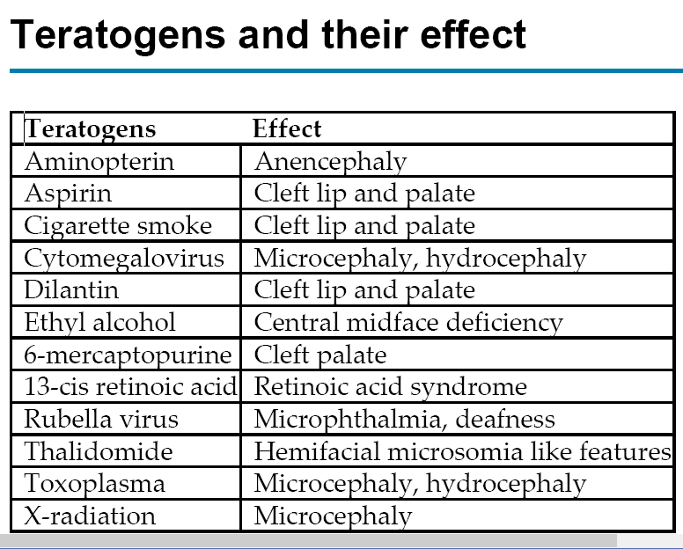

Slide 31
BIRTH HISTORY

Slide 32
BIRTH HISTORY
Type of delivery: Premature , Normal , Late
Related problems :
Low birth wt
Neurodevelopmental disabilities
Cerebral palsy
Mental retardation , visual & hearing impairment
Behavioral problems

Slide 33
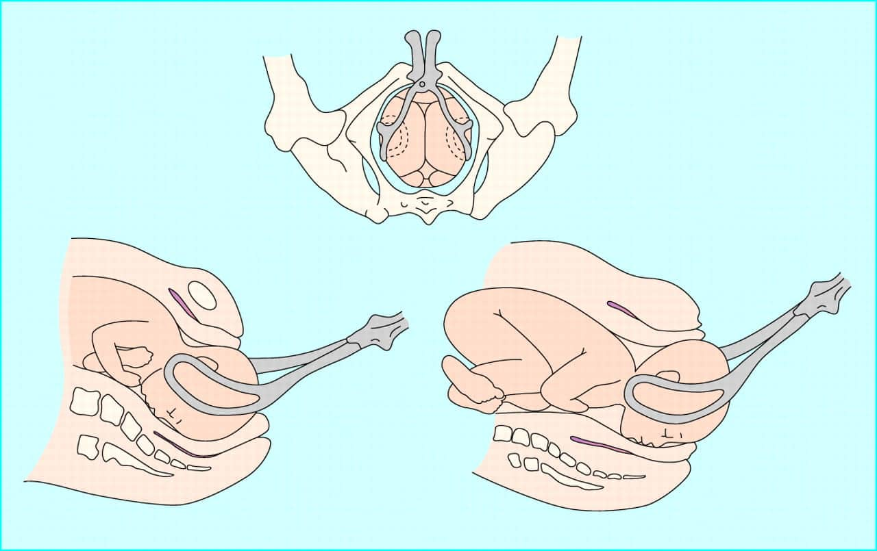
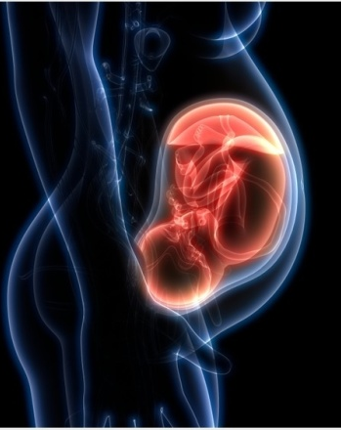
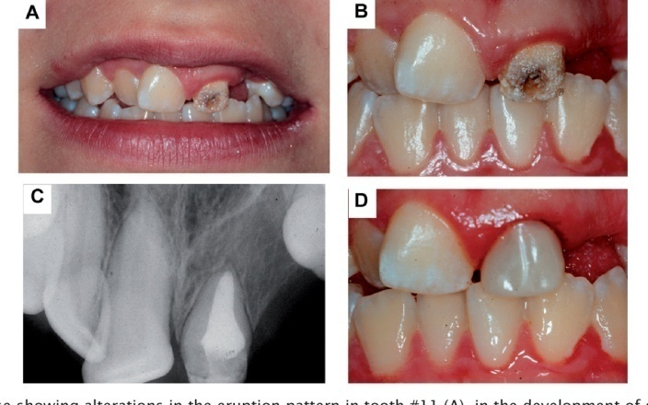
BIRTH HISTORY
Primary & permanent teeth affected - illness during infancy.
Chronic illness affects growth.
Forceps delivery –TMJ injuries can manifest as marked
mandibular growth retardation.

Slide 34
POSTNATAL HISTORY

Slide 35
POSTNATAL HISTORY
It includes information on the type of feeding, presence of oral habits &milestones of normal development.
Developmental state at birth :-
Normal
Underdeveloped
Hospitalized

Slide 36
Milestones of normal development
Crawling- starts between 7 to 10 mths
Learned to walk - Normally: around 10 to 13 months
Learned to speak
Helps in evaluating normal growth or any deviation
-any defect
-children with tongue thrusting habit tend to lisp
-cleft palate patient have nasal tone.

Slide 37
PARAFUNCTIONAL HABITS

Slide 38
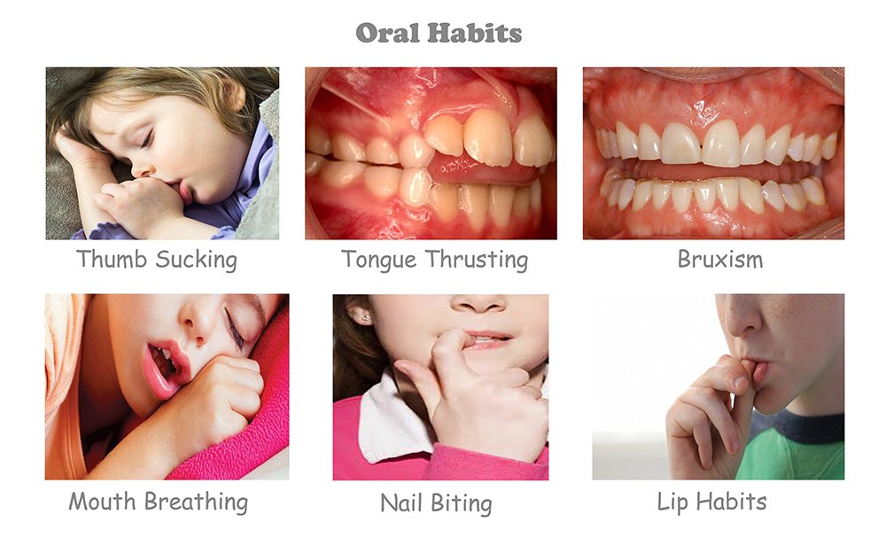
Habits

Slide 39
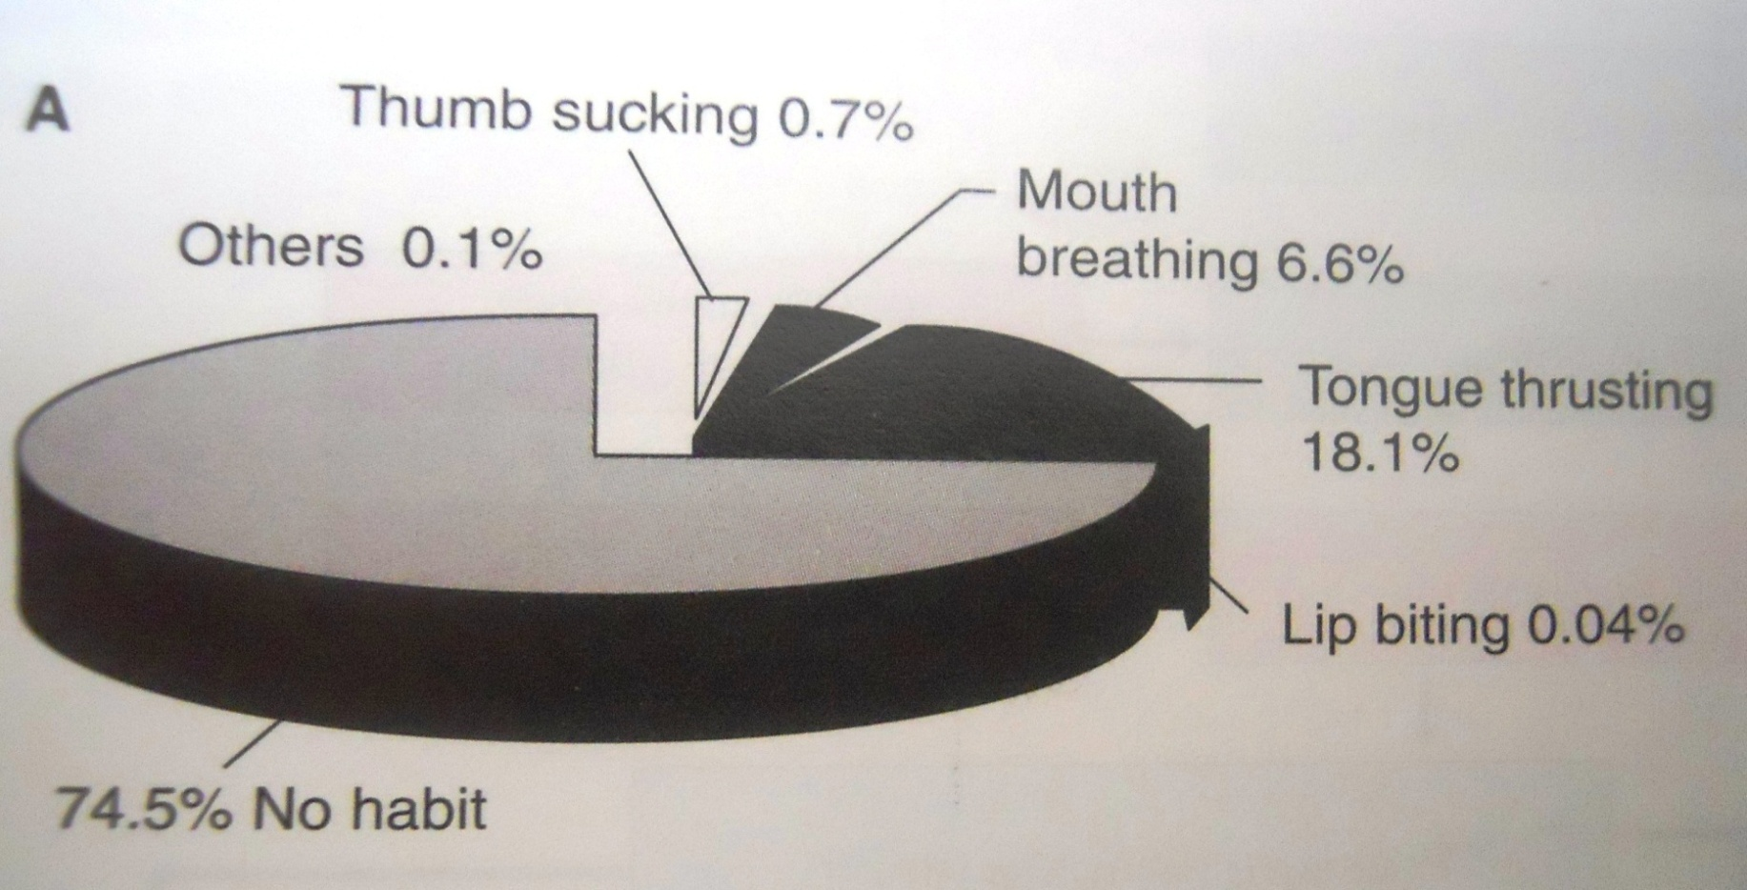
Prevalence of various oral habits

Slide 40
  MEDICAL HISTORY

Slide 41
Medical History
Knowledge of patients' general health is essential and should be obtained prior to examination.
Very few medical conditions contraindicate the use of orthodontic appliances like:-
Epilepsy
History of blood dyscrasias
Diabetic patient
Rheumatic fever
Cardiac anomalies
Physically and mentally handicapped children

Slide 42
Medical History
Should find out etiology while taking history
Old injury- growth deficit- true facial asymmetry
trauma to teeth- impaired occlusion
Periodontium must be sound prior to orthodontic treatment
Systemic diseases should be under control.

Slide 43
Drugs
NSAIDS
NSAIDS disturbs orthodontic tooth movement.
Paracetamol may be analgesic of choice in orthodontic cases.
Corticosteroids
Postpone orthodontic treatment in patients taking acute doses of corticosteroids – periodontal problems

Slide 44
Hypoglycemia: Most Important Complication
Hypoglycemia- tremors , sweating, anxiety tachycardia, mental confusion, slurred speech, drowsiness
Meal & medication prior to treatment

Slide 45
Allergy with nickel
Imp: History of atopic dermatitis to nickel containing metal
Treated with caution
Diagnosed nickel hypersensitivity
Replace Ni –Ti arch wires with s/s arch wires with low nickel content
  Titanium molybdenum alloy –nickel free
  Fiber reinforced composite wires
  Pure titanium or gold plated wires

Slide 46
Allergy with latex
Reduce latex exposure to patient
Latex free goods to be stored in ‘latex screened’
Early morning appointments to reduce exposure

Slide 47
Dental aspect of increased blood pressure
No elective dental procedure on patient with uncontrolled hypertension (Malignant Hypertension)
Increase risk of stroke or myocardial infarction in dental chair

Slide 48
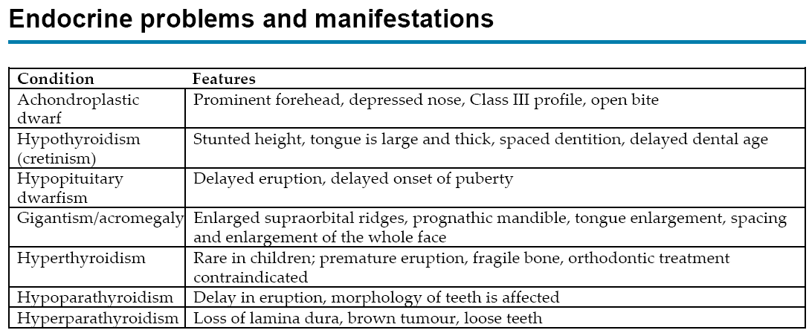

Slide 49
DENTAL HISTORY

Slide 50
DENTAL HISTORY
Age of eruption & exfoliation of deciduous &permanent teeth
History of :-
    extraction
    Decay
    Restoration
    Trauma
    Patient’s & parent’s attitude towards dental health

Slide 51
FAMILY HISTORY

Slide 52
Family history
Family history should record details of malocclusion existing in other members of the family.
Class II, class III malocclusions and congenital conditions such as clefts of lip & palate are inherited.

Slide 53
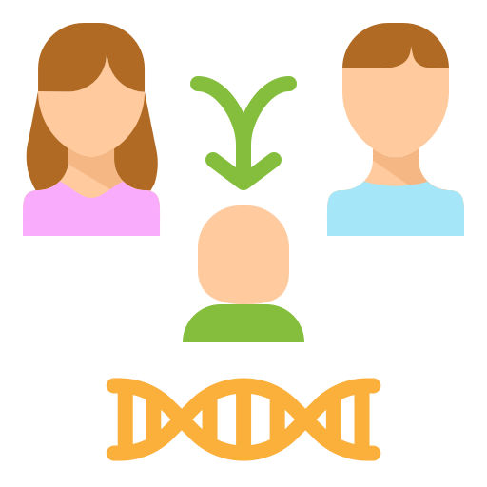
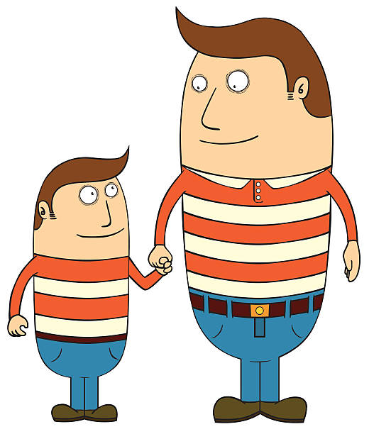

Slide 54
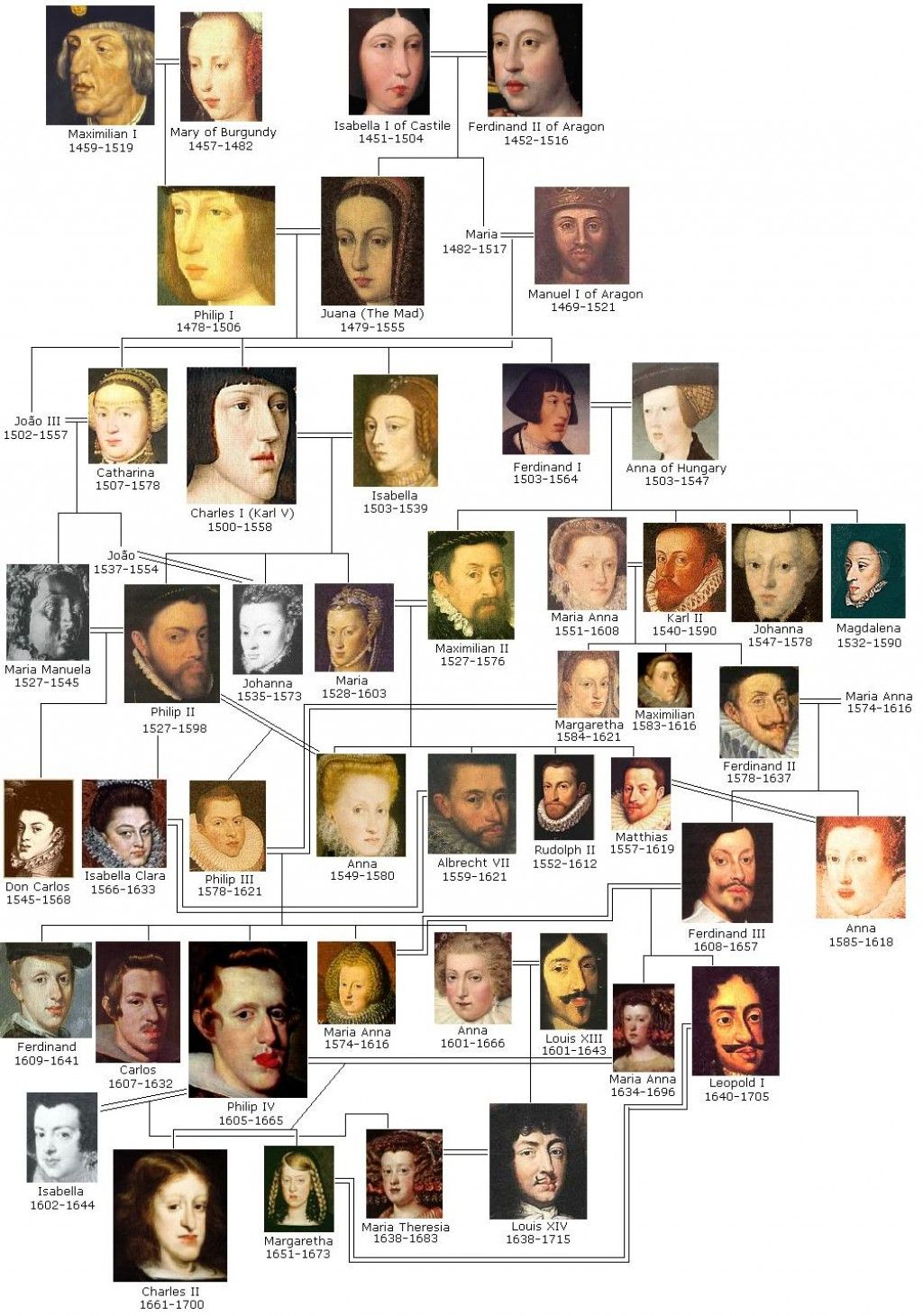
Habs burgs jaw.

Slide 55
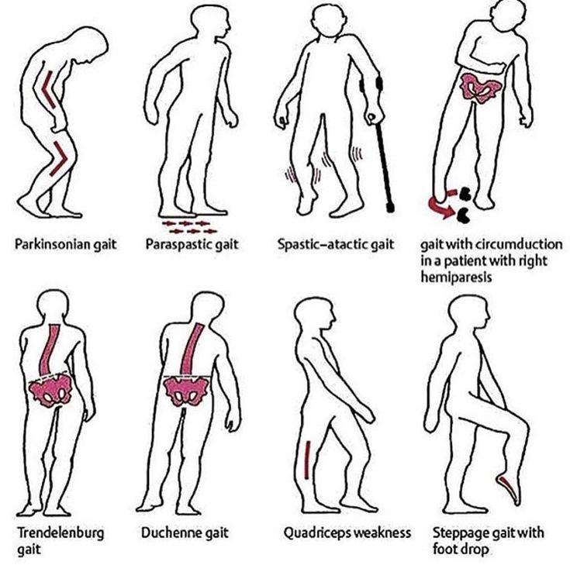
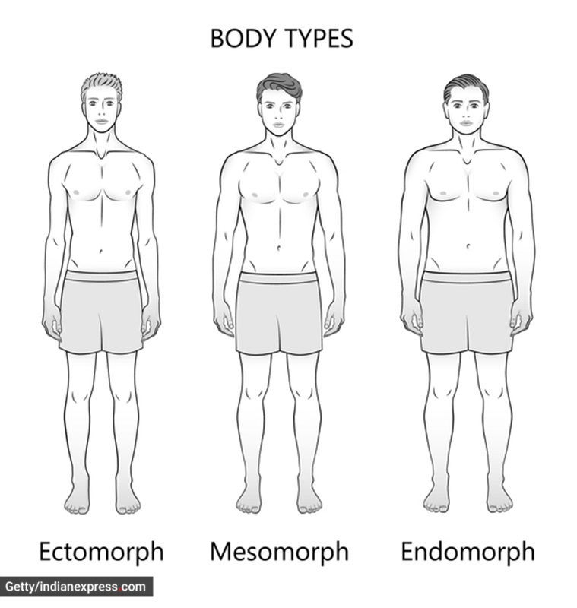
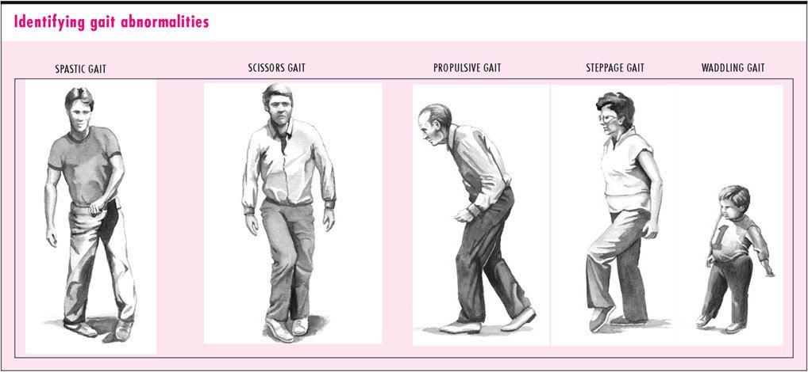
General examination
Height
Gait
Posture
Body built

Slide 56
