Slide 1
Case history, diagnosis and treatment planning.
Dr. Yarlagadda Siva Kiran Babu

Slide 2

contents
Introduction
Principles of perception
Definition
Personal data
Medical history
Dental history
Clinical evaluation
extra oral
intra oral

Slide 3
Investigation
Diagnosis
Treatment planning
Patient education
prognosis

Slide 4

INTRODUCTION
prosthodontic needs- general health,
socioeconomic status,
lifestyle
-ZARB.BLONDER.
Successful complete denture-
physical and psychological condition
function of complete denture
-WINKLER

Slide 5
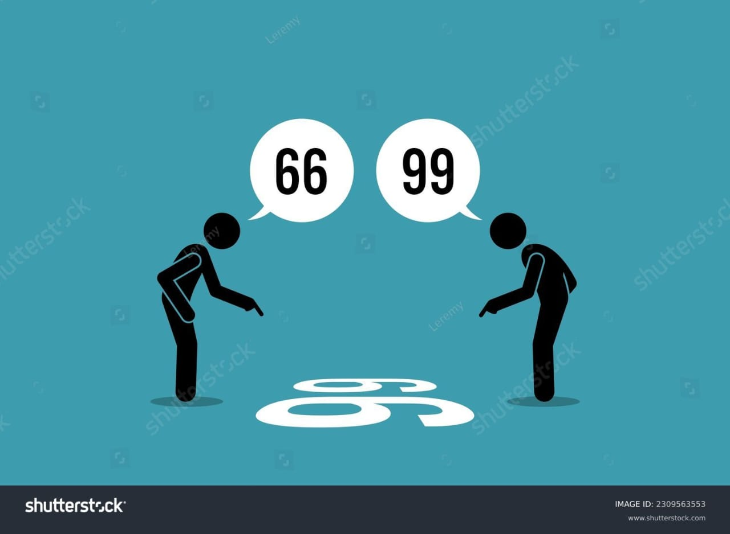
Principles of perception
Visual perception will be the primary mode of data gathering in the examination.
1. Detection
2. Discrimination
3. Recognition
4. Identification
5. Judgement

Slide 6
Definition (GPT10)
Case history: The collected data about an individual, family, environmental factors (including medical and dental history), and any other information that may be useful in analyzing and diagnosing conditions or for instructional purposes.
Diagnosis: The determination of the nature of a disease

Slide 7
According to DCNA case history should include
Personal data :-
Name
  Age
  Gender
  Occupation
  Address
  Contact details
  Cosmetic index
  Personality and mental attitude
  Socio-economic status

Slide 8
Medical History :
  Systemic factors
  Localized lesions
  Pathology
Dental History:
  Expectations
  Years of Edentulousness
  Previous/ existing dentures.
  Experience with dentures
  Pre extraction records

Slide 9
Clinical evaluation:
  EXTRA-ORAL
    Facial form
    Muscle tone
    Muscle development
    Complexion
    Lip
    TMJ
    Neuromuscular evaluation

Slide 10
Intra oral examination:
    Arch size
    Lateral throat form
    Palatal throat form
    Palatal sensitivity
    Mucosal thickness
    Mucosal condition
    Defects
    Tori

Slide 11
    Inter-arch space
    Ridge parallelism
    Ridge relation
    Border attachment
    Frenal attachment
    Saliva
    Tongue size
    Tongue position

Slide 12

Name
The dentist should always address the patient by him/her name.
Its a good way of gaining the patients confidence.
To maintain records.

Slide 13
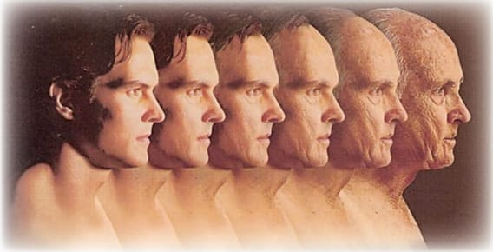
Age
The age of the patient has a definite bearing on diagnosis for complete dentures.
A young person will be more adaptable to new situations and learning new skills such as new dentures than an older person.

Slide 14

Gender
Appearance is a higher priority for women than for men.
However, men shift their concern more towards comforts and function.
Young men though have high priority for looks, older men grow indifferent for the looks.

Slide 15

Contact number
Patient number is required for follow-up appointments.
To change appointments if required

Slide 16

Address/location
Address is important for purpose of maintaining the record and for future correspondence.
Community
Some endemic disorders like fluorosis are confined to certain localities
gives an idea about the dietary habits of patients

Slide 17

Occupation
It influences the degree of importance of factors like esthetics, phonetics & general appearance.
Job & social standing determines the value patient gives on his/her dental health/esthetics.
Professionals having direct people contact prefer appearance/retention more often than efficiency.

Slide 18

Race
Race can be a critical factor in the characterization of dentures
    Choice of denture base shade
    Placement of denture base stains, etc

Slide 19
Cosmetic Index
Classify the patient from
  class 1: high cosmetic index
  class 2: average cosmetic index
  class 3: low cosmetic index
Notes:
Patients with high cosmetic indices, though often exacting, usually are appreciative and cooperative
patients with low cosmetic indices often are indifferent, uncooperative, and place little value on the efforts of the prosthodontist

Slide 20

Mental Attitude of Patients
Dr. Milus Marylson House in 1960 classified patient's psychology into four types:
    Class I: Philosophical or reasonable
    Class II: Exacting or critical
    Class III: Hysterical or antagonistic
    Class IV: Indifferent or passive

Slide 21
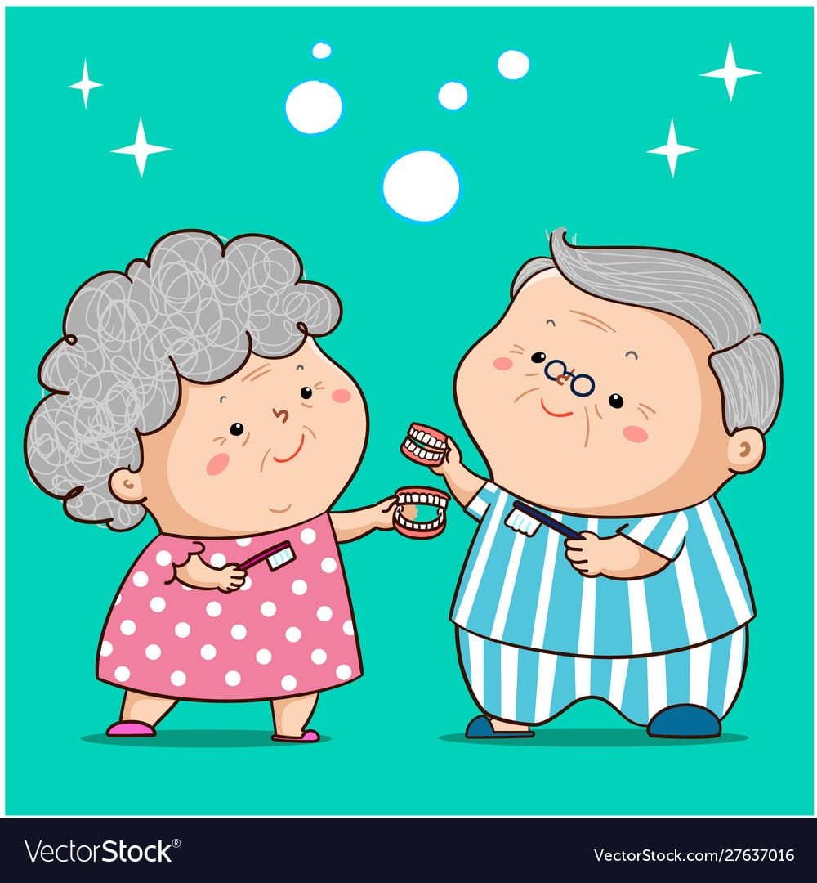
Philosophic:
Those patients are easygoing, congenial, mentally well-adjusted, cooperative, and confident in the dentist.
Prognosis is excellent.

Slide 22
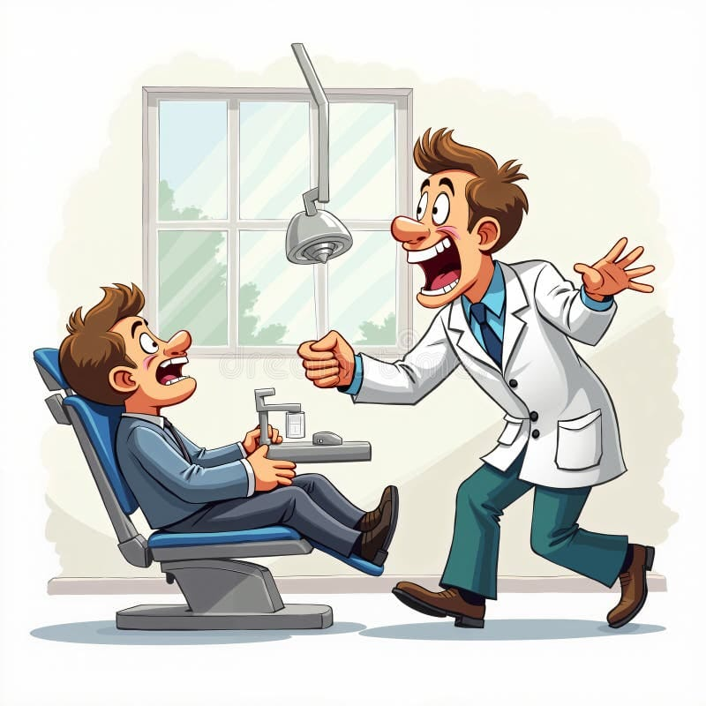
Exacting:
These patients are precise, above average in intelligence, doubt the ability of the practitioner, often want written guarantees or remakes.
Once satisfied, an exacting patient may become the practitioner's greatest supporter

Slide 23
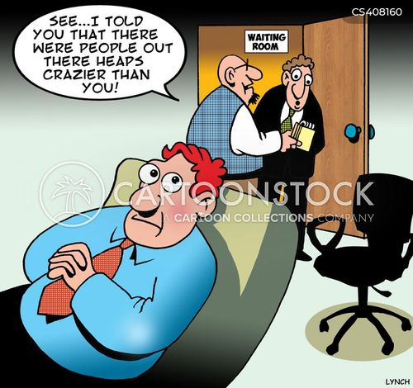
Hysterical:
These patients submit to treatment as a last resort, have a negative attitude, are often in poor health, are poorly adjusted have unrealistic expectations.
Hysterical patients often demand esthetics and function equal to or greater than natural teeth.
Prognosis is poor.

Slide 24
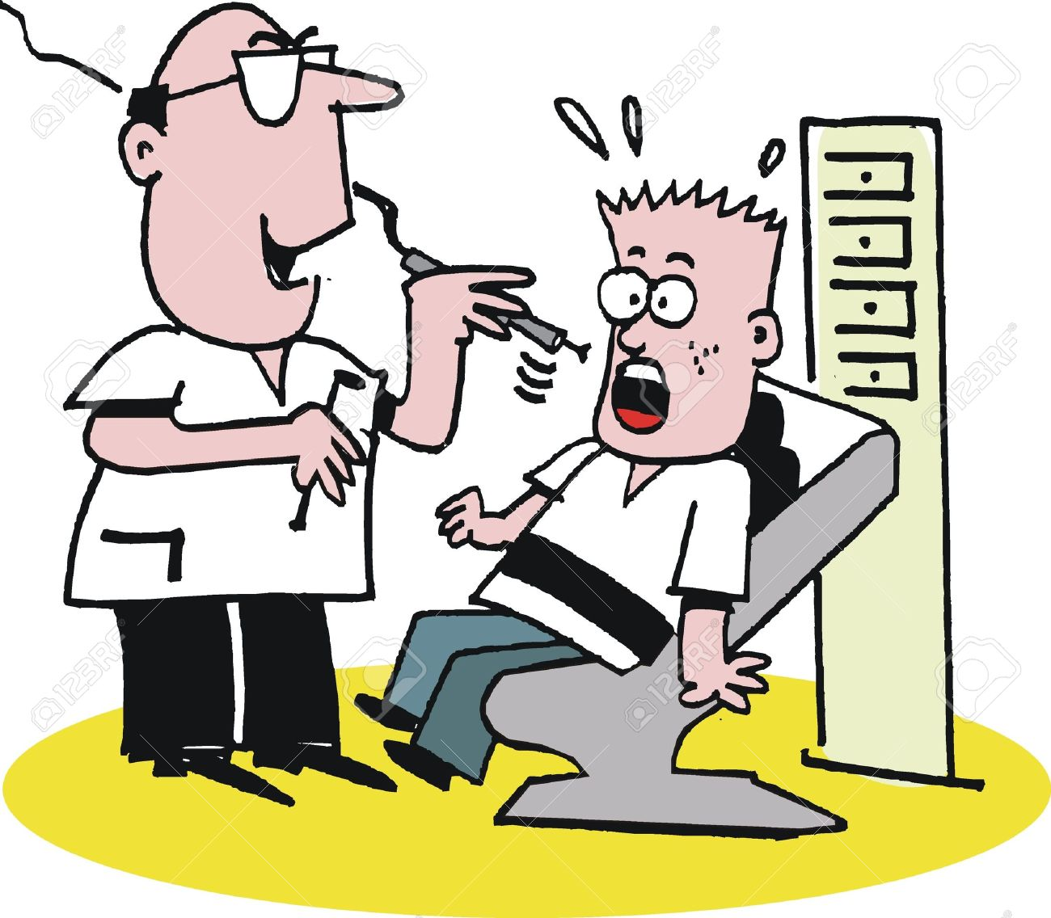
Indifferent:
These patients are not concerned with appearance, often go without dentures for years and do not adapt well
Such patients have no desire to wear dentures and do not value the efforts or skills of the dentist.

Slide 25
Winkler's Classification (1977)
Hardy elderly - Physically and psychologically well preserved Active in their social and professional lives
Able to quickly adapt to age changes.
Senile-aged syndrome - Emotionally and physically disadvantaged individuals
Handicapped/chronically ill/disabled/ infirm and truly aged

Slide 26
Satisfied old-denture wearers - These are patients who are highly satisfied with their existing set of dentures even though there might be problems with dentures.
Geriatric patients who do not want dentures - These are individuals who have remained completely edentulous for a long time and have no desire or motivation for treatment.

Slide 27
Socio economic status
    Determined by
      Occupation
      Income
      Education

Slide 28
Habits
It helps to identify conditions responsible for present condition & those which may affect future success or failure of treatment
It may give idea about oral hygiene habit/denture cleansing habit

Slide 29

Chief Complaint
Chief Complaint should be recorded in the patient's own words.
It gives ideas about the patient's psychology.
If it is not done, the chief complaint may be overlooked during therapy
Notes:
The response allows the practitioner to assess whether the patient’s expectations are “realistic” or “attainable”
According to Devan, "The dentist should meet the mind of the patient before he meets the mouth of the patient.“ that means knowing patient’s problem in his own words

Slide 30
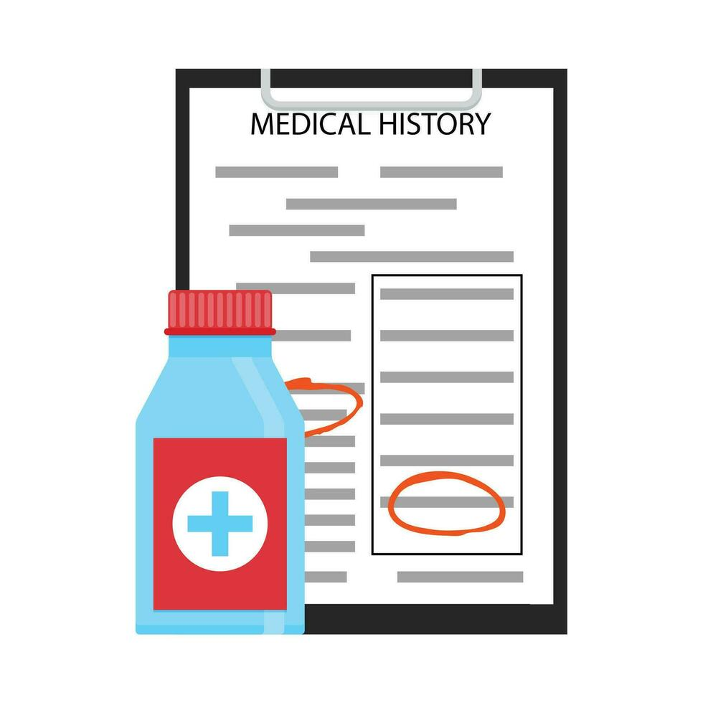
Medical history
A complete health history should include:-
  A record of patient opinion of his/her general health.
  By being aware- the practitioner is ready in case of any medical emergency arising during treatment.

Slide 31
Patient with known debilitating diseases like Diabetes, tuberculosis, blood dyscrasias, etc. should be under medical control.
These patients require extra instructions in oral hygiene, eating habits and tissue rest.
And taking physicians consent before carrying out any treatment in such patients becomes necessary

Slide 32
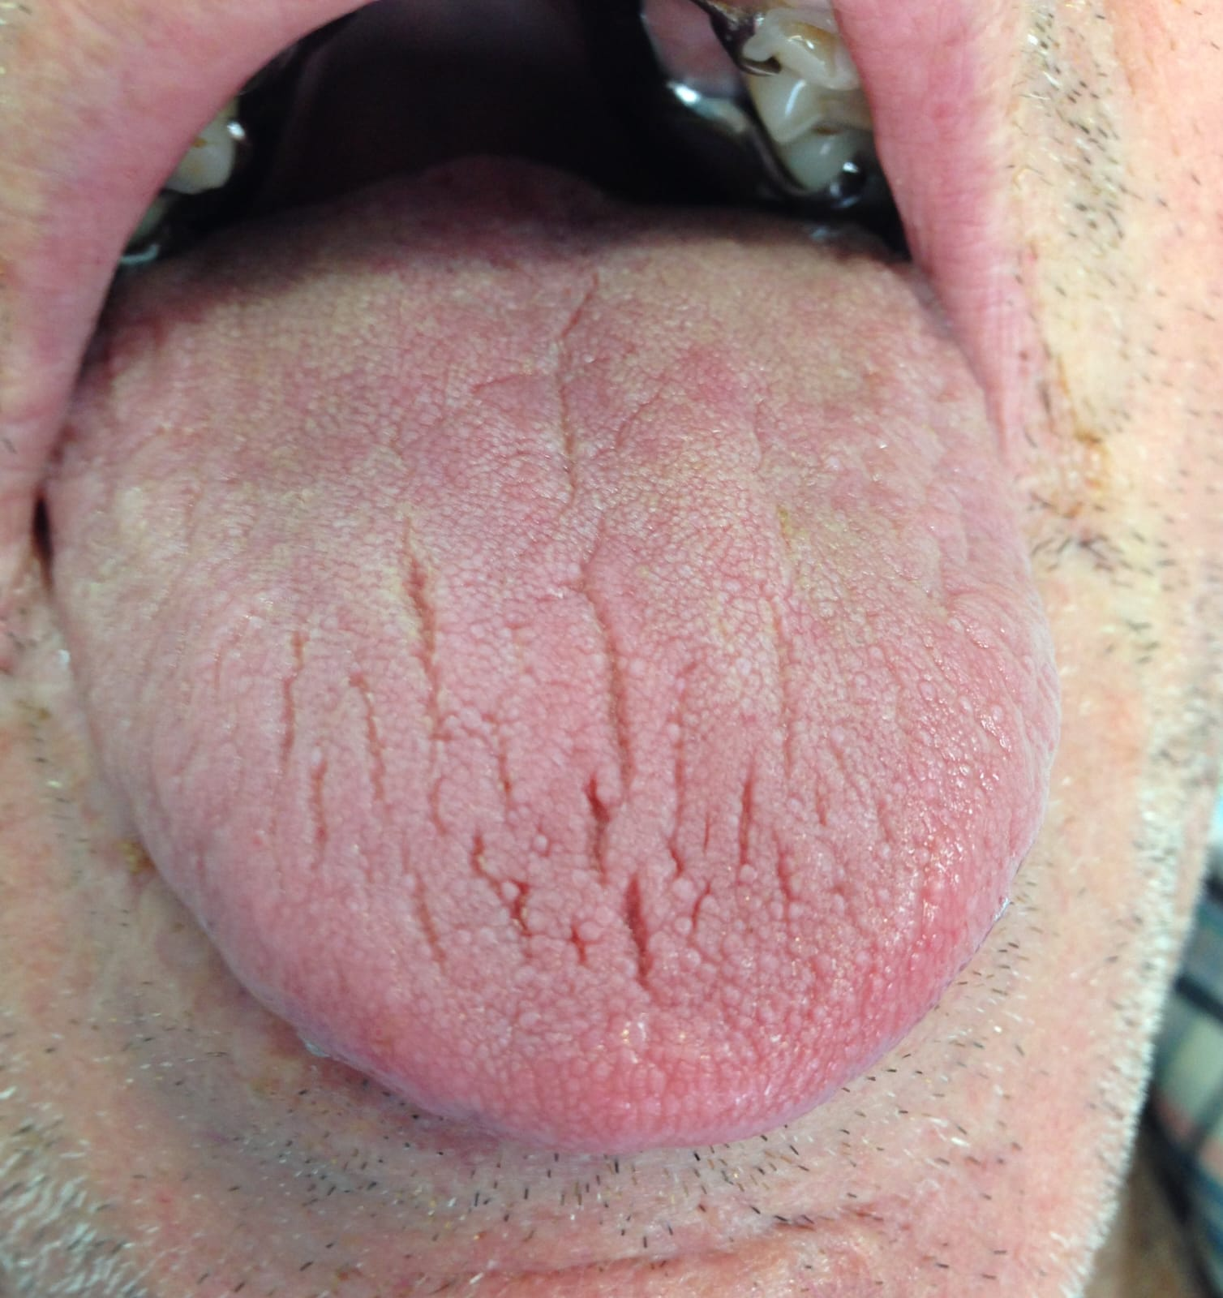
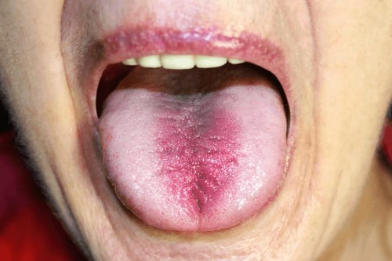
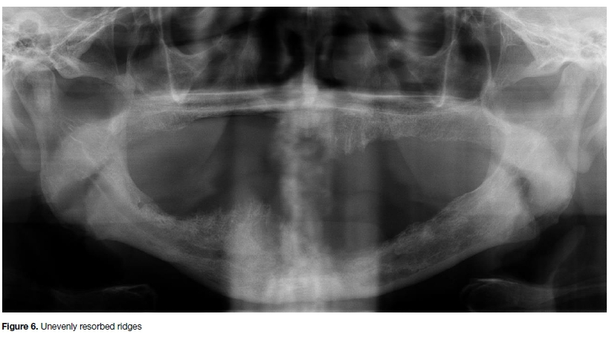
Diabetes
An uncontrolled or poorly controlled diabetics are
more prone to infection
Xerostomia- it causes dry atrophic oral
mucosa accompanied by mucositis, ulcers,
desquamation & opportunistic infection.
Burning mouth syndrome
Residual alveolar bone resorption
Osteoporosis

Slide 33
Prosthodontic considerations
Poor wound healing: Care should be taken as not to traumatize the tissues
Non- pressure impression should be used for maximum physiologic compatibility of denture base with supporting tissues.
To prevent insulin shock during dental appointments → patient should not skip meals.

Slide 34
.
Most common complication like hypoglycemia :-
Prevention-instruct the patient to take regular diet & then insulin.
Schedule the appointment in morning.
Keep treatment visit short.
Notes:
Appointment schedule should be carefully done so that the patient does not miss any medication.
Mucostatic or Passive Impression
→First proposed by Richardson and later popularized by Harry Page.
The impression is made with the oral mucous membrane and the jaws in a normal, relaxed condition.
Border molding is not done here.
The impression is made with an oversized tray

Slide 35
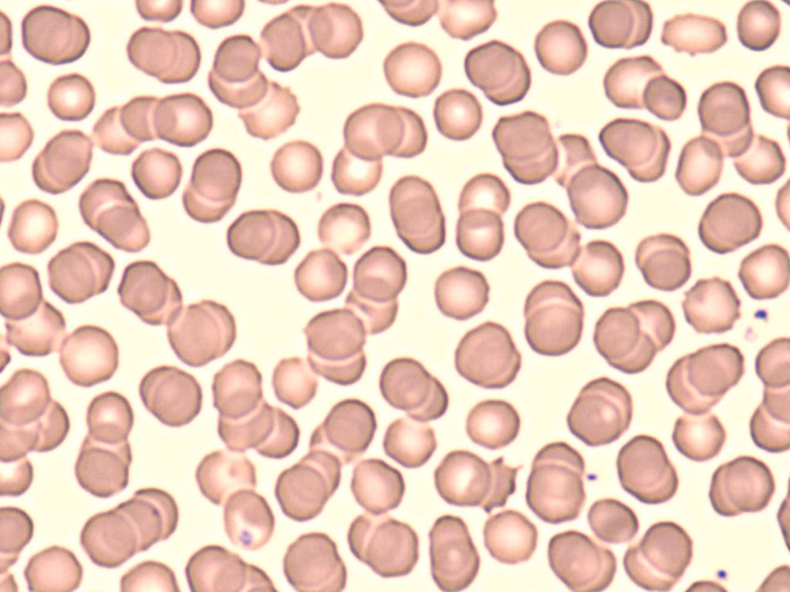
Blood Dyscrasias
Anemia- most commonly found.
Results in mucosal ulceration / infection.
Tongue becomes atrophic, inflamed & sore.
Prosthodontic considerations
Other blood dyscrasias are like leukemia, neutropenia which may affect denture success.
In all cases care should be taken not to bruise oral mucosa
while extending or recording border tissues.

Slide 36

Cardiovascular disease
Consult patient’s physician and take written approval.
Short appointments with premedication - In patients with history of angina and cardiac arrest.
Antibiotic prophylaxis - In rheumatic heart disease, congenital value disorder, etc. if some kind of surgery required.
Increased blood pressure - Not a contraindication if
patient is under medication.

Slide 37
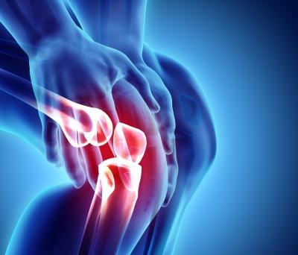
Diseases of joints
Osteoarthritis:
Normally affects weight bearing joints &
secondarily TMJ.
Osteoarthritic TMJ → problems in CD construction as mandibular movements are painful.

Slide 38
Prosthodontic consideration
Jaw relation records are difficult to record & repeat.
If terminal finger joints become arthritic, it is difficult to clean or insert dentures.
Occlusion correction must be made often because of subsequent change in joint.

Slide 39
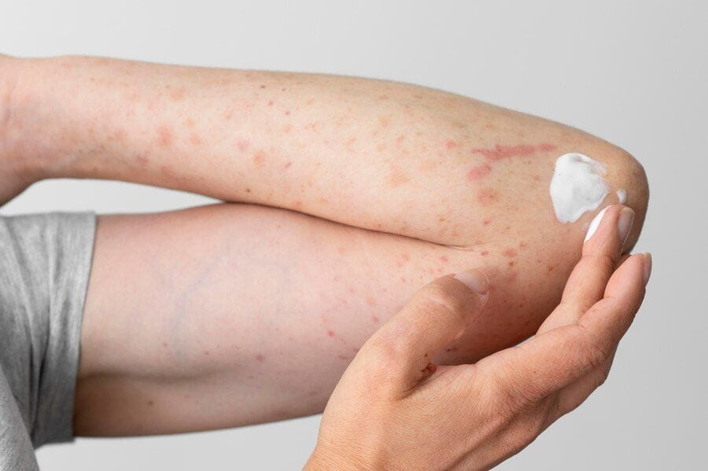
Disease of Skin
Dermatological conditions like pemphigus, erosive oral lichen planus may make oral mucosa extremely painful.
Establish smooth and well polished contours & borders

Slide 40
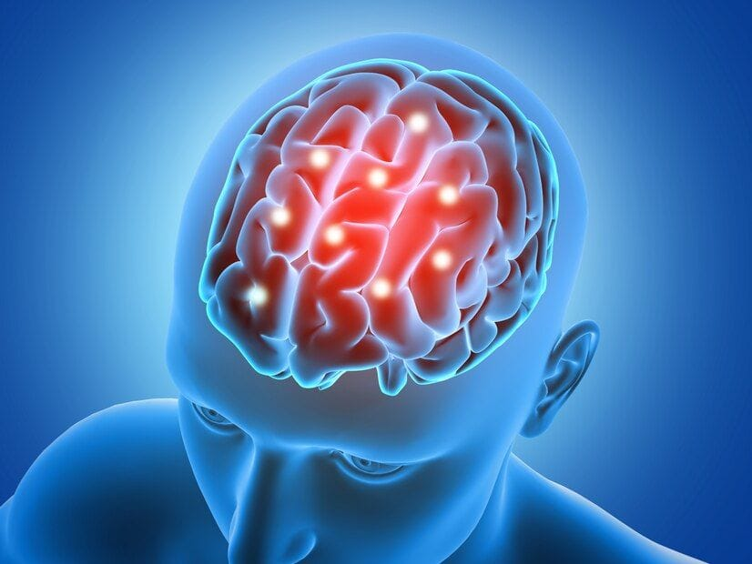
Neurological disorders
Bell's Palsy
  Unilateral facial paralysis
  Expression becomes very obvious when the patient attempts to smile.
  The skin on the forehead does not wrinkle nor does the eyebrow rise, causing a masklike, expressionless appearance

Slide 41
Parkinson's Disease
Oral manifestations include difficulty in swallowing and excess salivation.
Most muscles are involved so there is coarse
tremor of the mandible and tongue even at rest.
Denture treatment is complicated due to
excessive flow of saliva

Slide 42
Prosthodontic consideration
  Difficulty in making impression.
  Cheek biting is a common complaint.
  If patient wears dentures, speech and eating may become difficult. patient should be educated about it.
  Reduced saliva secretion and a loss or decrease in the sense of taste on the paralyzed side of your mouth is experience

Slide 43
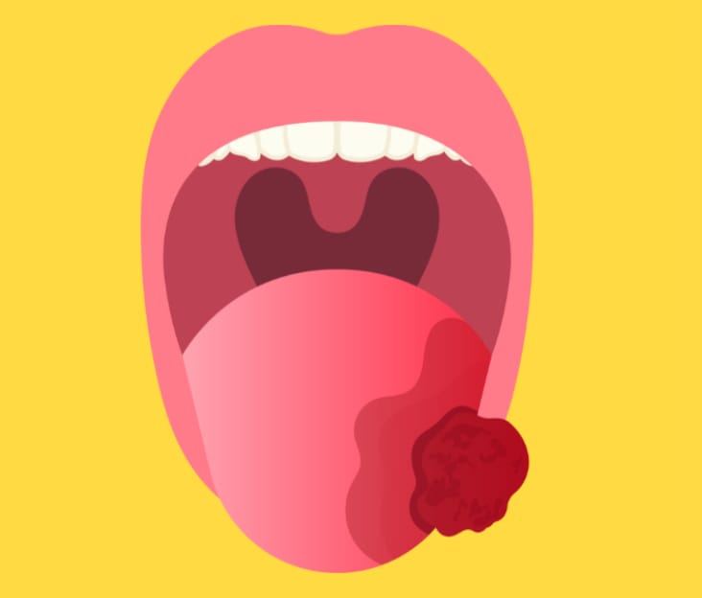
Oral malignancies
Cancer of mouth not uncommon in India.
Surgical removal of affected parts makes it necessary to construct a denture with an added obturator or maxillofacial prosthesis
Malignancies also treated using radiation therapy. Denture construction should be delayed until tissue regain health.

Slide 44

Hormonal Disturbances
Acromegaly-
  Enlargement of mandible.
  Observed frequently to evaluate the fit and occlusion of the prosthesis.
Hyperparathyroidism → Increased alveolar resorption.
Hypothyroidism → may develop to hypothyroid coma under stress.
decreased salivary flow Increase tongue size & gingival edema leads to poor denture design stability.

Slide 45
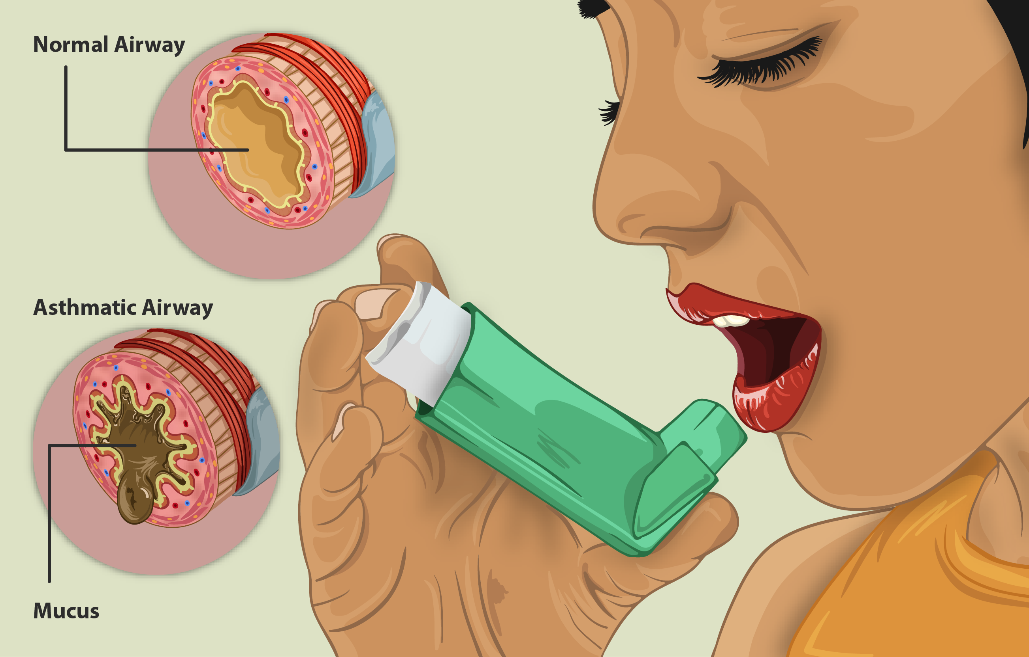
Disease Of Respiratory System
Asthma /COPD/ Pneumonia.
Consult physician.
Short morning appointments.
Keep inhaler in handy.
Allergy to any drug or denture material has to be noted
Avoid all allergic factors

Slide 46

Drug history
INSULIN
  Hypoglycemic shock when blood glucose levels drops below normal.
  Ask if patient has eaten his meals after his injections.
  Give glucose immediately.
ANTICOAGULANTS
  Important consideration when pre-prosthetic surgery planned.
  Consultation with physician is mandatory

Slide 47
Drug allergy
Dentist should know all the medicines patient takes because:
It indicates systemic diseases the patient is suffering from & this could alter dental treatment.
Compatibility of dentist's prescribed medicines & physician should be there to avoid drug interaction.

Slide 48
Dental history
Past dental history
  Type of previous denture
  Number of previous denture
  Experience with previous denture

Slide 49
History of present illness
It’s a detail description of chief complaint.
It should include
reason for teeth loss.
Sequence of teeth loss
Duration of edentulousness
Previous denture experience
Evaluating existing denture

Slide 50
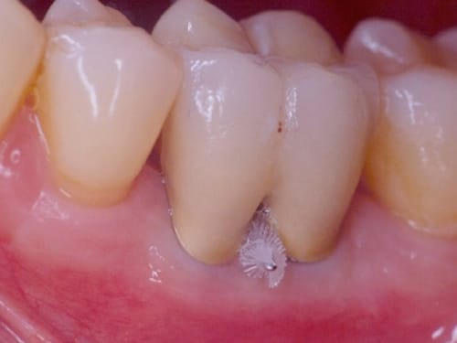
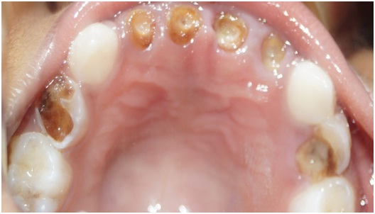
Reason for loss of tooth
lost because of periodontal problems → the ridge resorption is more
In cases where teeth have been lost because of caries→ comparatively less resorption

Slide 51
Period of Edentulousness
Indicate new denture wearer who will require more patient education.
It provides information regarding bone resorption pattern & progression as well as timing of tooth loss.

Slide 52
EXISTING DENTURE
Chief complaint
Phonetics
Esthetics
Retention and stability
Proper basal seat coverage
Occlusal vertical dimension
Occlusion

Slide 53
SEQUENCE OF LOSS OF TEETH
This would result in an overhanging tuberosity of posterior ridge when the upper teeth are lost at a later time.
If all posteriors were extracted some years before → anterior ones →no partial dentures were worn →then a habit of eating with the front teeth will have been formed

Slide 54
General Examination:
Built / gait of patient
Physical ability and motor skills
Nutritional status

Slide 55
Built / gait of patient:
The patient's walk level of coordination and steadiness should be noted
Unusual gait can be the result of a bone, muscle or joint problem neurological problem like Parkinson’s disease or severe arthritis

Slide 56
Physical ability and motor skills
Difficulty to get out of the waiting room chair may be indicative of a bone, joint or muscle problem.

Slide 57
Diet and nutrition
Nutrition and diet are important factors with all edentulous patients, but particularly with the geriatric.
Aged individual requires fewer calories than the young, the geriatric diet must include the proper amount of protein, fats, carbohydrate, vitamins and sufficient minerals in diet.

Slide 58
CLINICAL EXAMINATION:
Extraoral
Intraoral

Slide 59
EXTRA ORAL EXAMINATION
Facial examination
  Form
  Asymmetry
  Profile
  Complexion
Temporomandibular joint
  Tenderness/discomfort
  Clicking/crepitus
  Mandibular movement

Slide 60
Lips :
  Length
  Tonicity
Neuromuscular Evaluation
Facial muscle evaluation

Slide 61
Facial features
Observe length, fullness & apparent support of lips
Observe philtrum, nasolabial fold& labio mental groove for hollowness or puffiness
Texture of skin help establish the tone of anterior setup
Size of oral cavity & width of the vermilion border- related to degree of tooth display

Slide 62
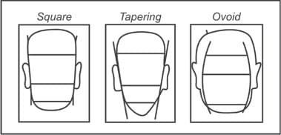
Face Form - according to House And Loop
Square
Tapered
ovoid

Slide 63
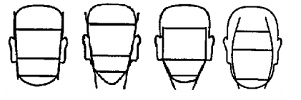
Face Form - House and Loop, Frush and Fisher and William’s classified face form as:
Square
Tapered
Ovoid
Square tapered
square
Tapered
Ovoid
Square tapered

Slide 64
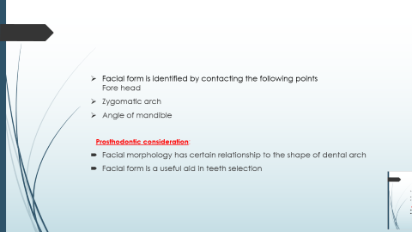
Facial form is identified by contacting the following points
Fore head
Zygomatic arch
Angle of mandible
Prosthodontic consideration:
Facial morphology has certain relationship to the shape of dental arch
Facial form is a useful aid in teeth selection

Slide 65
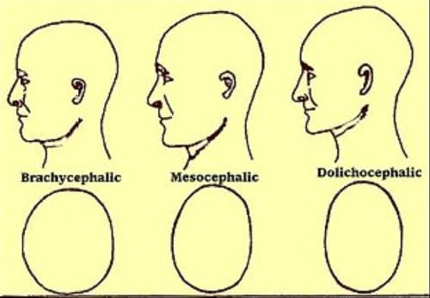
Classification according to the shape of the head
Mesocephalic (mesoprosopic) - Average shape of head.
                normal dental arches
Brachycephalic (europrosopic) – broad, square arches
Dolicocephalic (leptoprosopic) - Long and narrow head.
narrow dental arches

Slide 66
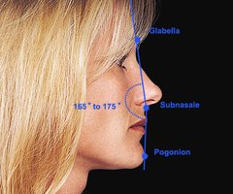
Facial profile - According to Profitt
3 points : Glabela, Sub-nasion & Pogonion
Line joining the forehead, bridge of nose, & border of upper lip.
Line joining upper lip to chin (soft tissue pogonion )..
When joined, if these 2 lines are
            Straight- class 1
            Convex- class 2
            Concave-class 3

Slide 67
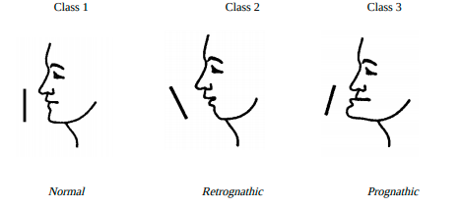
Facial profile : Classify according to Angle:

Slide 68
Vertical face length
Length of the patient’s face should be observed as it is directly related to the vertical height of the denture.
Patient’s occluding vertical facial height can easily be seen in profile and judgement can be made about the occlusal vertical dimension of an existing denture.
Helpful in jaw relation
A closed vertical dimension --.face to appear collapsed , excessive wrinkling around the mouth.
They are useful aids in tooth selection. The labial surfaces of the maxillary central incisors are to be kept generally parallel to the profile line of the face.

Slide 69
Face - Asymmetry
To determine disproportions in transverse and vertical plane
Some degree of asymmetry is acceptable as normal whereas gross asymmetry are recorded
If asymmetry is due to ankyloses of joint it will affect the mandibular movements

Slide 70
Complexion
Complexion with age, skin becomes thinner and melanin pigmentation accumulates in skin and hair leading to darker in shade with age.
Hair, eye, and skin color provide useful guides in shade selection.
Skin color also can reveal underlying disease and pathology..

Slide 71
Muscle Tone - House Classification
Class 1 -
  Normal tension, tone, & placement of muscles of mastication & facial expression.
  No degenerative changes.
  Immediate edentulous patient

Slide 72
Class 2-
  Slightly impaired tone. Seen in recently edentulous patient
Class 3-
  Greatly impaired muscle tone & function.
  Associated with poor health, inefficient

Slide 73
Greatly impaired muscle tone and function
Poor health
Loss of vertical dimension
Decreased biting force
Inefficient dentures
Wrinkles
Drooping commissures

Slide 74
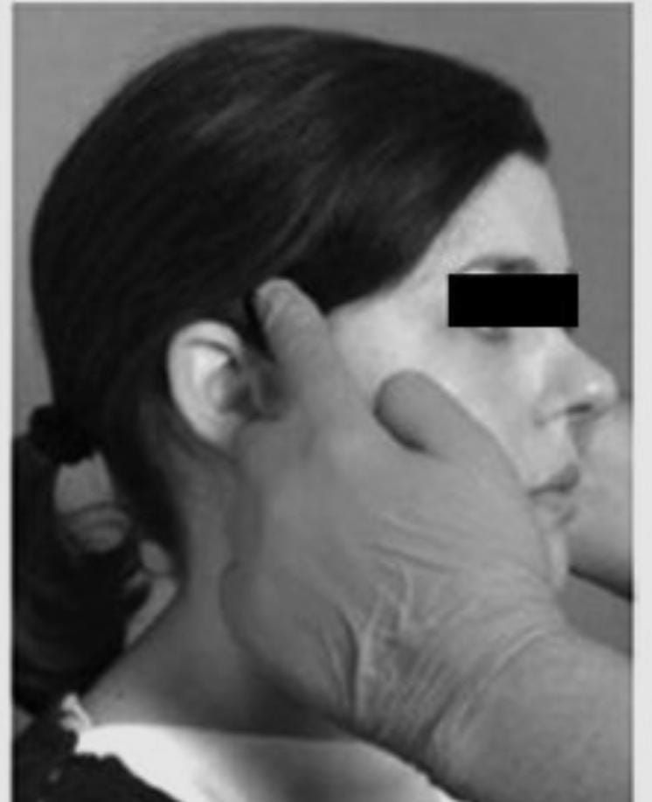
Palpation Of Muscles Of Mastication
Temporalis
It is palpated bilaterally and extra orally in isometric contraction.
Tendon of temporalis is palpated intraorally when mouth is half open in the posterolateral region of buccal vestibule near coronoid process

Slide 75
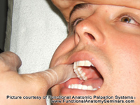
Lateral pterygoid
Palpated intraorally in close proximity to neck of condyle and joint capsule behind maxillary tuberosity.
Examination is carried out with mouth open and mandible displaced laterally.

Slide 76
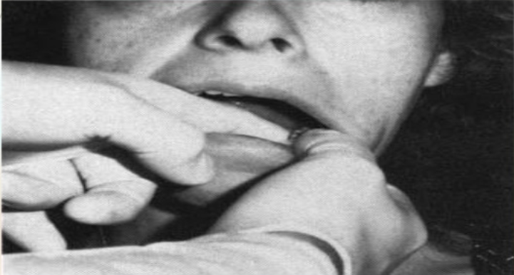
Medial Pterygoid
Functional manipulation is done when the muscle becomes fatigued and symptomatic.
The muscle contracts as the
teeth are coming in contact
Also stretches when the mouth
is opened wide

Slide 77
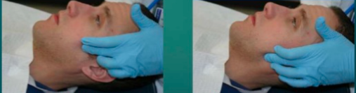
Masseter
Examined extra orally in isometric contraction.
Superficial muscles are palpated beneath the eye inferior to zygomatic arch.
Deep portion is palpated two fingers width in front of the tragus

Slide 78
Temporomandibular Joint
Inspection – Deviation/Deflection
Palpation - Pain & Tenderness
Auscultation - Crepitus Or Clicking

Slide 79
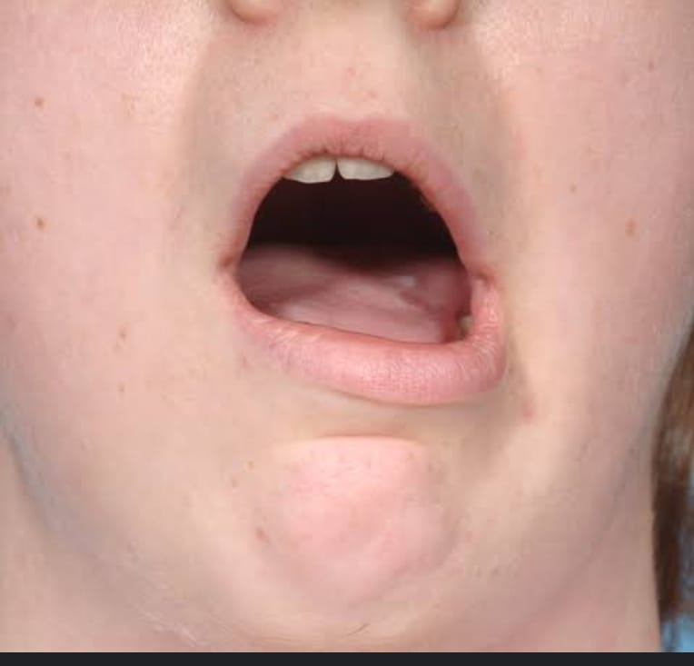
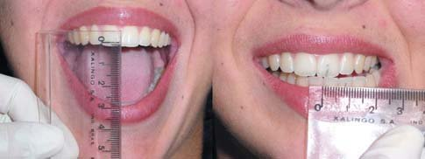
Inspection
Assessment of range of mandibular movements:
  Maximum Mouth Opening
  Lateral Movement
  Deviation While Opening
  Protrusive Movement

Slide 80
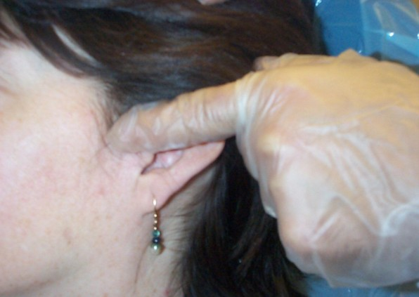
Pre-tragus palpation
Exert slight pressure on condylar process with index figure.
Register any pain/ tenderness
/irregularity in movement
while closing or opening
Coordination between
left and right TMJ should be noted

Slide 81
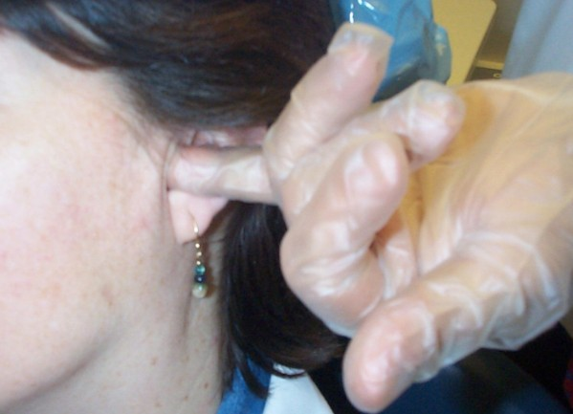
Intra auricular palpation
Position little finger in external auditory meatus and palpate posterior surface of condyle during opening and closure.

Slide 82
Auscultation
Auscultation done by stethoscope
Types of clicking
  Initial movement → sign of retruded condyle in respect to disc
  Intermediate → sign of unevenness of condyle and disc
  Terminal → occurs most commonly results in condyle being moved too far anteriorly on maximum opening
  Reciprocal → occurs during opening and coordination
  between disc and condyle

Slide 83
Temporomandibular joint disorder symptoms
Pain and tenderness at TMJ and muscles of mastication
Clicking or crepitus during condylar movement
Limitation of mandibular movements
TMJ problem affects mandibular movement and
masticating efficiency, difficult jaw relation recording .

Slide 84
Lips
Lip support
Lip length
Lip tonicity
Lip mobility
Health of lips

Slide 85
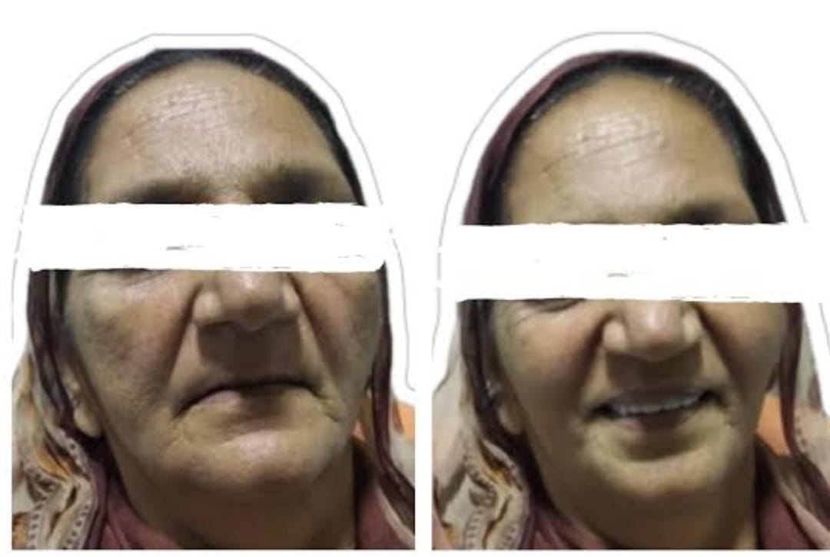
Lip support/ lip fullness
LIP SUPPORT →Adequately supported
→ Unsupported
Contour and appearance of the vermillion border
usually are altered by tooth loss
→ Restoration of lip support and vermillion border
width must be considered during
placement of anterior teeth

Slide 86
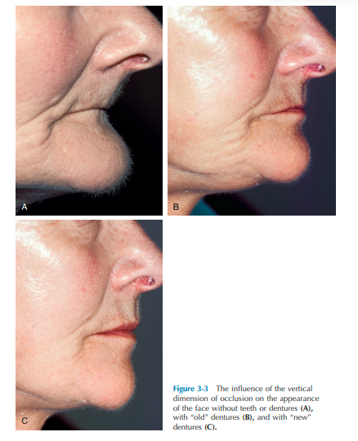
Lip support /Lip fullness
An obliterated philtrum or mento-labial fold suggests excessive support.
Poor lip support - a collapsed appearance and wrinkling around the modiolus of the mouth and the vermilion border of the lip will be weak, turned in, and not very visible.

Slide 87
Lip tonicity
Thick lips – need lesser support from the artificial teeth and the labial flange
Thin lips – depend on the appropriate labiolingual position of the teeth, for their fullness and support
Any slight change in the labiolingual tooth position makes an immediate change in the lip contour

Slide 88
Lip length
Lip length: Affect the amount of tooth exposure and the anterior tooth size
Classified as:
→ Long → Medium → Short
    (26-36mm) (16-25mm) (10-15mm)
Length of the lip will affect how much the teeth will be exposed during rest and function
Lip length also plays an important role in esthetics.

Slide 89
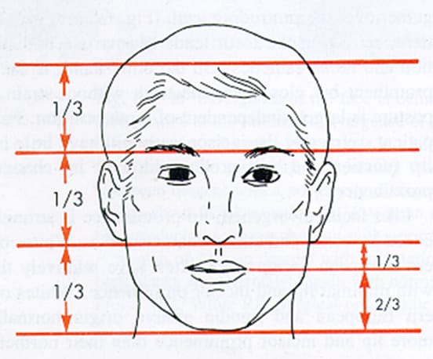
How to check lip length
Vertical lip relation:
In lower facial height, length of upper lip is equal to one third. Length of lower lip plus chin should be two third.

Slide 90
Lip mobility
Normal
Reduced
Paralysied
Patients with minimal lip mobility show very little of the anterior teeth
Some stroke victims may have paralysis of half the lip, leading to unilateral mouth droop and facial asymmetry

Slide 91
Health of lip
Lips should be examined for cracking, fissuring at the corners, and ulceration
These changes can be caused by - vitamin B-complex deficiency
Candida albicans
Excessive overclosure of an existing denture

Slide 92
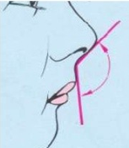
Nasolabial angle
Normal is 110 degree
It is measured line joining subnasale and anterior most point of collumella and subnasale and upper lip border.
In class II or protrusion of upper lip angle is decreased.
In class III or retrusive position of upper lip nasolabial angle increases.

Slide 93
Neuromuscular evaluation
COORDINATION: -
  Good:- learn to manipulate dentures relatively quickly and likewise adapt readily to new dentures.
  Poor coordination:- or a neurologic deficit may never adapt to a denture completely.
  It also affects impression & making jaw relation recording.
  It is to be classified as:
  Excellent Fair Poor

Slide 94
SPEECH EVALUATION
Patients with speech impairments require special attention in setting of anterior teeth and forming the palatal portions of the upper denture.
Speaking activity may be classified as
Normal
Affected

Slide 95
Intra oral examination
Mucosa
Saliva
Border attachment
Frenal attachment
Mylohyoid ridge
Maxillary tuberosity
Tongue
Palatal tori
Mandibular tori

Slide 96
Arch size
Arch form
Ridge mucosa
Inter-arch space
Ridge parallelism
Ridge relation
lateral throat form
Hard palate
Soft palate

Slide 97
Classification System for Complete Edentulism
Based on diagnostic findings the American College of Prosthodontists developed four categories from Class I to Class IV,
Class I - uncomplicated clinical situation
Class IV - most complex and higher-risk situation.
Bone Height: mandible.
Type I (most favorable): residual bone height of 21 mm
Type II: residual bone height of 16 to 20 mm
Type III: residual alveolar bone height of 11 to 15
Type IV: residual vertical bone height of 10 mm or less

Slide 98
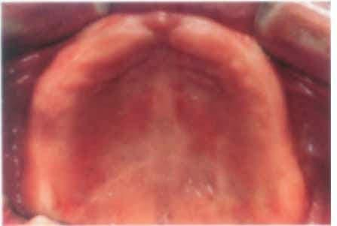
Residual Ridge Morphology: Maxilla
Type A (most favourable)
Anterior labial and posterior buccal vestibular depth that resists vertical and horizontal movement of the denture base.
Sufficient tuberosity
Hamular notch well defined
Absence of tori or exostoses.

Slide 99
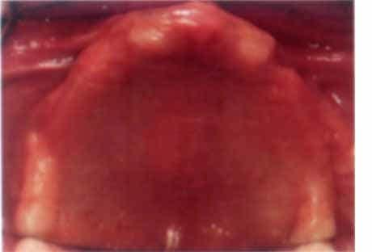
Type B
Loss of posterior buccal vestibule.
Palatal vault morphology resists vertical and horizontal movement of the denture base.
Tuberosity and hamular notch are poorly defined
tori are rounded

Slide 100
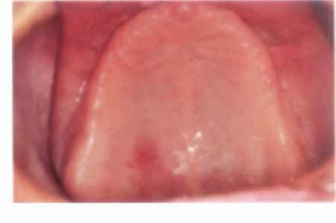
Type C
Loss of anterior labial vestibule.
Palatal vault minimal resistance to vertical and horizontal movement of the denture base.
palatal tori with bony undercuts that do not affect the posterior extension of the denture base.
Hyperplastic, mobile anterior ridge offer minimum support and stability.

Slide 101
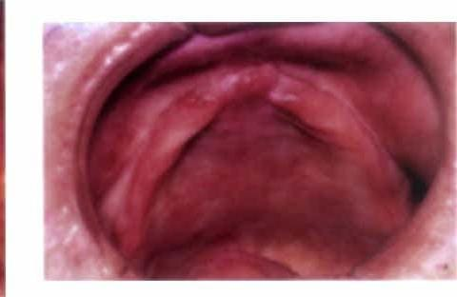
Type D
Loss of anterior labial and posterior buccal vestibules.
Palatal vault morphology does not resist vertical or horizontal movement of the denture base.
Maxillary palatal tori and/or lateral exostoses" (rounded or undercut) that interfere with the posterior border of the denture.
Hyperplastic, redundant anterior ridge.

Slide 102
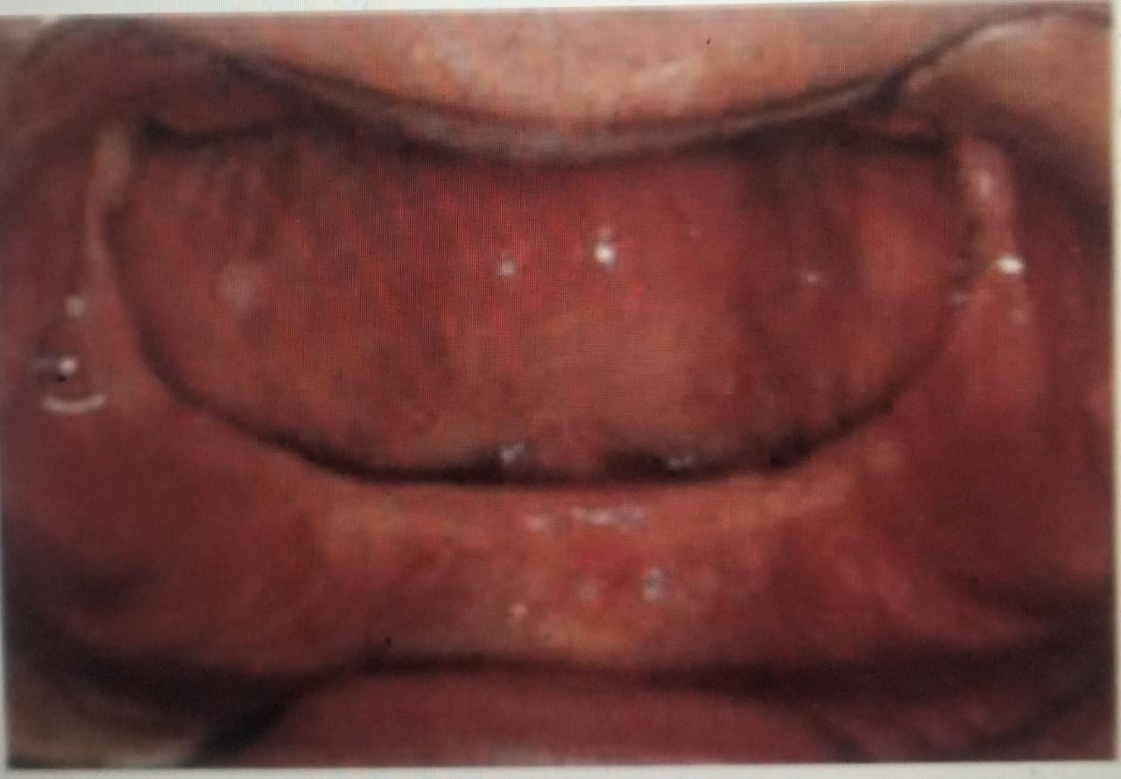
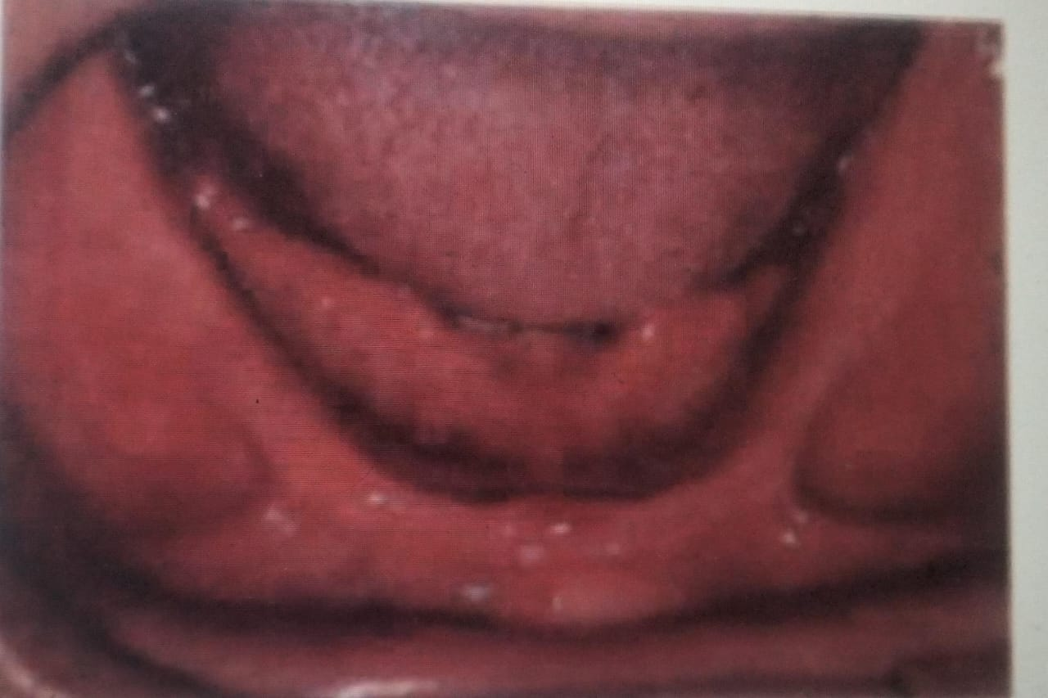
Muscle Attachments: Mandible only
Type A (most favorable) Attached mucosal base without undue muscular impingement during normal function in all region
Type B Attached mucosal base in all regions except labial vestibule . Mentalis muscle attachment near crest of alveolar ridge
Type C Attached mucosal base in all regions except anterior buccal and lingual vestibules-canine to canine.
Genioglossus and mentalis muscle attachments near crest of alveolar ridge.

Slide 103
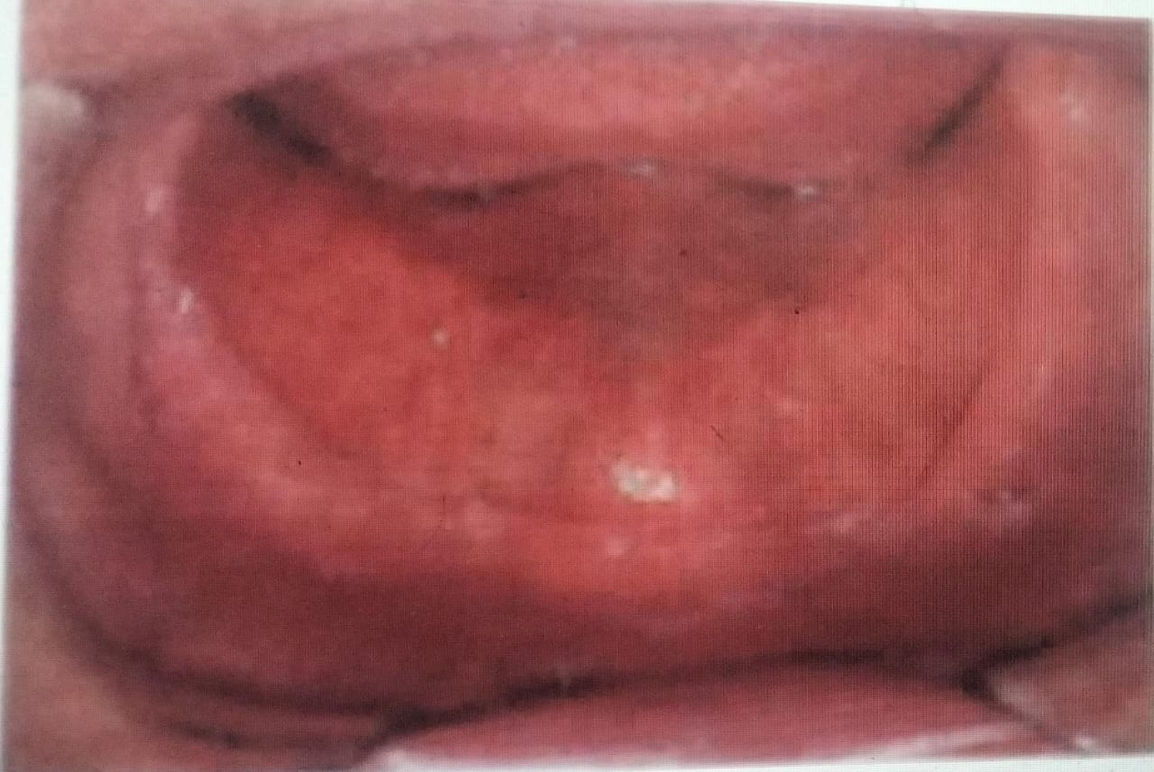
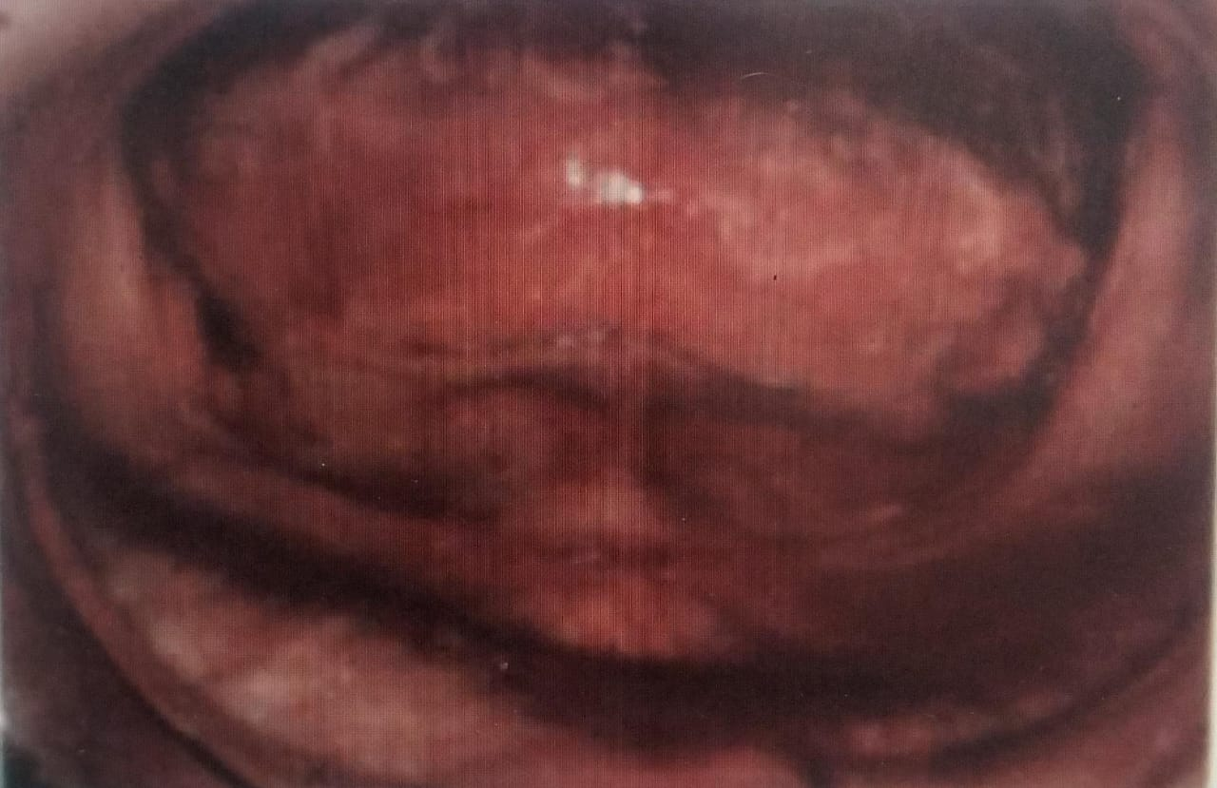
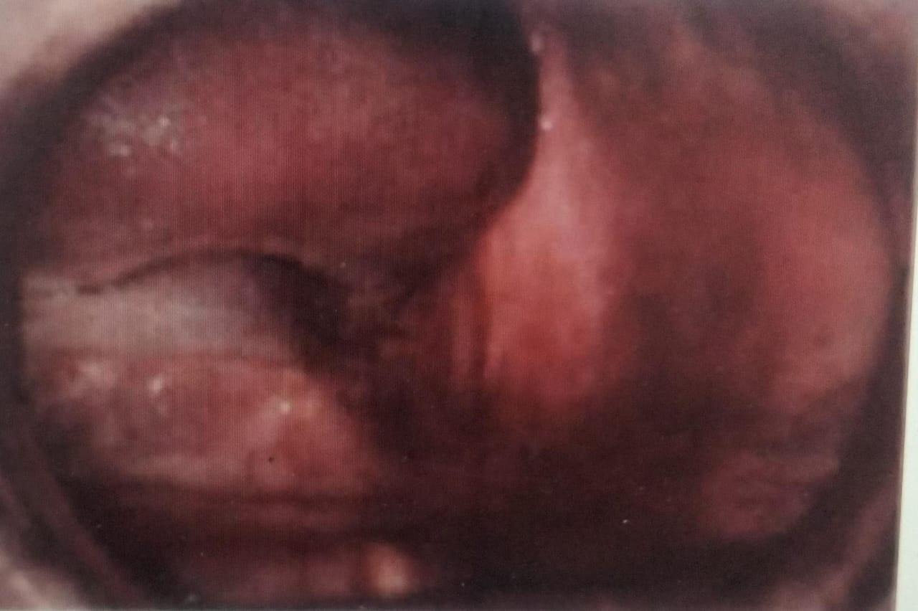
Type D -Attached mucosal base only in the posterior lingual region.
Mucosal base in all other regions is detached
Type E- No attached mucosa in any region.

Slide 104
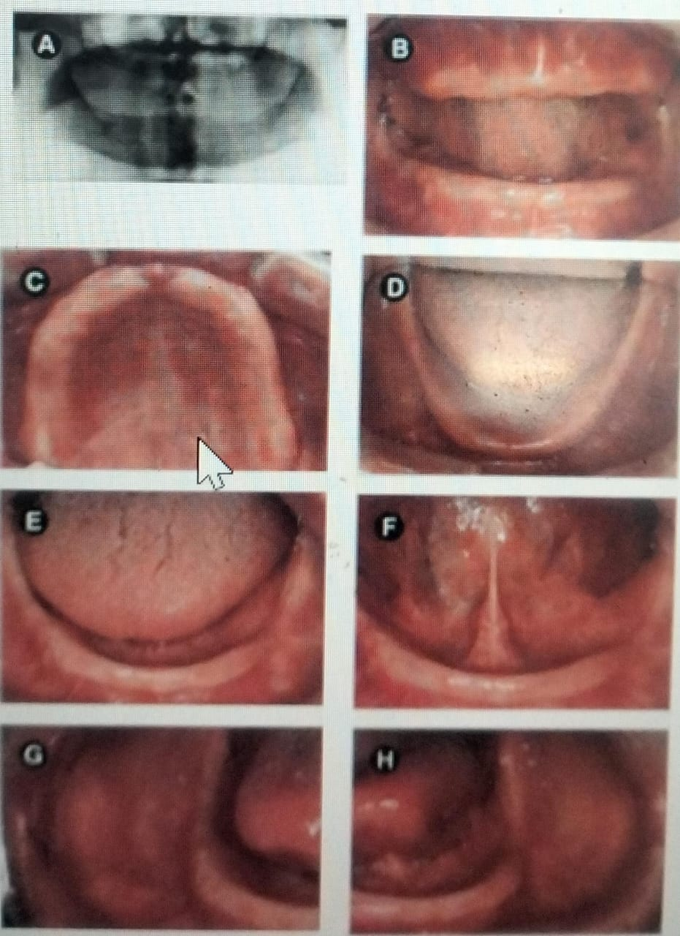
Maxillomandibular Relationship
Class-1
Residual bone height of 21 mm or greater
Residual ridge morphology type A maxilla
Location of muscle attachments Type A or B mandible.
Class I maxillomandibular relationship.

Slide 105
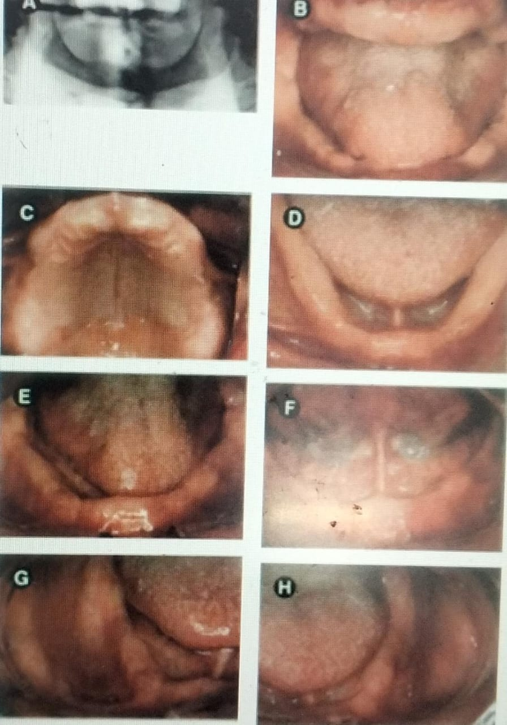
Class II
Residual bone height of 16 to 20 mm.
Residual ridge morphology Type A or B maxilla.
Location of muscle attachments ; Type A or B mandible.
Class I maxillomandibular relationship.
Minor modifiers, psychosocial considerations, mild systemic disease with oral manifestation.

Slide 106
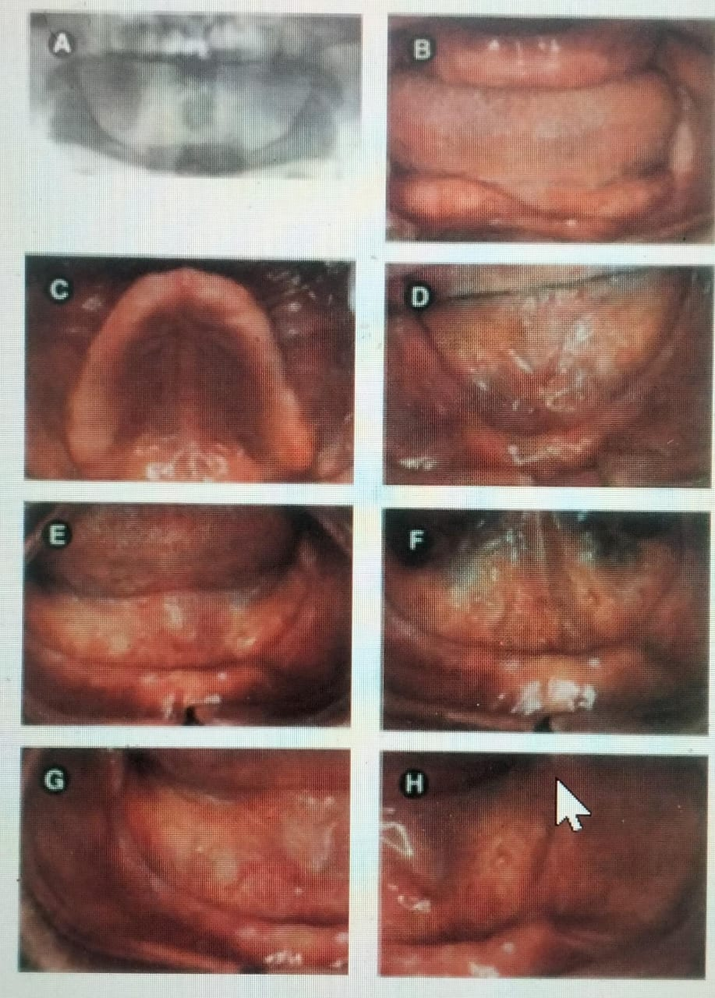
Class III
Residual alveolar bone height of 11 to 15 mm
Residual ridge morphology Type C maxilla.
Location of muscle attachments Type C mandible
Class I, II, or III maxillomandibular relationship
Limited inter arch space (18-20 mm).
Moderate psychosocial consideration systemic diseases or conditions such as xerostomia.
TMD symptoms ,Large tongue, Hyperactive gag reflex.

Slide 107
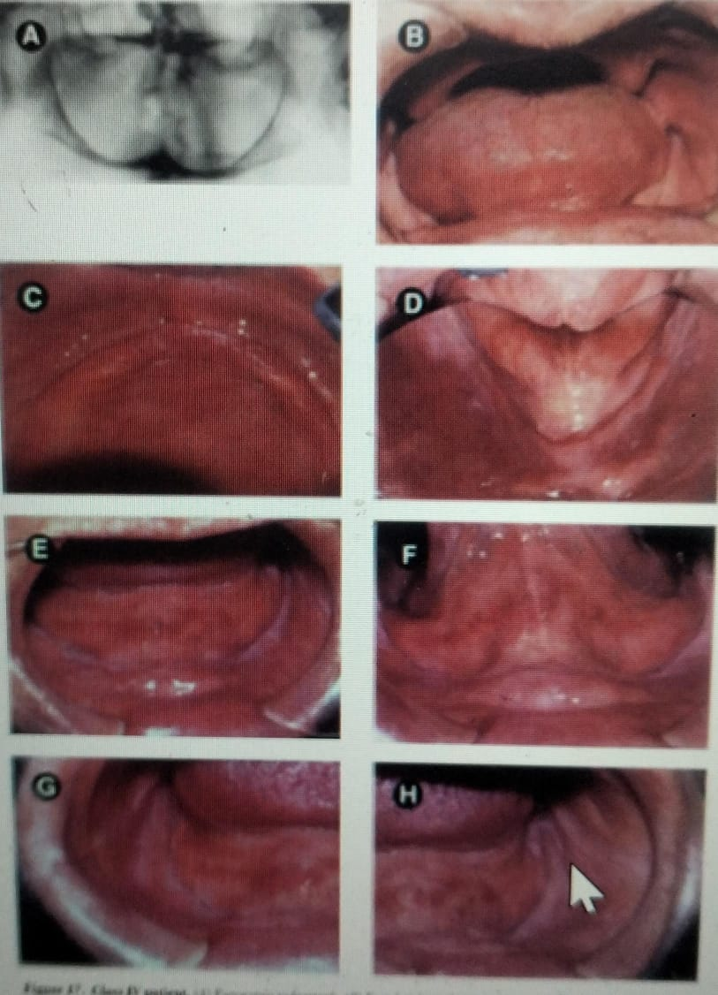
Class IV
residual vertical bone height of 10 mm
Residual ridge Type D maxilla.
Muscle attachment location Type D or E mandible.
Class I, II,III maxillomandibular relationships.
Insufficient inter arch space with surgical correction.
Maxillo-mandibular ataxia
Hyperactivity of tongue
Hyperactive gag reflex
Psychosocial conditions warranting professional intervention

Slide 108
CHEEKS
    General contour of cheeks noted.
    For filling buccal spaces- need concave buccal contours on dentures
MUCOSA-
Depending on its location
    Masticatory
    Lining
    Specialized mucosa

Slide 109
MUCOSA
Mucosa is examined for:-
  Thickness
  Colour
  Condition

Slide 110
Mucosal Thickness – according to House
Class 1:
  Normal uniform density of mucosal tissue (approximately 1-mm thick).
  Investing membrane is firm
  forms an ideal cushion for the basal seat of a denture.
Class 2:
  Soft tissues have thin investing membranes and are highly susceptible to irritation under pressure.
  The mucous membranes twice the normal thickness.

Slide 111
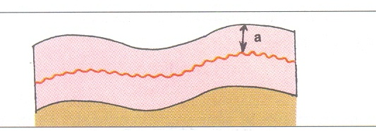


Class 3:
  Soft tissues have excessively thick investing membranes.
  This may requires tissue treatment such as surgical correction.
Class-1
Class-2
Class-3

Slide 112
Mucosa Atrophy
Epithelial atrophy
Reduction in no. of epithelial cell layers and thickness of the underlying connective tissues
Reduction of the surface area of the oral mucosa (shortening of collagen fibres )
Applies pressure to the underlying ridge

Slide 113
Significance :
Variation in tissue thickness make it difficult to equalize pressure under the denture and to avoid soreness.
Thin mucosa gets ulcerated easily
Thick mucosa leads to lack of stability, less tissue tolerance and jaw relation will be difficult to obtained.
Inflamed and abused mucosa → etiology should be → treated→ before impression

Slide 114
Mucosa Condition
Classified according to House:
      Class 1: Healthy
      Class 2 : Irritated
      Class 3 : Pathologic

Slide 115
Common prosthetic cause of irritation of mucosa
Overextension of denture border
Dry ill fitting denture
Continuous wearing of denture
Faulty occlusion of denture
Rubber suction discs
Traumatic injury
Small spicules of alveolar ridge
Denture stomatitis

Slide 116
Saliva
Class 1: Normal quality and quantity of saliva.
Cohesive and adhesive properties of saliva are ideal.
Class 2: Excessive saliva
Class 3: Xerostomia; remaining saliva is mucinous.
Character of Saliva
Thin serous : more favorable for denture retention.
Thick mucus : difficult to work with and tends to displace the denture.
Mixed : Contains equal quantities of both kinds
Notes:
Serous –watery, antibodies, inorganic ions.
Mucous- slippery, viscous, contain mucin helps in lubrication of oral cavity.
Normal salivary secretion is 1 ml/min (Zarb)
pH : 6.2 - 7.4

Slide 117
The physical forces in which saliva is involved are:
Adhesion
Cohesion
Atmospheric pressure
Capillary attraction
Peripheral seal
Viscosity of saliva
Surface tension

Slide 118
In new denture patients
- The insertion of dentures has a tendency to create an increased flow of saliva for the first few days or weeks of their use.
- This excess saliva frequently goes under the denture and
dislodges it.

Slide 119



Border Attachments
They should be examined for favorable and unfavorable position in relation to the crest of the ridge.
It the attachment is close enough to the ridge then surgical correction is required to ensure border seal.

Slide 120

Labial frenum attachment - according to House
  Class 1: High in the maxilla or low in the mandible with respect to the crest of the ridge.
  Class 2: Medium
  Class 3: Freni encroach on the crest of the ridge and may interfere with the denture seal.
  Muscle fibers – orbicularis oris.
  Significance: Superficial freni produces denture instability
and freni may also get ulcerated

Slide 121

BUCCAL FRENUM
Buccal frenum is a fold of mucous membrane
It can be single or multiple
Muscle fibers – orbicularis oris
levator anguli oris
buccinator
Significance:
  Because of muscle attachments, it requires more clearance for its action (in both horizontal and vertical direction) than the labial frenum.

Slide 122

Mylohyoid ridge
It is an oblique ridge on the lingual side of the mandible extending from the third molar region to the lower border of the mandible in the region of the chin.
Undercut that can pose a real problem is prominent, sharp mylohyoid ridge

Slide 123
Significance:
The lingual flange of the mandibular denture should extend inferior but not lateral to the mylohyoid line.
The irregularity of the ridge often presents a problem
to the denture patients.

Slide 124

Maxillary tuberosity
Maxillary tuberosity represents most distal portion of maxillary alveolar ridge.
The tuberosity region often hangs abnormally low when maxillary posterior teeth are retained after mandibular molars are lost and not replaced.

Slide 125

Tuberosity can be
  Bulbous
  Pendulous
  Undercuts
      Unilateral
      Bilateral
  Significance
  Often the low hanging tuberosity prevents proper location of occlusal plane.
  Most often tuberosity enlargements are only fibrous in nature.

Slide 126

Tongue
The tongue plays an important role in determining denture success or failure, with its size and activity being the main concerns.
The tongue will expand into any edentulous space by a reorientation of its intrinsic musculature and become habitually active within its extended boundaries.

Slide 127
Tongue - should be examined for the following
Size:
  Large tongue →decreases the stability of the denture
  → interfere in impression making.
  Small tongue →does not provide adequate lingual peripheral seal.
Notes:
Intrensic :-
4 paired superior lomg
Inf long
Transvers
Vertical
Extrensic:- palate, stylo, genio, hyo glossius

Slide 128
Movement and coordination:
  → Important to register a good peripheral tracing.
  → Necessary in maintaining the denture in the mouth during functional activities like speech, deglutition and mastication, etc.

Slide 129
Classify tongue according to House:
Class 1: Normal in size, development and function.
Sufficient teeth are present to maintain normal form and function.
Class 2: Teeth have been absent long enough to permit a change in the form and function of the tongue.
Class 3: Excessively large tongue..

Slide 130

Tongue Position - Wright's classification
Class 1 Tongue lies in the floor of mouth with the tip forward and slightly below the incisal edges of mandibular anterior.
Class2 Tongue is flattened and broadened but tip is in normal position
Class 3 Tongue is retracted and depressed into floor of the mouth with tip curled upward downward or assimilated in body of the tongue.

Slide 131
Tongue Shape
Smith described two anatomic tongue types:
Broad flat thick: Better for border seal but may complicate impression procedures.
Long tapered narrow: Good for impression, Making but less effectiveness for lingual border seal.

Slide 132
Prosthodontic consideration
The tip of the tongue should rests against the inside of the denture flange and the mandibular anterior denture teeth.
- This action helps to seat the mandibular denture.
- Tongue-biting →common after insertion of the denture.

Slide 133

Tori
Tori: Classify maxillary and mandibular as follows:
Class1 : Absent or minimal in size
do not interfere with denture
Class2 : - Moderate size
- Offer mild difficulty in denture construction and use
- Surgery is not required

Slide 134
Class3 : - Large tori
- Compromise the function and fabrication of dentures
- Require surgical contouring and removal

Slide 135
Significance
The mucosa over tori is usually thin.
-Tori present in the midline of the palate and not relived it lead to rocking of the denture.
-And may also lead to midline fracture of upper denture.
Management included
Surgical removal of large tori or construction of window in the denture for management of small midline tori

Slide 136
Arch size
The size is determine by amount of basal seat available for denture foundation
Classify arch size as follows:
Class 1: Large
Class 2: Medium
Class 3: Small

Slide 137
Smaller arch poor retention poor prognosis
Greater the size
More support
Retention increases
Large contact surface
Better prognosis

Slide 138
Significance
This will lead to difficulty in teeth arrangement
There will be decreased stability of denture resting in smaller one of the two arches.
Traumatic early loss of teeth in one of the arches with a resultant increase in resorption from a severe class 2 or class 3 malocclusion

Slide 139




Arch form

Slide 140
Significance
  The form of ridge will influence the support of denture and perhaps the tooth selection.
  Discrepancies between the maxillary and mandibular arch forms can create problems during teeth setting

Slide 141



Residual Ridge form
Maxillary ridge and vault form classified:-
Class-1: Square to gently rounded
Class-2: Tapering or "V" shaped
Class-3: Flat
High ridge with flat crest and parallel side - this gives max support and stability

Slide 142






Mandibular ridge
Class 1: Inverted "U" shaped
Class 2: Inverted "U" shaped
Undercut (results from all teeth in labial or lingual version)
class 3: Unfavourable
Short inverted "V"
Inverted "W"
Tall Thin inverted "V"

Slide 143


Inter-arch space
This is the space between the maxillary and the mandibular arches. Normally it should be 20mm.
Class I: Ideal inter-arch space to
accommodate the artificial teeth
Class II: Excessive inter-arch space
Class III: Insufficient inter-arch space to
accommodate the artificial teeth

Slide 144



Ridge parallelism
Class I – Both ridges are parallel to the occlusal
plane
Class II – The mandibular ridge is divergent
from occlusal plane anteriorly
Class III – The maxillary ridge is divergent from the
occlusal plane anteriorly and/or both
ridges are divergent anteriorly
Notes:
It refers to relative parallelism between the plane of the ridge
As teeth are gradually lost, residual ridges diverge from each other.
When the ridges are not parallel to the occlusal plane, the dentures slide over basilar tissues on application of occlusal forces. This is because of an unfavorable direction of forces.
Denture stability is enhanced by parallel ridge

Slide 145
Ridge relation
The positional relation of the mandibular ridge to the maxillary ridge -(GPT)
Maxilla resorbs- upward and inward
Mandible resorbs- downward, forward, and laterally

Slide 146

Classification by Angle:
Angle Class I (Normal)
Angle Class II (Retrognathic)
Angle Class III (Prognathic)

Slide 147

Lateral throat form
Neil classified lateral throat form (retro-mylohyoid fossa) area as
Class I – Deep:0.5 inch of space exists between mylohyoid ridge & floor of mouth
Class II – Moderate :Less than 0.5 inch space exists.
Notes:
The contour of the hard lingual surfaces of the mandibular ridge in the
molar area and the velum like tissue distal to the mylohyoid ridge in the
retromylohyoid fossa as it functions under the influence of tongue. (Neil)
This is done by placing the index finger into the pouch and asking the patient to perform the above mentioned actions when the alterations in the extent in the extent of the pouch can be felt.
- If a pouch persists during tongue movement and swallowing then the lingual flange of the denture can be carried into this area which will materially assist in the retention of the lower denture.
Diagnostic procedure for lateral throat form :
- The extent of the pouch with the tongue at rest and with the tongue protruded sufficiently to lick the lips and also during the act of swallowing should be noted.

Slide 148

Class III – Shallow : Mylohyoid fold is at the same level as mylohyoid ridge. Retention of lower denture is difficult.

Slide 149
Hard palate
Shape of palatal vault
U shaped: Most favorable for retention and lateral stability
V shaped: Less favorable for retention
slightest movement of denture base will cause break in peripheral seal
Flat palatal vault: Unfavorable.
Seen in resorbed ridges
Retention is good
Lateral stability is poor

Slide 150

Soft palate
Class I : Horizontal curving downwards.
      -Most favorable as more surface area covered for retention & wider seal area.
      - Muscular activity minimal.
      - More than 5mm of movable tissue is available for post-damming

Slide 151

  CLASS II :
              - Palate turns downward at about 45 degree angle to the hard palate
              - Tissue coverage is less than Class 1
              - 1-5mm of movable tissue available for post-damming
              - Good retention is usually possible

Slide 152

Class III :
Turns downward sharply at 70º angle.
Greater movement of soft palate during function and the narrower seal area- hence less favorable.

Slide 153

Classification of soft palate according to You M et al

Slide 154



THE PALATAL THROAT FORM
Class I: Large and normal in form -immovable band of tissue 5-12mm distal to line drawn across the distal edge of the tuberosities
Class II: Medium size and normal in form- resilient band of tissues 3-5mm distal to line drawn across the distal edge of the tuberosities.
Class III: Accompanies small maxilla. Soft tissues turn down abruptly 3-5mm anterior to the line drawn across the distal edge of the tuberosities.

Slide 155
Palatal Sensitivity (gag reflex)
House Classification
Class 1: Normal
Class 2: Subnormal (hyposensitive)
Class 3: Supernormal (hypersensitive)

Slide 156
Investigation
Pre-extraction records
Diagnostic cast
Radiograph

Slide 157
Pre-extraction records
Photographs:
Effective tool in achieving proper esthetics & patient satisfaction
Showing natural teeth relay much information regarding tooth size, position & color
Observation of facial form and jaw relation
For comparison, when the prosthetic works
are completed

Slide 158

Diagnostic cast
Diagnostic casts allow for an evaluation of anatomy and relationships in the absence of the patient.
Serves to assess the inter ridge space, ridge form .

Slide 159
Diagnostic casts allow for an evaluation of anatomy and relationships in the absence of the patient.
Serves to assess the inter ridge space, ridge form .

Slide 160
Diagnostic cast can be evaluated for
      Arch size and symmetry
      Inter-arch space
      uniformity of arch
      Anteroposterior jaw relation
      Lateral jaw relationships
Soft tissues will be more obvious on a cast than intraorally.

Slide 161
Radiograph
It is an essential part of diagnosis and treatment planning in patients seeking prosthodontic care.
OPG can be advised. Check for:
  Root pieces
  Foreign bodies
  Impacted/Embedded teeth
  Rarefaction of bone
  TMJ-Findings

Slide 162
Bone Resorption Wical, K. E., & Swoope, C. C. (1974)
The amount of resorption can be classified as follows:
Class I: (Mild resorption) loss of up to 1/3 of the ordinal height
Class II: (Moderate resorption) loss of up to 1/3 to 2/3 of the vertical height.
Class III: (Severe resorption) loss of more than 2/3 of the vertical height.

Slide 163

Bone quality - lekhloam and zarb 1985
Quality 1 – Homogeneous compact bone
Quality 2 – Thick layer of compact bone around a core of dense trabecular bone
Quality 3 – Thin layer of cortical bone around dense trabecular bone
Favorable strength
Quality 4 – Thin layer of cortical bone around a core of low density trabecular bone

Slide 164

Misch in 1988
Bone density | Description | Typical anatomic location
D1 | Dense cortical | Anterior mandible
D2 | Porous cortical & coarse trabacular | Anterior mandible Posterior mandible Anterior maxilla
D3 | Porous cortical(thin) & fine | Anterior maxilla Posterior maxilla
D4 | Fine trabecular | Posterior maxilla

Slide 165
Diagnosis
Is based on the examination and positive findings of maxillary and mandibular edentulous arches
Depending upon the diagnosis made, the patient can be treated with an appropriate prosthesis.

Slide 166
Treatment planning
Matching possible treatment options with the patient needs and systematically arranging the treatment in order of priority but in keeping with a logical or technically necessary sequence.
Requires - broad knowledge of treatment possibilities & detailed knowledge of patient needs

Slide 167
Treatment modalities
  Adjunctive care
  Patient education
  Elimination of infection/ pathosis
  Tissue conditioning
  Surgical correction of denture base support
  Nutritional counseling

Slide 168
  Edentulous
    Conventional complete denture
    Implant supported over denture
    Implant supported fixed denture prosthesis
    Unconventional complete denture

Slide 169
Patient education
Inform patient of their dental health and significance.
Match patients expectations with reality of treatment potential.
Explain nature, use and shortcomings of prosthesis.
Identify alternative treatment plans.

Slide 170
PROGNOSIs
After considering all factors – an experienced dentist must be able to predict the degree of success that can be expected
Give patient a fair idea of the possible outcome that can be expected
Includes a realization by the patient of what can and cannot be achieved
Leads to more realistic expectations.

Slide 171
References
Engelmeier RL, Phoenix RD. Patient evaluation and treatment planning for complete-denture therapy. Dent Clin North Am. 1996;40:1-18
Syllabus of complete denture - Charles M Heartwell,4th edition
Essentials of complete denture prosthodontics, Winkler; 2nd edn.
BOUCHER ‘S Prosthodontics and treatment for edentulous patients 9th edition.
MM House.The relationship of oral examination to dental diagnosis. J Prosthet Dent. 1958;8:208-19...
Prosthodontics treatment for edentulous patients by Zarb Bolender 12th edition
Winkler S. The geriatric complete denture patient. Dent Clin N Am.1977;21:403-25.

Slide 172
Barone JV. Diagnosis and prognosis in complete denture prosthesis. J Prosthet Dent. 1964;14:207-13.
Koper A. The initial interview with complete denture patients: its structure and strategy.J Prosthet Dent.1970;23:590-7
Farkas, LG, Munro IR. Anthropometric facial proportions in Medicine. Springfield: Charles C. Thomas Publisher; 1986.
Rakosi T, Jonas I, Graber T. Orthodontic diagnosis (Color Atlas of Dental Medicine). 1st ed. Thieme; 1993.
Journal of the National Cancer Institute Monographs No. 29, 2001
Mucosal response to oral prostheses, Textbook of shafer’s, 8th edition

Slide 173
Thank you…

