Slide 1
Case HISTORY and intraoral examination

Slide 2
INTRA ORAL EXAMINATION

Slide 3
SOFT-TISSUE EXAMINATION

Slide 4
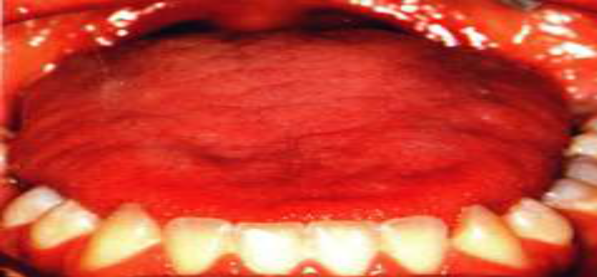
EXAMINATION OF TONGUE :-
•Abnormalities of the tongue can upset the muscle balance and equilibrium leading to malocclusion.
•Presence of excessively large tongue is indicated by scalloping on the lateral margins of the tongue.
•The lingual frenum should be examined for tongue–tie as it alters the resting tongue position and impairs the tongue movement.

Slide 5
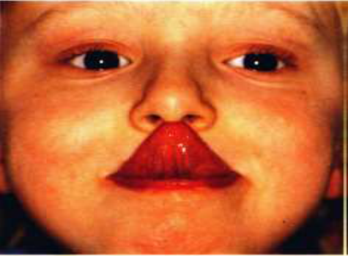
EXAMINATION OF TONGUE :-
TONGUE IS EXAMINED FOR:-
SIZE
SHAPE
MOVEMENTS
POSTURE
A patient whose tongue can reach the tip of the nose is said to have a long tongue.
Macroglossia could lead to lateral open-bite and spacing in the dentition.

Slide 6
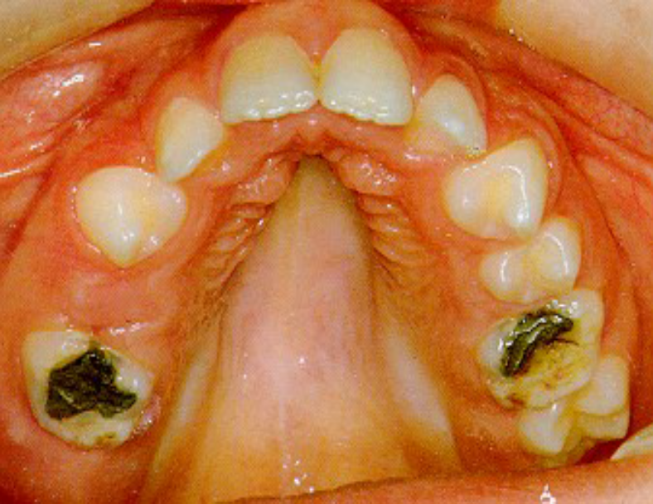
EXAMINATION OF THE PALATE :-
The palate should be examined for the following findings :-
• Variation in palatal depth
• Presence of swelling
• Mucosal ulceration and indentations
• Presence of clefts
Palate is classified as:-
Normal
Deep
Shallow

Slide 7
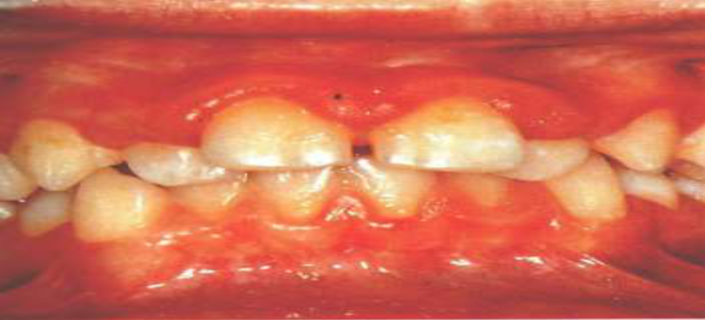
EXAMINATION OF GINGIVA:-
GINGIVA SHOULD BE EXAMINED FOR:-
1. INFLAMMATION
2. RECESSION
3. MUCOGINGIVAL LESIONS
ANTERIOR GINGIVITIS COMMON IN MOUTH BREATHERS DUE TO DRYNESS OF MOUTH CAUSED BY OPEN LIP POSTURE.

Slide 8
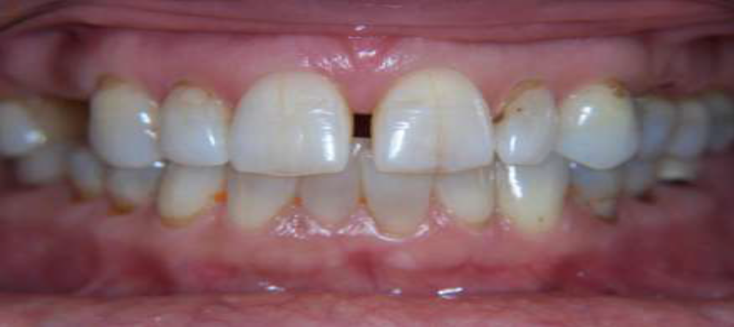
EXAMINATION OF FRENAL ATTACHMENTS
•A high maxillary labial frenum may be cause of a midline diastema.
•An abnormally high attachment of the mandibular labial frenum can cause recession of the gingiva in that area.
•Abnormal frenal attachments are diagnosed by a blanch test where the upper lip is stretched upwards and outwards for a period of time.

Slide 9
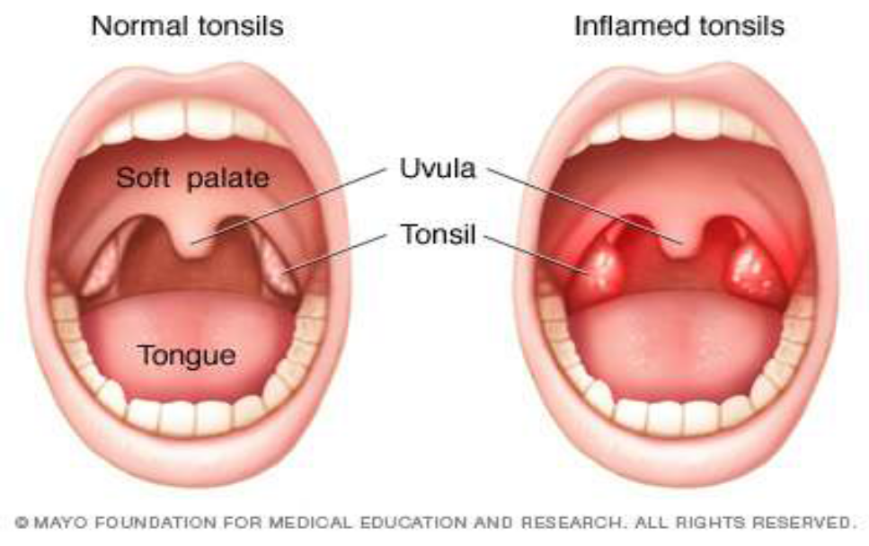
EXAMINATION OF TONSILS & ADENOIDS:-
ABNORMALY INFLAMED TONSILS CAUSE
alterations in tongue and jaw posture there by upsetting the oro-facial balance leading to malocclusion.

Slide 10
HARD-TISSUE EXAMINATION

Slide 11
ASSESSMENT OF DENTITION:-
Dentition is examined for :-
1. Teeth present in the oral cavity.
2. Teeth unerupted.
3. Teeth missing.
4. Oral hygiene status and brushing habits.
5. Presence of caries,restorations,malocclusions,
hypoplasia ,wear & dislocation.
6. Check for the malocclusions.
7. Record overbite and overjet.
8. Check for crossbite.
9. Individual tooth irregularities such as rotation, displacement ,intrusion and extrusion are noted.
10. Check arch form.

Slide 12
Maxillary and madibular arch are assessed for:-
Shape :-average/ V-shape/ U-shape/ square
Arch symmetry:- symmetrical/asymmetrical
Arch alignment
Crowding / spacing
Curve of spee
Freeway space
Maximum opening

Slide 13
Occlusion is assessed for:-
Intra-arch malocclusions
Inter-arch malocclusions
Skeletal Malocclusion

Slide 14
Intra-Arch malocclusions
Rotation
Inclination/ Tipping-
Buccal/Labial
Lingual
Mesial
Distal
Total displacement
Transposition
Infraversion
Supraversion

Slide 15
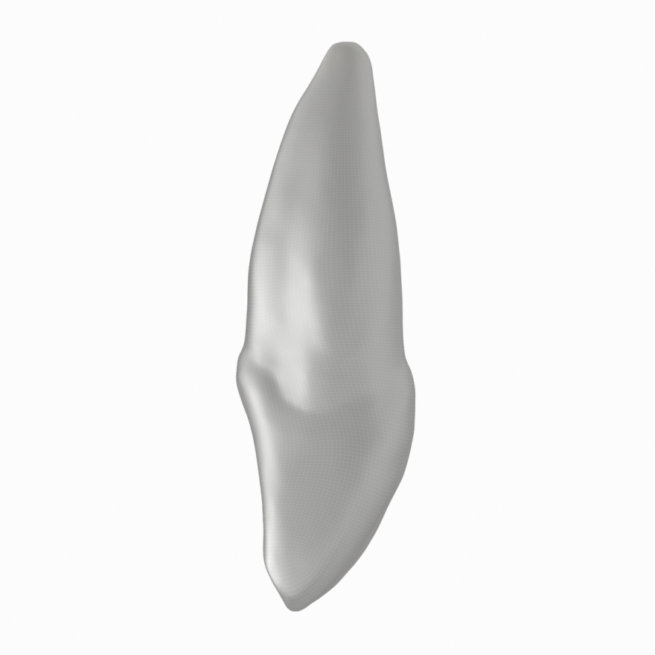
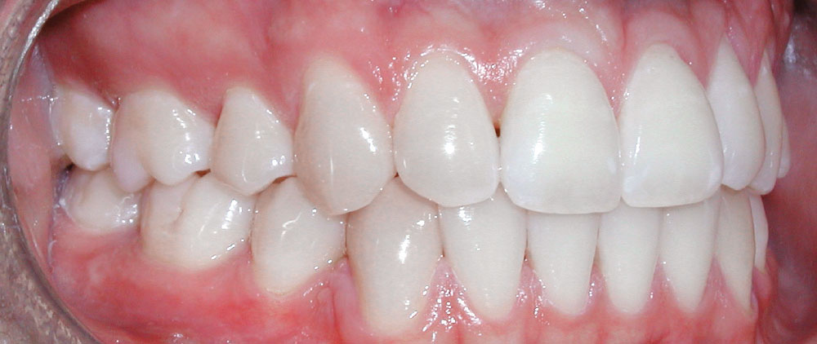
Buccal and palatal inclination & displacement
Palatal
Buccal

Slide 16
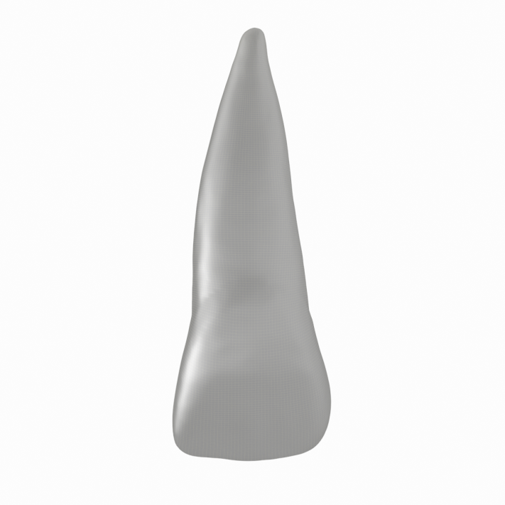
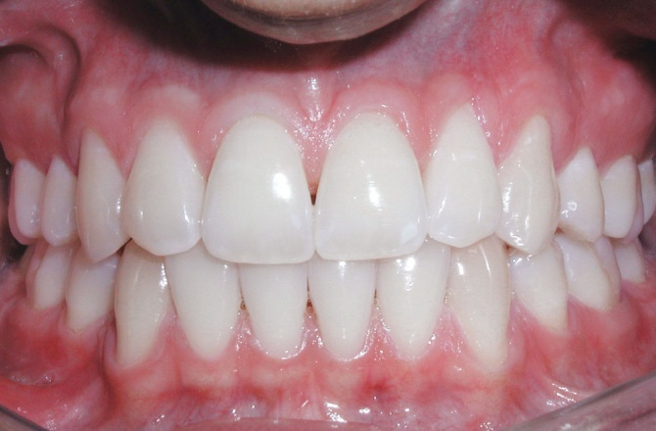
Mesio-distal inclination & displacement
Mesial
Distal

Slide 17
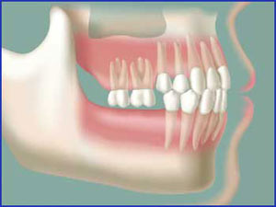
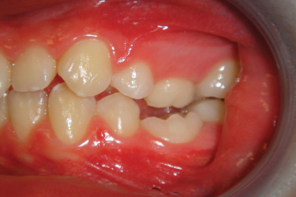
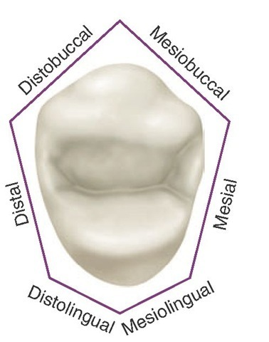
Supra, infraocclusion & rotation

Slide 18
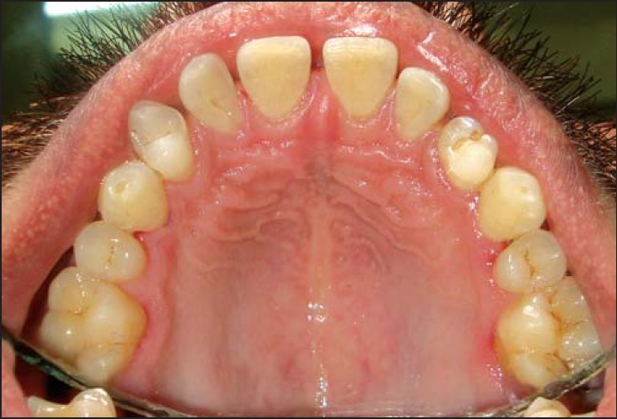
Transposition

Slide 19
Inter-arch Malocclusions
SAGITTAL PLANE MALOCCLUSION
VERTICAL PLANE MALOCCLUSION
TRANSVERSE PLANE MALOCCLUSION
SAGITTAL PLANE MALOCCLUSION
VERTICAL PLANE MALOCCLUSION
TRANSVERSE PLANE MALOCCLUSION

Slide 20
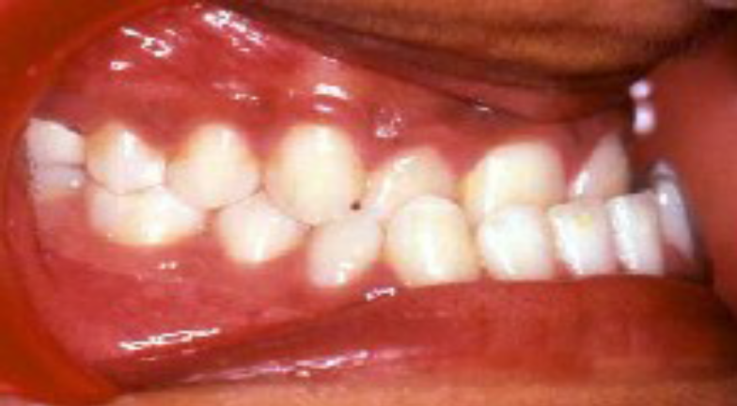
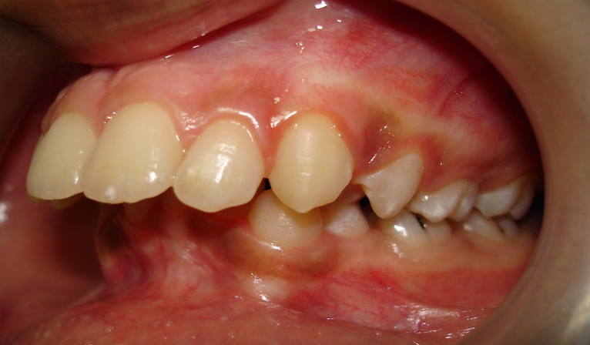
SAGITTAL PLANE MALOCCLUSION
Pre-normal occlusion
-mandibular dental arch is placed anteriorly in centric
occlusion.
Post-normal occlusion
-mandibular dental arch is
placed more posteriorly
in centric occlusion.

Slide 21
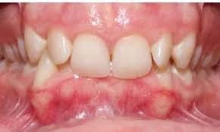
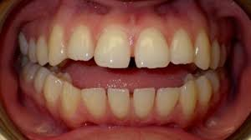
Vertical plane malocclusion
Deep bite or increased overbite.
This refers to a condition where there is an excessive vertical overlap between upper and lower anterior teeth.
Open bite. It is a condition where there is no vertical overlap between upper and lower teeth .

Slide 22
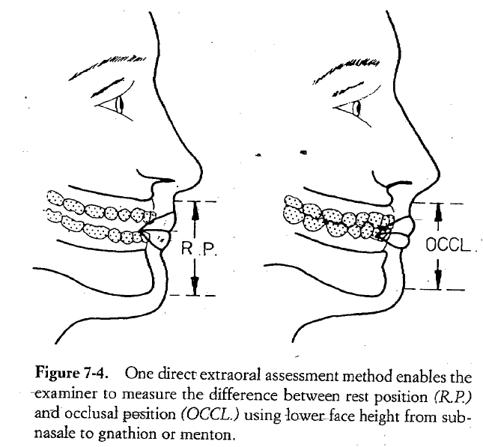
Freeway space
This is important in those orthodontic cases where the functional analysis is significant for treatment planning.
Most common methods:
DIRECT INTRAORAL METHOD
DIRECT EXTRAORAL METHOD
INDIRECT EXTRAORAL METHOD

Slide 23
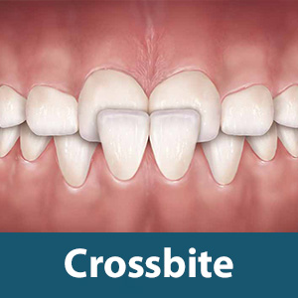
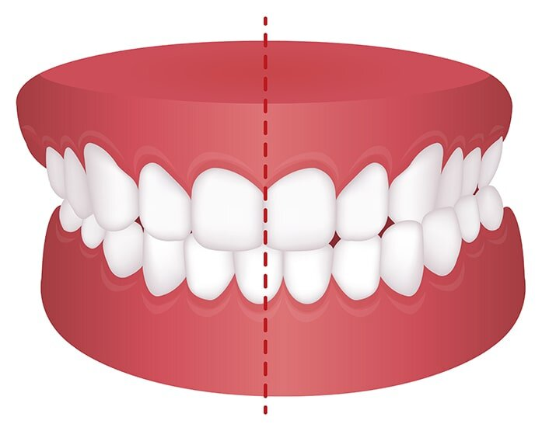
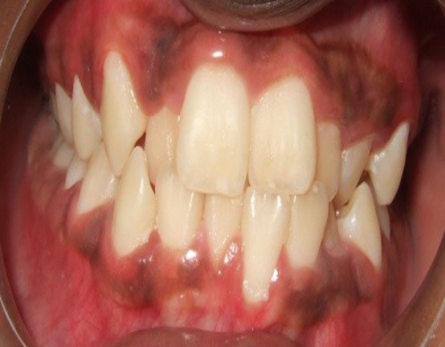
TRANSVERSE PLANE MALOCCLUSION

Slide 24
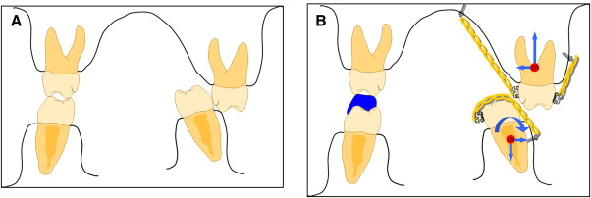
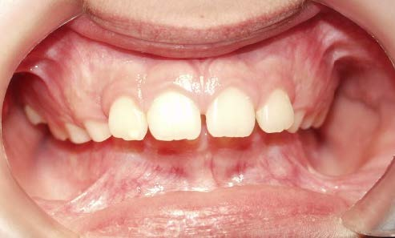
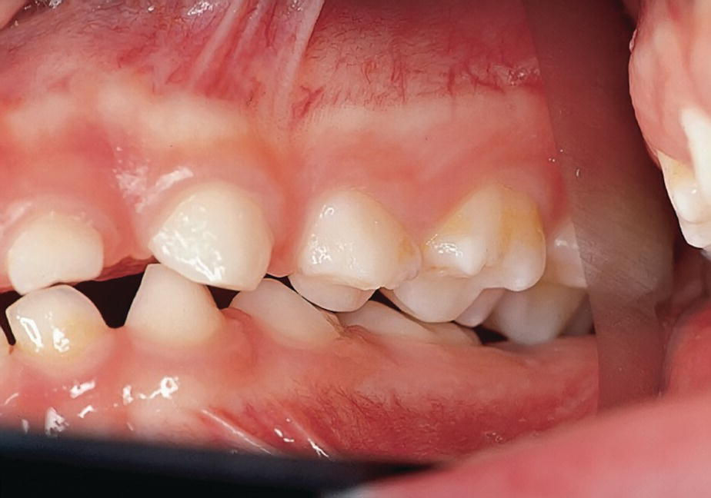
Scissor bite

Slide 25
Skeletal Classification
Class I- orthognathic maxilla and orthognathic mandible.
Class II- orthognathic maxilla and retrognathic mandible
Class III- orthognathic maxilla and prognathic mandible

Slide 26
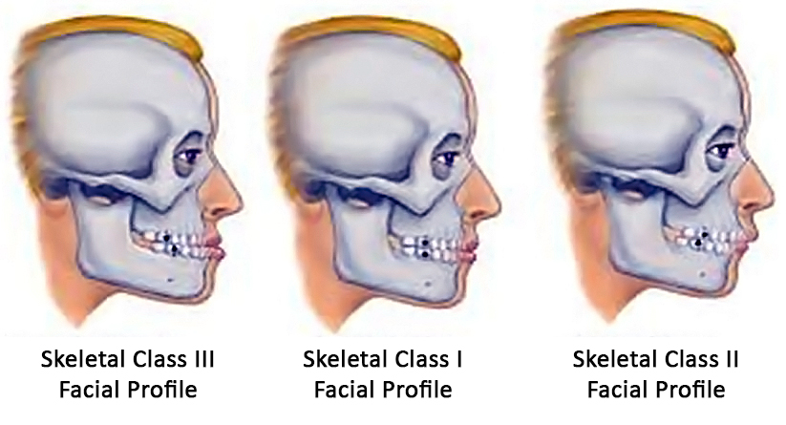
Skeletal classification

Slide 27
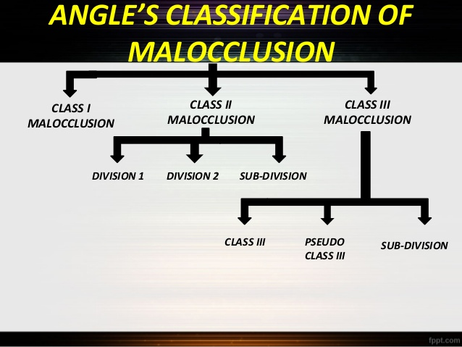
Antero-posterior plane
Molar relation:-

Slide 28
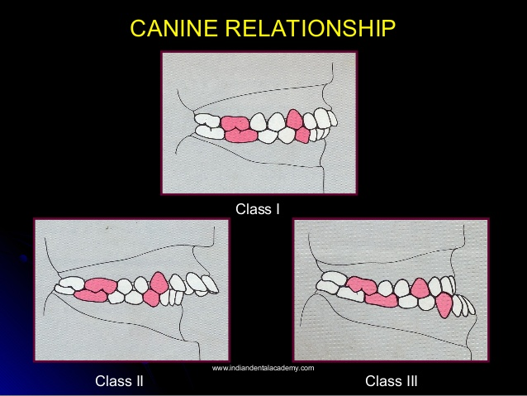
Canine relation :-

Slide 29
Midline
The position of the midline of the mandible is observed while the jaw is moved from the postural rest to habitual occlusion.
Two types of skeletal mandibular deviation can be differentiated :
Laterognathy
lateroclusion

Slide 30
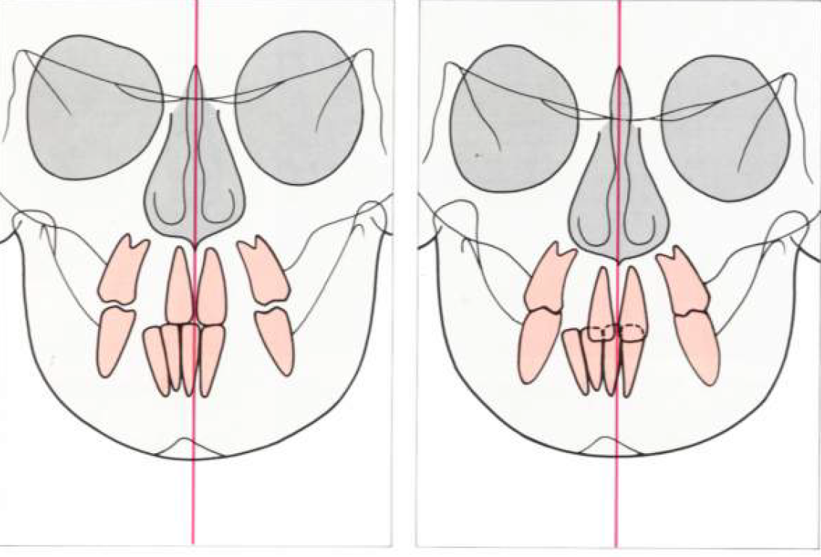
LATEROGNATHY
The centre of the midline is not aligned with the facial midline in rest and in occlusion.
These dysplasia constitute true neuromuscular or anatomical asymmetry.
A lateral crossbite with laterognathy is termed true cross bite.
Successful functional appliance treatment is not possible in such cases; in severe cases, surgery is the only alternative.

Slide 31
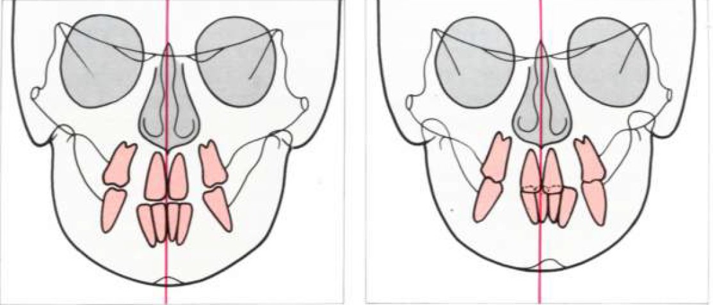
2. LATEROLUSION
The skeletal midline shift of the mandible can be observed only in the occlusal position
In postural rest both midlines are well aligned.
The deviation is due to tooth guidance (functional non-true malocclusion)

Slide 32
Provisional diagnosis

Slide 33
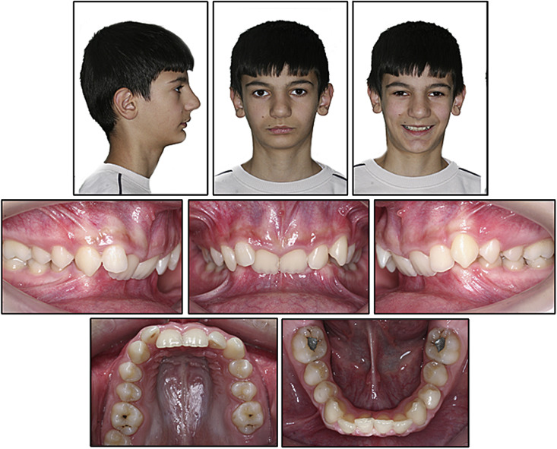

Slide 34
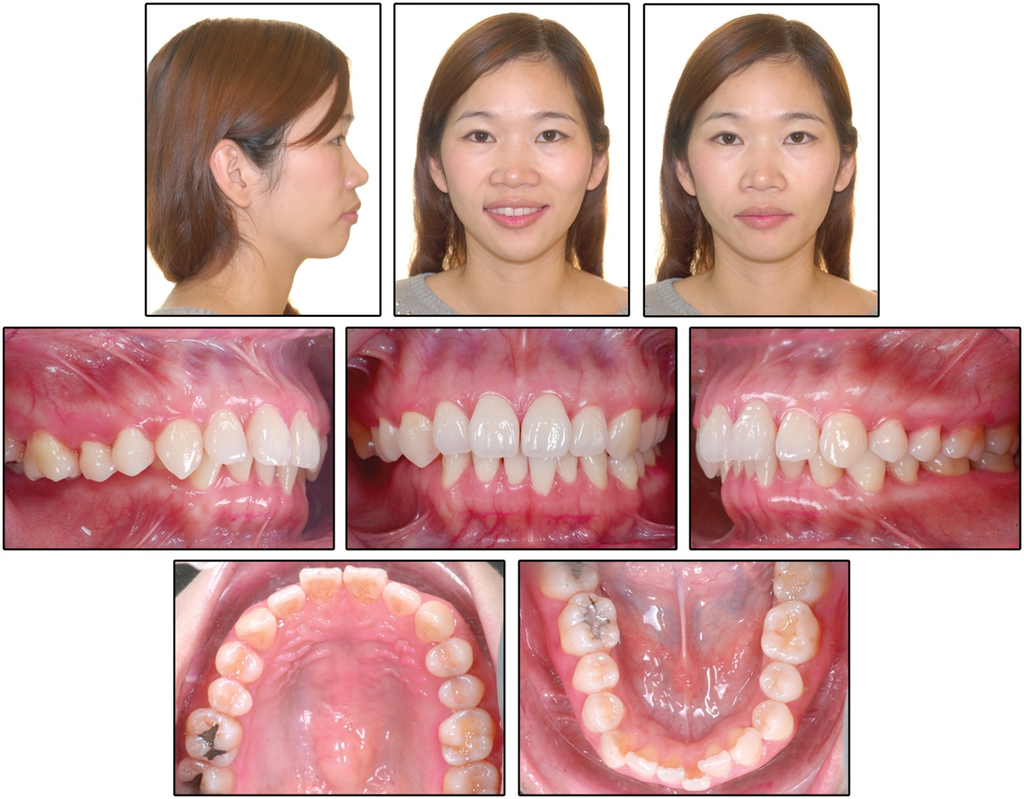

Slide 35
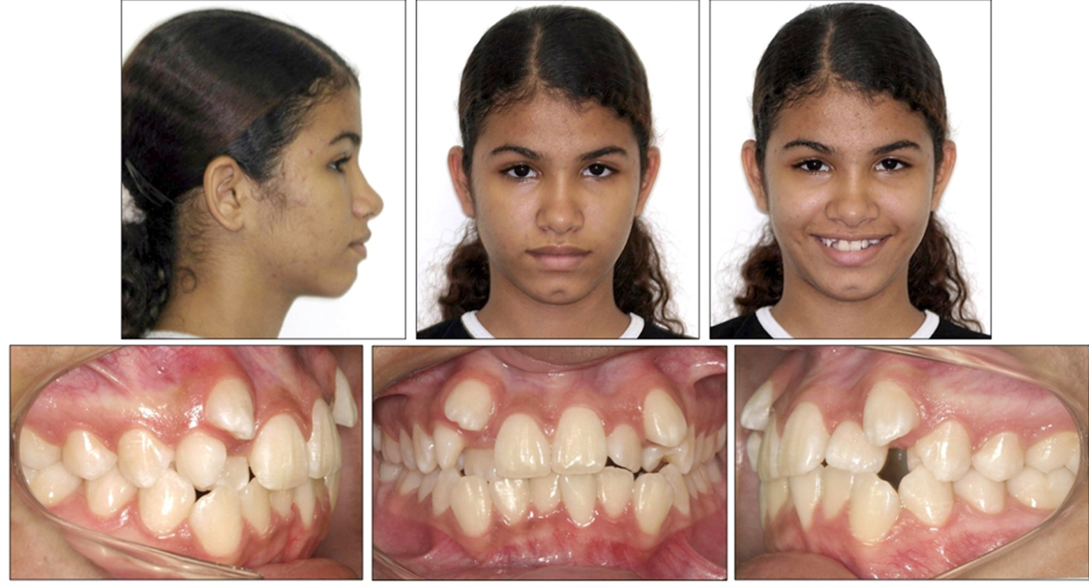

Slide 36
REFERENCES :-
Contemporary orthodontics 4th edition by proffit
Orthodontic diagnosis by Thomas Rakosi, Irmtrud Jonas, Thomas M. Graber
Orthodontics – the art and science, 4th edition by S. I. Bhalajhi
Orthodontics - Current principles and technique (Graber) 2000

Slide 37
THANK YOU

