Slide 1
BONE

Slide 2
CONTENTS
INTRODUCTION
COMPOSITION OF BONE
CLASSIFICATION OF BONES
FUNCTIONS OF BONE
CELLS OF BONE

Slide 3
Bone, also called osseous tissue, (latin: "os") is a type of hard endoskeletal connective tissue found in many vertebrate animals.
Bones support body structures, protect internal organs, and (in conjunction with muscles) facilitate movement; are also involved with cell formation, calcium metabolism, and mineral storage.
The bones of an animal are, collectively, known as the skeleton.

Slide 4
INTRODUCTION
Bone is a specialized connective tissue that is mainly characterized by its mineralized organic matrix.
The bone matrix is comprised of :
Collagenous &
Non- collagenous proteins.

Slide 5
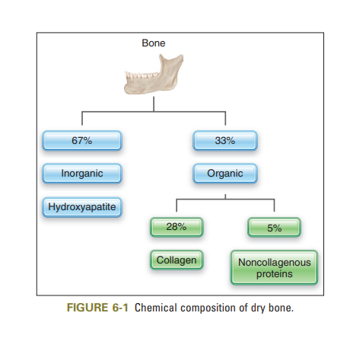

Slide 6
COMPOSITION :
BONE
67%
33%
Inorganic
Organic
Hydroxyapatite crystals
Non collagenous proteins
Collagen
type I
calcium
phosphates
hydroxyl
carbonate
sodium
magnesium
fluorine
Osteocalcin
Osteonectin
Phosphoproteins
proteoglycans
Sialoprotein
Bone morphogenetic protein
Notes:
Mineralised c.t consists of about 28% type-I collagen, 5 % of non collagenous matrix proteins
Growth factors and serum proteins also in bone

Slide 7
CLASSIFICATION

Slide 8
Compact or cancellous
Woven or Lamellar.
Long, Short, Flat or Irregular
Skull bones – Desmocranium,
Chondrocranium &
Visceral part of skull

Slide 9
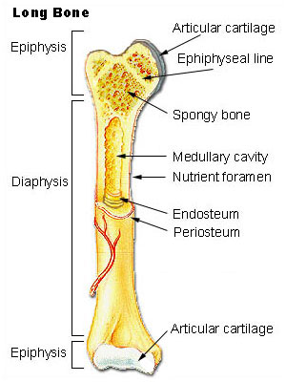

Slide 10
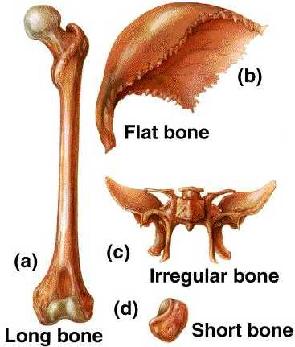
Types of bones
According to shape -
Short- carpals & tarsal
2. Flat – protects underlying organs & soft tissue, as well as provide attachments (scapula, sternum, ribs)

Slide 11
3. Irregular – in shape (vertebrae, sacrum)
or with specific functions (attachment, weight bearing)
4. Long – forms framework of skeleton. Eg clavicle, fibula

Slide 12
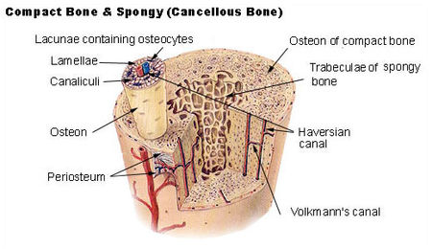
Notes:
Osteons are the functional units of cortical bone. Osteons can be divided into primary osteon and secondary osteons. Primary osteons are adjacent to the primary bone where the blood vessels are surrounded by few circular lamellae.

Slide 13
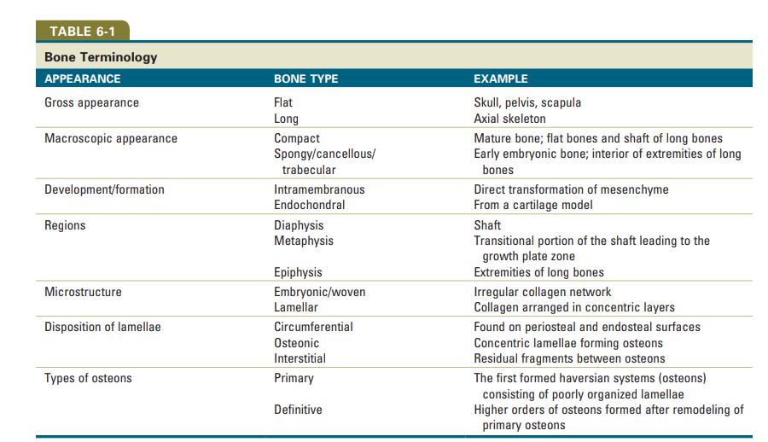
Notes:
Osteons are the functional units of cortical bone. Osteons can be divided into primary osteon and secondary osteons. Primary osteons are adjacent to the primary bone where the blood vessels are surrounded by few circular lamellae.

Slide 14
Functions of bone
Support – forms a supporting framework, giving shape & rigidity to the body.
Locomotion – forms a system to which the voluntary muscles are attached.
Protection – serves to protect the soft & delicate tissues of the body. Eg skull protects the brain.
Manufacturing of blood cells – RBC are manufactured in red bone marrow which is situated in spongy tissue at the ends of long bones.

Slide 15
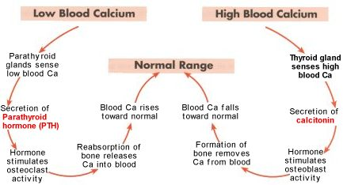
5. Homeostasis – plays a imp role in homeostasis by maintaining Ca ion concentration in blood.
Notes:
Sytematically – hormanal factors regulate bone physiology
Locally – mechanical forces – tooth movement, growth factors and cytokines.
Resist compressive and tensile forces.
Fractures= tensile and slicing stresses.
Homeostasis= automatic process that a living thing uses to keep its body steady on ths insided while continuing to adjust to conditions outsided the body, or in its environment. The body make these changes in order to work the right way and survive.

Slide 16
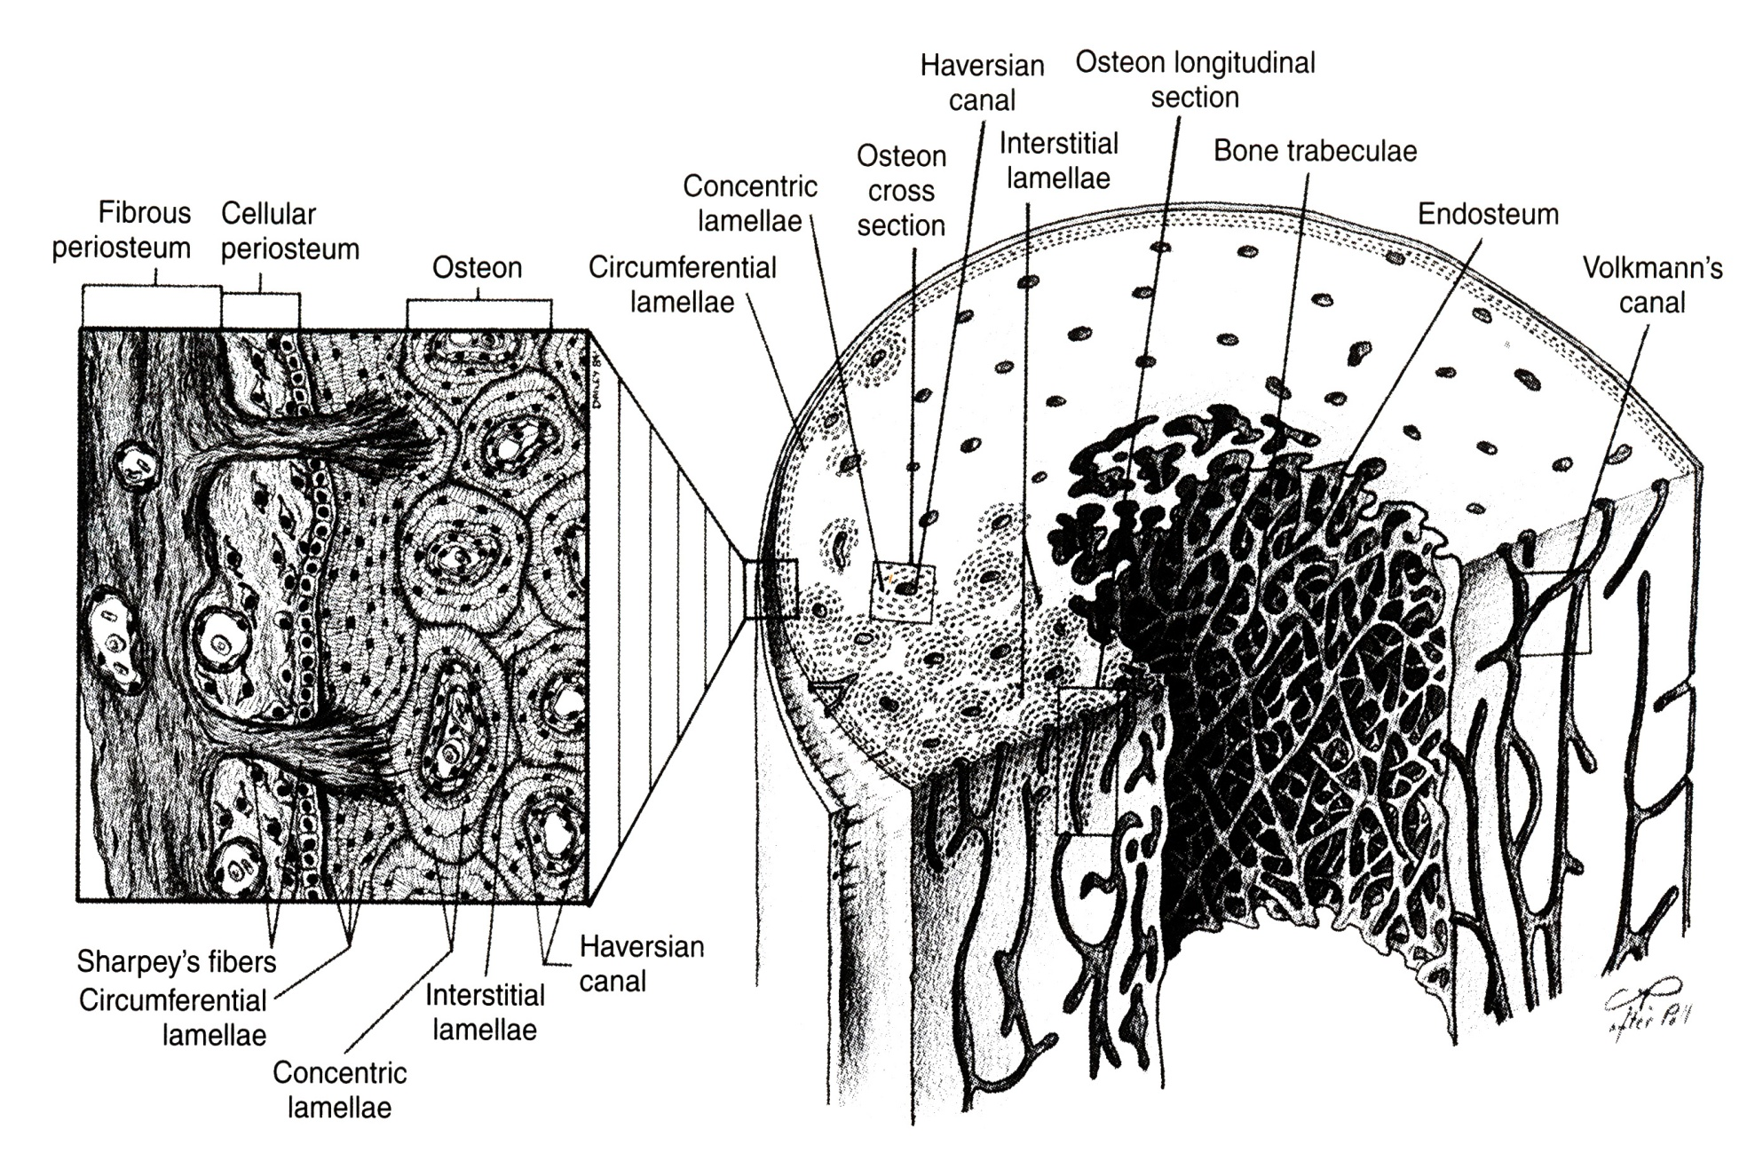
MICROSCOPIC STRUCTURE OF BONE ;

Slide 17
COMPOSITION
Matrix and Cells

Slide 18
MATRIX
It has inorganic and organic parts (65% & 35%).
The inorganic is mainly crystalline mineral salts in the form of hydroxyapatite.
The matrix is initially laid down as unmineralized osteoid.
Mineralisation involves osteoblasts secreting vesicles containing alkaline phosphatase. This acts as the foci for calcium and phosphate deposition.
The vesicles then rupture and act as a centre for crystals to grow on.

Slide 19
The organic part of matrix is mainly Type I collagen.
This is made intracellularly as tropocollagen and then exported.
It then associates into fibrils. Also the organic part of matrix include various growth factors.
Other factors present include GAGs, osteocalcin, osteonectin, and bone sialo protein.

Slide 20
bone cells:
Two cell lineages are present in bone:
Osteogenic cells, which form and maintain bone, and
Osteoclasts, which resorb bone.
Osteogenic cells include osteoprogenitors, preosteoblasts, osteoblasts, osteocytes, and bone-lining cells.
Notes:
Lineage=derivatives

Slide 21
Cells
OSTEOBLASTS, OSTEOCYTES & OSTEOCLASTS
Osteoblasts are typically viewed as bone forming cells. They are located near to the surface of bone and their functions are to make osteoid.
Osteoblasts are mononucleate. Active osteoblasts are situated on the surface of osteoid communicate with each other via gap-junctions.
They contain alkaline phosphatase—a chemical which has a role in the mineralisation of bone.
Notes:
Osteoid= like bone, defined as un mineralized bone tissue and is key structure in development of matured mineralized bone.

Slide 22
Osteocytes originate from osteoblasts which have migrated into and become trapped and surrounded by bone matrix which they themselves produce.
The space which they occupy is known as a lacuna.
Osteocytes have many processes which reach out to meet osteoblasts probably for the purposes of communication.
Their functions include to varying degrees: formation of bone, matrix maintenance and calcium homeostasis.

Slide 23
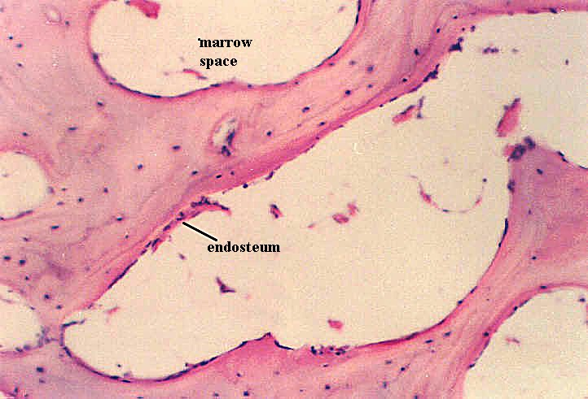

Slide 24
Osteoclasts can be described as bone destroying cells.
Osteoclasts are large, multinucleated cells located on bone surfaces in what are called Howship's lacunae.
These lacunae, or resorption pits, are left behind after the breakdown of bone and often present as scalloped surfaces.

Slide 25
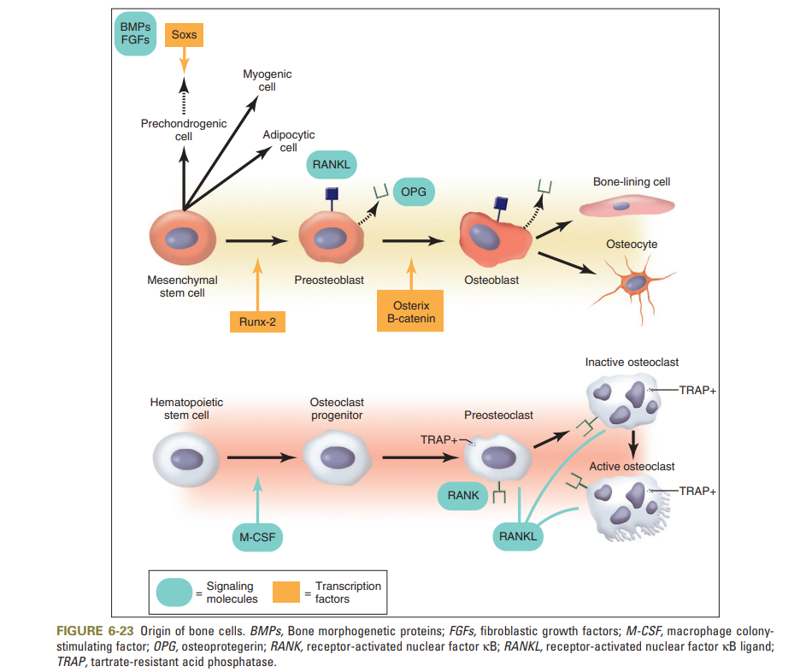

Slide 26
OSTEOBLASTS:
SOURCE:
Osteoprogenitor cells from the bone marrow.
Periosteum
Notes:
Periosteum during childhood growth, after skeletal fractures or with bone forming tumors.
Osteoprogenitor cells, are small, pale-staining, spindle shaped cells that are present on all nonresorbing surfaces of living bone
When circumstances cause osteogenic cells of the periosteum or endosteum to proliferate, these cells give rise to osteoblasts in regions that is well vascularized and to chondroblasts in regions that are avascular.

Slide 27
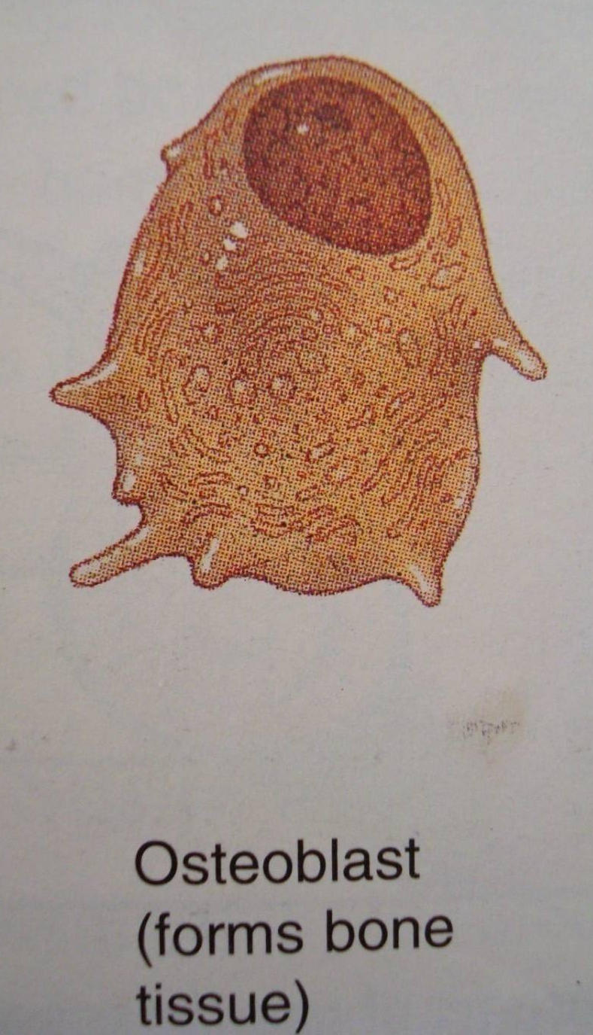
Basophilic,plumped cuboidal or elongated cells with eccentric placed nucleus and osteoblastic processes.
In H & E sections, cytoplasm is deeply basophilic.
Functions:
Bone formation.
Regulation of bone remodeling.
Notes:
Cbfa1 (osteoblast specific transcription factor)
Osteoprogerin- osteoclast inhibitor

Slide 28
Formation:
Undifferentiated pluripotent stem cells
BMP’s, Growth factors
Inducible osteo-progenitor cells
Determined osteo-progenitor cells
Bone derived growth factors
osteoblasts

Slide 29
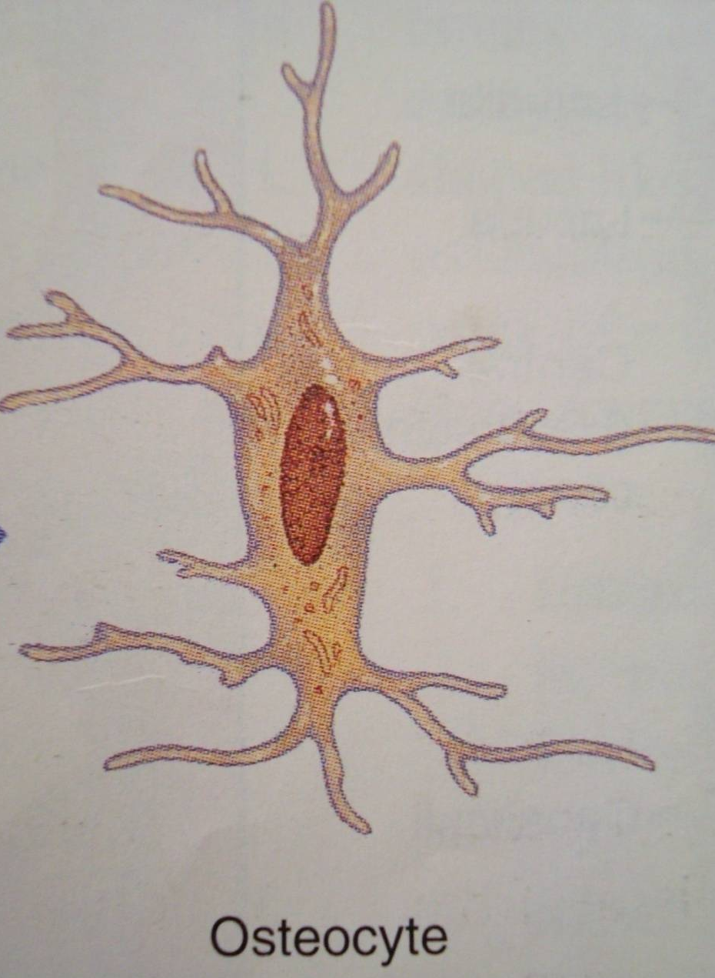
Osteocytes
Osteoblasts forms bone matrix in which they get entrap to form osteocyte.
Cells are smaller, less basophilic than osteoblasts.
Osteocytic processes contacts processes of adjacent cells and osteoblast for diffusion of nutrients, gases, waste products.
Notes:
Within the bone matrix, the osteocyte reduces in size, creating a space around it, called the osteocytic lacuna. The lacunae can appear ovoid or flattened. Narrow extensions of these lacunae form channels called canaliculi. Osteocytic processes are present within these canaliculi.

Slide 30
Osteocytes
Functions:
Maintain bone matrix and
Release calcium ions from bone
matrix when calcium demands increase.

Slide 31
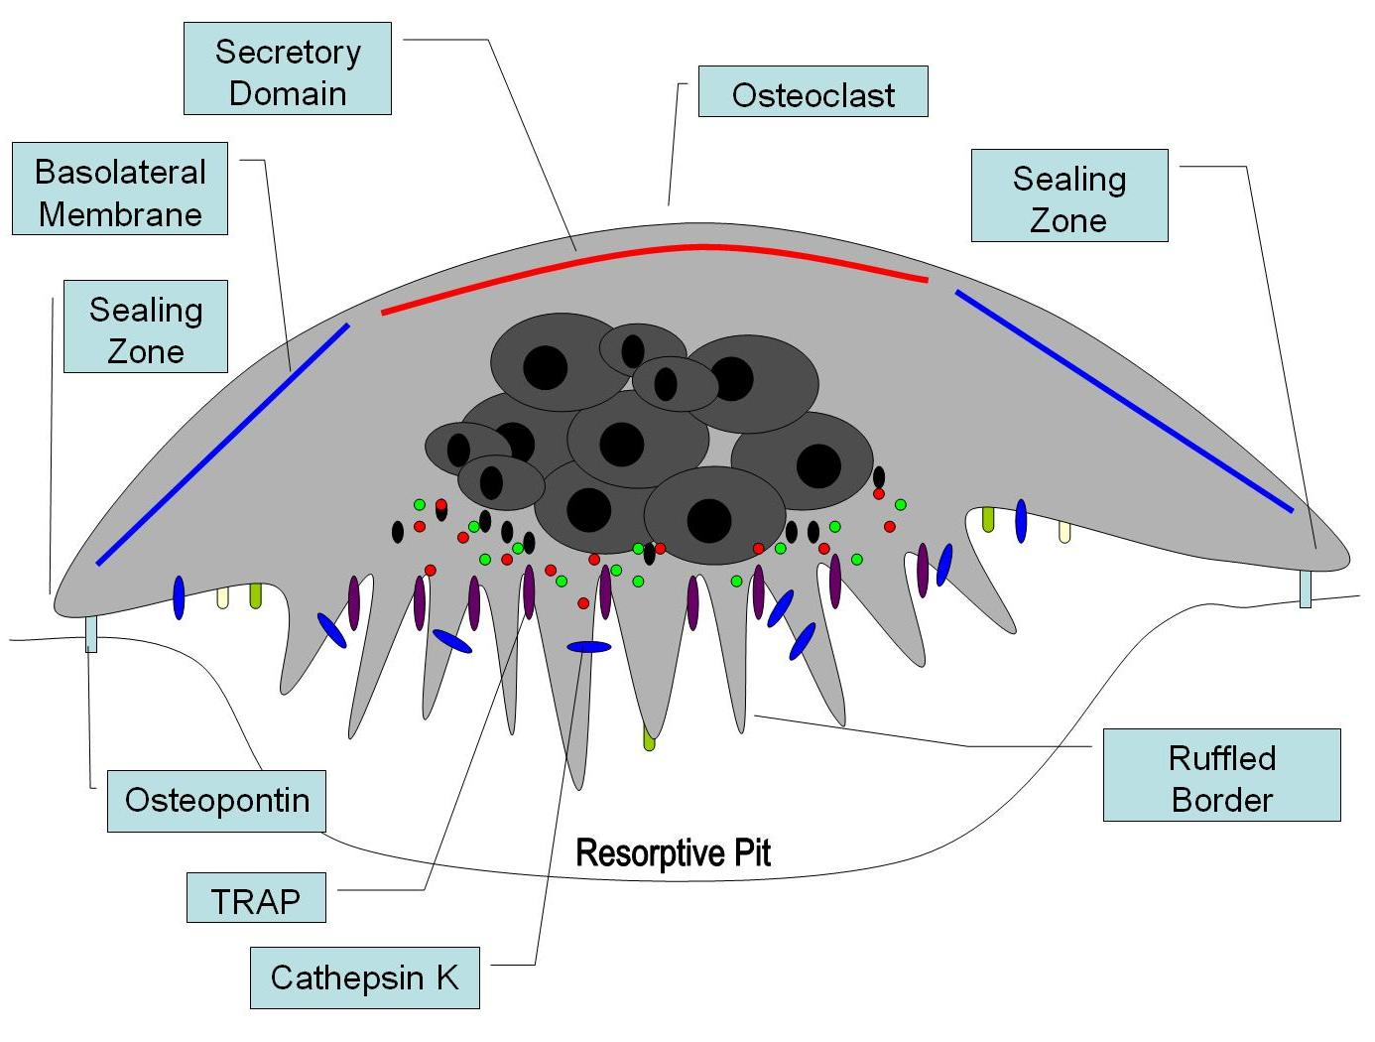
Osteoclasts
40-100 µm in diameter with 15 to 20 closely packed nuclei.
Cytoplasm shows acid phosphatase containing vesicles and vacuoles.
Lie in resorption bays called as HOWSHIP’s LACUNAE
Notes:
bone destroying cells.

Slide 32
Formation:
Hemopoietic stem cells of
monocyte-macrophage lineage
cell cell interaction RANKL, M-CSF
osteoclast

Slide 33
osteoclasts
Regulation:
Osteoprotegerin (RANKL antagonist)
Estrogen (inhibits IL-1 & IL-6)
Vitamin D3 and parathyroid hormone
TGF-β and Interferon-γ
Biophosphonates.
Notes:
bone resorbing cytokines including IL-l and IL-6
TGF-β and interferon-γ inhibit proliferation and differentiation of committed precursors into mature osteoclasts.
Biophosphonates are used as anti bone resorbing agents

Slide 34
Another feature of osteoclasts is a proton pump associated with the ruffled border that pumps hydrogen ions into the sealed compartment. Thus the sequence of resorptive events is considered to be as follows:
1. Attachment of osteoclasts to the mineralized surface of bone
2. Creation of a sealed acidic microenvironment through action of the proton pump, which demineralizes bone and exposes the organic matrix.
3. Degradation of the exposed matrix by the action of released enzymes, such as acid phosphatase and cathepsin B
4. Endocytosis at the ruffled border of organic degradation products
5. Translocation of degradation products in transport vesicles and extracellular release along the membrane opposite the ruffled border (transcytosis).

Slide 35
Bone formation
Bone formation occurs by three main mechanisms:
1. Endochondral,
2. Intramembranous
3. Sutural.
Endochondral bone formation takes place when cartilage is replaced by bone.
Intramembranous bone formation occurs directly within mesenchyme.

Slide 36
Endochondral ossification:
Replacement of a cartilaginous model by bone.
Occurs at the extremities of all long bones, vertebrae, ribs, articular extremity of the mandible and base of the skull.
The process involves the following steps:
Formation of a cartilaginous model.
Formation of bone collar.
Formation of periosteal bud.
Formation of medullary cavity.
Formation of secondary ossification center.
Mechanism of calcification.

Slide 37
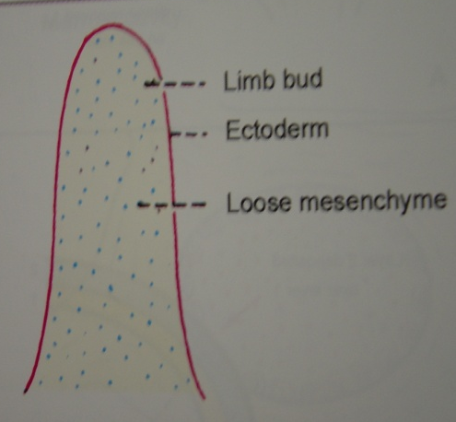
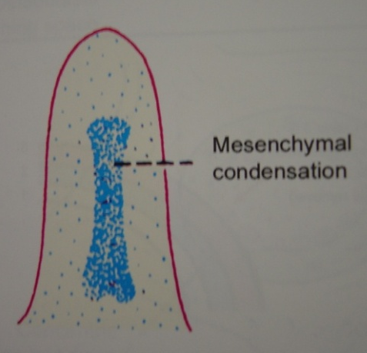
Formation of a cartilaginous modeL:
Zone of proliferation
Zone of hypertrophy and maturation
Zone of provisional mineralization
Notes:
At the site where a limb will later emerge, the embryo shows outgrowth of mesoderm covered by ectoderm. The mesenchymal cells in this site condense, differentiate into chondroblasts and resulting in the development of a hyaline cartilage model. The model is surrounded by a perichondrium made up of an inner chondrogenic layer and outer fibrous layer. No osteoblasts are produced by the cells in the chondrogenic layer, because differentiation is taking place in an avascular environment.
The growth of the cartilage model is by interstitial and appositional growth. Increase in the length is by interstitial growth . Widening of the model is due to appositional growth. As the differentiation of cartilage cells moves towards the metaphysis, the cells organize into longitudinal columns which are subdivided into three zones
Zone of proliferation: The cells are small and flat, and constitute a source of new cells.
Zone of hypertrophy and maturation: This is the broadest zone. The chondrocytes hypertrophy, and in the early stages secrete Type II collagen. As hypertrophy proceeds, proteoglycans are secreted. The increased cell size and increased cell secretion, lead to an increase in the size of the cartilaginous model.
Zone of provisional mineralization: Matrix mineralization begins in the zone of mineralization by formation of matrix vesicles

Slide 38
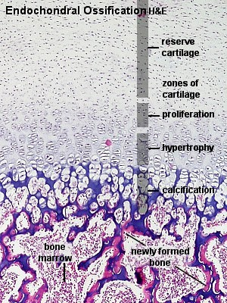
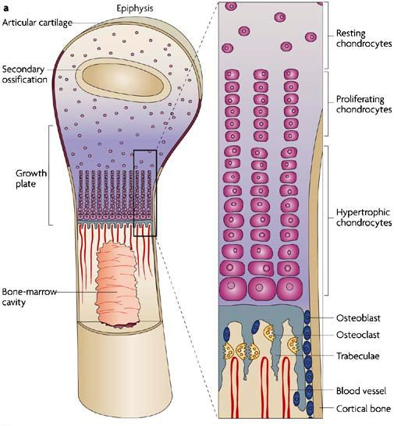
Formation of a cartilaginous model.

Slide 39
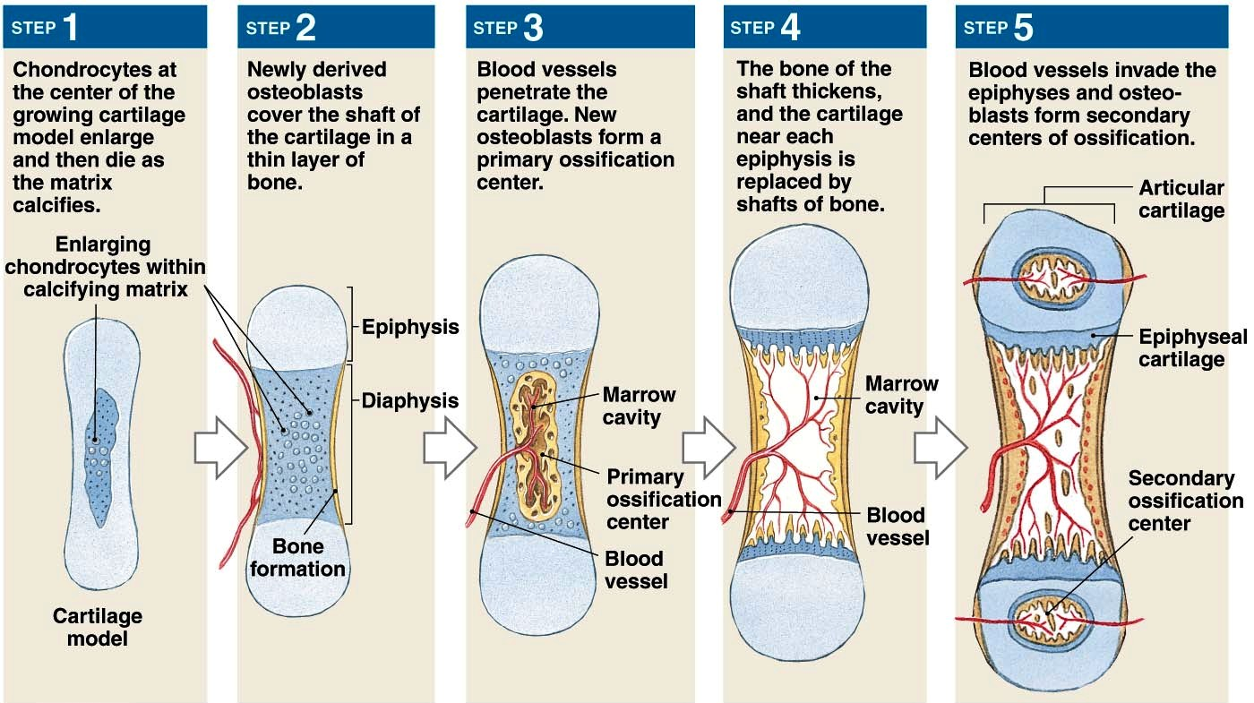
Notes:
The capillaries grow into the perichondrium .
The cells in the inner layer of the perichondrium differentiate into osteoblasts in a vascular environment and form a thin collar of bone matrix around the mid region of the model. Vascularisation of the middle of the cartilage occurs, and chondroclasts resorb most of the mineralized cartilage matrix. The bone collar holds together the shaft, which has been weakened by disintegration of the cartilage
Formation of periosteal bud:Periosteal capillaries accompanied by osteogenic cells invade the calcified cartilage comprise a structure called the periosteal bud. The periosteal capillaries grow into the cartilage model and initiate development of a primary ossification center. Osteogenic cells in the periosteal bud give rise to osteoblasts that deposit bone matrix on the residual calcified cartilage.
Formation of medullary cavity:With enlargement of primary ossification center,osteoclasts breakdown the spongy bone to form medullary cavity, in centre of shaft
Haematopoietic stem cells enter the medullary cavity giving rise to myeloid tissue

Slide 40
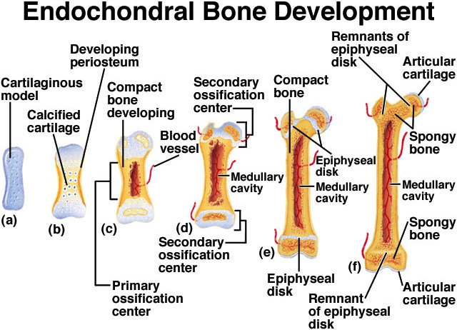
Notes:
Formation of secondary ossification center: Shortly before or after birth, secondary ossification centers appear in one or both epiphysis
Periosteal buds carry mesenchymal cells and blood vessels and process is same as that occurring in a primary ossification center, except that the spongy bone in the interior is retained and no medullary cavity forms in the epiphysis. The ossification spreads from secondary center in all directions. Eventually, the cartilage in the middle of epiphysis gradually gets replaced by cancellous bone. When secondary ossification is complete, hyaline cartilage remains at two places on the epiphyseal surface as articular cartilage and at the junction of the diaphysis and epiphysis, where it forms the epiphyseal plates

Slide 41
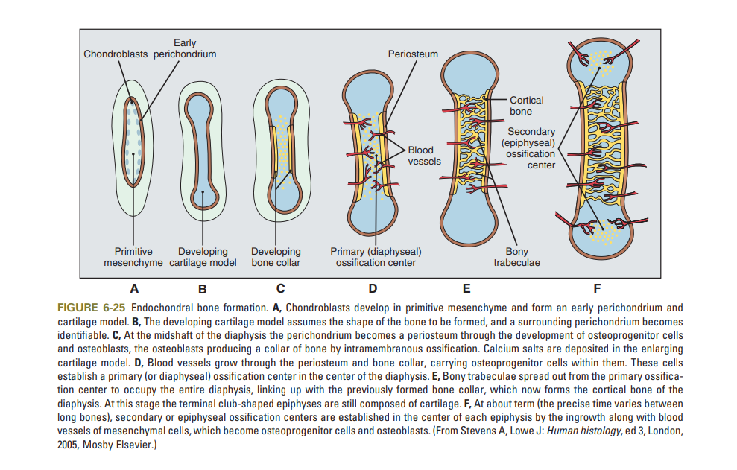

Slide 42
calcification:
Theories of calcification:
MATRIX VESICLE THEORY
BOOSTER THEORY
NUCLEATION THEORY

Slide 43
calcification:
Theories of calcification:
MATRIX VESICLE THEORY-
Matrix vesicles are cell derived structures
Arise as outgrowth of cell membrane that bud from chondrocytes, osteoblasts and odontoblasts in ECM
They lie free in the matrix at the sites where calcification is under way
They provide a microenvironment suitable for nucleation of hydroxyapatite crystals

Slide 44
Matrix vesicle contains alkaline phosphatase.
It release calcium and Pi ions from calcium glycerophosphate at pH 7.4 elevating these ions concentration.
Thus the Ca + Pi ions concentration is high to facilitate mineralization.
They are able to accumulate calcium ions and so is possible that there membrane acts as nucleation site of hydroxyaptite crystals.

Slide 45
BOOSTER THEORY
It proposes that mitochondria can be earliest possible site of storage of amorphous calcium phosphate which are discharged in ECM by matrix vesicles
This hypothetical participation by mitochondria can lead to accumulation of ions for mineralization.

Slide 46
NUCLEATION THEORY
Proposes that organic matrix components helps in precipitation by acting as nucleating agents.
Proteoglycans were found to facilitate calcification, but they have to be modified to release bound calcium.
Phospho-proteins and phospholipids can also act as nucleating agents.

Slide 47
Intramembranous ossification:
Direct formation of bone within highly vascular sheets of condensed primitive mesenchyme.
Occurs in the flat bones of the skull and clavicles.
Begins towards the end of second month of gestation.
Process involves the following steps:
Formation of bone matrix within the fibrous membrane.
Formation of woven bone.
Appositional growth.
Formation of osteon.

Slide 48
CLASSIFICATION OF BONES:
Bones may be classified according to:
Their shape.
Mode of development
By their histologic appearance.
Based on position.
LONG BONES
SHORT BONES
FLAT BONES
IRREGULAR BONES
SESAMOID BONES
PNEUMATIC BONES
ACCESSORY BONES
ENDOCHONDRAL
INTRA-MEMBRANOUS BONES
MATURE BONE
Compact bone
Cancellous bone
WOVEN/ IMMATURE BONE
AXIAL BONES
APPENDICULAR BONES

Slide 49
Formation of bone matrix within the fibrous membrane.
Loose mesenchyme at bone development site.
centre of osteogenesis develops
Proliferation & condensation of mesenchyme to form compact nodules.
Center cells differentiate to OSTEOBLASTS.
Forms bone matrix which later calcifies to irregular bony spicules.
Notes:
Osteoblasts bone forming cells

Slide 50
Formation of woven bone
Bony spicules gradually lengthen into longer and anastomosing structures called trabeculae.
Trabeculae grow in radial pattern to enclose blood vessels (Woven bone).
External to the woven bone, there is condensation of vascular mesenchyme to form Periosteum.
Cbfa1 and BMP’s are required for the process to take place**
Notes:
osteoblasts that deposit new layers of bone matrix on preexisting bone surfaces. This is appositional growth, which results in buildup of bone tissue one layer at a time
Woven bone= primary bone, characterized by irregular arrangement of collagen fibers, large cell number and reduced mineral content.

Slide 51
Difference between mature & woven bone
Features | Mature bone | Woven bone
Orientation of collagen fibres | Collagen fibres in one lamella lies at right angles to other lamella | Collagen fibres oriented in different directions
Interfibrillar space | Space less | Space is more
Deposition and mineralization | Slow than woven bone,osteocytes lesser in number | Faster, more number of osteocytes are present
Resorption | Portion of lamellar matrix is resorbed at one time | Woven bone can be entirely removed
H & E staining | Eosinophilic | Basophilic
Notes:
Hyaline cartilage= glass like smooth appearance of cartilage

Slide 52
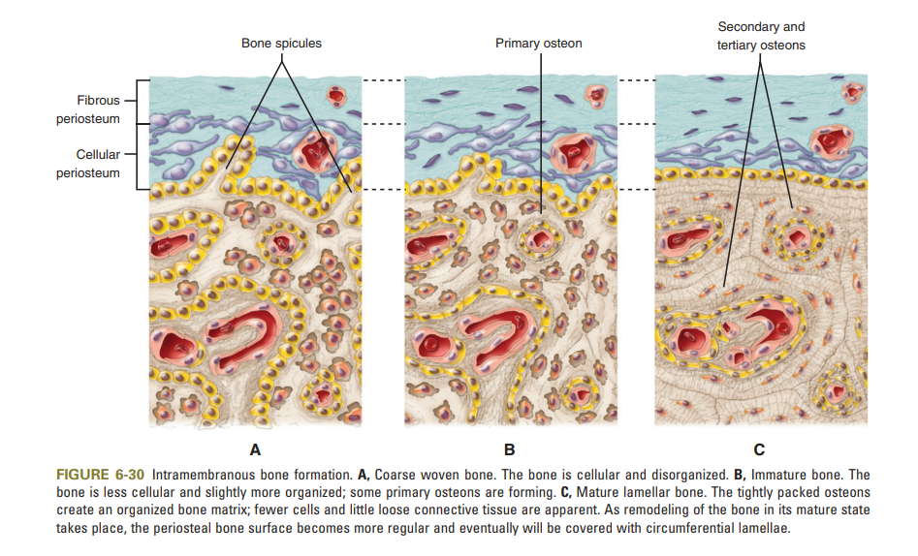

Slide 53
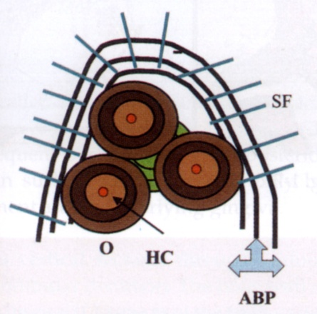
OSTEON :
It is the structural & metabolic unit of the lamellar bone.
It consists of haversian canal in the center which harbors blood vessels.
This is surrounded by concentric, mineralized lamellae to form the osteon; known as concentric lamellae.
Spaces between the different osteon is filled with interstitial lamellae.
Notes:
Lamella of bone
the matrix of the bone is in the form of concentric rings called LAMELLAE. The fluid filled spaces present between the lamellae are called LACUNAE. In which are present the bone cells called osteocytes that communicate with each other by a network of fine canals called CANALICULI

Slide 54
Sutural bone growth
Important role in growing the face and skull
Exclusively in skull
Sutures are fibrous joints between bones
Sutures allow only limited movement
FUNCTIONS: Permit the skull and face to accommodate growing organs, such as eyes and brain

Slide 55
Bone resorption:
Removal of mineral and organic components of the ECM
SEQUENCE OF EVENTS
Ist PHASE: formation of osteoclast progenitors in the blood.
IInd PHASE: vascular dissemination & formation of osteoclasts.
IIIrd PHASE: activation of osteoclasts and retraction of osteoblasts to expose minerals to osteoclasts.
IVth PHASE: activated osteoclasts resorbing bone.
Notes:
DISSEMINATION= spreading

Slide 56
ALTERATION IN OSTEOCLASTS:
Formation of ruffled borders.
Clear (sealing) zone.
REMOVAL OF HYDROXYAPATITE:
Dissolution by HCL creating a pH of 2.5-3.
DEGRADATION OF ORGANIC MATRIX:
Brought about by proteolytic enzymes CATHEPSIN-K, MMP-9
Notes:
Clear zone creates an isolated microenvironment in which resorption can take place with out diffusion of hydrolytic enzymes produced by the cell into adjacent tissue.

Slide 57
REMOVAL OF DEGRADATION PRODUCTS:
Endocytosis and removal from FUNCTIONAL SECRETORY DOMAIN (exocytosis).
Following resorption osteoclasts undergo APOPTOSIS.
Recently TRAP (tartrate resistant acid phosphatase) role is emphasized in regulation of bone resorption.
Notes:
Endocytosis= process of capturing a substance or particle from outside the cell by engulfing it with the cell membrane
Exocytosis= discharge of substance out side

Slide 58
Bone remodeling:
Process by which the overall size and shape of bone is established (COUPLING)
SEQUENCE OF EVENTS:
Osteoclasts tunnel into surface of bone.
Osteoclasts travel along the vessel and resorb HAVERSIAN LAMELLAE & part of CIRCUMFERENTIAL LAMELLAE & form a “CUTTING CONE”.
After sometime resorption ceases and osteoblasts lay down a new set of HAVERSIAN LAMELLAE.(FILLING CONE)

Slide 59
Markers of bone turnover:
BONE FORMATION
Alkaline phosphatase
Osteocalcin
BONE RESORPTION
Urine calcium
Urine hydroxy proline.
Urine N telopeptide
Urine C telopeptide
SERUM MARKERS
Serum TRAP and β2 macroglobulin

Slide 60
DEVELOPMENT of alveolar bone

Slide 61
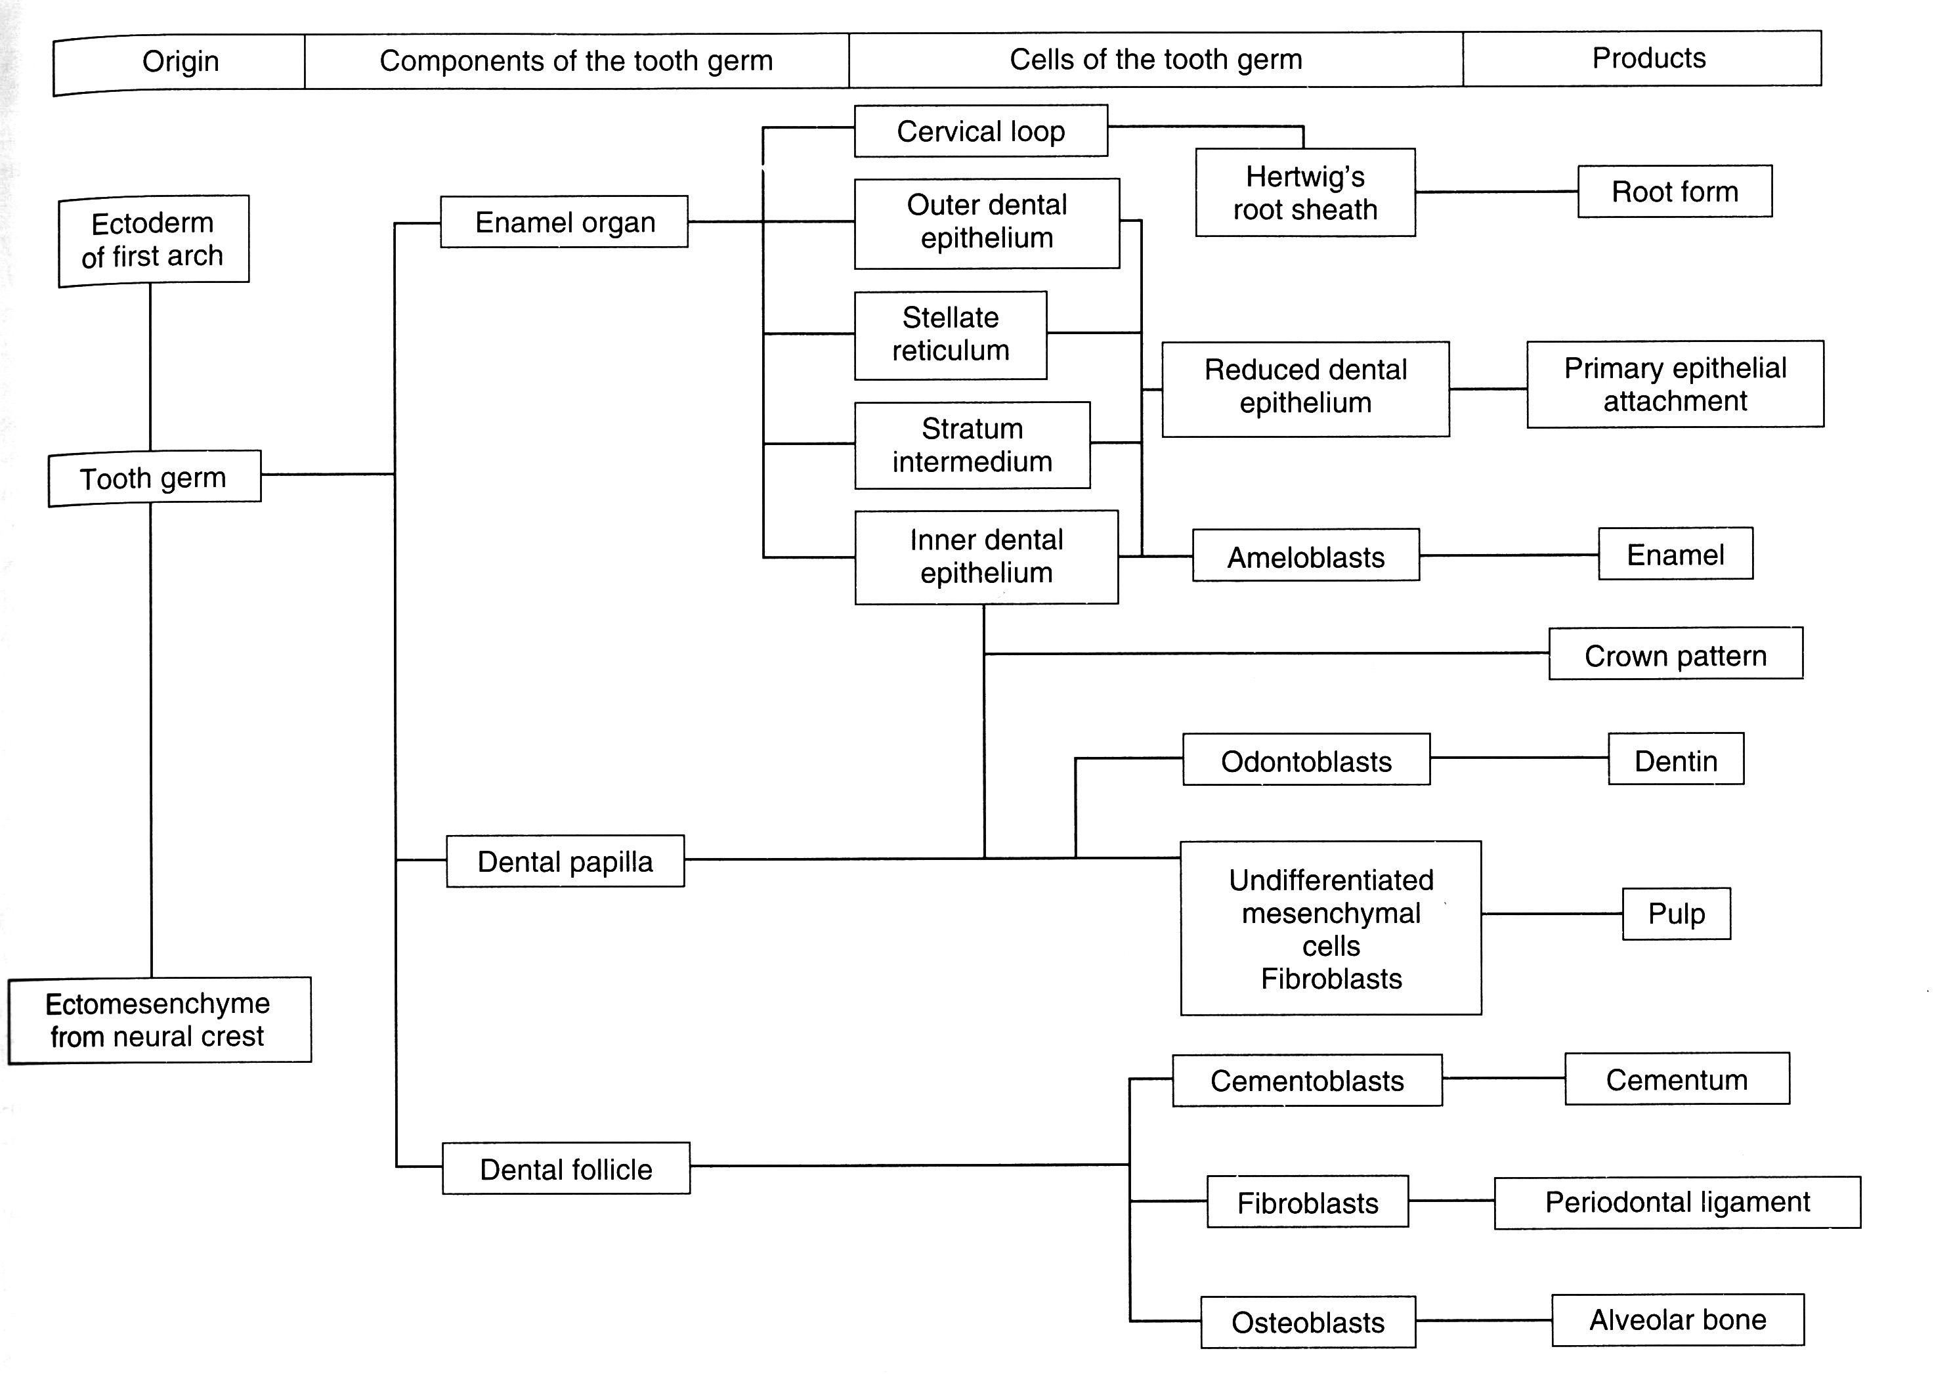

Slide 62
DEVELOPMENT
The alveolar process starts to form early in foetal life, with mineral deposition at small foci in the mesenchymal matrix surrounding the tooth buds.
These small mineralized areas increase in size, fuse and become resorbed and remodelled until a continuous mass of bone has formed around the fully erupted teeth.
Just before mineralization, osteoblasts start producing matrix vesicles.{These vesicles contains enzymes such as alkaline phosphatase}.

Slide 63
As these crystals grow and develop, they form coalescing bone nodules & form woven bone, the first bone formed in the alveolus.
Later, through bone deposition, remodelling and the secretion of oriented collagen fibres in sheets, mature lamellar bone is formed.
The HA crystals are generally aligned with their long axes parallel to the collagen fibres and appear to be deposited on and within the collagen fibres in mature lamellar bone.

Slide 64
The alveolar bone develops around each tooth follicle during odontogenesis.
When a deciduous tooth is shed, its alveolar bone is resorbed.
The succedaneous permanent tooth moves into place, developing its own alveolar bone from its own dental follicle.
As the tooth root forms and the surrounding tissues develop and mature, alveolar bone merges with the separately developing basal bone and the two become one continuous structure.
Although alveolar bone and the basal bone have different intermediate origins, both are ultimately derived from neural crest ectomesenchyme.

Slide 65
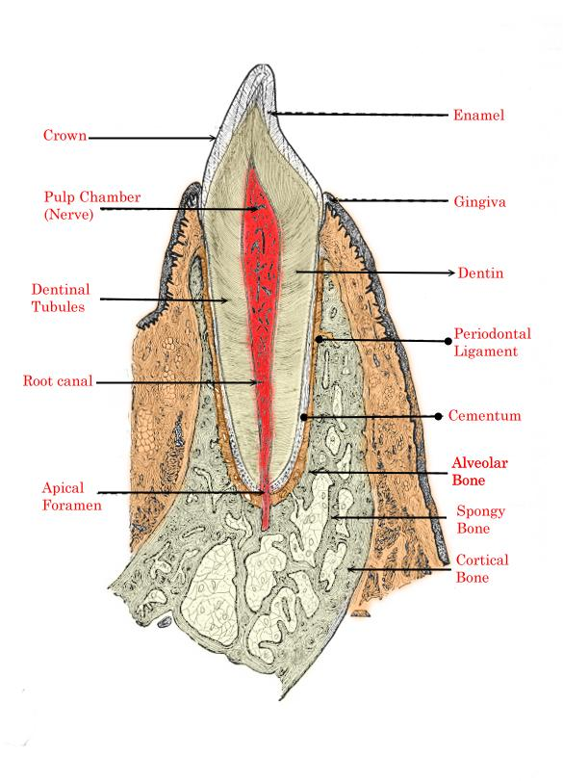

Slide 66
Alveolar bone:
FUNCTIONS:
Houses the roots of teeth.
Anchors the roots of teeth to the alveoli
Helps to move the teeth for better occlusion.
Helps to absorb and distribute Occlusal forces.
Supplies vessels to PDL.

Slide 67
STRUCTURE OF ALVEOLAR BONE:
ALVEOLAR BONE PROPER: thin lamella of bone that surrounds the root of tooth & gives attachment to the PDL
Lamellated bone
Bundle bone
SUPPORTING ALVEOLAR BONE:
Cortical plates
Spongy bone
Type I- interdental & inter radicular trabeculae are regular & horizontal. (MANDIBLE)
Type II- shows irregularly arranged, numerous, delicate trabeculae.(MAXILLA)
Notes:
Lamellated bone: some lamellae are arranged parallel to surface of adjacent marrow spaces.

Slide 68
ALVEOLAR BONE PROPER :
It surrounds the roots of the tooth & gives attachment to the principal fibers of the periodontal ligament.
It is also known as the cribriform plate as it is perforated by many openings; through which branches of the interalveolar nerve & vessels pass into the periodontal ligament.
Histologically bundle bone & lamellaler bone
BUNDLE BONE :
The bone which lines the socket in which sharpey’s fibers are embedded is known as bundle bone.
Contains more calcium salts per units area than other bone.
It is also know as lamina dura.
Notes:
Sharpey,s fibres= also known as perforating fibres or bone fibres
These are bundles of collagen fibres which connect periosteum to bone
They originate in the periosteum and penetrate deeply in the bone matrix, anchoring the periosteum to the underlying bone.

Slide 69
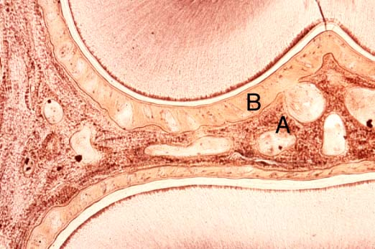
ALVEOLAR BONE PROPER: Thin lamellae of bone that surrounds root of tooth and gives attachment to principle fibers of PDL

Slide 70
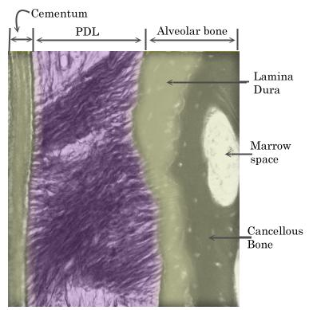
BUNDLE BONE

Slide 71


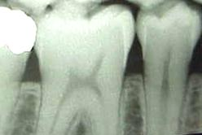
LAMINA DURA
Notes:
Lamina dura= thin layer of dense cortical bone, which lines the root of teeth
Radiographic landmark

Slide 72
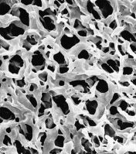
CRIBRIFORM PLATE
Notes:
Alveolar bone proper
Cribriform plate= portion of ethmoid bone located at the base of the skull
Acts as a barrier between nasal cavity n brain

Slide 73
SUPPORTING ALVEOLAR BONE :
It is the bone that surrounds the alveolar bone proper & gives support to the socket.
Consists of cortical plates & spongy bone ( cancellous bone)
CORTICAL PLATES :
Consists of compact bone & form the outer & inner plates of the alveolar process.
Thinner in maxilla than in the mandible.
Thickest in the premolar & molar region of the mandible.
SPONGY BONE:
It is the bone which fills the space between the outer & inner plates & the alveolar bone proper.
Consists of heavy trabeculae with bone marrow spaces.

Slide 74
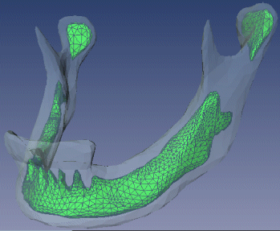
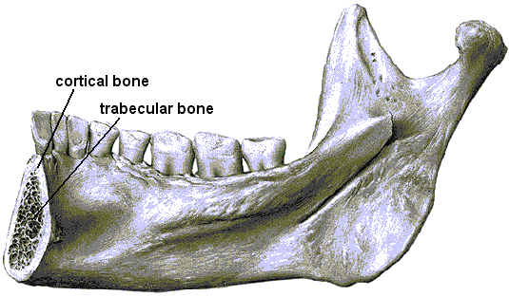
CORTICAL BONE
Notes:
Cancellous= made up of spongy, porous, bone tissue that is filled with red bone marrow
Cortical= dense that contain less than 10% soft tissue

Slide 75
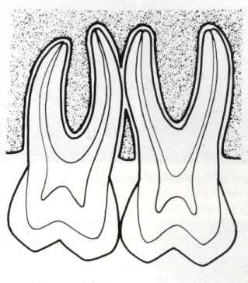
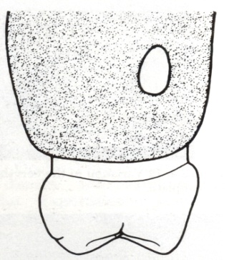
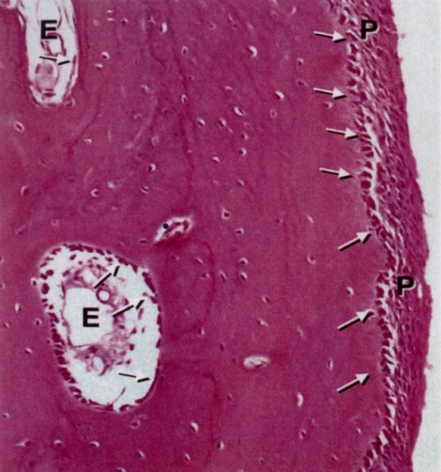
THE INTERDENTAL SEPTUM :
Consists of cancellous bone bordered by the socket walls of approximating teeth & the facial & lingual cortical plates.
If roots are too close together, an irregular window can appear in the bone adjacent roots.
PERIOSTEUM :
The outside of all compact bone is covered by a thin connective tissue membrane called the periosteum.
ENDOSTEUM :
The internal surface of compact bone as well as the entire surface of the cancellous bone are covered by a single layer of bone cells called the endosteum.

Slide 78
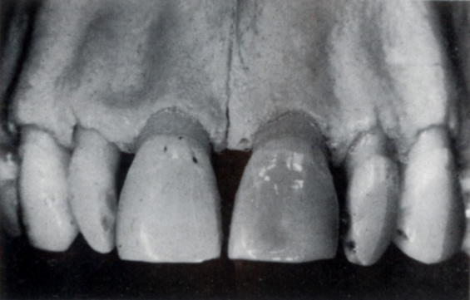
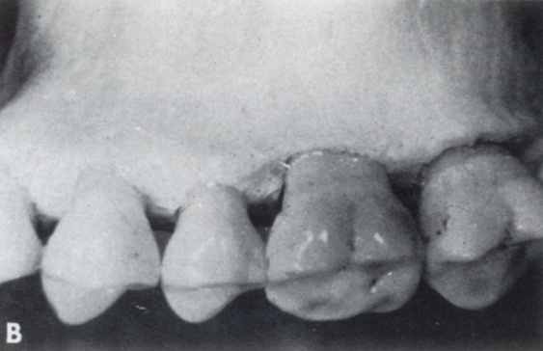
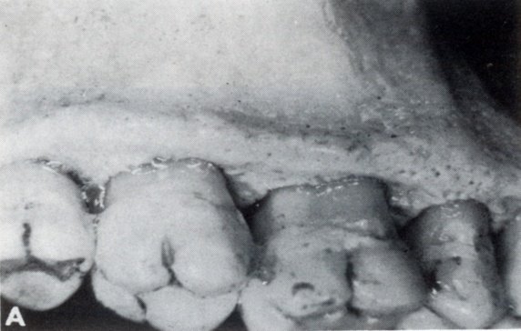
OSSEOUS TOPOGRAPHY :
Normally : prominence of the roots with the intervening vertical depressions that taper toward the margin.
On the labial version ; the margins of the labial bone is thinned to a knife edge & presents an accentuated arc in the direction of the apex.
On the lingual version ; the margins of the labial bone is blunt &rounded & horizontal rather than arcuate.

Slide 79
CLINICAL CONSIDERATION:
In orthodontic teeth movement.
During healing of fractures.
Periodontal disease.
Functional forces leads to formation of new bone while loss of antagonist causes bone resorption due to disuse atrophy.
Notes:
Becoz of the biologic plasticity enables orthodontist to move teeth
On pressure side there is increase in c amp which cause bone resorption.initial response involves osteoblasts which can produce collegonolytic enzymes to remove a portion of unmineralized ECM thereby facilitationg the excess of osteoclasts to bone surface.
On tension side osteoblasts are activated.
During healing of fractures embryonic type bone is formed which is later replaced by mature bone.
Periodontal disease: hz and vt bone loss is seen becoz of sub gingival plaque which releses exotoxins.
Pattern of resorption is do in mand. And ui in maxilla.

Slide 80
ANOMALIES OF BONE FORMATION
Dyschondroplasia or enchondromatosis.
Exostosis, diaphyseal aclasis
Osteogenesis imperfecta
Fibrous dysplasia
Cleido-cranial dysostosis
Dwarfism and gigantism.
Chondroosteo-dystrophy
Notes:
Disorderly and excessive proliferation of cartilage cells in the epiphyseal plate, or the failure of normally formed cartilage to be replaced by bone, leads to the formation of irregular masses of cartilage within the metaphysis
. Abnormal masses of bone may be formed in the region of the metaphysis and may protrude from the bone. Such a protrusion is called an exostosis, and the condition is called multiple exostoses or diaphyseal aclasis. This condition may be a result of interference with the process of remodeling of bone ends
Calcification of bone may be defective (osteogenesis imperfecta) and may result in multiple fractures.
Parts of bone may be replaced by fibrous tissue
, there is insufficient, or disorderly, formation of bone in the region of the epiphyseal cartilage. This interferes with growth of long bones. The individual does not grow in height and becomes a dwarf. A similar condition in which the limbs are of normal length, but in which the vertebral column remains short, is called chondroosteo-dystrophy

Slide 81
Therapeutic consideration:
OSSEOUS GRAFTING MATERIALS:
AUTOGRAFTS.
ALLOGRAFTS.
XENOGRAFTS.
SYNTHETIC BONE GRAFT MATERIALS.
BIOLOGICAL MEDIATED STRATEGIES.
Notes:
With an aim to produce new bone.
AUTO- FROM SAME BODY. ADV WELL ACCEPTED, FASTEST BONE GROWTH AND NO IMMUNE RXN.
ALLO- FROM ANOTHER HUMAN. THEY ARE FREEZE DRIED AT ULTRA LOW TWMP.. TEY ARE OSTEOINDUCTIVE
XENO- FROM COWS AND PIGS.
SYNTHETIC EG CA.CARBONATE, HYDROXYAPATITE, ADV NO IMMUNE REJECTION.
BIOLO. EG BMP

