Slide 1
BIOLOGY OF
TOOTH MOVEMENT

Slide 2
INTRODUCTION
Orthodontic tooth movement has been defined as the result of a biological response to an interference in the physiological equilibrium in the dentofacial complex by an externally applied force (Proffit).
Accurate and precise control of tooth movement can be optimized with the proper use of mechanics and knowledge of the subsequent tissue response.

Slide 3
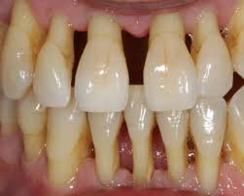
PATHOLOGIC PHYSIOLOGIC
PATHOLOGIC TOOTH MOVEMENT
Carranza defined it as ‘displacement that results when the balance among the factors that maintain physiological tooth position is disturbed by periodontal disease’. most frequently in the anterior region, but posterior teeth may also be affected
TYPES OF TOOTH MOVEMENT

Slide 4
PHYSIOLOGIC TOOTH MOVEMENT
The term physiologic tooth movement designates, primarily, the slight tipping of the functioning tooth in its socket and, secondarily, the changes in the tooth position that occur in young persons during and after tooth eruption.
Contrary to the relatively short eruption period, the teeth and their supporting tissues have a life-long ability to adapt to functional demands and hence drift through the alveolar process, a phenomenon called physiologic tooth migration.

Slide 5
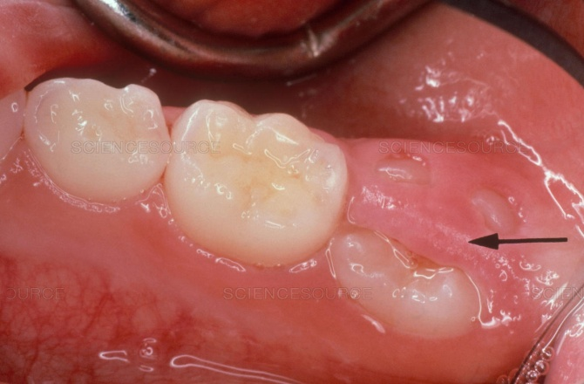
PHYSIOLOGIC TOOTH MOVEMENT
Physiologic tooth movements include:
Tooth eruption
Migration or drift of teeth.
Changes in tooth position during mastication.

Slide 6
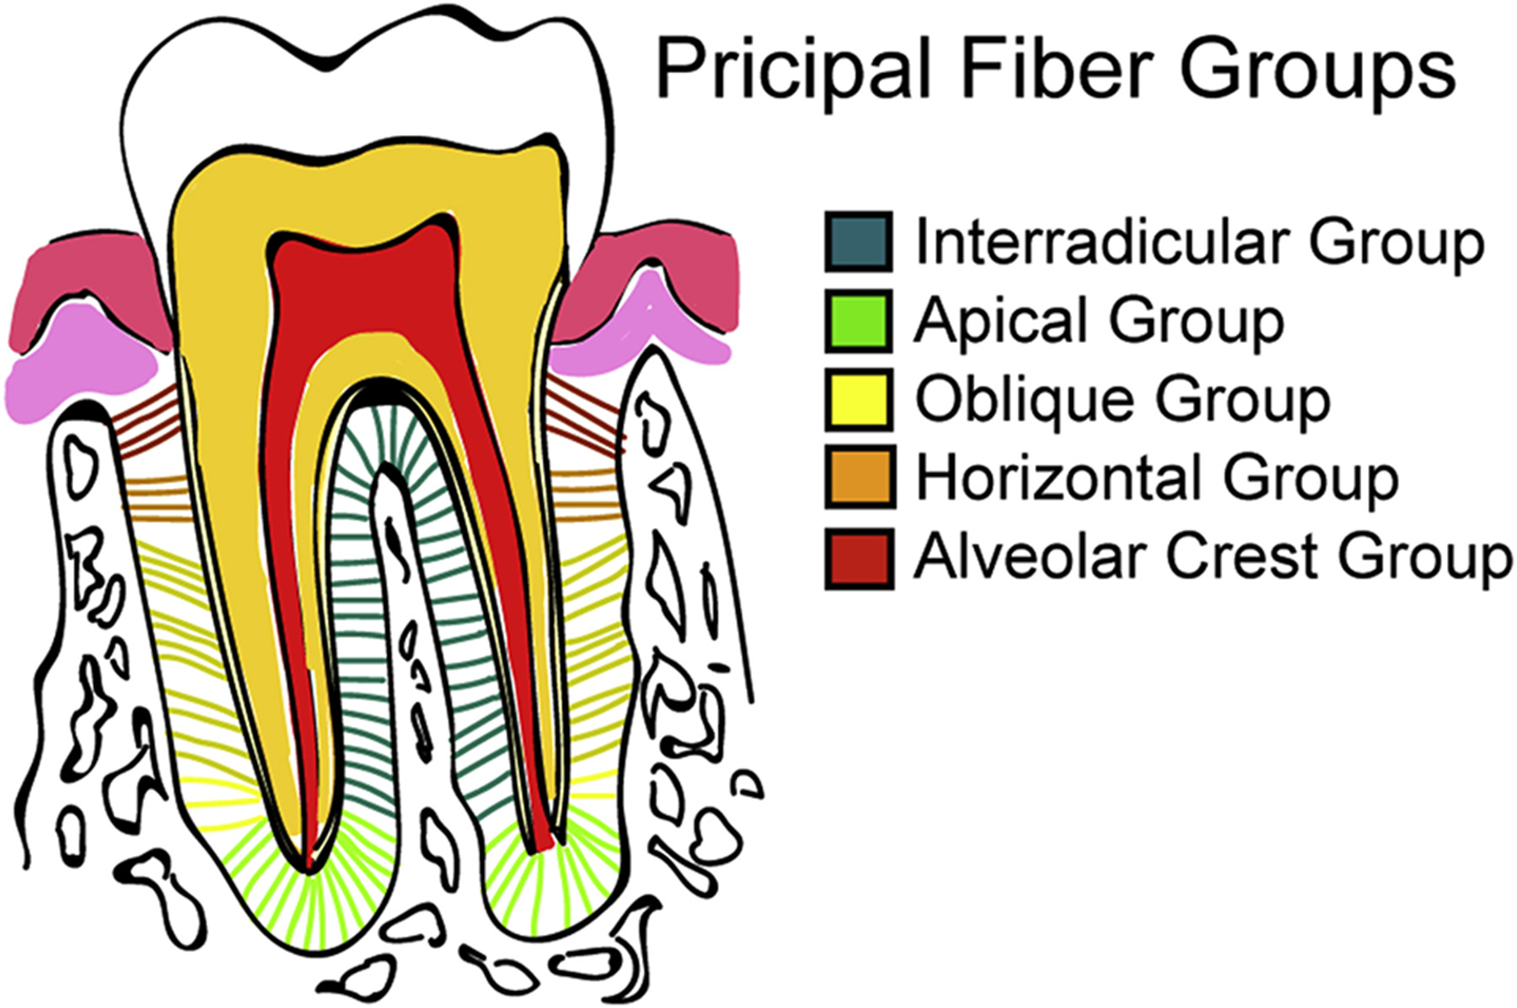

Slide 7
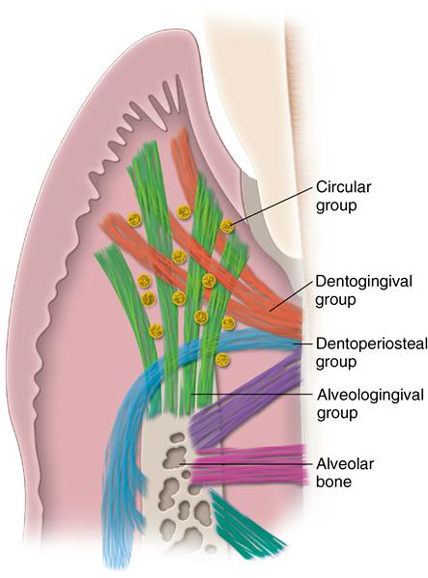

Slide 8
ORTHODONTIC TOOTH MOVEMENT
No great difference exists between the tissue reactions observed in physiologic and those observed in orthodontic tooth movement.
However, since the teeth are moved more rapidly during orthodontic treatment, the tissue changes elicited are consequently more marked and extensive.
Application of continuous force leads to tooth movement within the alveolus that is marked by narrowing of the periodontal membrane, particularly in the marginal area.

Slide 9
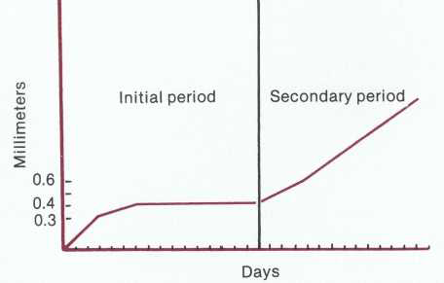
ORTHODONTIC TOOTH MOVEMENT
Tooth movement is divided into: (Graber, Vanarsdall)
Initial period – undermining resorption
Secondary period – frontal resorption

Slide 10
Initial phase
Initial application of force
Compression in the limited areas of the membrane
impedes
Vascular circulation & cell differentiation
causing
Degradation of the cells & vascular structures
Glassy appearance with sterile necrotic area limited to 1 or 2 mm in diameter - HYALINIZATION

Slide 11
Initial phase
Initial phase – 3 main stages
Degeneration
Elimination of destroyed tissue
Establishment of new attachment

Slide 12
Degeneration
It starts where the pressure is highest & the narrowing of the
membrane is most pronounced.
Retardation of blood flow
Degradation of vessel walls
Cellular changes
  Swelling of mitochondria & ER
  Rupture of cytoplasmic membrane leaving only isolated nuclei between the fibrous elements (pyknosis) First indication of hyalinization

Slide 13
Degeneration
Mild inflammation is observed.
Tooth movement stops until the adjacent alveolar bone has been resorbed, hyalinized structures removed & the area repopulated by cells.

Slide 14
Elimination of destroyed tissue
Invasion of the hyalinized areas by the cellular elements i.e macrophages and multinucleated giant cells.
Adjacent undamaged areas give rise to the osteoclasts (multinucleated giant cells) which appears within the adjacent bone marrow spaces and begins an attack on the underside of bone immediately adjacent to necrotic PDL area. This process is termed as undermining resorption.
Since the attack is from the underside of the lamina dura.

Slide 15
When hyalinization and undermining resorption occur, an inevitable delay in the tooth movement results.
A delay in stimulating differentiation of cells within marrow
spaces.
A considerable thickness of bone must be removed from the
underside before any tooth movement can take place.

Slide 16
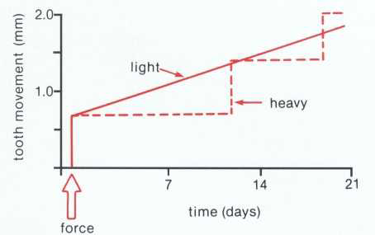
Frontal resorption vs undermining resorption

Slide 17
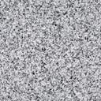
Frontal resorption
Undermining resorption
LF
HF
PDL
Os.cl
Marrow
Os.cl
Cell action
Cell death

Slide 18
Establishment of new attachment
Reestablishment of the tooth attachment in the hyalinized areas starts by synthesis of new tissue elements once the hyalinized tissue is removed.

Slide 19
Secondary phase
Tooth movement occurring after hyalinization is termed secondary period.
Osteoclasts differentiate & cause frontal resorption.
Deposition of new bone on tension side – osteoblasts.
New bone is deposited until the width of the membrane has returned to normal limits.

Slide 20
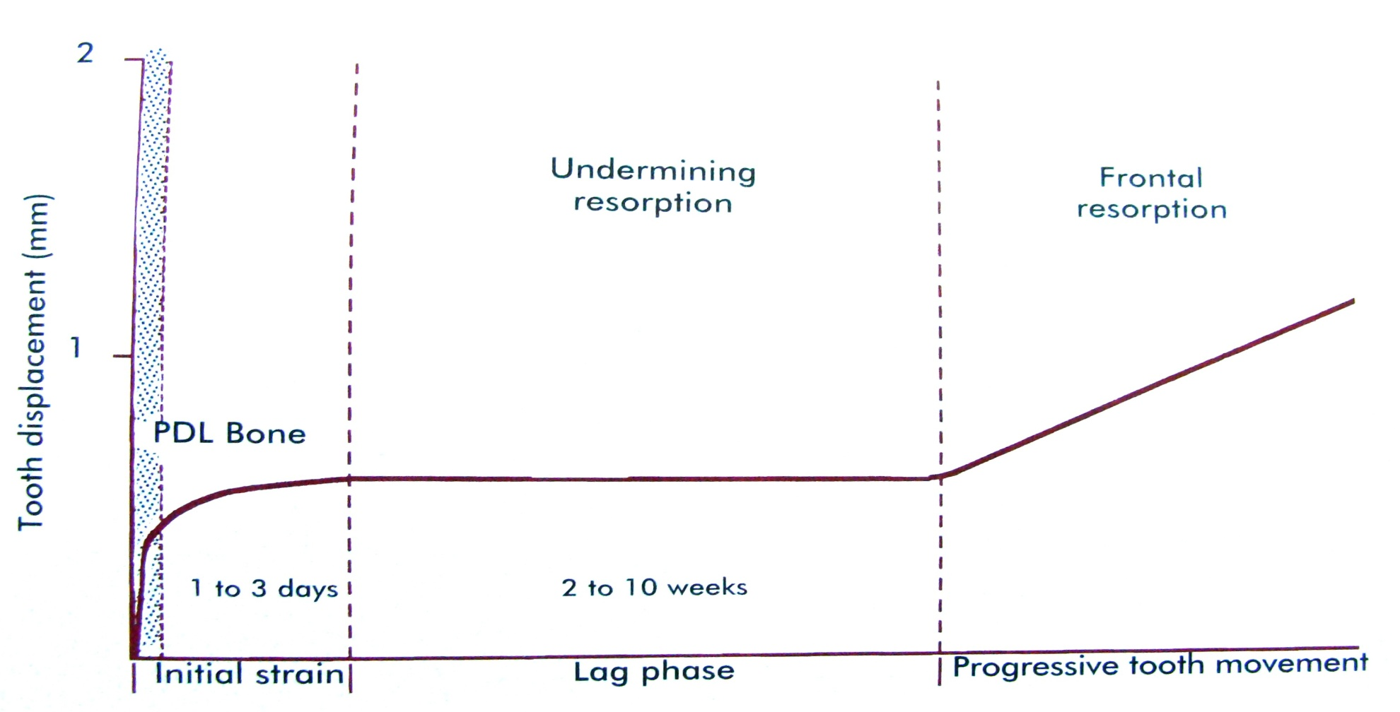
Phases of tooth movement
Burstone(1962) has divided it as:

Slide 21
Pilon at el have proposed a new displacement model of tooth
movement.
These studies performed on beagles, divided the tooth movement into 4 phases.
First phase- initial tooth movement lasts for 24hrs to 2 days.
Second phase- tooth movement stops,lasts for 20-30days
Third phase- after the removal of necrotic tissue ,tooth movement is accelerated.
Fourth phase- continues in this linear phase.

Slide 22
ORTHODONTIC FORCE
BIO-PHYSICAL REACTIONS
Bone deformation
Compression of PDL
Tissue Injury
PRODUCTION OF FIRST MESSENGERS
Hormones (e.g.. PTH)
Prostaglandins
Neurotransmitters
PRODUCTION OF SECOND MESSENGERS
C amp, C gmp, Ca⁺⁺
Increase in cells of Resorption (osteoclasts)
Increase in cells of Deposition (osteoblasts)
Bone Remodelling
ORTHODONTIC TOOTH MOVEMENT
BIOCHEMICAL REACTIONS TO
ORTHODONTIC TOOTH MOVEMENT
Inflammation due to tissue injury
Activation of Collagenase

Slide 23
First messenger
PROSTAGLANDIN & LEUKOTRIENES
NITRIC OXIDE
CYTOKINES
VITAMIN D
NEUROTRANSMITTERS
GROWTH FACTORS
COLONY STIMULATING FACTORS
EXTRACELLULAR MATRIX

Slide 24
Prostaglandins
The term PG was introduced by Von Euler.
PGs are important mediators of mechanical stress. (Harell et al)
Yamasaki et al 1984 in a series of experiments with a rat model of tooth movement demonstrated that injection of PGs increase osteoclast number.

Slide 25
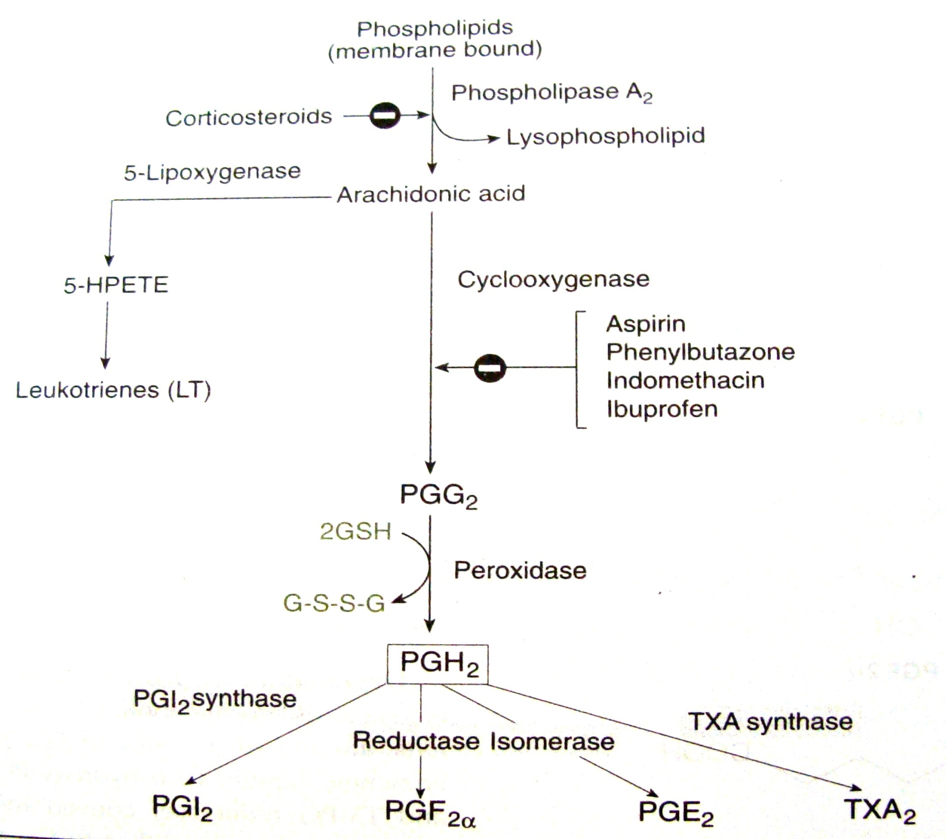

Slide 26
Prostaglandins
Clinical and animal studies….
PGE1 & PGE2
role in stimulating bone resorption (Lee 1990 and Leiker & Nanda 1995)
Kale et al also identified the role of other agents such as growth factors,hormones and interleukins or cytokines that induce PGE2 production to effect the bone remodelling and tooth movement.

Slide 27
Leukotrienes
Also a metabolite of Arachidonic acid.
Originally demonstrated in leukocytes.
Inhibition of leukotriene synthesis can significantly reduce orthodontic tooth movement.

Slide 28
Cytokines
Cytokines are extracellular signaling proteins that act as signals between the cells of the immune system.
Clinically important in orthodontic tooth movement are IL-1,IL-6,TNF-alpha,interferons, polypeptide growth factors.
IL-1 exists in two forms alpha and beta of which IL-beta is involved in bone metabolism,stimulation of bone resorption and bone cell replication.
The role of cytokines of RANKL/RANK/OPG system in inducing bone remodelling was demonstrated recently by Drugarin et al 2003.

Slide 29
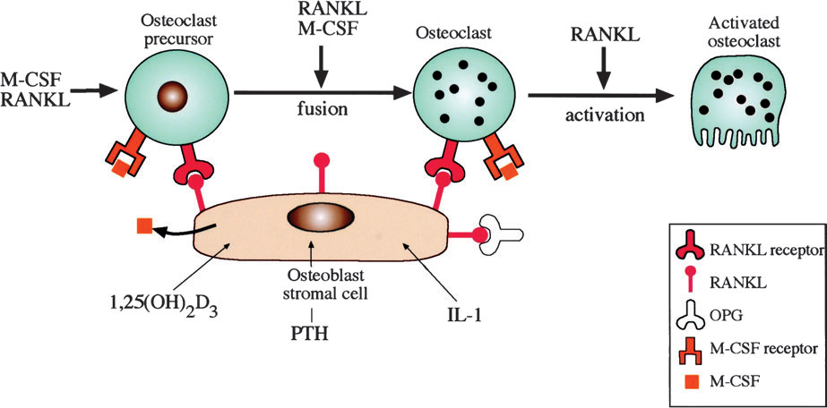

Slide 30
Nitric oxide
It is produced by various cells & is present in blood vessels, nerves and PDL fibroblasts.
NO acts as a marker of vascular signal transduction during the initial state of orthodontic tooth movement.
NO shows enhanced differentiation of osteoblasts and inhibits osteoclastic activity.

Slide 31
Vitamin D
Vitamin D
PTH
↑Ca REABSORPTION
↑BONE RESORPTION

Slide 32
Neurotransmitters
Substance P (SP)
Vasoactive intestinal polypeptide (VIP)
Calcitonin gene related peptide (CGRP)
Act as neurotransmitters from sensory nerve fibers in the PDL & supply the link between physical stimulus & the biochemical response.

Slide 33
Growth factors
Growth Factors are also released during inflammation and repair by the cells of PDL and bone.

Slide 34
Growth factors
Fibroblast Growth Factor,
Insulin like Growth Factors (IGF – I, IGF – II),
Transforming Growth Factor (TGF-alpha, TGF-beta),
Platelet Derived Growth Factor (PDGFS),
Bone Morphogenic Proteins (BMP).

Slide 35
Colony stimulating factors
G-CSF (Granulocyte-CSF)
M-CSF (Macrophage-CSF)
GM-CSF (Granulocyte macrophage-CSF)
Erythropoietin
Implication in OTM through osteoclast formation.

Slide 36
EXTRACELLULAR MATRIX & CYTOSKELETON INTERACTIONS
The macromolecules which make up the ECM include collagen & glycosaminoglycans (GAGS).
These macromolecules are secreted at local levels by cells, particularly fibroblast in the PDL & osteoblast in the bone.
The matrix metallo-proteins (MMPS) represents major class of enzymes responsible for ECM metabolism.

Slide 37
Second messenger
cAMP
cGMP
INOSITOL PHOSPHATASE
Ca
Low levels of cAMP and cGMP influence the differentiation of cells for bone production

Slide 38
THEORIES OF TOOTH MOVEMENT
The mechanism of movement of a tooth by an orthodontic force is a subject of ongoing research for decades.
Major theories of orthodontic tooth movement:
Pressure-tension theory
Blood flow theory
Bioelectric theory

Slide 39
Pressure-tension theory
Tissue reactions in the orthodontic forces were first described by Sandstedt(1905) and later by Oppenheim (1911).
Schwarz (1932) introduce this theory.
This theory relies on chemical rather than electric signals.

Slide 40
Pressure-tension theory
According to Schwarz, whenever a tooth is subjected to an orthodontic force, it results in areas of pressure & tension.
The area of the periodontium in the direction of tooth movement is under pressure while the area of periodontium opposite the tooth movement is under tension.
According to him, the area of pressure show bone resorption while areas of tension show bone deposition.

Slide 41
Alteration in blood flow within the PDL (produced by the sustained pressure)
Tooth shifts within the PDL space
Compressing of Stretching of Ligament
Ligament (pressure) (tension)
Blood flow is decreased Blood flow is maintained or
increased (if overstretched
blood flow may be decreased)
Alteration of blood flow Changes in the chemical
environment
stimulate
Cellular differentiation and activity

Slide 42
Pressure-tension theory
In essence, this view of tooth movement shows 3 stages:
Alteration in blood flow associated with pressure within the PDL.
The formation &/or release of chemical messengers.
Activation of cells.

Slide 43
Pressure-Tension theory
FORCE
Pressure side
Tension side
Changes in fibres
Changes in fibres
Changes in vessels
Changes in vessels

Slide 44
Blood flow theory
Proposed by Bien in 1966.
According to this theory, tooth movement occurs as a result of alterations in fluid dynamics in the PDL.
The periodontal space contains a fluid system made up of intestitial fluid, cellular elements, blood vessels & viscous ground substances in addition to the periodontal fibers.

Slide 45
Blood flow theory
Passage of fluid in & out of this space is limited.
The contents of the PDL thus creates a unique hydrodynamic condition resembling a hydraulic mechanism & a shock absorber.

Slide 46
Application of orthodontic force
Compression of PDL
Blood vessels of PDL get trapped between the principal fibers
Stenosis
Vessel beyond the stenosis balloons up, resulting in formation of an “aneurysm”.
Blood gases escape into the interstitial fluid
favorable local environment for resorption.

Slide 47
Squeeze film effect by Bien
When a force of greater magnitude & duration is applied, the interstitial fluid in the periodontal space gets squeezed out & moves towards the apex & cervical margins & results in decreased tooth movement.

Slide 48
Bioelectric theory
Farrar (1876) noted deformation or bending of interseptal alveolar bone plays a pivotal role in orthodontic tooth movement(bone bending theory).
This hypothesis was later confirmed with the experiments of Baumrind(1969) in rats and Grimm in humans.
This theory relates tooth movement to changes in bone metabolism controlled by the electric signals that are produced when alveolar bone flexes & bends.

Slide 49
Bioelectric theory
In 1962, Bassett and Becker proposed that, in response to applied mechanical forces, there is generation of electric potential in stressed tissues.
Electric signals that initiate tooth movement initially were thought to be piezoelectric.
Piezoelectricity is a phenomenon observed in many crystalline materials. Deformation of the crystal structure
A flow of electric current (as electrons are displaced from one part of the crystal lattice to another).

Slide 50
Bioelectric theory
A small electric current is generated when bone is mechanically
deformed.
The possible sources of the electric current are:
Collagen
Hydroxyapatite
Collagen-hydroxyapatite interface
Mucopolysaccharide fraction of the ground substance.

Slide 51
Bioelectric theory
Piezoelectric signals have 2 unusual characteristics:
A quick decay rate
The production of an equivalent signal, opposite in direction, when the force is released.

Slide 52
When force is applied
Crystal structure is deformed (electron migrate from one location to another & an electric charge is observed)
As long as the force is maintained, the crystal structure is stable
When force is released
Crystal returns to its original shape & a reverse flow of electrons is there
With this arrangement, rhythmic activity would produce a constant interplay of electric signals.

Slide 53
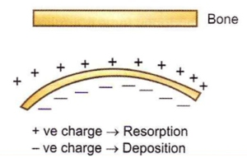

Force
Bone bending
Piezoelectric current
Cell signal
Cell activation
The
concept
Bone remodeling
Tooth movement

Slide 54
Bioelectric theory
Borgens(1984) observed generation of endogenous ionic currents evoked in intact and damaged mouse bones called as stress generated potentials or streaming potentials.
Stress-generated signals are important in the general maintenance of the skeleton. Without such signals, bone mineral is lost & general skeleton atrophy.
In contrast to piezoelectric spikes, streaming potentials had longer decay periods.

Slide 55
Bioelectric theory
Davidovitch et al (1980) suggested recently that piezoelectric potentials results from distortion of fixed structures of periodontium.
Whereas streaming potentials predominate in hydrated tissues as the interstitial fluid moves.
Electromagnetic fields can be also induced within tissues by adjacent magnets, without the contact required by electrodes.

Slide 56
This electromagnetic effect can be utilized in the future to enhance orthodontic tooth movement &/or alter jaw growth
Even though stress-generated electrical signals do not explain tooth movement, electric & electromagnetic influences can modify the bone remodeling on which tooth movement depends and may yet prove useful therapeutically.

Slide 57
ORTHODONTIC FORCES
Orthodontic forces comprise those that are brought to bear on the PDL & alveolar process, where as Orthopedic forces are more powerful & act on the basal parts of the jaws.

Slide 58
Types of force
Continuous
Continuous interrupted
Intermittent

Slide 59
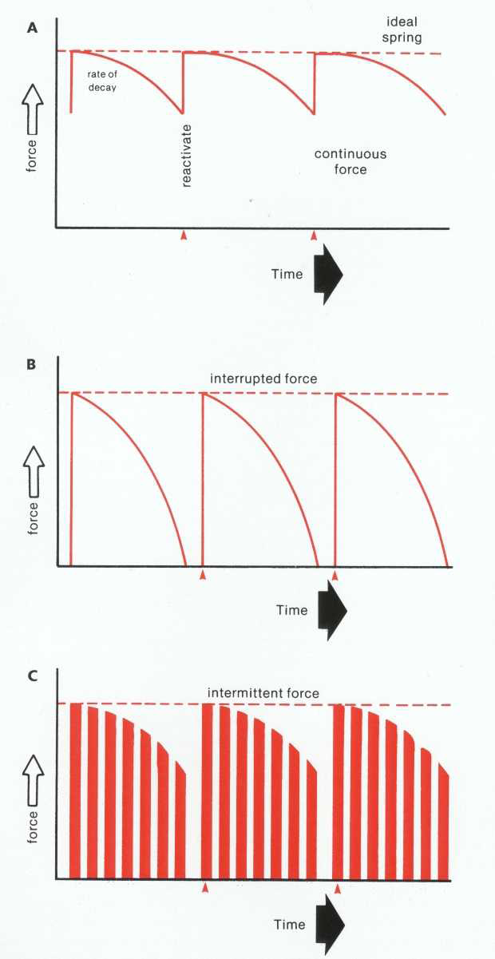

Slide 60
Magnitude of force
Light forces moves a tooth more rapidly & with less injuries to the supporting tissues than a heavy one.

Slide 61
Light forces
<1sec - PDL fluids incompressible, alveolar bone bends, piezoelectric signals generated.
1-2sec – PDL fluid expressed, tooth moves within PDL space.
3-5sec – Blood vessels partially compressed on pressure side, dilation on tension side.
Minutes – Blood flow altered, O2 tension change. PGs cytokines released.
~4hours - cAMP, cellular differentiation begins within PDL.
~2days – Tooth movement begins as osteoclasts/osteoblasts remodel bony socket (frontal resorption).

Slide 62
Heavy force
3-5 sec
Blood vessel occlude on pressure side
minutes
Blood flow cut off to compressed area
hours
Sterile necrosis
3-5 days
Cell differentiation in adjacent narrow space, remodeling of bone bordering the necrotic area (undermining resorption)
7-14 days
Undermining resorption removes lamina dura adjacent to compressed PDL, tooth movement occurs.

Slide 63
Optimal orthodontic force
“The force leading to a change in tissue pressure that approximated the capillary vessels’ blood pressure, thus preventing their occlusion in the compressed PDL.” (SCHWARZ 1932)
Optimum force is equivalent to the capillary pulse pressure which is 20-26 gm/sq. cm of root surface area. (OPPENHEIUM & SCHWARZ)

Slide 64
Types of tooth movement
Tipping 35-60 gm
Bodily movement 70-120 gm
Root Uprighting 50-100 gm
Rotation 35-60 gm
Extrusion 35-60 gm
Intrusion 10-20 gm

Slide 65
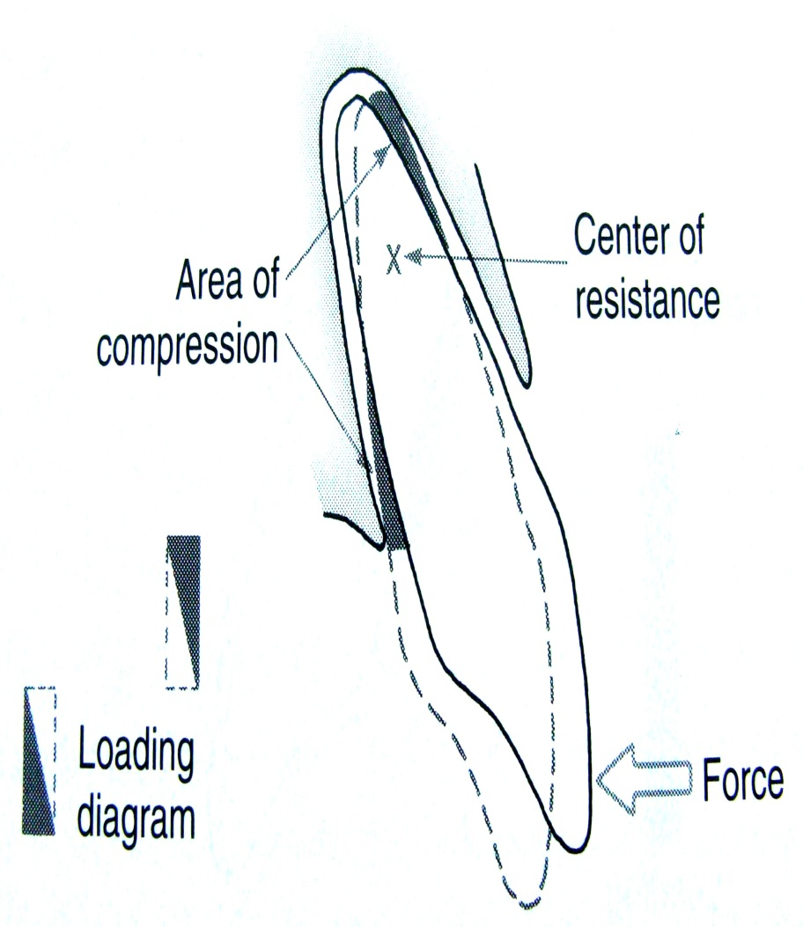
Tipping
Application of single force to the crown creates a rotation around the centre of resistance
Heavy pressure in the PDL is felt at the root apex and at the crest of alveolar bone, but pressure decreses to zero at the centre of resistance.

Slide 66
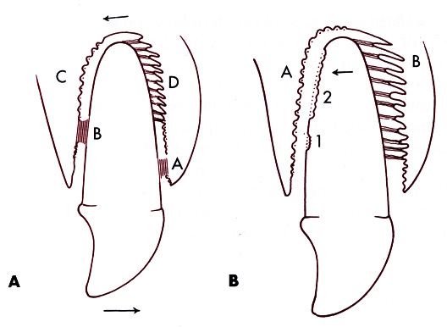
Torque
The pressure area is usually locate close to the middle region of the root.
It requires a force intermediate between the pure tipping and bodily movement.

Slide 67
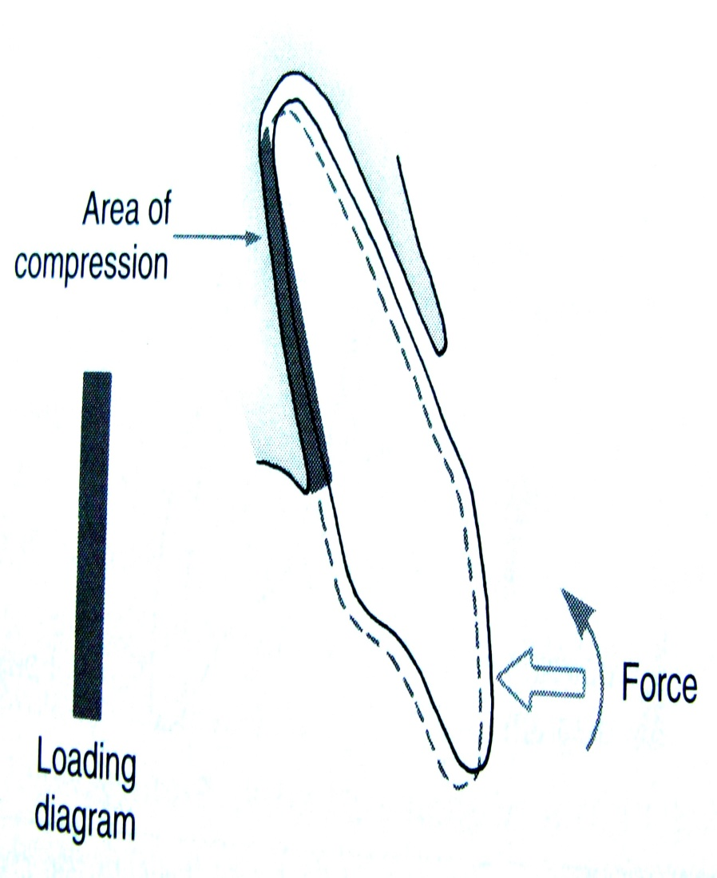
Bodily movement
PDL space is loaded uniformly from alveolar crest to apex, creating a rectangular loading diagram.
Twice as much as force is required to produce the same pressure within the PDL as compared with tipping

Slide 68
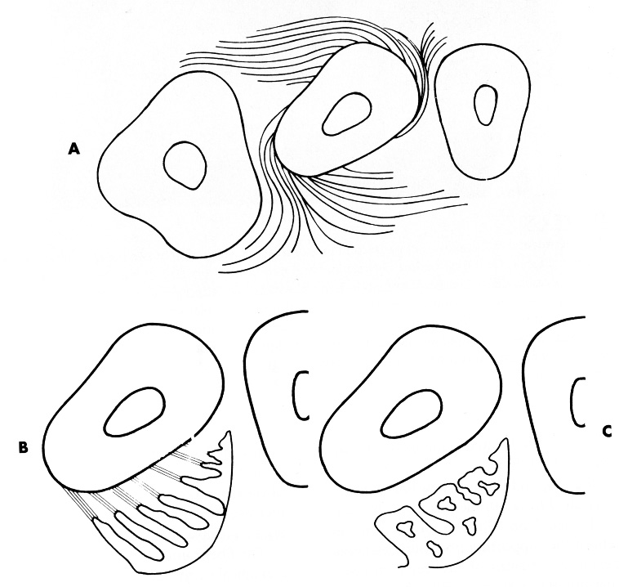
Rotation
The forces could be much larger than those to produce other tooth movements, since the force could be distributed over the entire PDL rather than over a narrow vertical strip.
The appropriate force is similar to those of tipping.

Slide 69
Extrusion
Ideally it would produce no area of compression within the PDL, only tension.
Extrusive force should be of same magnitude as those for tipping.

Slide 70
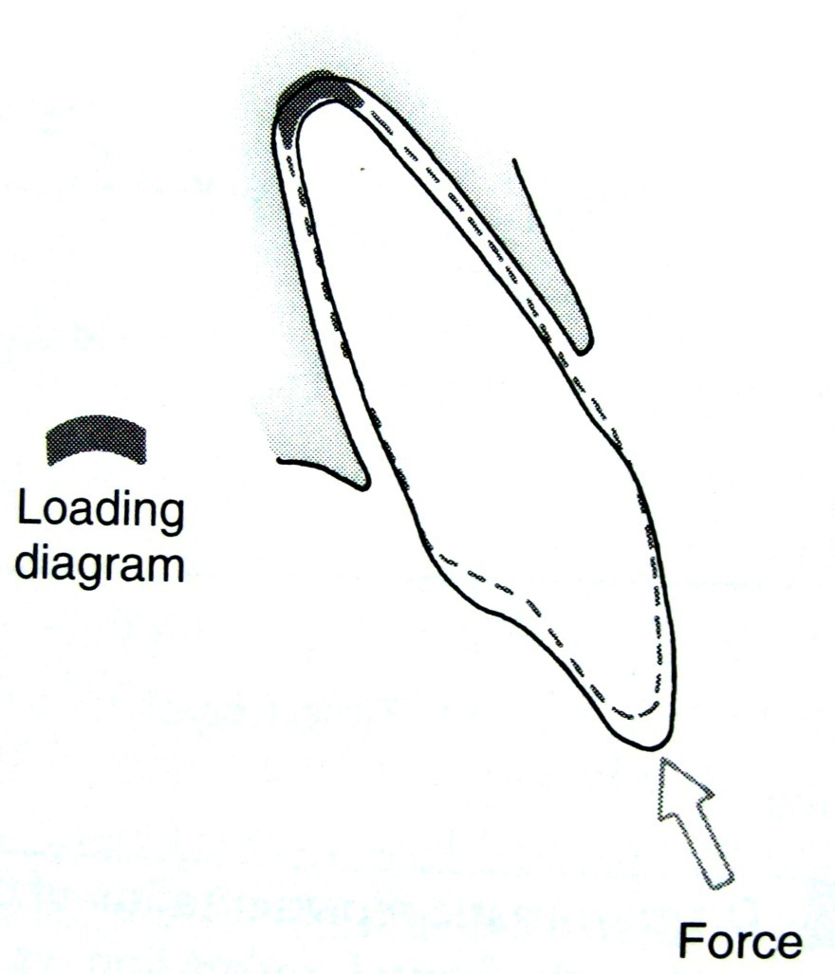
Intrusion
When a tooth is intruded, the force is concentrated over a small area at the apex.
So extremly light force is needed to produce aprropriate pressure within the PDL.

Slide 71
DELETETRIOUS EFFECTS OF ORTHODONTIC FORCES
Gingival Inflammation
Mobility
Pain
Effect on pulp
Root
Alveolar bone

Slide 72
DRUG EFFECTS ON THE RESPONSE TO ORTHODONTIC FORCE

Slide 73
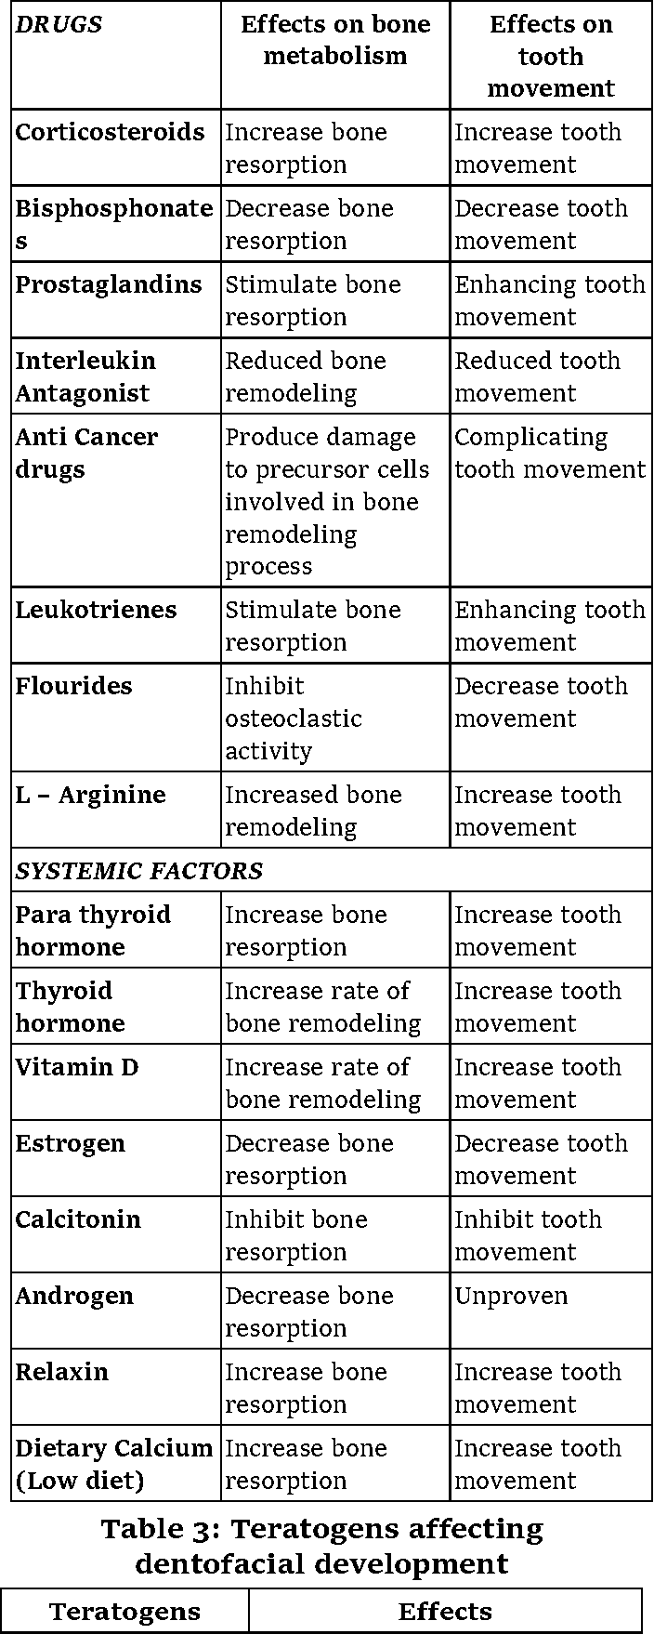

Slide 75
CONCLUSION
Tooth movement is a highly conserved physiological mechanism for continuous adaptation of the dentition. Orthodontic tooth movement is a biomechanical exploitation of the physiologic mechanisms for developing and maintaining optimal occlusal function. The tooth continues to move until it achieves equilibrium with natural and applied loads.

Slide 76
REFERENCES
Contemporary Orthodontics: William R. Proffit.
Orthodontics Current Principles & Techniques: Graber, Vanarsdall.
Orthodontics, diagnosis&mangement of MO and dentofacial deformities: O P Kharbanda
Krishnan, Davidovitch: cellular,molecular and tissue level reactions to orthodontic force.AJODO 2006
Meikle : the tissue, cellular and molecular regulation of orthodontic tooth movement-100yrs after Carl Sandstedt.EJO 2006
Sandy, Farndale. Advances in mechanically induced bone remodelling. AJO DO 1998 March (212-222).

