Slide 1
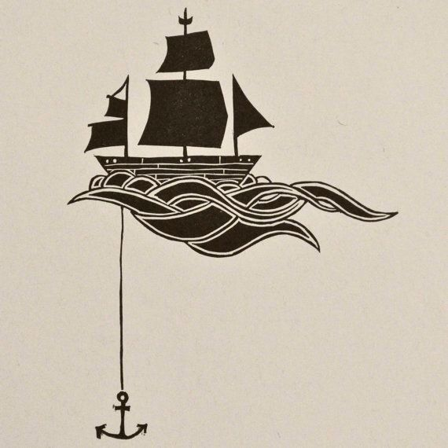
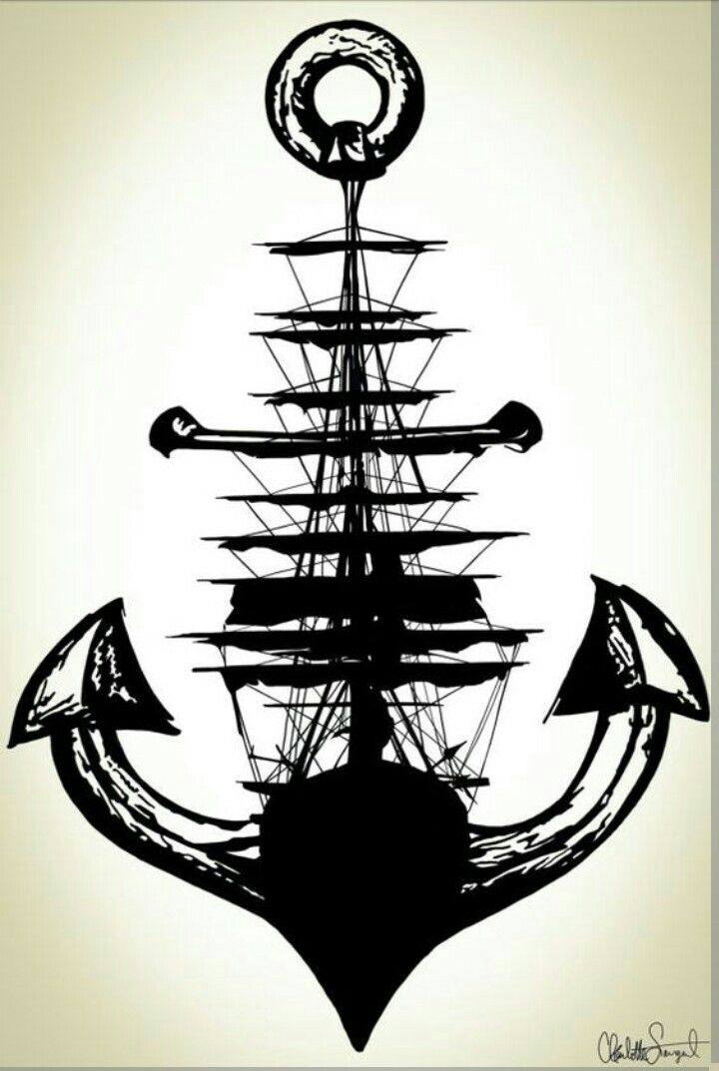
A
N
C
H
O
R
A
G
E
I
N
ORTHODONTICS

Slide 2
Contents
Introduction
Definitions
Classifications
Source of anchorage
Methods to save anchorage
Anchorage planning
Anchorage loss
Anchorage in different appliance systems
Conclusion
Reference

Slide 3
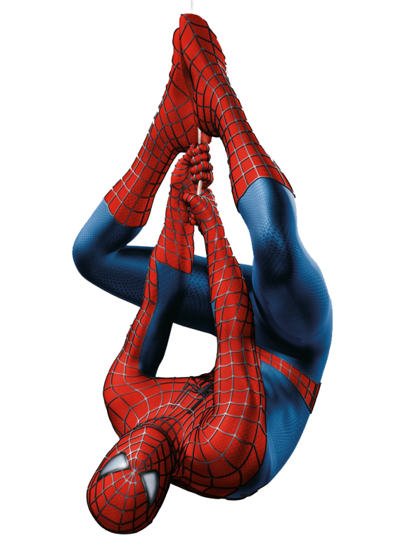
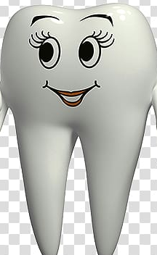
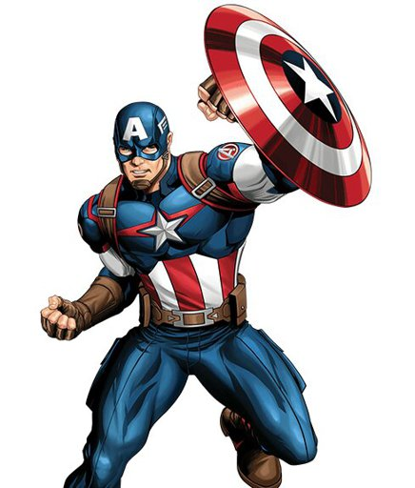
INTRODUCTION
Anchorage is the word used in orthodontics to mean resistance to
displacement.

Slide 4
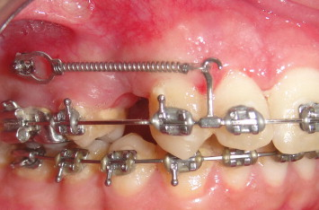
Every orthodontic appliance consists of two elements an active
element and a resistance element.
The active parts of the orthodontic appliance are concerned with
tooth movements.
The resistance units provide resistance (anchorage) that makes
tooth movements possible.

Slide 5
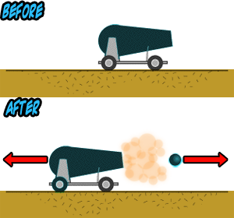
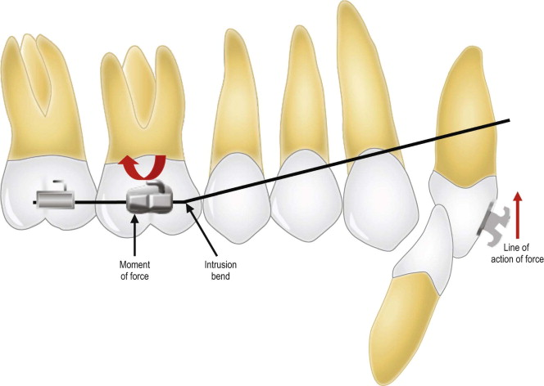
According to Newton’s third law there is equal and opposite
reaction to every action.
Therefore in orthodontics, all anchorage is relative and all
resistance is comparative

Slide 6
To avoid unwanted Tooth movements and maintain treatment
success, these reciprocal forces must be diverted or resisted.
The orthodontist must decide where the resistance to the forces is
needed to produce the desired tooth movement.
During orthodontic treatment the teeth are exposed to forces and
moments, and these acting forces always generate reciprocal
forces of the same magnitude but opposite in direction.

Slide 7
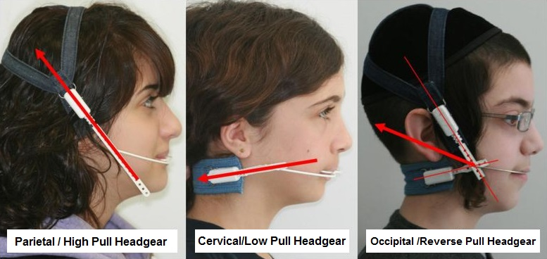
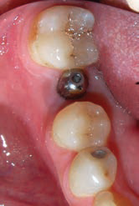
Utilization of the resistance of dental units should be the first
consideration.
If this proves to be inadequate, it must be supplemented by other
anchorage sources, either Intraoral extra oral, or both.

Slide 8
DEFINITIONS
Moyers
“ Resistance to displacement.”
T.M. Graber
“ Nature and degree of resistance to displacement offered by an anatomic unit when used for the purpose of effecting tooth movement.”
Stoner :
“source which can resist the reactions of orthodontic forces.

Slide 9
Nanda :
“Amount of movement of posterior teeth (molars, premolars) to
close the extraction space in order to achieve selected treatment
goals.”
Louis Ottofy :
“ Base against which orthodontic force or reaction of orthodontic
force is applied”

Slide 10
According to Proffit:
“Resistance to unwanted tooth movement.
Resistance to reaction forces that is provided (usually) by other teeth, or (sometimes) by the Palate, head or neck (via extra oral force), or implants in bone.”

Slide 11
CLASSIFICATION OF ANCHORAGE
PULLEN CLASSIFICATION:
Based on Form of attachment
a. Pivotal
b. Reinforced
c. Stationary
Based on source of resistance
a. Inter maxillary
b. Occipital
c. Cervical

Slide 12
MOYERS CLASSIFICATION:
According to the manner of force application
a. Simple anchorage : Resistance to tipping.
b. Stationary anchorage : Resistance to bodily movement.
c. Reciprocal anchorage : Two or more teeth moving in
opposite directions and pitted against each other by the
appliance.

Slide 13
Simple Anchorage:
Resistance of anchorage unit to tipping is utilized to move
another tooth or teeth.

Slide 14
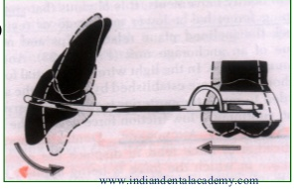
Stationary anchorage:
Dental anchorage in which the manner and application of
force tend to displace the anchorage unit bodily in the plane of
space in which the force is being applied is termed stationary
anchorage (Graber).

Slide 15
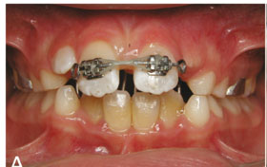
Reciprocal Anchorage:
It involves pitting of two teeth or two groups of teeth of equal
anchorage value against each other to produce reciprocal tooth
movement
eg: Closing diastema, two central incisors are pitted against
each other.

Slide 16
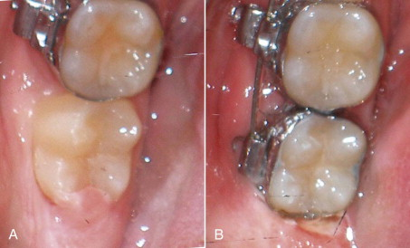
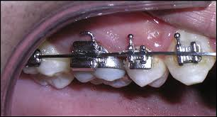
Reinforced anchorage:
It involves reinforcing the anchorage or resistance area either by
adding more resistance units or by the use of various adjuncts.
A simple way of reinforcing anchorage is to band the second
molars.

Slide 17
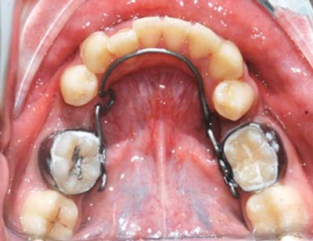
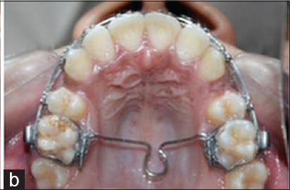
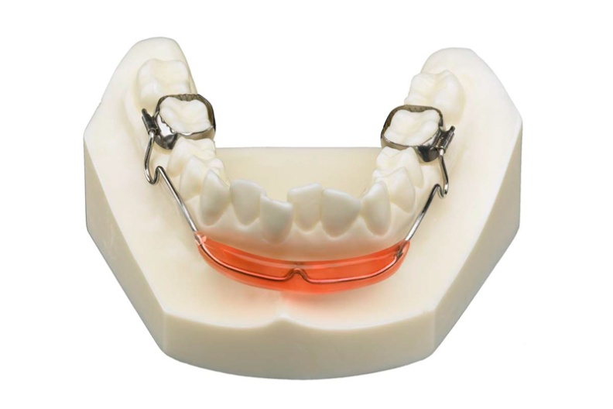

Slide 18
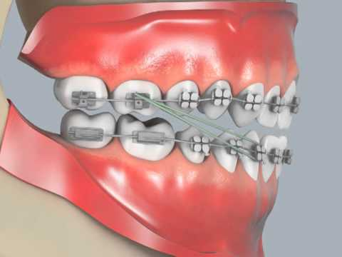
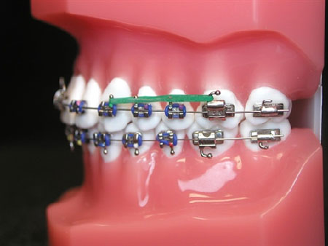
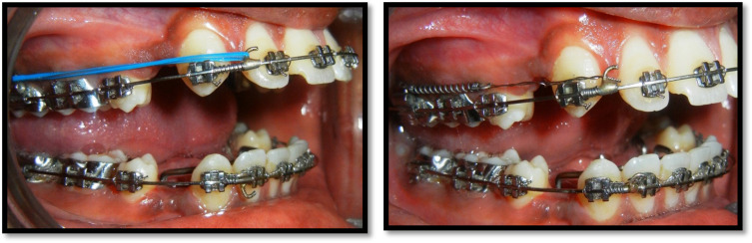
According to the jaws involved:
1. Intra maxillary: Anchorage established in the same jaw.
2. Inter maxillary: Anchorage distributed to both jaws.Baker’s anchorage (1904)

Slide 19
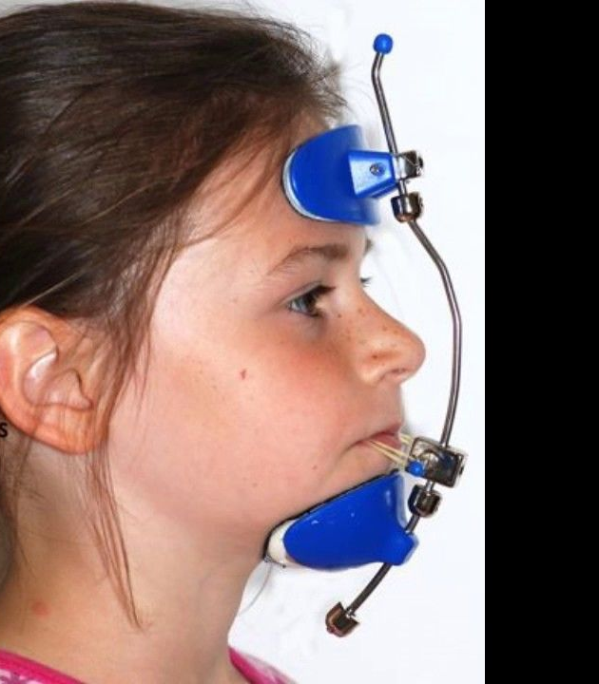
According to the site of anchorage:
1. Intra oral : Anchorage established within the mouth.
2. Extra oral : Anchorage obtained outside the oral cavity

Slide 20
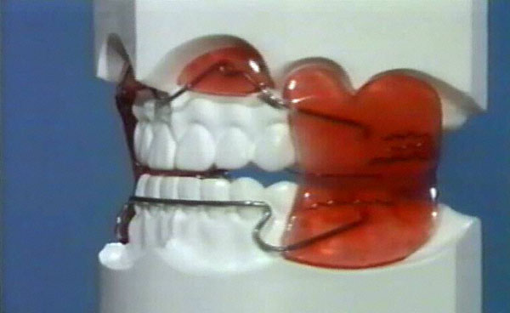
3. Muscular: Anchorage derived from action of muscles. e.g.
Vestibular shields.

Slide 21
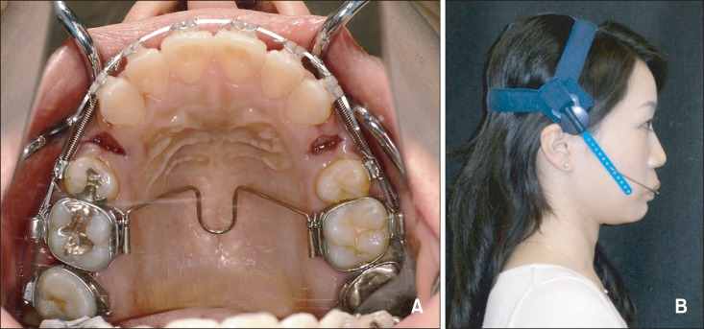
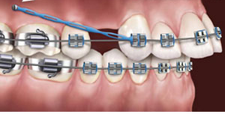
According to the number of anchorage units:
1. Single or primary anchorage
Anchorage involving only one tooth.
2. Compound anchorage :
Anchorage involving two or more teeth.
3. Reinforced anchorage :
Addition of non-dental anchorage Sites.
e.g. Mucosa, muscle, head, etc.

Slide 22
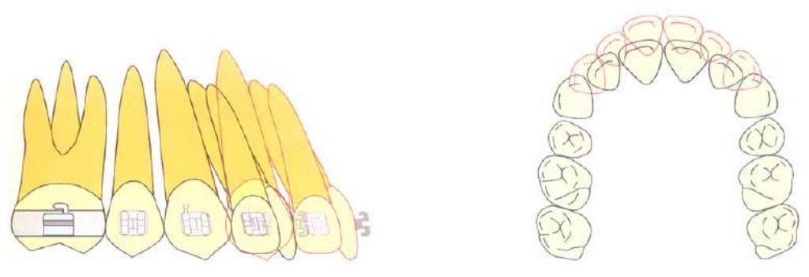
Nanda classified anchorage as
A anchorage: critical / severe
75% or more of the extraction space is needed for anterior retraction.

Slide 23
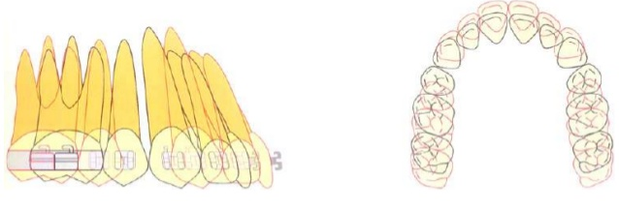
2. B anchorage: moderate
Relatively symmetric space closure(50%)

Slide 24
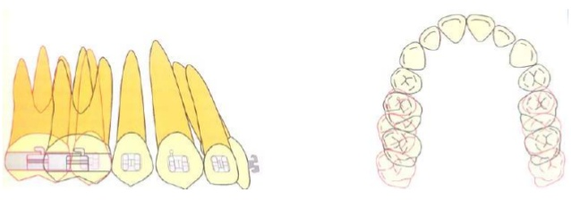
3. C anchorage: mild / non critical
75% or more of space closure by mesial movement of posterior teeth

Slide 25
MARCOTTE’S CLASSIFICATION (1990):
Group A Anchorage: Also refers to maximum posterior
anchorage.
75% or more space required for anterior retraction.
The biomechanical paradigm is to increase posterior M/F ratio
(beta M/F ratio) relative to the anterior M/F ratio (Alfa M/F ratio).

Slide 26
Group B Anchorage: Simplest form of space closure.
The requirement includes equal translation of the anterior and
posterior segments into the extraction space.
Equal and opposite moments and forces are indicated.
Group C Anchorage:
Also refers to maximum anterior anchorage. 75% of space closure
achieved through mesial movement of posterior teeth.

Slide 27
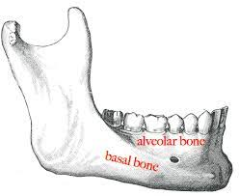
SOURCES OF ANCHORAGE
INTRAORAL SOURCES
I .Alveolar bone

Slide 28
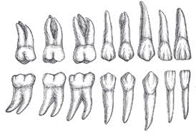
II.Teeth
Roots form, Size of the roots, Number of roots, Position of tooth,
Axial inclination of the teeth, Root formation., Contact points and
Intercuspation are the factors which decide anchor value of a
tooth .

Slide 29
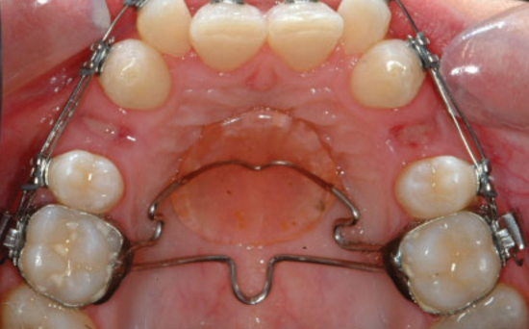
III.Basal bone
Certain areas of the basal bones like the hard palate and the
lingual surfaces of the mandible in the anterior regions can be
used to augment the anchorage

Slide 30
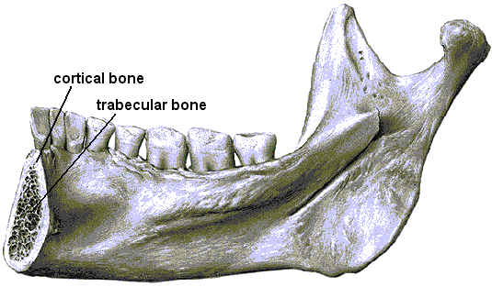
IV.Cortical bone
Ricketts floated the idea of using cortical bone for anchorage.
The contention being that the cortical bone is denser with
decreased blood supplies and the bone turnover.
Hence, if certain tooth torqued to come
in contact with the cortical bone they
would have a greater anchorage potential.

Slide 31
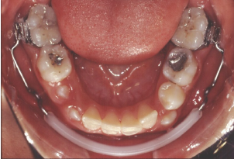
V. Musculature
Hypertoncity of the perioral musculature and enhances the
anchorage potential of the mandibular molars preventing
their mesial movement.

Slide 32
Methods to save anchorage
1. Reinforcement of anchorage
Anchorage can be reinforced by including as many teeth as
possible in the anchorage unit.
The ratio of PDL area of anchorage unit to PDL area of tooth
movement unit should be 2:1 without friction and 4:1 with
friction.

Slide 33
2. Subdivision of desired tooth movement
To pit the resistance of a group of teeth against the movement of
a single tooth rather than dividing the arch into or less equal
segments .
e.g. to reduce strain on posterior anchorage – retraction of canine
individually.
3. Tipping /uprighting
Another possible strategy for Anchorage control is to tip the teeth
and then upright them rather than moving them bodily.

Slide 34
4. Friction and anchorage control Strategies
In a typical extraction case it is desired to close the extraction
space 60% by retraction of anterior teeth and 40% by forward
movement of posterior segments.

Slide 35
This can be obtained by 3 approaches:
• One step space closure with a friction less appliance.
• Two step procedure by sliding the canine, then retracting the
incisors.( tweed technique )
• Two step closure by tipping the anterior segment with some
friction and then up righting the tipped teeth.

Slide 36
5. Cortical anchorage
Cortical bone is more resistant to resorption; tooth movement is
slowed when root contacts it.
By torquing the roots of posterior teeth outward against the
cortical plate it inhibits the mesial movement when extraction
spaces are to be closed.

Slide 37
6. Transpalatal arch
The purpose of these arches is to maintain arch width and molar
position after buccal expansion of the maxillary arch and to keep
molars from tipping buccally in response to forces
The TPA offers the option of expansion, rotation, contraction, and
torque of the molars due to an omega loop in the center of the
vault. The central loop is oriented either mesially or distally.

Slide 38
7. Nance holding arch
It can be used to maintain maxillary arch length. The arch consists
of a wire embedded in an acrylic button on the anterior palate and
soldered to bands on the maxillary first permanent molars.

Slide 39
8. Lingual arch
When excess crowding present in the permanent dentition and
extractions are required, the application of a lingual arch can
allow spontaneous alignment of labial segment while preventing
the mesial movement of distal teeth.
The fixed holding arch is most commonly used to maintain arch
width and arch length.

Slide 40
9. Class II elastics (intermaxillary anchorage)
In 1898 Calvin case advocated the use of reciprocal elastics to
effect movement between individual teeth in opposite arches.
However it remained for Baker, with the use of Angles E arch, to
apply those elastics in correction of class II irregularities .

Slide 41
Alternatively class III elastic hooks from the lower anterior teeth
to the upper posterior teeth creates a force for lower anterior
retraction and upper protraction for the resolution of a class III
occlusion.
The major limitation of elastics as an anchorage technique is their
dependence on patient compliance.

Slide 42

10. Lip bumper
It exerts distal force on molars from muscle pressure of lower lip.
it maintains arch length and anchorage potential of lower molars
The lower incisors may be proclined as a result of lower lip being
held out ofcontact with labial surface of the lower incisors ,which
is desirable in some situations .the patient is generally asked to
wear it full time.

Slide 43
11. Differential force (tip edge concept)
This technique allows initial tipping followed by root uprighting.
Simple tipping free tipping requires far less anchorage than
moving the same teeth bodily.
Tipping constitutes only half the treatment and the root uprighting,
necessary to produce finishing root angulations may occupy latter
half of the treatment time.

Slide 44
12. Segmental mechanics
Controlled distribution of forces between the anterior and
posterior parts of a fixed appliance can only be accomplished by
dividing the arch into segments.
Each segment is consolidated into a rigid unit by a section of
heavy rectangular wire, with little or no play between wire and
bracket slot.

Slide 45
The anterior segment, usually including the four incisors and
possibly the canines, forms the active unit,and the two posterior
segments, including the premolars and molars, are the reactive
units. When necessary, the reactive units are connected by a
transpalatal bar to form a single rigid, multirooted entity.

Slide 46
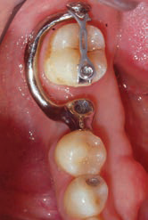
13. Skeletal anchorage
Skeletal anchorage is applied to orthodontic tooth movement
when ‘Absolute anchorage’ is necessary ,various skeletal fixtures
forces might be applied to produce tooth movement in any
direction without detrimental reciprocal forces

Slide 47
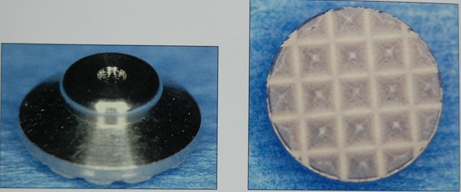
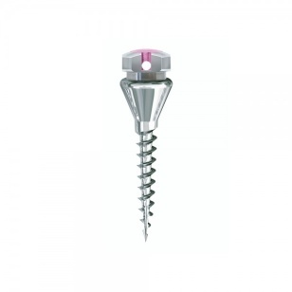
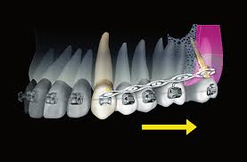
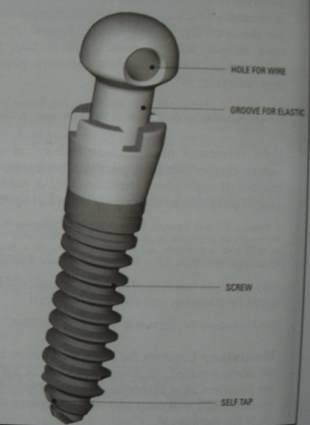
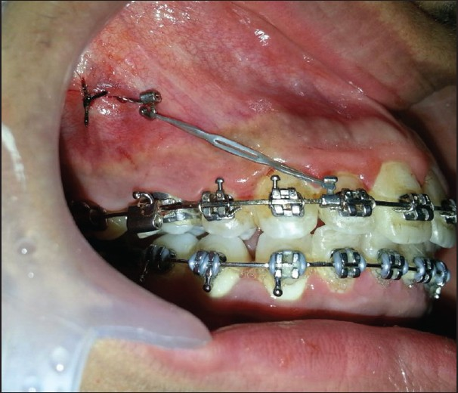
METHODS OF OBTAINING SKELETAL ANCHORAGE
1. Conventional Dental Implants
2. Palatal Endosseous Implants
3. Onplant
4. Mini implant
5. Spider Screw
6. Micro implant
7. C-orthodontic Micro implant
8. Impacted Titanium Post
9. Transitional Implants
10. Mini Plate
11. Zygoma Anchorage System
12. Zygomatic Ligatures

Slide 48
EXTRA ORAL METHOD OF ANCHORAGE
In the treatment of many types of malocclusion,intra oral anchorage
is insufficient to achieve the required tooth movements.
To overcome this problem ,extra oral anchorage used to supplement
the intraoral anchorage
Head gear they are again classified according to the point of origin
of force as follows:
1. Cervical-Anchorage derived from the nape of neck.
2. Occipital-Anchorage obtained from the back of the head.
3. Parietal-Anchorage obtained from the upper part of the head’

Slide 49
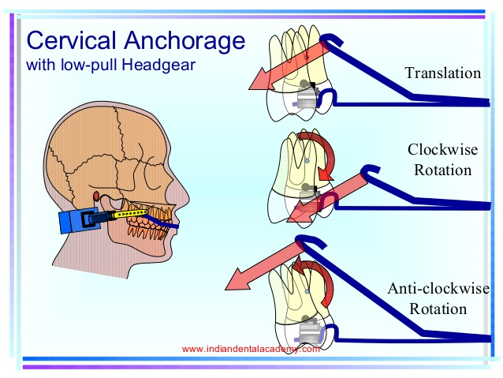

Slide 50
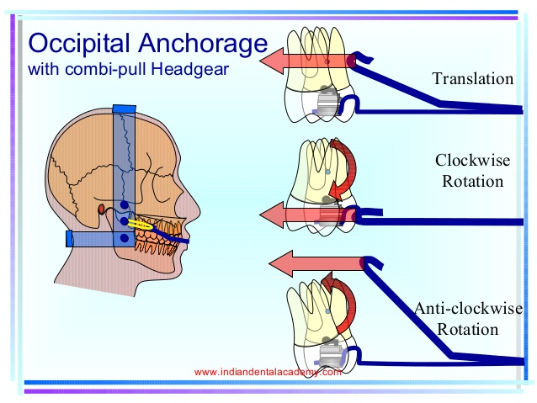

Slide 51
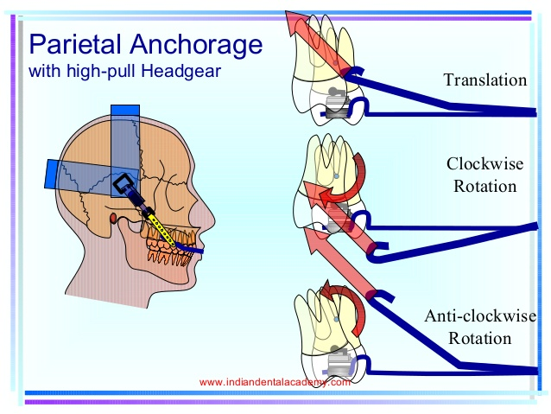

Slide 52
The center of resistance of the maxilla is in the area of postero-
superior aspect of zygomatico maxillary suture.
The center of resistance of the maxillary dentition is situated
between the roots of the premolars.
The center of resistance of maxillary molar is in the trifurcation
area.

Slide 53
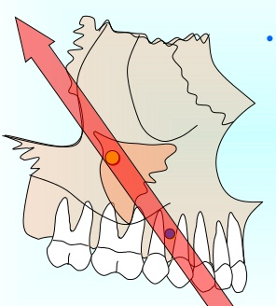
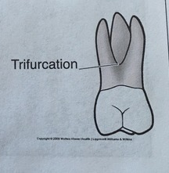

Slide 54
ANCHORAGE PLANNING
The anchorage requirement depends upon
1. The number of teeth to be moved
2. The type of teeth being moved
3. Type of tooth movement
4. Periodontal condition
5. Duration of tooth movement
6. Anchorage value -Anchorage value of any tooth

Slide 55
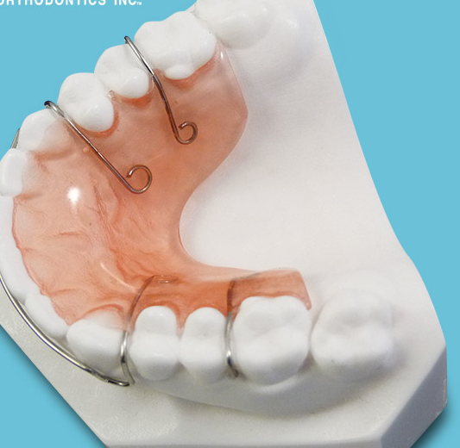
ANCHORAGE IN DIFFERENT APPLIANCE SYSTEMS
ANCHORAGE IN REMOVABLE APPLIANCES
Removable appliances mainly obtained anchorage from
base plate.

Slide 56
In removable functional appliance: Tooth borne appliances
Activator Bionator and Twin block
1.Capping of incisal margins of lower incisors and proper fit of
cups of teeth into acrylic.
2. If deciduous molars are present, it is used as anchor teeth.
3. Edentulous areas after loss of deciduous molars.
4. Labial bow prevents anterior flaring and posterior displacement of the appliance.
Base plate
Labial bow

Slide 57
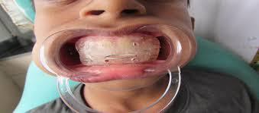
ANCHORAGE IN FUNCTIONAL APPLIANCES
Tissue borne appliances
Vestibular screen and Frankels functional regulator Gains
anchorage by extending acrylic into vestibule.
Head gears can be used as adjuncts

Slide 58
In fixed functional appliances
Partial anchorage
Total anchorage
Pellot anchorage

Slide 59
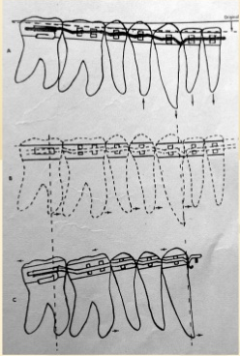
ANCHOR MEASURES IN DIFFERENT APPLIANCES
EDGEWISE TECHNIQUE
Second order tip back bends

Slide 60
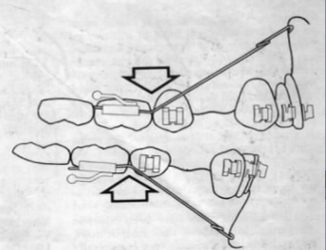
BEGG APPLIANCE
The Beggs appliance offers an economy in the use of intra oral
anchorage.
This is brought about in the first place, through bodily control
given to anchor units with the help of anchor bend(tip-back bend)
and, the freedom to tilt offered to the units that are to be moved
and the light Differential forces employed.
Anchor bend in Begg Technique.

Slide 61
Anchorage for retraction
After arch wire attached Class II elastic between intermaxillary
hook of upper arch wire and hook on mesial end of lower molar
tube.it will tend to pull molar forward and retract anteriors.
Anchorage Bend counteracts mesial pull.

Slide 62
Anchorage Bend force in first stage and net distal movement
of upper molar :
Anchorage Bend tends to tip the molar roots forward and crown
backward.
Net effect of widespread difference between the high resistance
root tipping and the low resistance crown tipping leads to more
crown movement.

Slide 63
Anchorage Bend force in first stage with or without net distal
movement of lower molars
Lower molar crown also have tendency to tip back that can be
controlled by varying the force of class II elastics. 11/2– 21/2
ounce (nonext.) crown may tip back more and root tip forward
less.
21/2 – 31/2 ounce (ext.) both crown and root may tip, up righting
the tooth but imparting little or no distal tipping .

Slide 64
ROTH PRESCRIPTION
He Provides over-corrected tooth positions prior to the appliance
removal. The banding of second molars at the onset of treatment
can minimize the need for extra oral reinforcement of anchorage.
Leveling and alignment:
small flexible wire helps conserve anchorage.
Leveling the curve Spee:
Leveling with a continuous wire will lead to slippage of anchorage
This can be avoided by assessing the incisor portion and if
permitted by intruding them.

Slide 65
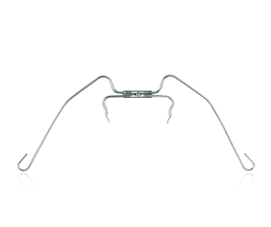
Retraction of the canines and incisors:
Retracting procumbent incisors using reciprocal forces burn up
more anchorage than that which can be anticipated.
Upright the anterior,using Ascher’s face bow in both the upper
and lower arches, for upto6-8 weeks.
Once incisors upright, they offer very little resistance as anchor
unit and can be easily retracted.

Slide 66
Space closure:
If one attempts to close the space faster regardless of wire size,
tipping will occur inevitably.
It is possible to close extraction spaces on an 0.016” round wire
at a well modulated rate without tipping whereas one can take a
large rectangular wire with closing loop mechanics and end up
tipping if the activation of the loop is done too frequently.

Slide 67
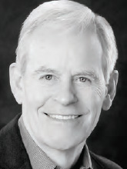
4. Varisimplex technique
• Developed by Wick Alexander
• Used Single width brackets except u/incisors
• Increased interbracket distance leading to Lighter force delivery.
Driftodontics
Individual Canine Retraction.
Anchorage Conservation in Mandible(6 distal tip)
Anchorage Conservation in Maxilla(omega loop,bend back )
Headgear
Elastics
.

Slide 68
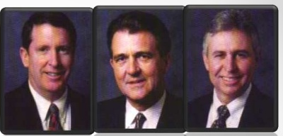
MBT TECHNIQUE
Anchorage control can be discussed in three planes,
horizontal, vertical and lateral planes.
Anchorage control inall the three planes is inter-connected and
failure to control one plane can cause problems with another.

Slide 69
Control of anchorage in horizontal plane
1. Control of anterior segments
2. Control of the posterior segments in the upper and lower arch.

Slide 70
Control of anchorage in anterior segments
• Lace backs and bends backs – to prevent proclination of anterior
teeth during aligning and leveling phase.
• Reduce the anchorage needs during leveling and aligning.
• Bracket design – reduced tip.
• Arch wire forces – use of very light arch wire forces.
• Avoidance of elastic chain

Slide 71
Control of anchorage in upper posterior segments
Posterior anchorage requirements are normally greater in the
upper arch than in the lower arch.
• A transpalatal arch can be used in moderate anchorage cases.
• The Nance holding arch can be used during leveling,aligning
and canine retraction stages.

Slide 72
Control of anchorage in lower posterior segments
• When extra anchorage support is needed in lower posterior
segments it can be effectively obtained by
• Lingual holding arch.
• Class III elastics (by not taxing the lower anchorage)
• Head gear.

Slide 73
Control of anchorage in vertical plane
Anchorage control in vertical plane involves prevention of the
vertical skeletal and dental development in the posterior segments
(as with high mandibular plane angle cases) and prevention of
vertical eruption or intrusion of anterior segments

Slide 74
Vertical control of incisors
Because of the tip built in the canine brackets a transient deepening
of bite occurs in the initial aligning and leveling phases.
If canines are distally tipped to begin with as the arch wire is
engaged in the canine slot it lies incisal to the incisor bracket slots
causing undesirable extrusion incisors when the wire is engaged.
This effect can be minimized by either not encaging the wire in
Incisor brackets or not bonding the incisors until canines are up
righted.

Slide 75
Vertical control of canines
High labial canines should not be engaged with arch wire because it causes unwanted vertical movement of lateral incisors and premolars.
The unwanted effects of fully encaging the arch wire in the brackets of high labial canines may be minimized by lightly tying the canines into the primary arch wire with elastics thread.

Slide 76
Vertical control of molars in high angle cases
Vertical control of molars is critical in high angle cases:
Transpalatal arch
In high – angle cases either a combination pull or a high
pull headgear is used.
Upper or lower posterior bite planes in molar region
4 Upper 2nd molars are generally not initially banded, to minimize extrusion of these teeth.
5. If upper molars require expansion, an attempt is made to
achieve bodily movement rather than tipping.

Slide 77
6. BIOPROGRESSIVE THERAPY
Bioprogressive therapy given by Rickets includes
1. Stabilization of upper and lower molar anchorage according to grade of anchorage.
2. Retraction and uprighting cuspids with sectional mechanisms.
3. Retraction and consolidation of upper and lower incisors.
4. Continuous arches for details of ideal and finishing occlusion.

Slide 78
Maxillary molar
Maximum | Moderate | Minimum
Nance, Head gear Combination of both | Quard helix Upper utility arches Utility arch Sectional retraction | Reciprocal closure

Slide 79
Mandibular molar
Maximum anchorage
1. Buccal root torque (45).
2. Expansion of molar section of 10mm on each side.
3. Tip back of 30 – 40 keeps the molar upright and resists the forward pull.
4. Distal molar rotation of 300 -400 is also placed.
Moderate anchorage: Contraction utility arch
Minimum anchorage: Round wire in the molar tube.

Slide 80
LINGUAL ORTHODONTIC
Takemoto suggested anchorage value of posterior teeth in the
lingual technique is higher than that of the labial technique due to
proximity of the lingual brackets to the center of resistance of the
tooth.

Slide 81


Anchorage preservation in LO sliding mechanics follows the
principle of six anchorage keys:
1.Standard LBJ prescription in the anterior segment,with slight
extra torque and no additional tip for extraction treatment, and
posteriorly, mesial position and tip-back of the molar brackets

Slide 82
2. Bidimensional approach, with its inherent feature of less friction during sliding mechanics
use of a 0.018 x 0.025-inch slot for the six anterior teeth
0.022x 0.028-inch slot brackets for the posterior teeth
It is also possible to use a bidimensional wire (Wilcock
Australian wire, AJ Wilcock, Whettesea, Victoria,Australia) with
dimensions of 0.018 0.025 inch for the anterior teeth (3-3) and a
0.018-inchround wire for the posterior teeth

Slide 83



3. Bite stops for bite opening

Slide 84


4. Light orthodontic forces for space closure, with Class I, II, or III elastics and elastomeric chain

Slide 85


5. Inclusion of the second molar in the anchorage unit
6. Placement of an exaggerated or reversed curve of Spee, in the maxillary and mandibular space-closing archwire, respectively

Slide 86
In addition, the direction of forces during space closure creates a
degree of buccal root torque and distopalatal rotation of the molar
crown, which in turn produces cortical bone anchorage.
In certain cases were anchorage need to be reinforced, a modified
pendulum appliance can be placed to reduce anchorage loss.
Good anchorage control is achieved with lingual orthodontic
sliding mechanics when following simple anchorage principles. .

Slide 87

Pharmacological management
Choi J, et al Korea 2010 Clodronate inhibits bone resorption
induced by orthodontic force.

Slide 88



Slide 89


Slide 90
Keles A, et al Boston USA 2007OPG results in a more powerful inhibitor of osteoclast recruitment and activity than pamidronate, with a reduction of osteoclasts number of 95% and tooth movement of 77%.
Ortega A, et al USA 2012 A single, small, locally applied dose of zoledronate was sufficient to provide maximal anchorage in extraction space closure(rats)
Toro E, et al Gainesville USA 2013 BE(Bis-enoxacin) inhibits osteoclast formation and bone resorption(rats)

Slide 91
Gurton AU, et al Ankara, Turkey 2004
Indomethacin and Imidazole decrease the rate of tooth movement at high concentration,
De Carlos F, et al Spain, 2006
Both drugs significantly inhibit dental movement, partially in the case of Rofecoxib and totally in the case of Diclofenac
De Carlos F, et al Spain,2007
Rofecoxib inhibit tooth movement while Celecoxib and Parecoxib do not affect orthodontic movement

Slide 92
Mermut S, et al Ankara, Turkey 2007
IFN- ɣ seems involved in bone remodeling during orthodontic tooth movement, which strongly suppresses osteoclastogenesis

Slide 93

Chae HS Seoul, Korea 2011
Antioxidants decrease the expression of pro-inflammatory cytokines in human PDLFs induced by mechanical compression and hypoxia.

Slide 94
Anchorage loss assessment of the indirect anchor tooth during
adjunctive orthodontic treatment -Jang et al Am J Orthod
Dentofacial Orthop 2019
An indirect anchorage system can be used effectively in
adjunctive orthodontic treatment. just less than 1 mm of
movement of the indirect anchor tooth is anticipated, especially
in the mandible.

Slide 95
Factors Predisposing to Maxillary Anchorage Loss: A
Retrospective Study of 1403 Cases Hong Su etal -2014
The initial UM angulation is the most significant factor
contributing to anchorage loss. The more distally tipped the UMs
are before treatment, the more they will tip mesially during
treatment.
Mesial tipping of the UM, and therefore, anchorage loss, is
more likely to occur in certain groups, such as adolescents, males,
those with class II malocclusion and/or those who have undergone
maxillary premolar extraction.

Slide 96
CONCLUSION
Anchorage should be of prime consideration before the treatment plan is formulated.
The skeletal and dental anchorage should be judiciously planned for a better finish and complete success in orthodontic therapy.
Anchorage plays a prominent role in utilization of extraction spaces, use of head gears, retraction mechanics, etc
Proper diagnosis through recognition of anchorage availability must be made for better finishing of the case.

Slide 97
1.Proffit WR, Fields HW, Sarver DM Contemporary orthodontics: Mosby St Louis, Mo.
2. Andrews LF (1972) The six keys to normal occlusion. Am J Orthod 62: 296–309.
3. Roth RH (1981) Functional occlusion for the orthodontist. J Clin Orthod 15:32–40, 44–51 contd.
4. Roth RH (1987) The straight-wire appliance 17 years later. J Clin Orthod 21:632–642.
5. Graber, Vanarsdall, Vig. Orthodontic CurrentPrinciples And Technique. 5th Ed. St. Louis USA:Mosby; 2011.

Slide 98
6.Anchorage in orthodontics: a literature review-Siva Krishna P
7.Six Anchorage Keys Used in Lingual Orthodontic Sliding
Mechanics Silvia Geron
8.Factors Predisposing to Maxillary Anchorage Loss: A
Retrospective Study of 1403 Cases Hong Su etal -2014

